Slide 2
Power Up: Reading ACT Prep, Week 10
Putting Strategies Into Practice

Slide 3
Essential Question
How can I increase my ACT score?

Slide 4
Learning Objectives
Evaluate ACT reading knowledge.
Apply ACT reading knowledge.

Slide 5
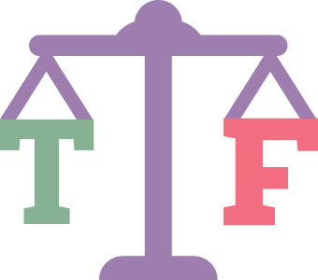
Justified True or False
It is better to leave answers blank than to guess.
Knowing the type of reading passage can help infer which types of questions will be asked.
To avoid taking a remedial English class in college, a score of 19 is required on the ACT reading section.
There are 40 minutes and 35 questions on the ACT reading test.
Notes:
K20 Center. (n.d.) Justified true or false. Strategies. https://learn.k20center.ou.edu/strategy/174

Slide 6
Justified True or False
False: By guessing, there is a 25% chance of guessing the correct answer.
True: There are four types of passages. Looking at the type before reading can help with anticipating questions.
True: A sub-score of 19 on each ACT section test is required to avoid remedial college classes.
False: There are 35 minutes and 40 questions on the ACT reading test.
Notes:
K20 Center. (n.d.) Justified True or False. Strategies. https://learn.k20center.ou.edu/strategy/174

Slide 7
Clara Luper: Reading Passage
Read the passage and answer the questions in nine minutes.
Aim for four minutes to read and five minutes to answer the questions.
9-Minute Timer
Notes:
K20 Center. (2021, September 21). K20 Center 9-minute timer. [Video]. YouTube. https://youtu.be/ZvN435zg2zE?si=4ToRIQx-IcnQwP81

Slide 8
Clara Luper: Answers
B
G
A
E
C
G
C
F
C
F

Slide 9
Clara Luper: Responses
Review each question and the response chosen.
Talk with a partner about the strategies used to answer each question.
Discuss how any strategies used can help on the actual ACT.

Slide 10
Reading Score Chart
Reading Score | Answers Correct
1 | 0
2 | 1
3 | —
4 | 2
5 | 3
6 | 4
7 | —
8 | 5
9 | 6
Reading Score | Answers Correct
10 | 7
11 | 9
12 | 10
13 | 11
14 | 13
15 | 14
16 | 15
17 | 17
18 | 18
Reading Score | Answers Correct
19 | 19
20 | 21
21 | 22
22 | 24
23 | 25
24 | 27
25 | 28
26 | 29
27 | —
Reading Score | Answers Correct
28 | 30
29 | 31
30 | 32
31 | 33
32 | 35
33 | 36
34 | 37
35 | 39
36 | 40

Slide 11
Reading Score Prediction Chart
Based on how many questions you usually get correct, what should you hope to get on the real ACT reading test?
Number Correct | Predicted Score
1 | 6
2 | 10
3 | 13
4 | 15
5 | 21
Number Correct | Predicted Score
6 | 22
7 | 25
8 | 30
9 | 33
10 | 36

Slide 12
My ACT Website
Although this is the last ACT reading test prep session, continue to prepare for the ACT.
Use the question of the day on my.act.org.

Slide 13
You Powered Up!

