Slide 2
Steps to Success
9th Grade Campus Visit

Slide 3
Housekeeping: Norms
Keep cell phones on silent.
Stay engaged in all activities.
Ask related questions.
Follow all instructions.
Notes:
During a traditional campus visit, it’s a good idea to go over with students the norms and expectations of the day. Here are several of norms you may consider discussing with students before a visit to a college campus. As this activity will be done in the classroom, the norms and expectations may look slightly different than they typically would. Please read over the listed norms and include any others that would be relevant to your classroom. Then, take a few minutes to read over and discuss these norms with students prior to beginning the activity.

Slide 4
Objectives
You will:
Find out what you need to do to get into the postsecondary education (PSE) option of your choice.
Learn about an option to help you pay for your education.
Create a plan that will help you pursue your educational goals.
Ask yourself:
“What steps do I need to take to reach my future goals?”
“How can I fund my postsecondary education goals?”
Notes:
Formal objectives:
After this activity, students will be able to:
recognize the factors that influence students’ ability to gain acceptance to the PSE option of their choice.
identify at least one solution to fund their postsecondary education.
create one actionable step they can take to increase their chances of success in pursuing postsecondary education.
*Throughout the activity, there may be words that students are unfamiliar with. You can also access the College Knowledge Terms document in the LEARN lesson. Students participating in the virtual version of the activity have access to this document via their activity document.

Slide 5
What Are Colleges Looking For?
What are some things that you can do to increase your chances of getting into college?
Notes:
In this section, students begin discussing what colleges are looking for from students, such as the various factors that influence college admission. To do so, students will answer the question, “what are some things that you can do to increase your chances of getting into college?” As the facilitator, you can do this activity in several different ways.
First, students can popcorn answers to the proposed question.
If you wish to provide more guidance to students during this activity, consider allowing students to rank the importance of the following factors in college acceptance: advanced coursework, attendance, college entrance exam scores, extracurricular activities, and GPA.
If you wish to embed technology in this portion of the activity, consider creating a multiple-choice Mentimeter with the aforementioned factors as pre-populated options. This allows students to vote and create a bar graph as a class. If you do so, be sure to add your Mentimeter code to this slide before facilitating the activity.
If your access to technology doesn't allow for the Mentimeter option, try preparing a Sticky Bars poster with each factor written under the x-axis. Allow each student to place a sticky note above the factor that is most important, creating a class bar graph.

Slide 6
GPA Game (Video)
Watch the video to find out about other enrollment factors.
Answer questions and read the other information that pops up in the video.
Hit play once you are ready to continue watching the video.
The GPA Game (video)
Notes:
Tell students that their GPA can make a big impact on whether or not they are accepted to the college or technical program of their choice, but GPA is not the only thing postsecondary schools consider when accepting students.
Video link: https://staging.k20center.ou.edu/wp-admin/admin-ajax.php?action=h5p_embed&id=14

Slide 7
GPA Game Discussion
What did you notice?
Are you surprised by where the students ended up in the line?
Is there anything you wonder about after viewing the video?
Notes:
Ask guiding questions to debrief, such as, “What did you notice? Are you surprised by where the students ended up in the line? Is there anything you wonder about after viewing the video?” Solicit a few answers from the group for each question.

Slide 8
The GPA Game (Whole-Class)
Your GPA card includes your GPA and statements about your applicant. Write your starting points (based on your GPA) on your scorekeeper.
Listen to the statements as they are read. Add or subtract points with your scorekeeper based on the statements read versus the statements on your card.
When the game is over, add up your points to find out if you were accepted, waitlisted, or rejected for admission.
Notes:
“GPA is not the only factor that impacts whether you are accepted to college or not. In this game you will be introduced to other college admissions factors and gain a better understanding of how each of those impacts your acceptance into college. You will receive one applicant card with a list of statements. Using the GPA Game Score Keeper, you will add or subtract points based on the statements that are listed on your card. If your card has a statement that I read, you will add or subtract points based on the directions for that statement. Total your points to find out if you are accepted, waitlisted, or rejected the university you applied to.”
Students will be handed a student card which lists a GPA and several bullet point statements. Tell students you will read a list of statements and directions for each statement. If the statement you read is listed on a volunteer’s card, they will follow the directions listed for that statement and add or subtract points using their scorekeepers.

Slide 9
Accepted!
If you ended the game with 4 or more points, you’ve been accepted!
Zoe Zuckerberg
Jessica Jackson
Suzie Johnson
Blake P. Griffin III
Winston Bishop Jr.

Slide 10
Waitlisted
If you ended the game with 1–3 points, you’ve been waitlisted.
Maxwell Smith
Joe Baskin
Notes:
Students may also have questions about what it means to be waitlisted, so this is a good place to discuss how colleges sometimes request final grades to help them make a decision.

Slide 11
Rejected
If you ended the game with 0 points, you’ve been rejected.
Karen Bublé

Slide 12
GPA Game: Whole-Class Discussion
If you were accepted, what were your applicant’s strengths?
If you were waitlisted or rejected, what were your applicant’s weaknesses?
What could students who were waitlisted or rejected do to increase their chances of being admitted?
Notes:
Ask guiding questions to debrief the whole-class activity:
If you were accepted, what were your applicant’s strengths? If you were waitlisted or rejected, what were your applicant’s weaknesses? What could students who were waitlisted or rejected do to increase their chances of being admitted?
Consider also asking the following:
What did you notice? Are you surprised by how the applicants ended up?
Solicit responses from group.

Slide 13
The GPA Game (Volunteer Participation)
Would you like to volunteer to participate in the game? We need eight students!
Volunteers:
Using your card, move forward or backward in the line based on the statements read aloud.
Audience:
Pay attention to the statements and the applicants. What do you notice? What do you wonder?
Notes:
“GPA is not the only factor that impacts whether you are accepted to college or not. In this game, you will be introduced to other college admissions factors and gain a better understanding of how each of those impacts your acceptance into college. We need eight volunteers to participate in the game.”
Volunteers will be handed a student card which lists a GPA and several bullet point statements. Tell students you will read a list of statements and directions for each statement. If the statement you read is listed on a volunteer’s card, they will follow the directions listed for that statement and move forward or backward in line.
Ask the rest of the class to pay attention to the statements being read and how those statements impact where the students end up in the line. What do they notice and wonder about the statements and the college applicants?

Slide 14
GPA Game: Volunteer Discussion
What did you notice?
Are you surprised by where the students ended up in the line?
Is there anything you wonder about after watching or playing the game?
Notes:
Ask guiding questions to debrief the video or game:
What did you notice? Are you surprised by how the applicants ended up? Is there anything you wonder about after watching or playing the game?
Solicit responses from the group.

Slide 15
Drag and Drop
Use this link to access the drag and drop activity, which highlights several factors for college admission:
https://k20center.ou.edu/h5p/collegeadmissionfactors/
Drag and drop answers (on left side of graph) to fit the correct college admission factor box.
Click “Check” to find out if your answers are correct!
Notes:
Ask students, “Did you know all of the factors from the GPA (video or game) are considered for acceptance to postsecondary education? Advanced classes, attendance, college entrance exams, extracurricular activities, and GPA are all important to the admissions process.”
Now, students will:
Use link to access the activity.
Click and drag on the answers (on the left side of the graphic) and drag those answers to the correct corresponding college admissions factor box. Ex. sports are extracurricular activities.
Click on “check” to check if their answers are correct.
If you prefer to do this activity as a whole class with an interactive whiteboard such as a SMARTboard, click on the link on the slide to access the activity and invite student volunteers to the board to take turns dragging and dropping. If you need to accommodate for social distancing, you can also ask for volunteers to guide you as you drag and drop the answers.

Slide 16
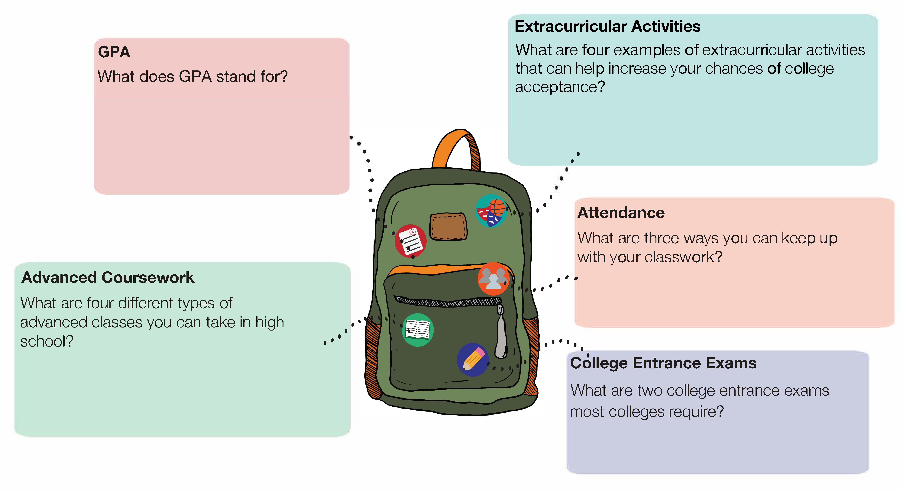
College Admissions Factors
Notes:
If access to technology is limited, you can discuss the five factors with students and answer questions they have. Answers to each factor are as follows:
GPA:
Grade Point Average
Advanced Coursework:
Advanced Placement (AP) Courses
College Prep Courses
Honor Courses
Concurrent Enrollment Courses
Extracurricular Activities:
Volunteering & Community Service
Student Clubs & Organizations
Fine Arts
Athletics
Attendance:
Be on Time
Keep Up With Missed Assignments
Attend Class as Often as Possible
College Entrance Exams:
SAT
ACT

Slide 17
College Admissions Factors Discussion
Which of these factors are you familiar with? Which are you unfamiliar with?
What opportunities are available in your school or community that contribute to PSE acceptance?
Notes:
Facilitator ask students:
Which of these factors are you familiar with? Which are you unfamiliar with?
What opportunities are available in your school or community that contribute to PSE acceptance?
Advanced classes, attendance, college entrance exams, extracurricular activities, and GPA are all important to the admissions process.

Slide 18
Now you know what it takes to get into a career tech or college, but how do you pay for it?
Notes:
Ask students for answers to the questions. Students might say they would get a job, apply for scholarships and grants, seek financial aid, take out student loans, or apply for Oklahoma's Promise.

Slide 19
Oklahoma’s Promise
Do you want to attend a technical school or college after high school?
Would you like up to $30,000 to help cover the cost of college?
Notes:
Ask students these questions one by one.
“If one or more applies to you, then you should consider applying for Oklahoma Promise. You can receive up to $30,000 to attend college or career tech but only if your parent or guardian completes the application. Let’s review the requirements together”

Slide 20
Oklahoma’s Promise Requirements
Oklahoma resident
8th, 9th, or 10th grade
Household income is $55,000 or less (x < $55,000)
Take 17 units of required high school classes
Make a 2.5 GPA or higher in 9th-12th grades
Notes:
Share requirement with students for applying and what they need to do to apply. Poll students to see how many have already completed the application. Encourage students to talk to their parent or guardian about this as soon as possible.
*Per Oklahoma’s Promise updates, there is an anticipated increase to the household income from $55,000 to $60,000 taking effect fall 2020.

Slide 21
You are 42% more likely to achieve your goal if you write it down. Write down your 9th-grade goal to improve your chances for college admission!
(Morrissey, 2017)

Slide 22
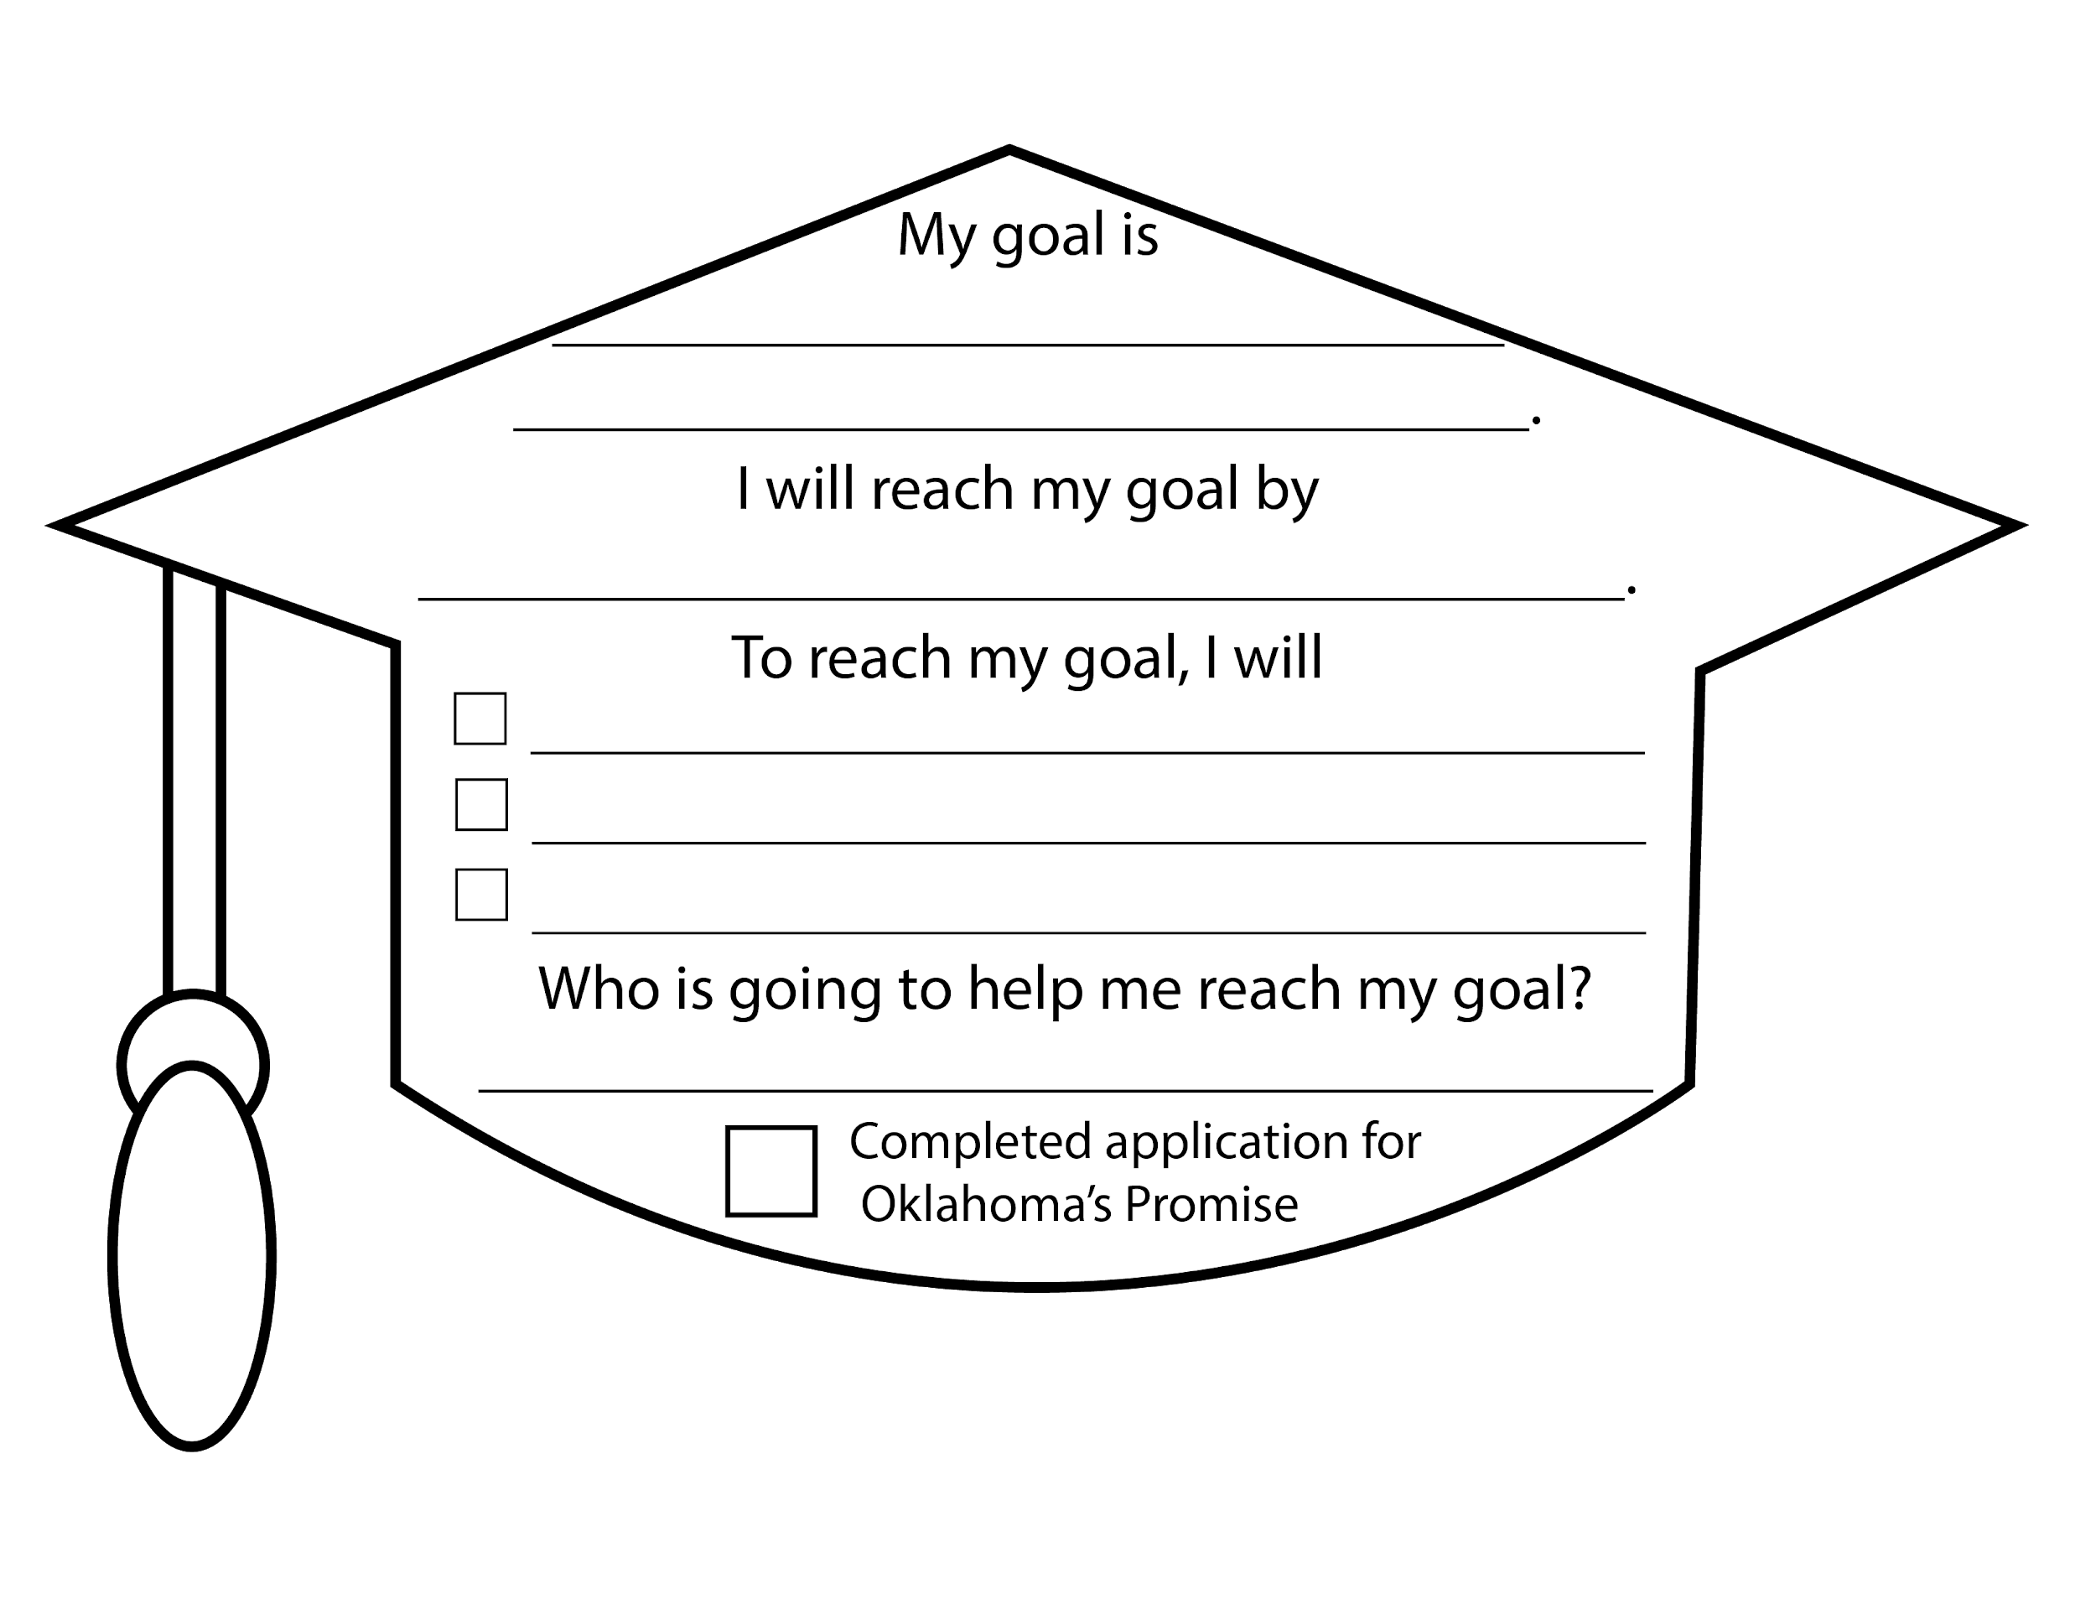
Let’s Get Smart about Goals!
Which of the college admission factors could you focus on to improve this school year?
Notes:
“Use the goal-setting tool in the graduation cap below to identify one goal that you will work on this school year and specific action steps you will take to complete it.”
Sample Goal: My goal is to increase my GPA to 3.5 from 3.25. I will reach this goal by the end of this school year. To reach my goal, I will have no missing assignments, attend tutoring once a week for help, and study 20 minutes a day. My mom will help me keep on track with this goal.
Oklahoma’s Promise: Check the box next to Oklahoma’s Promise once you’ve completed the application.

Slide 23
Additional Resources
To apply for Oklahoma’s Promise, go to https://www.okhighered.org/okpromise/
If you would like to explore careers, visit MyNextMove.org and bls.gov
You can research college at bigfuture.collegeboard.org
The Dream.US is another scholarship opportunity for students with undocumented citizenship status. You can learn about this scholarship by going to thedream.us/scholarships/
Notes:
You may wish to add these links to Canvas, Google Classroom, or email these resources to students so they are easily accessible.

Slide 24
Virtual Campus Visits (Optional)
Https://www.virtually-anywhere.net/tours/ou/campus/vtour/index.html
https://go.okstate.edu/admissions/visit/index.html/#virtualtour
Notes:
The following is an optional activity for students to virtually explore college campuses.
“Now that you’ve learned about the college admission factors, it’s time for you to check out two colleges:
Begin by selecting the University of Oklahoma and Oklahoma State University or choosing a college of your choice by typing in the name of the school and virtual tour on a search engine!
Image source: Riva, E. (2017 July). Technology. Pixabay. https://pixabay.com/illustrations/technology-equipment-responsive-web-2468063/

