Slide 2
Esports in College

Slide 3
Lesson Objective
Explain how Esports can be applied during college.

Slide 4
Always, Sometimes, Never True
Esports scholarships can help pay for college.
Even if a student qualifies for Oklahoma Promise and FAFSA, they can still earn an Esports scholarship.
Esports scholarships can pay for all of college.

Slide 5
Esports and College
Read the handout about Esports in college.
Highlight information important to your understanding of Esports at the college you are reading about. There are four colleges:
Maryville University
University of Oklahoma
Oklahoma City University
Carl Albert State College
Be ready to share information about Esports at the college.

Slide 6
Esports and College
Review the cost of attending college.
Review the different types of aid available.
How much difference is there between provided aid and cost?
How much can be earned from Esports scholarships?
Why is it important to understand the different types of aid available for college?

Slide 7
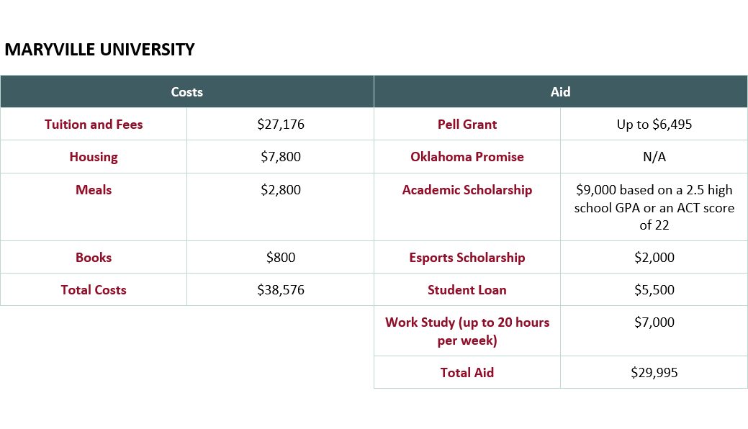

Slide 8
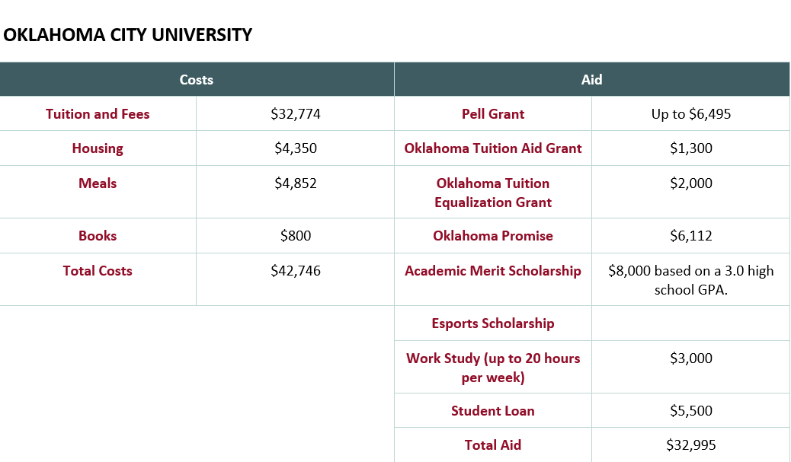

Slide 9
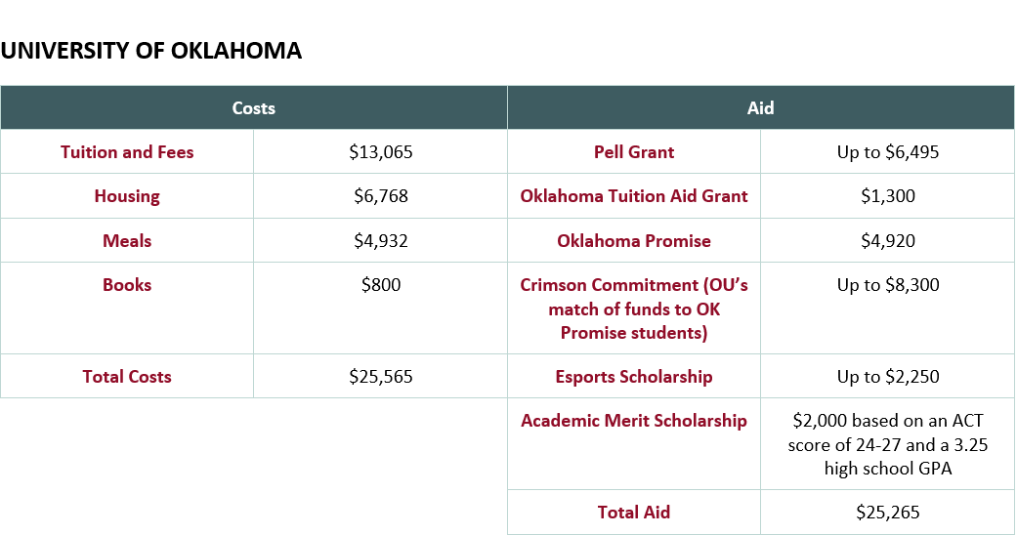

Slide 10
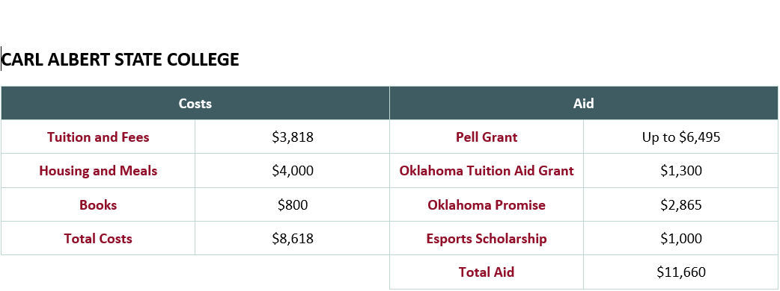

Slide 11
Esports and College
How confident are you in your understanding of Esports in college?
Write a sentence on the sticky note about your understanding of Esports in college.
Add a sentence about what you plan to do next to prepare for Esports in college.

