Slide 2
Esports Casting 101
Play-by-Play and Color Commentary

Slide 3
Lesson Objectives
Identify differences between the two types of casters
Understand how commentary evolves and impacts esports
Connect personal skills to casting

Slide 4
I Used To Think/Now I Know
What do you think Esports casting is?
Notes:
Maybe a poll here?
K20 Center. (n.d.). I Used to Think/Now I Know. Strategies. https://learn.k20center.ou.edu/strategy/137

Slide 5
What Is The Difference?
Cards | Play-By-Play | Color
Notes:
K20 Center. (n.d.). Card Sort. Strategies. K20 LEARN | Card Sort (ou.edu)

Slide 6
What Is The Difference?
Cards | Play-By-Play | Color
Notes:
K20 Center. (n.d.). Card Sort. Strategies. https://learn.k20center.ou.edu/strategy/147

Slide 7
What Is The Difference?
Cards | Play-By-Play | Color

Slide 8
What Is The Difference?
Cards | Play-By-Play | Color

Slide 9
What Is The Difference?
Cards | Play-By-Play | Color

Slide 10
What Is The Difference?
Cards | Play-By-Play | Color

Slide 11
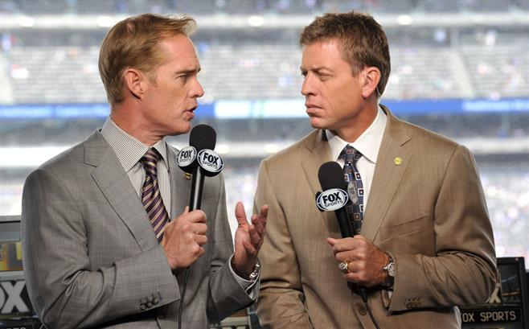
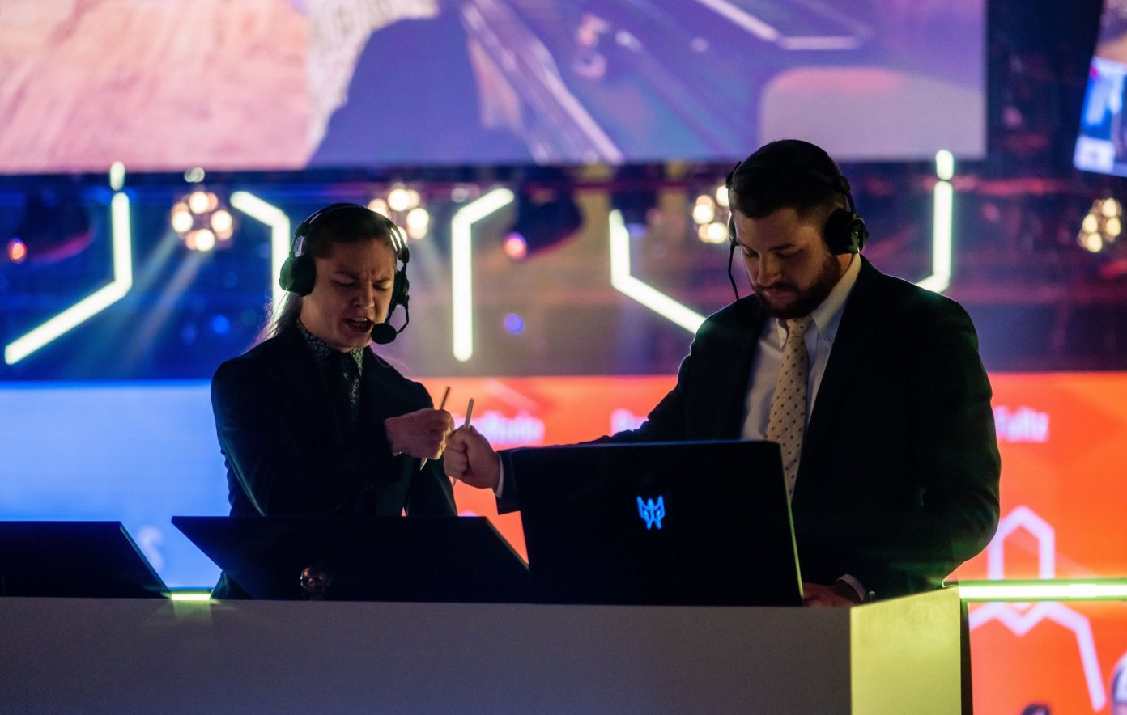
Similar to Sports
Professional Sports
Esports

Slide 12
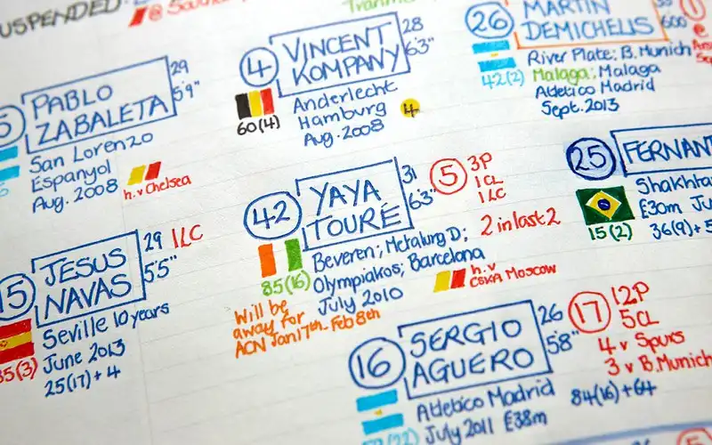
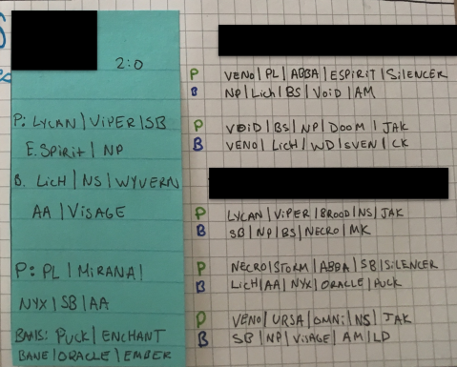
Similar to Sports (Cont.)
Soccer Notes Dota 2 Notes

Slide 13
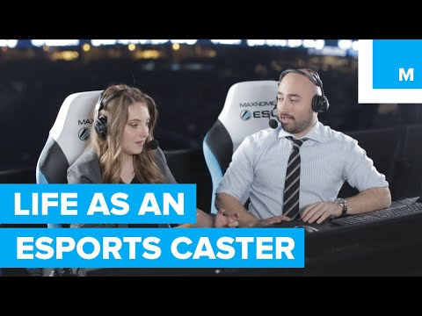
An Inside Look at Casting
Notes:
YouTube. Life as an Esports Caster. [Video]. https://youtu.be/UQDGS9Qvh8g

Slide 14
What Skills Are Needed?
Communication
Time-filler and content creator
Knowledge of the game
Casters must be aware of what has happened and what could happen at any given time in the game
Ability to self-critique
Ability to self-market

Slide 15
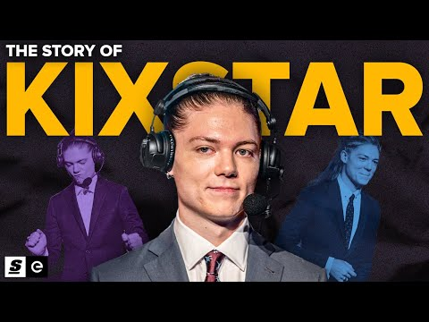
How A Great Caster Influences Esports
Notes:
YouTube. The Story of KiXSTAr: The Heart and soul of Rainbow Six. [Video]. https://www.youtube.com/watch?v=nYuIs98qNPs

Slide 16
3-2-1: A Casted Match
3 - What are three key characteristics of the casters that enhance the match?
2 - What are two questions you have about casting?
1 - What is one skill you have that transfers directly to casting?
Notes:
K20 Center. (n.d.). 3-2-1. Strategies. https://learn.k20center.ou.edu/strategy/117

Slide 17
How Do I Get Into Casting?
Find your game
Research
Practice on your own
Cast over professional games
Record your casting for reviewing and sharing
Find a community
Discord servers
Showcase your talents

Slide 18
Casting Salaries
Level | Salary | Notes
Entry | Usually unpaid, low hourly commission-based | Starting out for the love of the game
Medium | $10/hr as a freelancer ~25K salaried | Starting to use personal experience from local tournaments
High | Up to $600/day as a freelancer Up to $70K salaried | Many years of experience, willing to take a risk as the market is unpredictable
“Creme De La Creme” | Potential six-figures | Not the norm
Source: https://esportslane.com/shoutcasters-salary-earning/

Slide 19
I Used To Think/Now I Know
What do you now know about Esports casting?
Notes:
K20 Strategy. (n.d.). I Used to Think/Now I Know. Strategies. https://learn.k20center.ou.edu/strategy/137

