Slide 2
School’s Out! Now What?
Choices After High School Graduation

Slide 3

Fist to Five
Respond to the following statements by holding up 1 to 5 fingers based on how your feel.
1 finger: I completely disagree.
2 fingers: I somewhat disagree.
3 fingers: I neither agree or disagree.
4 fingers: I somewhat agree.
5 fingers: I completely agree.

Slide 4
Fist to Five
Once I graduate, I never want to go to school again.

Slide 5
Fist to Five
Statistics
Approximately 62% of high school graduates attend some form of post-secondary schooling.
35% of job openings will require at least a bachelor’s degree.
30% of job openings will require some college or an associate’s degree.
Notes:
Hanson, M. (2022, July 26). College Enrollment & Student Demographic Statistics. EducationData.org. https://educationdata.org/college-enrollment-statistics
Georgetown University. Job Growth and Education Requirements Through 2020. Georgetown University Center in Education and the Workforce. https://cew.georgetown.edu/cew-reports/recovery-job-growth-and-education-requirements-through-2020/

Slide 6
Fist to Five
I know I want to do something after high school, but I’m not sure what.

Slide 7
Fist to Five
Statistics
Most people will have 12 careers in their lifetime.
Notes:
)2022, March 19). 17 Remarkable Career Change Statistics to Know (2022). Apollo Technical. https://www.apollotechnical.com/career-change-statistics/

Slide 8
Fist to Five
I know what a Master’s degree is and how long it takes to earn one.

Slide 9
Fist to Five
Statistics
Levels of college degree vary by time.
  An Associate degree takes two years.
  A Bachelor’s degree takes four years.
  A Master’s degree takes six years.
  A Doctorate degree takes eight or more years.

Slide 10
Fist to Five
Nobody in my family has completed a four-year college degree.

Slide 11
Fist to Five
Statistics
First-generation college students are students that do not have a parent that completed a four-year degree.
Many scholarships and support systems are available for first-generation college students.
Notes:
Marquette University. (n.d.). What does being a first-generation student mean? First-generation College Students. https://www.marquette.edu/first-generation-students/about.php#:~:text=A%20formal%20definition%20of%20a,year%20college%20or%20university%20degree

Slide 12
Essential Question
What education options are available after high school?

Slide 13
Learning Goal
Understand the types of post-secondary options after high school.

Slide 14
Career Cluster Poster
Cut out the career cards and sort them into the following categories:
Career titles
Education levels required for the careers
Completion times for those education levels
Typical salaries of the careers
Notes:
Break into 2 slides - needs to be clearer

Slide 15
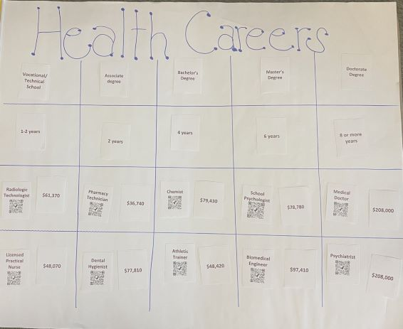
Career Cluster Poster
At the top of your poster, write the name of your career cluster. (e.g. “Health Careers”)
Follow the example poster.
To check for accuracy, use the QR code to access the career on the MyNextMove.org.
Notes:
Break into 2 slides

Slide 16

Gallery Walk
Walk around and view each poster.
As you view each career cluster, think about:
  Something you notice about the different career clusters and the listed careers.
  Something you wonder about the different career clusters and the listed careers.

Slide 17

Jigsaw
Read about the post-secondary institution you have been given.
As you read:
  Highlight phrases that stand out to you as important.
  Write notes in the margins that explain why you think those phrases are important.
After reading, summarize the most important information on the graphic organizer.

Slide 18
Costs and Aid
Review the costs associated with attending the institution you have been given.
Review the types of aid that are available for this institution.
Compare the costs to the amount of possible aid.
As you review, note one thing you find surprising, interesting, or troubling. Be prepared to share!

Slide 19

POMS: Point of Most Significance
Out of all the information you learned today, what was the most important detail to you?
Keeping your POMS in mind, what is a career or education program you are interested in learning more about during your next campus visit? What questions do you have about it?
Write your response and take it with you to your next campus visit.

