Slide 2
Keeping Track
Time Management 101

Slide 3
Essential Questions
Are we aware of how we are spending our time?
Do we spend our time in ways that are valuable to our life goals?

Slide 4
Learning Objectives
Estimate with accuracy how long everyday tasks take to complete.
Prioritize how to spend time to achieve desired outcomes.

Slide 5
Minute to Win it
Complete each task in less than 1 minute. Determine who on your team will take on each round:
Cookie Face: Move a cookie from your forehead to your mouth using only face muscles.
Balloon Juggle: Keep three balloons in the air for 1 minute on your own.
Cabbage Roll: Roll a cabbage from start to finish line with your nose.

Slide 6

Notes:
Paste the category totals table into Google sheets and make a pie chart, per the instructions in this video: https://www.youtube.com/watch?v=7vNLa9IiJkY

Slide 7
Reflection
How did the time pressure affect your performance?
Did some tasks take longer, or less time than you thought?
Were there unexpected challenges to the task that made it harder?
Notes:
Ask the group the questions on the slide and hold a discussion about planning ahead. Lead into the idea that in the next few activities students will be considering how long tasks take to get better at planning ahead so they don’t have to feel like everything they do in life is a Minute to Win it Challenge, but instead they can have time to think and plan to see better results.
Sample Responses:
When there isn’t much time you get stressed and it makes it harder to try to finish.
The cabbage took longer than I thought because I thought it would be easier to roll.
I didn’t think the cookie would fall so many times.

Slide 8
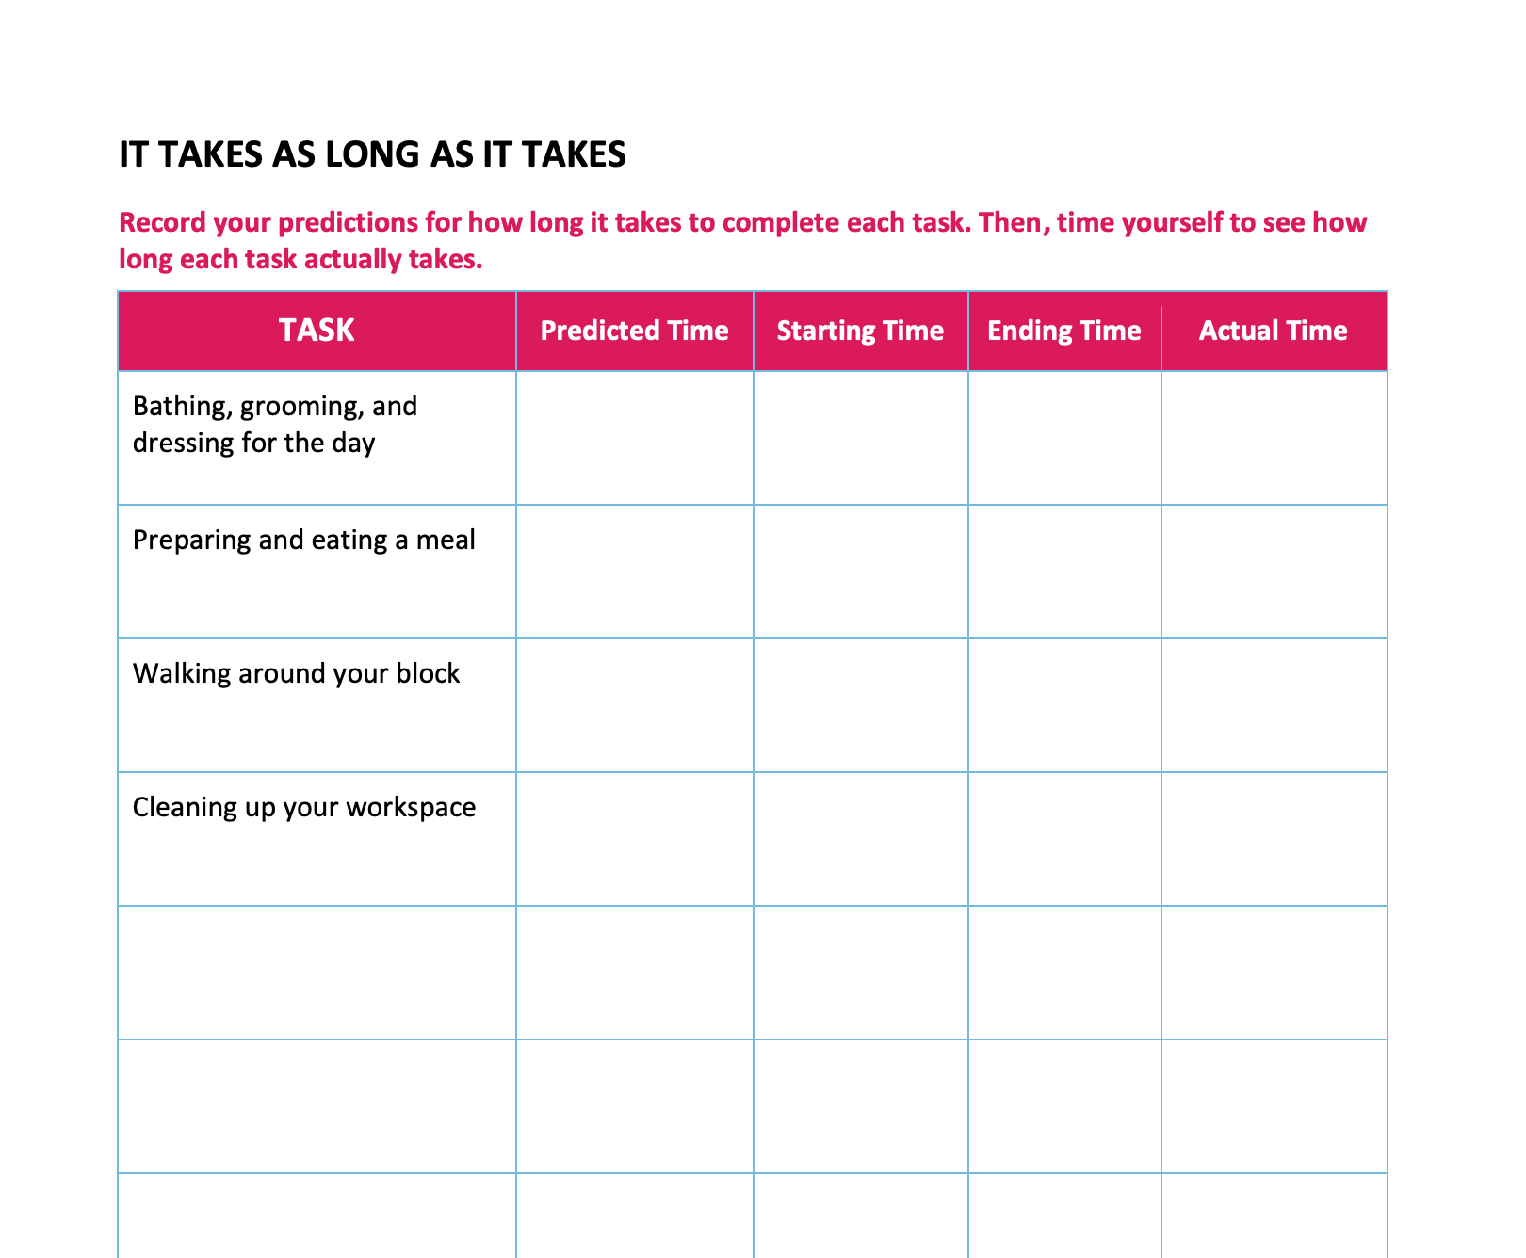
It Takes as Long as It Takes
Predict how long you think it takes to complete each of the everyday tasks listed in the chart.
Then, record how long it actually takes to do these tasks.
Notes:
Remind students we can’t really live our lives at a constant fast pace like we are constantly competing in a Minute to Win It challenge, so they shouldn’t view it as recording their “best time” but how long they think things usually take.

Slide 9
It Takes as Long as It Takes
Did some things take longer than you thought? Less time?
How did it feel to finish more quickly than you thought or take longer?
Notes:
Sample Student Response:
Getting done faster gives you time to relax. It is better to overestimate the times because then you feel good if you finish fast and you don’t feel as rushed.
Explain that now since they are experts on how long it takes to do what they have to do, how about the unexpected things?

Slide 10
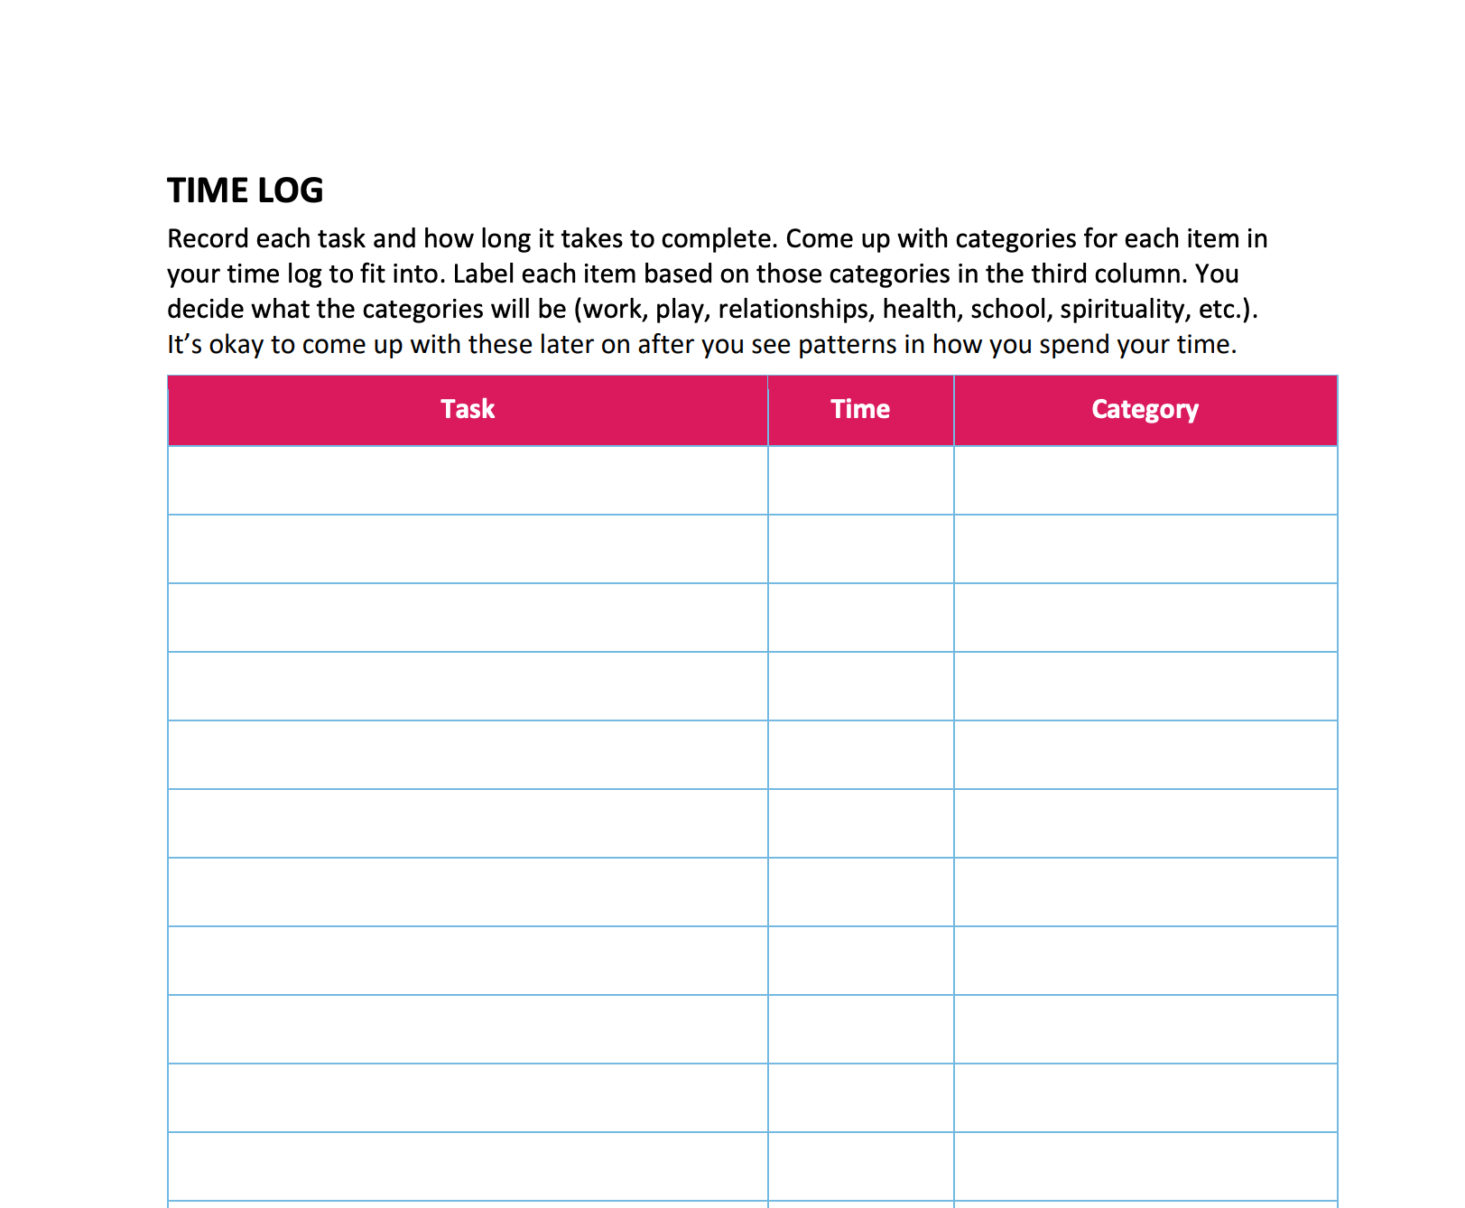
Expecting the Unexpected
Record what you did and how long you did it.
Note in the category column if it was fun, school, work, etc.
Notes:
Students could also record times using an app like Toggl Track, or a stopwatch to keep track digitally.
Record what you did and how long you did it - note in the category column if it was fun, school, work, etc. For x days next week.

Slide 11
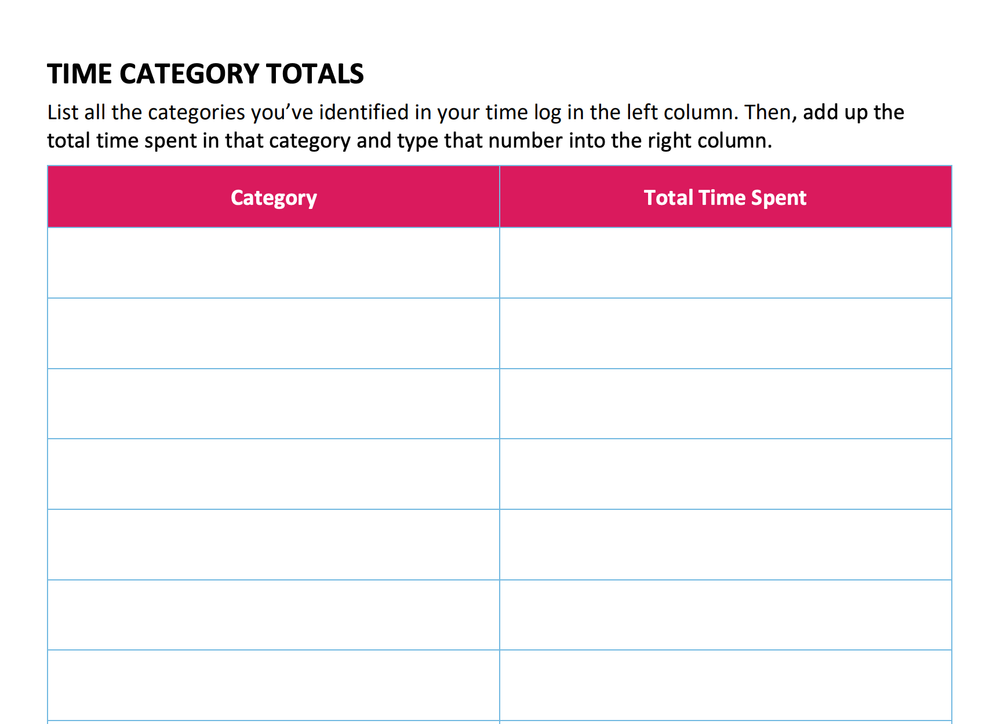
Time Category Totals
List all the categories you’ve identified in your time log in the left column.
Add up the total time spent in that category and type that number into the right column.
Notes:
Google Doc Copy Link: https://docs.google.com/document/d/14zBpxazboo7PVhh6QKgGojEMxLCDiL3Tlg1bNcV6ee8/copy

Slide 12
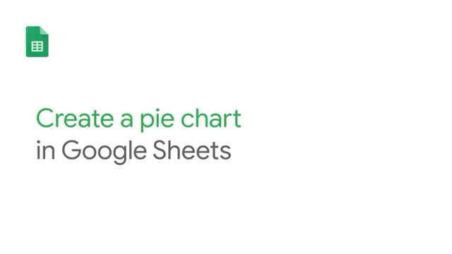
Notes:
Paste the category totals table into Google sheets and make a pie chart, per the instructions in this video: https://www.youtube.com/watch?v=7vNLa9IiJkY

Slide 13
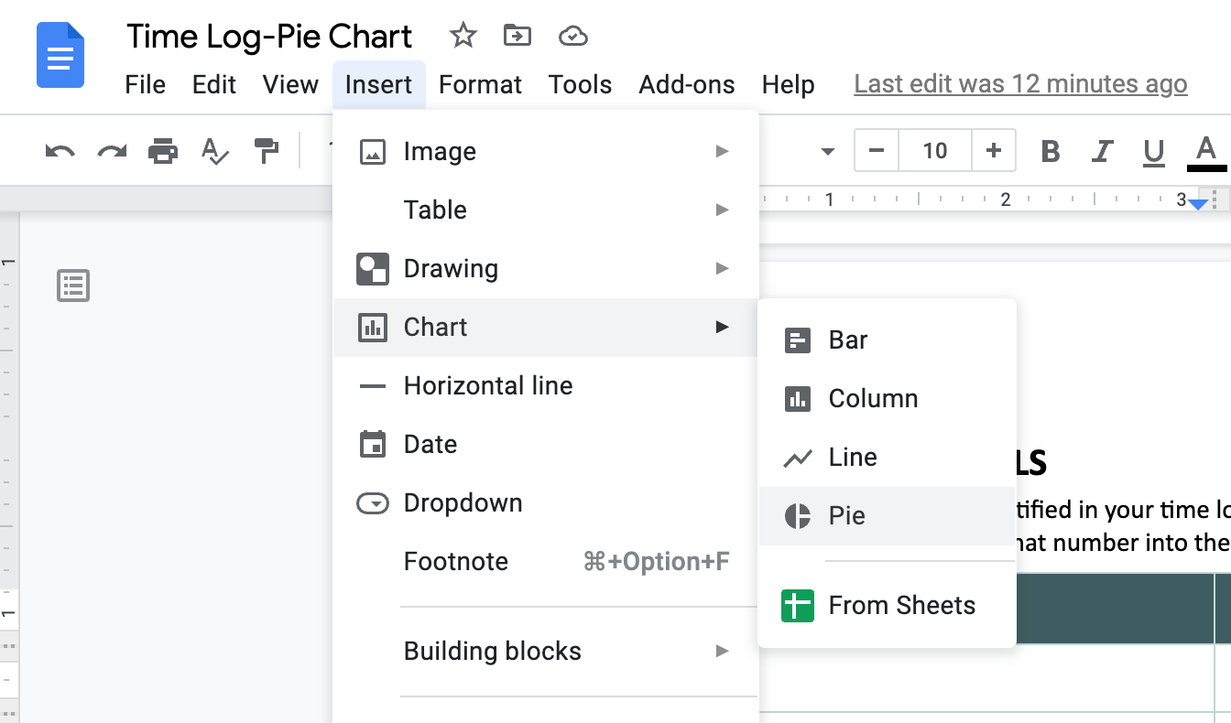
Baking a Pie Chart
In the document menu bar, go to “Insert.”
Select “Chart.”
Choose “Pie” from the dropdown menu on the right.

Slide 14
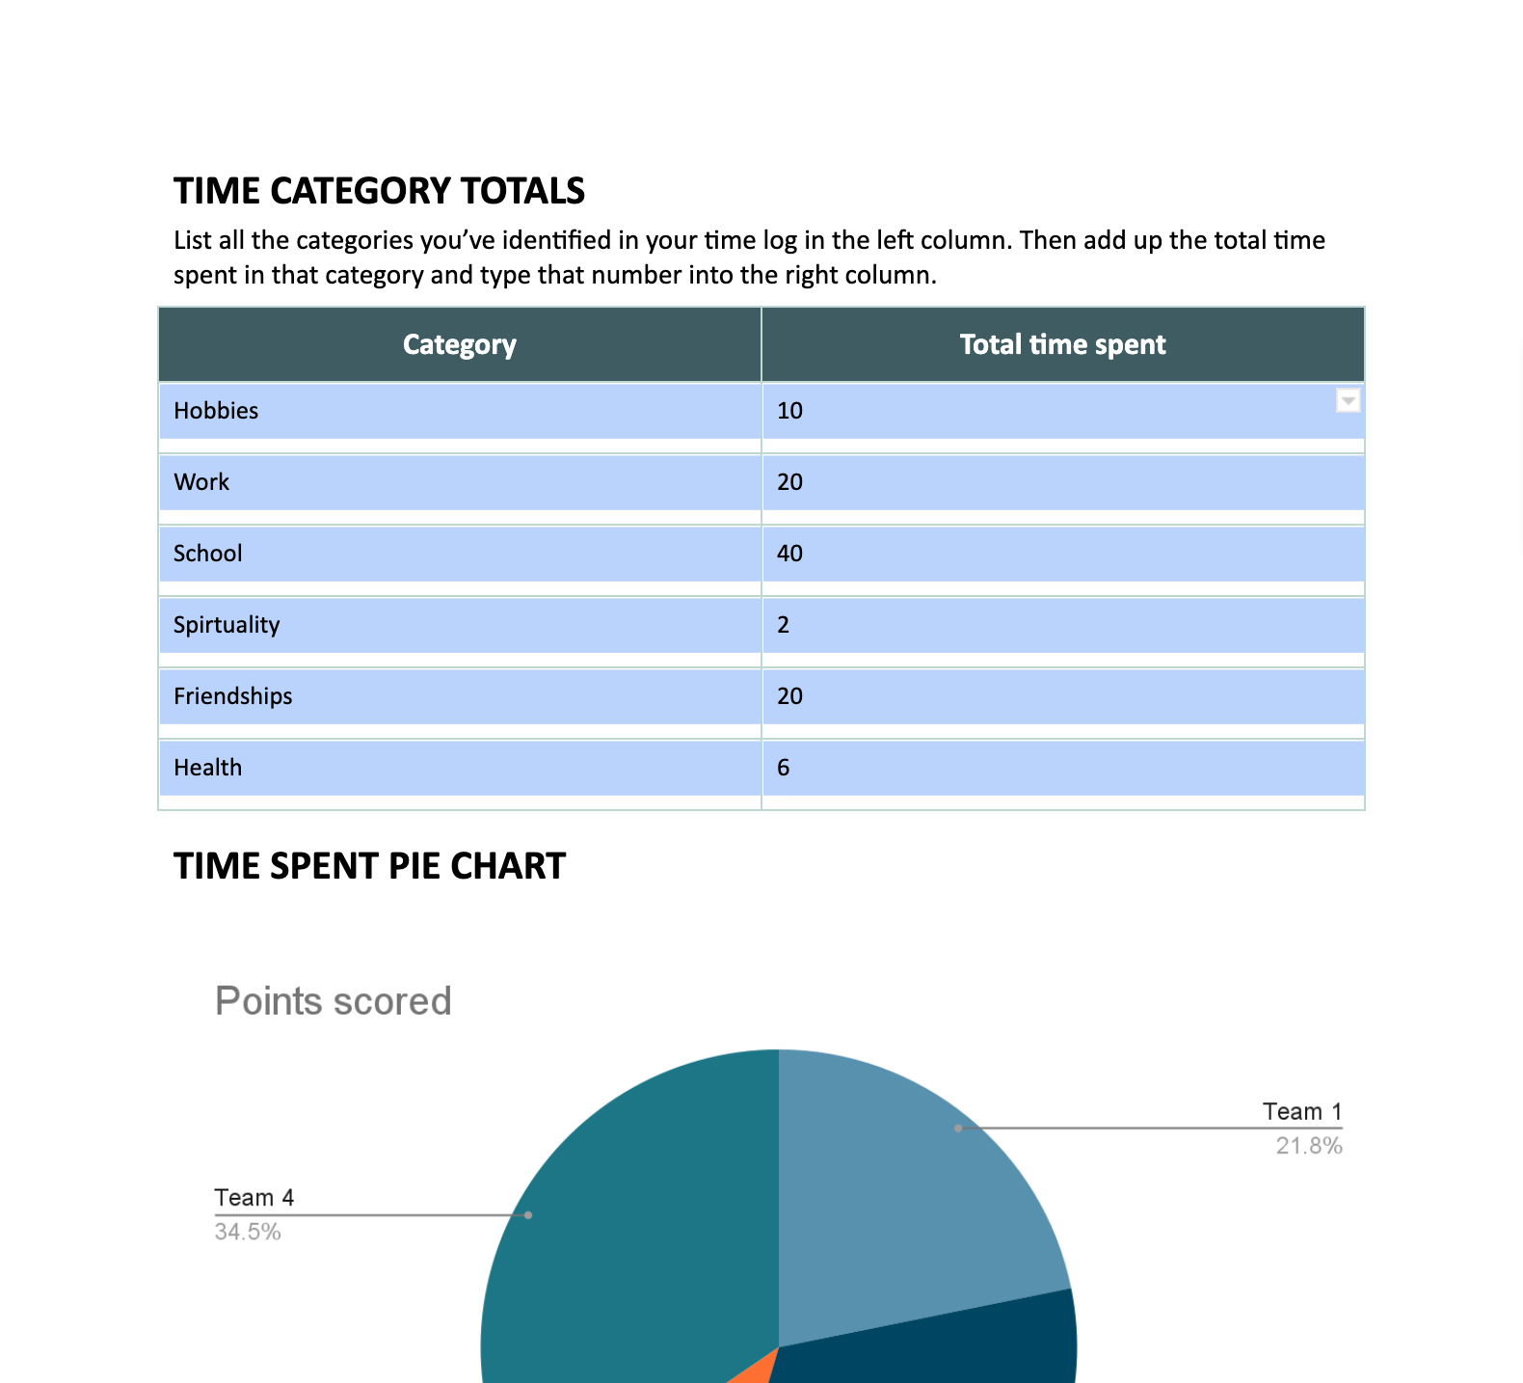
Baking a Pie Chart
Select all cells of the table above and copy (Ctrl+c).

Slide 15
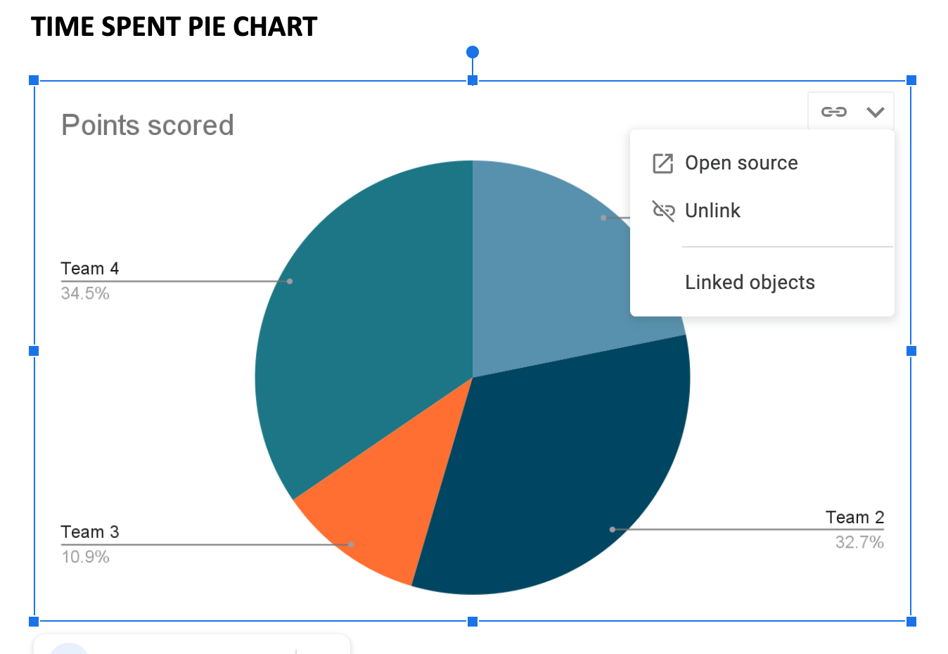
Baking a Pie Chart
Click on the link icon in the top right of the pie chart image. Click “open source.”

Slide 16
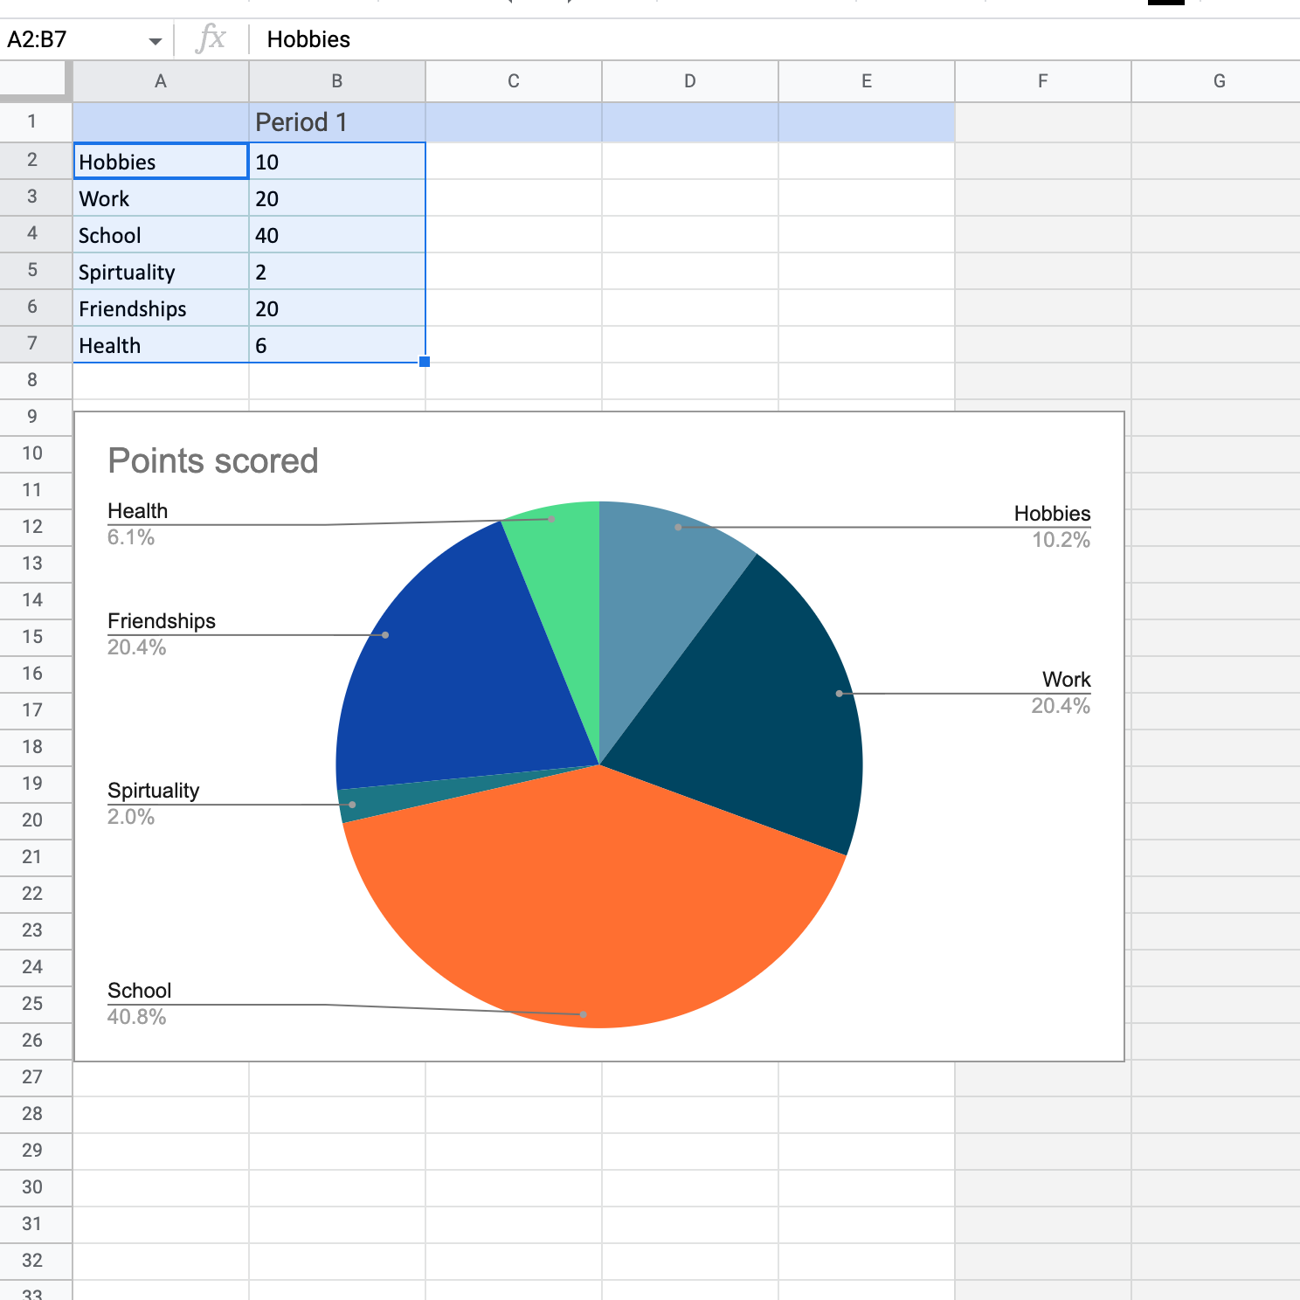
Baking a Pie Chart
Paste (Ctrl+v) the contents of your table into the spreadsheet that opens, replacing the default content that was there before.

Slide 17
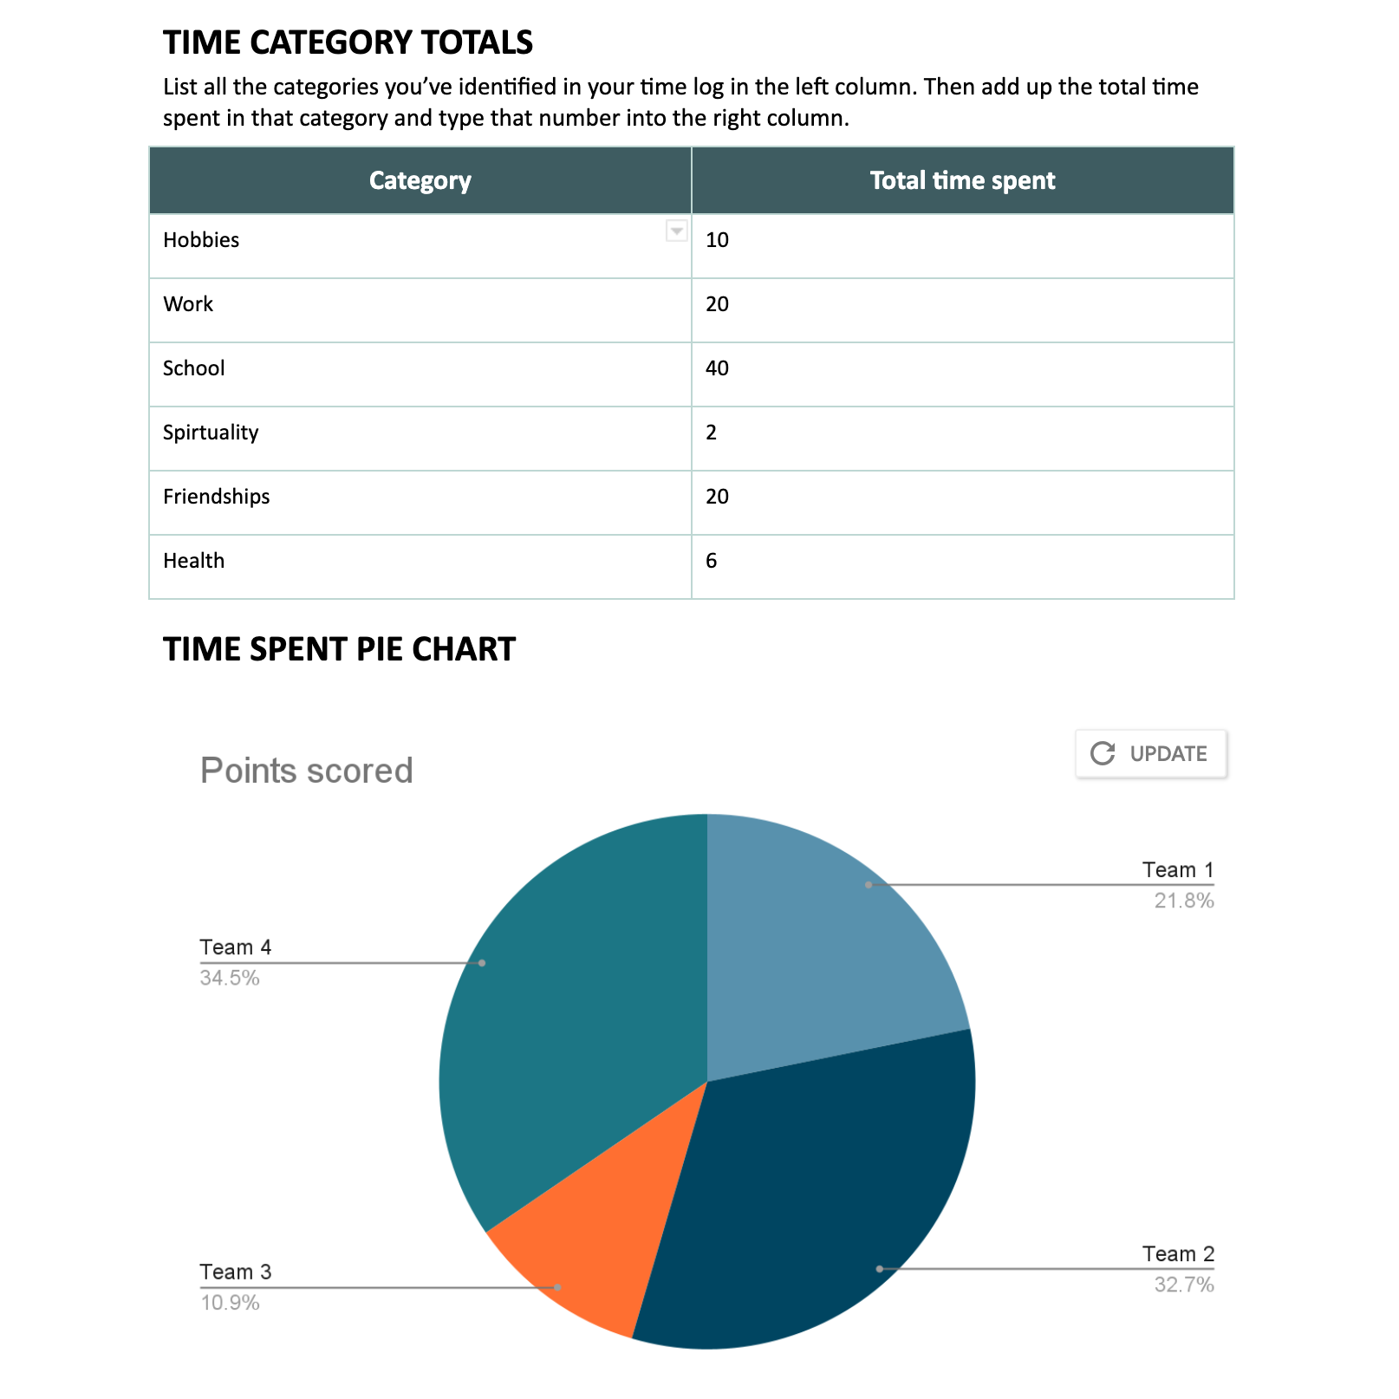
Baking a Pie Chart
Click “update” on the pie chart image below to see your changes on the document.

Slide 18
Time for Pie Reflection
Do you feel your pie chart represents how you spend your time?
Are there things about how you spend your time that you would like to change?
Are there things you ought to change to manage your time better?
Notes:
Sample Response: "I'd like to spend more time playing video games."
Note: The last two questions are not necessarily the same - I may want to change my time to play more video games, but I may need to change my time to read more.

Slide 19
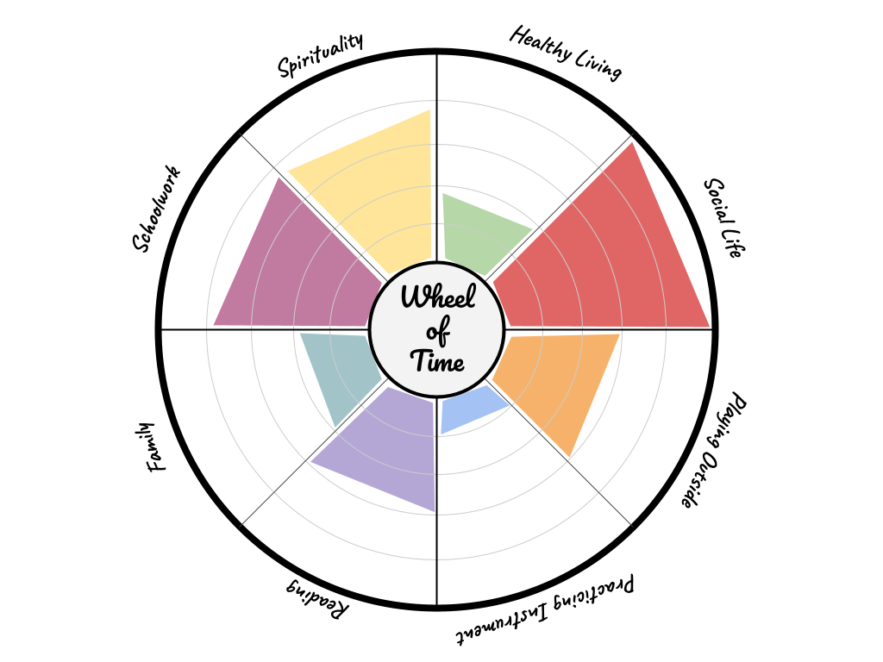
Wheel of Time
List your time usage “categories” in relation to your time log entries.
Notes:
YLS

Slide 20

Fold the Line
“How familiar are you with a course syllabus?”
1 = not at all familiar
2 = beginner
3 = competent
4 = knowledgeable
5 = expert
Line up with your chosen #.
Notes:
YLS

Slide 21

Syllabi Review: H-Chart
Review Syllabi
Complete an H-chart
    Left side – English Comp details
    Right side – College Algebra details
    Bridge – “What are the expectations of a college course? Be sure to include academics, deadlines, and classroom participation."
Notes:
YLS

Slide 22
Wheel of Time
Based on your Syllabi review, would you adjust the time in any of your categories?
Notes:
YLS

Slide 23
Time for Pie Reflection
Are there things about how you spend your time that you would like to change?
Are there things you ought to change to manage your time better?
Notes:
YLS

Slide 24
Wheel of Time
Rate your time usage in relation to your personal needs and goals.

Slide 25
Goal
Write down something you will do to improve your score in one area of your Wheel of Time.

