Slide 2
Shake It Up
Working With New People

Slide 3
Essential Questions
What are the benefits of working with new people?
What skills do we need to work well with others?

Slide 4
Learning Objectives
Analyze how our individual values guide our working styles and preferences.
Evaluate how diverse perspectives benefit a task.

Slide 5
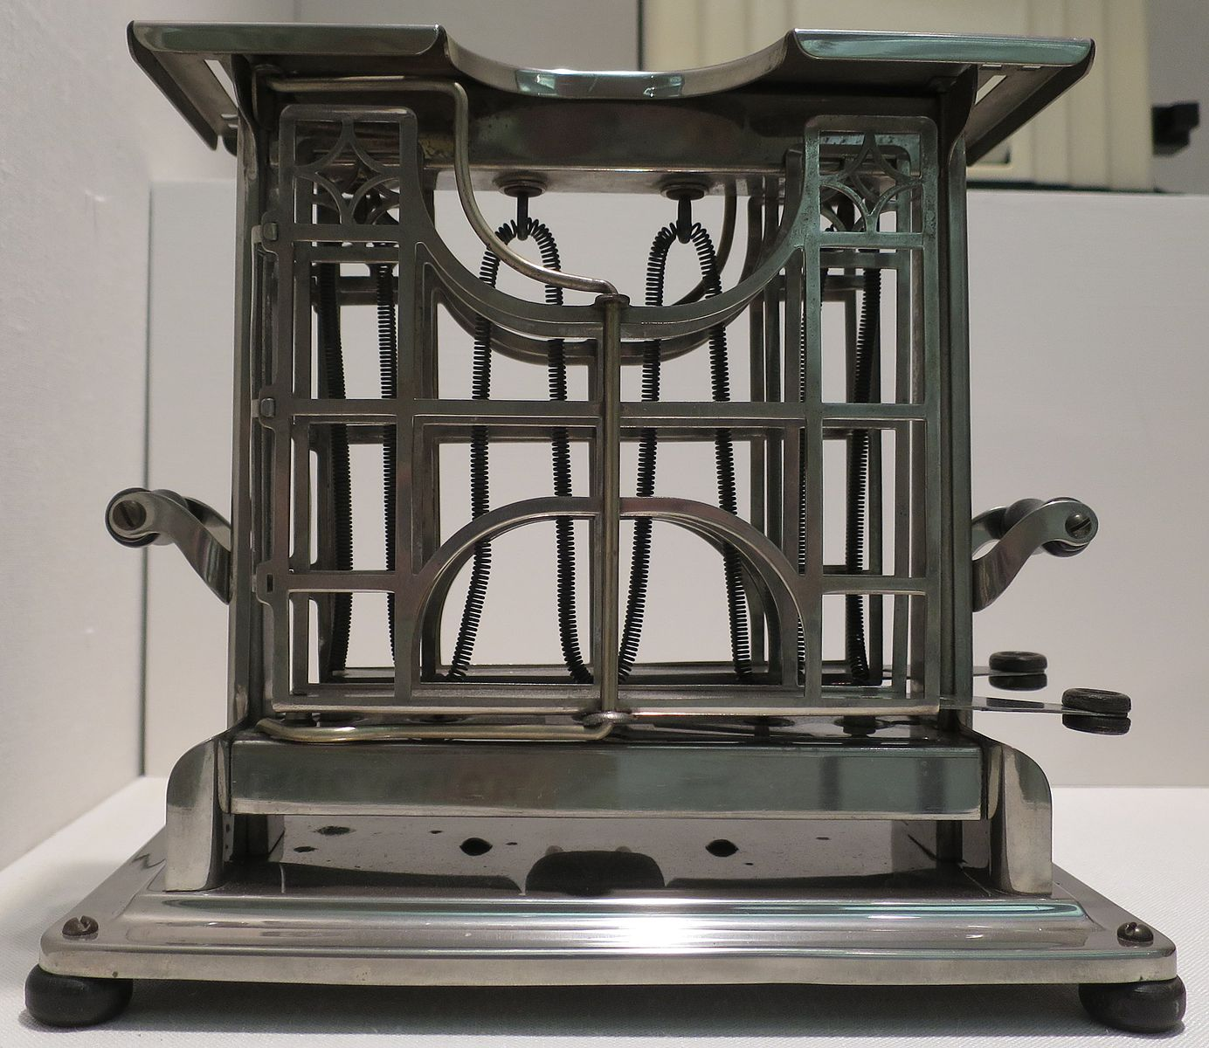
Artifact Detective
With your group, look at the photo
and make a guess as to what you think
it could be.
As you open each new clue, explain your new guesses OR explain how the clue supports your previous guess.
Record these guesses and reasonings on your Artifact Detective chart.
Notes:
Wmpearl. (2014). Toaster, Universal, Model E947, c. 1915, Landers, Frary and Clark, New Britain, Connecticut, Wolfsonian-FIU Museum. Wikimedia Commons.
Ask groups to look at the artifact and make a guess as to what it was used for. They should record their guess on the record sheet for round 1. Next, ask those with clue envelope 1 to read their clue to the group. Using this information, the group decides if they have a new guess for what the artifact is and records the guess on their sheet. Continue until all clues have been read. Share what the artifact was used for. Ask if any groups were correct? What clues helped?
http://www.toastermuseum.com/scripts/toastercollection/col_companies01.html

Slide 6
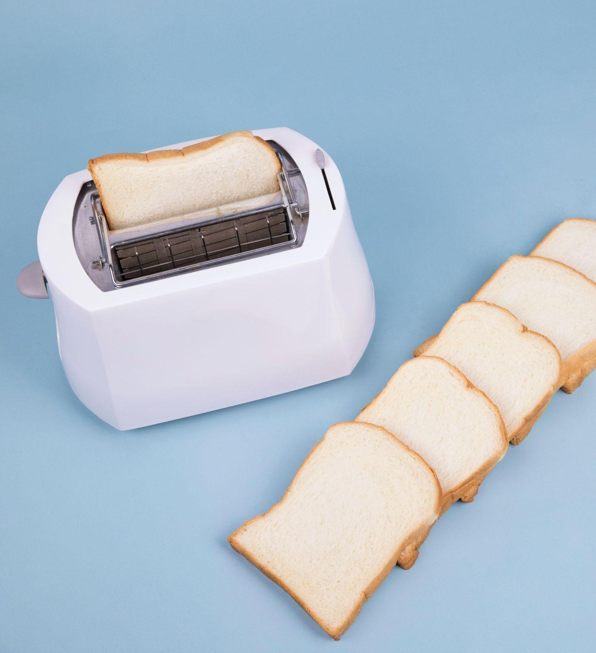
The artifact is… a toaster!
Were any of your guesses correct?
Which clues were the most helpful?
Were there clues or aspects of the artifact that kept you from reaching the right answer?
Notes:
Shenyi. (2018). Cut bread placed on table with toaster. Pexels. https://www.pexels.com/photo/cut-bread-placed-on-table-with-toaster-4417768/

Slide 7
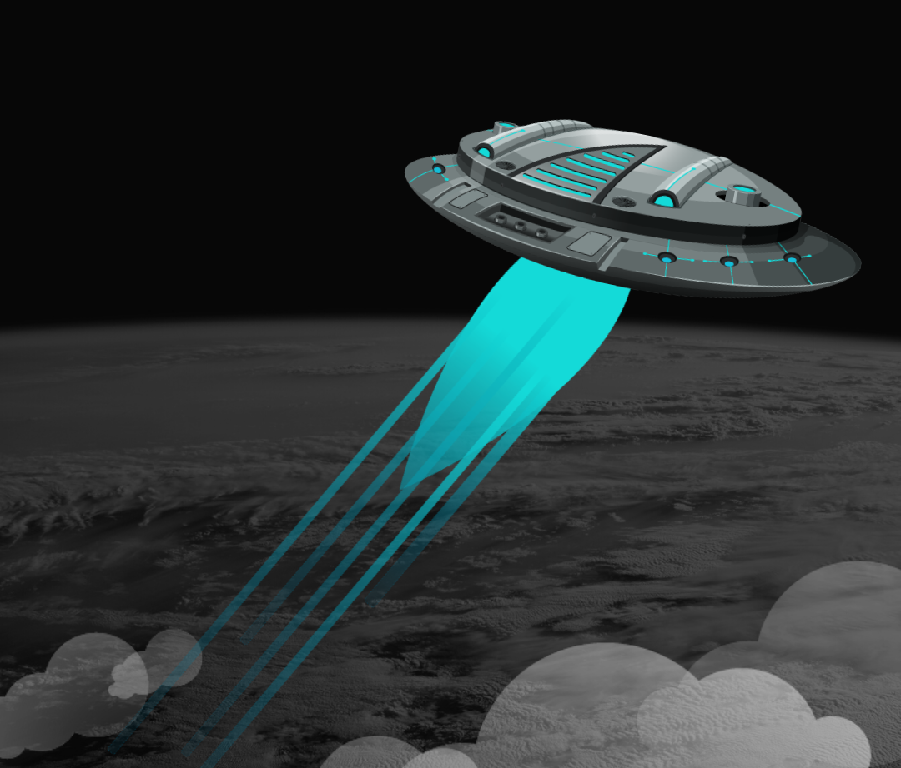
Crash Landing Consensus
Notes:
img: K20. (2022). My imaginary friend: Part 2. 5E Lessons. https://learn.k20center.ou.edu/lesson/1539

Slide 8
Crash Landing Consensus
A UFO crash landed outside, blocking the exit of the resort.
The alien might be hiding among you.
What do you think we should do about it?
Notes:
You have 15 minutes to mingle with one another.

Slide 9
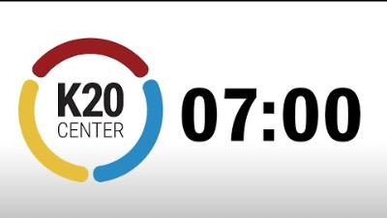
Crash Landing Consensus

Slide 10
Crash Landing Consensus
How do you feel about this solution?
I love it!
I can live with it.
I can’t live with it.

Slide 11
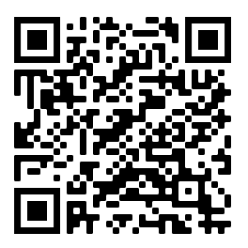
Work Preferences Inventory
https://www.careerperfect.com/services/free/work-preference
Notes:
Let student know they should now fully step out of their characters and in this next activity will be self-reflecting on how we as individuals prefer to work.

Slide 12
Work Preferences
If you scored higher than a 6 in Focuser, act like you’re looking through binoculars.
If you scored higher than a 6 in Relater, give an air high-five.
If you scored higher than a 6 in Integrator, twiddle your fingers like an evil genius.
If you scored higher than a 6 in Operator, act like you’re operating a spaceship.
Notes:
Group discussion questions:
What do you notice about these four styles in terms of projects, process?
What do we notice about the balance of these work styles in our club/group?
Is there a work style that we are missing?
Which style do you see yourself able to stretch into if it’s a need when working on a project? How would you work on making that stretch?
Teacher’s Notes:
We hope they will notice and you might have to probe more, these four styles each one fits best in a different part of the timeline of a project (Starter gets things going, Relater keeps things going, Finisher fits things together, Detailer finalizes and refines)
Hopefully this discussion will fuel productive goals later in the activity.

Slide 13
Fold the Line
Line up in ascending order of your score for your dominant work style.
i.e. Line up from highest score to lowest score.
“Fold the Line” and face the person opposite you.
Share your answers from your Values Chart and discuss your differences in values.
Notes:
Explain that these preferences in how we work affect how we behave when given tasks, especially complicated ones. It’s important to be aware of how our actions are motivated by our preferences and how they shape our working style. All of the styles are valid and can be beneficial to one another if we make for them to all exist on a project.
Have students fill out the attached Values Chart for completing a collaborative project. You could use this organizer as a way for group team members to set norms with one another before taking on a specific club project.
How do our values contribute to our working style?
How does diversity in working styles benefit collaborative projects?

Slide 14
Commit and Toss
Write your goal in the section at the bottom of the Values Chart handout.
Cut or tear the paper on the line.
Crumple up your goal and toss it.
Pick up another goal and be prepared to share it.
Notes:
Write a personal goal for how they can work best with different working styles and values in a group.

