Slide 2
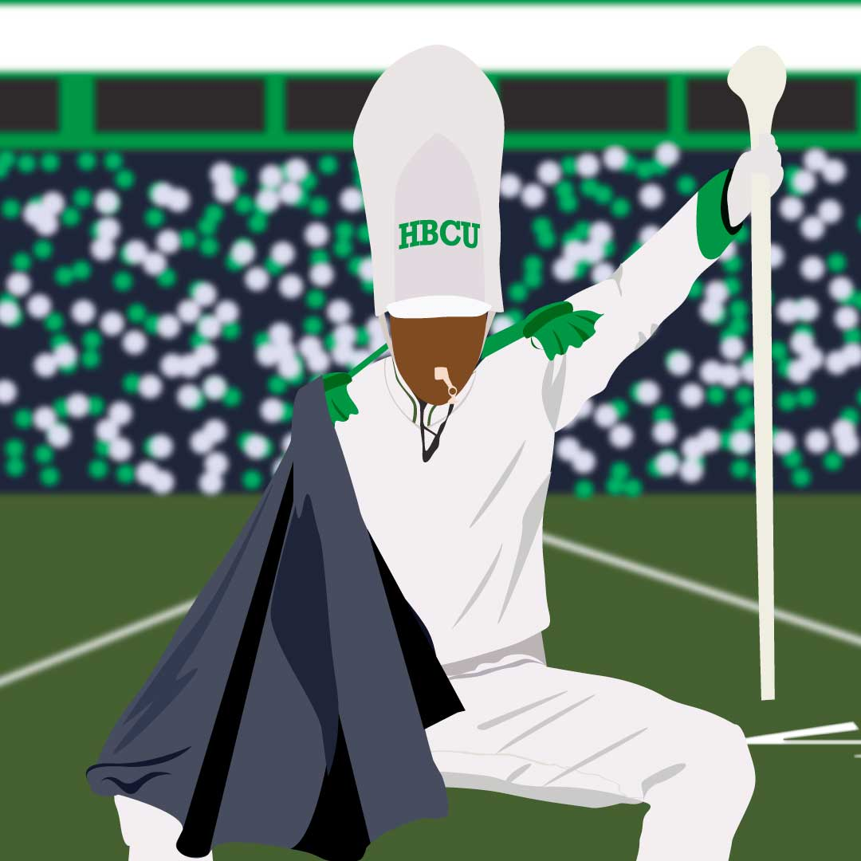
Road Trip to the Future

Slide 3

Tell Me Everything
You will be presented with a series of different individuals and a brief background overview.
As you learn about these individuals, consider what they might have in common.
Notes:
K20 Center. (n.d.). Tell me everything. Strategies. https://learn.k20center.ou.edu/strategy/107

Slide 4
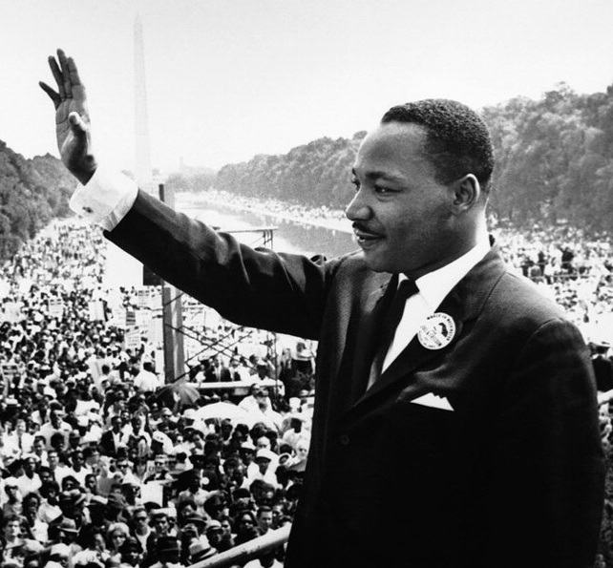
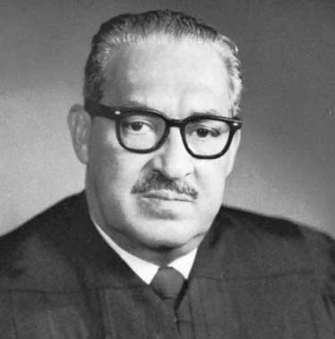
Dr. Martin Luther King Jr.
Thurgood Marshall
Baptist Minister and leader for the Civil Rights Movement.
Advocated for nonviolent resistance and civil disobedience.
American lawyer and Civil Rights Activist.
First African-American Associate Justice of the Supreme Court.
Notes:
Marshall, Thurgood. (2006). In M. I. Urofsky (Ed.), Biographical encyclopedia of the Supreme Court. http://library.cqpress.com/scc/bioenc-427-18168-979368
Public Affairs Office. (2010, Jan 14). Martin Luther King Jr. addresses a crowd from the steps of the Lincoln Memorial where he delivered his famous, “I Have a Dream,” speech during the Aug. 28, 1963, march on Washington, D.C. Retrieved from MARINES: https://www.mcasiwakuni.marines.mil/Images-photos/igphoto/255288/

Slide 5
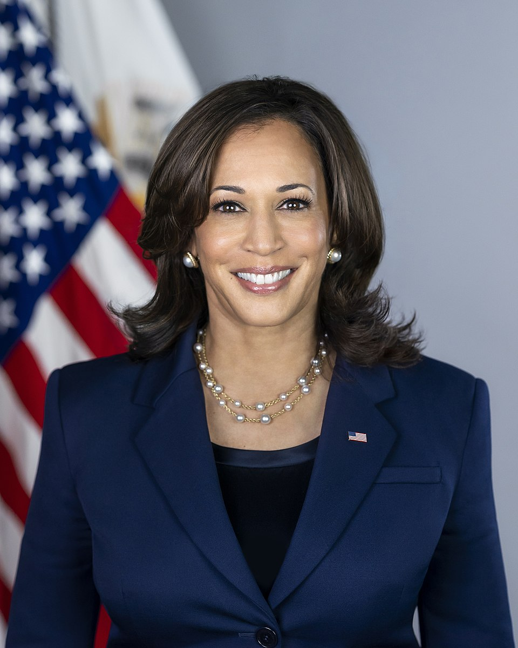
Kamala Devi Harris
Attorney and politician who previously served as Attorney General of the state of California and U.S. Senator.
49th Vice-President of the United States of America and first African American and Asian American VP.
First Female VP and the highest-ranking female official in the U.S. history to date.
Democratic Party nominee in the 2024 Presidential election.
Notes:
USA Today. (n.d.). Kamala Harris. Vice President Kamala Harris: A look at her political career. [Photograph]. https://www.usatoday.com/picture-gallery/news/politics/2019/01/21/kamala-harris-through-years/2635835002/

Slide 6
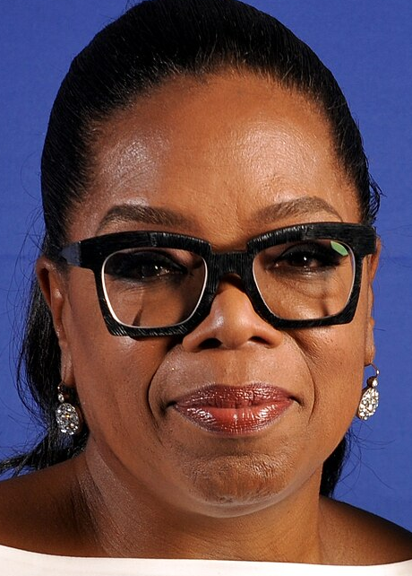
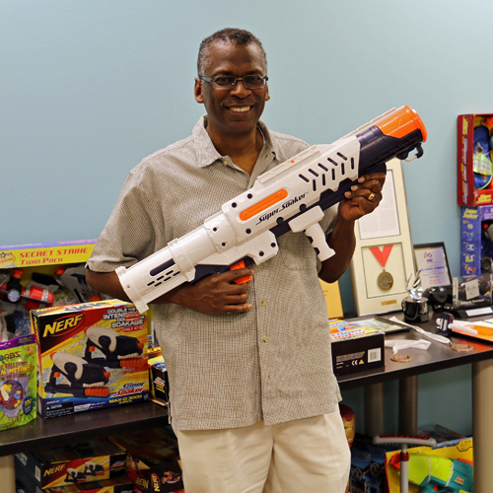
Oprah Gail Winfrey
Lonnie George Johnson
Inventor, aerospace engineer, & entrepreneur who served in the U.S. Air Force and NASA.
Founder and President of Johnson Research and Development CO.
In 1989, invented the Super Soaker water gun, one of the best-selling toys to date.
Billionaire, talk show host, TV producer, actress, author, media mogul and philanthropist.
Chairman and CEO of Harpo Productions and the Oprah Winfrey Network (OWN).
Notes:
Wikimedia Commons. (2016). Oprah Winfrey.[Photograph]. https://commons.wikimedia.org/wiki/File
Johnson Research & Development Co., Inc. (n.d.). Lonnie Johnson with Super Soaker and Nerf toys. https://invention.si.edu/invention-stories/meet-lonnie-johnson-man-behind-super-soaker

Slide 7
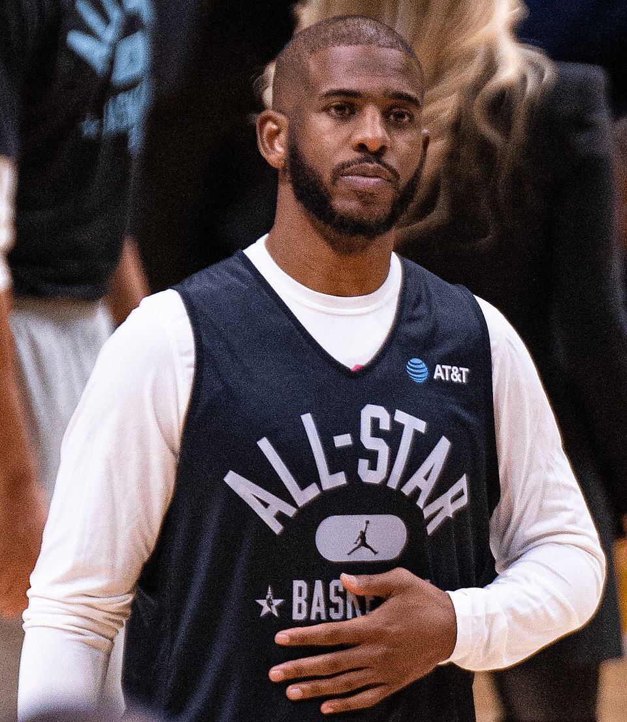
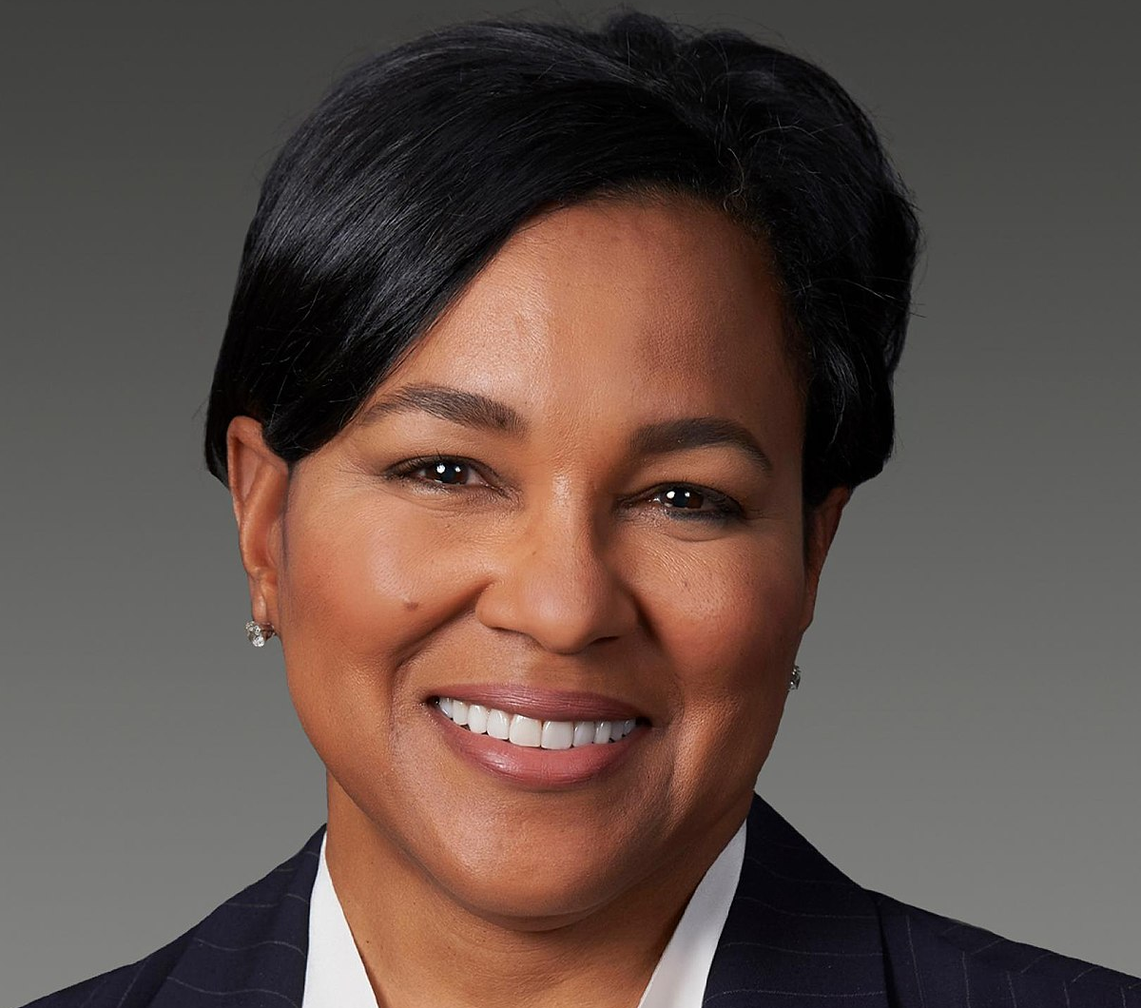
Chris Paul “CP3”
Rosalind G. Brewer
NBA player who has played with teams such as the Spurs, Suns, Rockets, Warriors, Thunder, Clippers, and Hornets.
Has won the NBA Rookie of the Year Award, MVP Award, and two Olympic gold medals.
Buisnesswoman and first African-American woman to serve as CEO of Walgreens Boots Alliance.
Former CEO of Sam’s Club, group President and COO of Starbucks.
Currently serves as interim president of Spelman College.
Notes:
Erik Drost. (2022). Chris Paul (2022 All‑Star Weekend) (cropped) [Photograph]. Wikimedia Commons. https://commons.wikimedia.org/wiki/File:Chris_Paul_(2022_All-Star_Weekend)_(cropped).jpg
Watch the Yard. (2017). Starbucks just named Alpha Kappa Alpha soror Rosalind Brewer as its new chief operating officer. [Photograph]. https://www.watchtheyard.com/akas/rosalind-brewer-alpha-kappa-alpha/

Slide 8
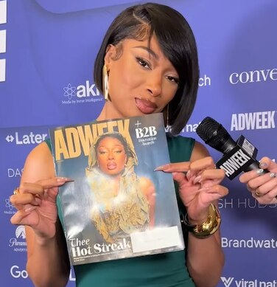
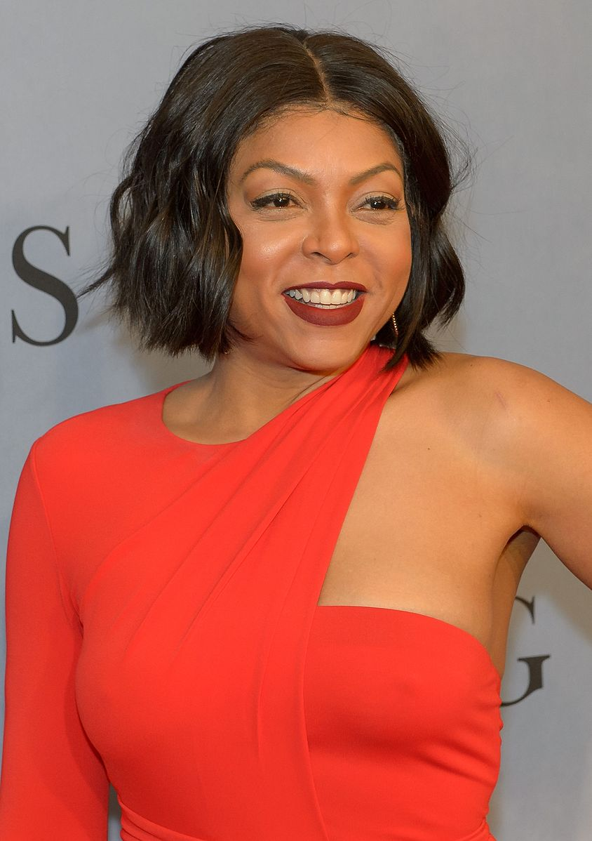
Megan Jovon Ruth Pete
Taraji P. Henson
Rapper and song writer know as “Megan Thee Stallion.”
Grammy award winning artist & featured in Time magazine’s 100 most influential people in the world list.
Actress, singer, and New York Times best selling author.
Featured in Time magazine’s 100 most influential people in the world list.
Member of the White House’s Board of Advisors on HBCUs.
Notes:
Wikimedia Commons. (2024, April 12). Megan Thee Stallion. [Photograph]. https://commons.wikimedia.org/wiki/File
NASA. (2016, Dec 10). American actress and singer Taraji P. Henson. https://www.flickr.com/photos/nasahqphoto/31525359096/

Slide 9
Tell Me Everything
From politicians to entertainers to corporate America, what might all these successful African-Americans have in common?
Notes:
K20 Center. (n.d.). Tell me everything. Strategies. https://learn.k20center.ou.edu/strategy/107

Slide 10
Historically Black Colleges and Universities
All of these individuals have attended or graduated from an Historically Black College or University (HBCU).
HBCUs are institutions that were established with the intention of providing access to higher education to the African-American community.

Slide 11
Learning Objectives
Analyze the historical background of HBCUs.
Examine which HBCU best aligns to personal and academic goals.

Slide 12
Essential Question
How is equal access and opportunity supported in higher education?

Slide 13
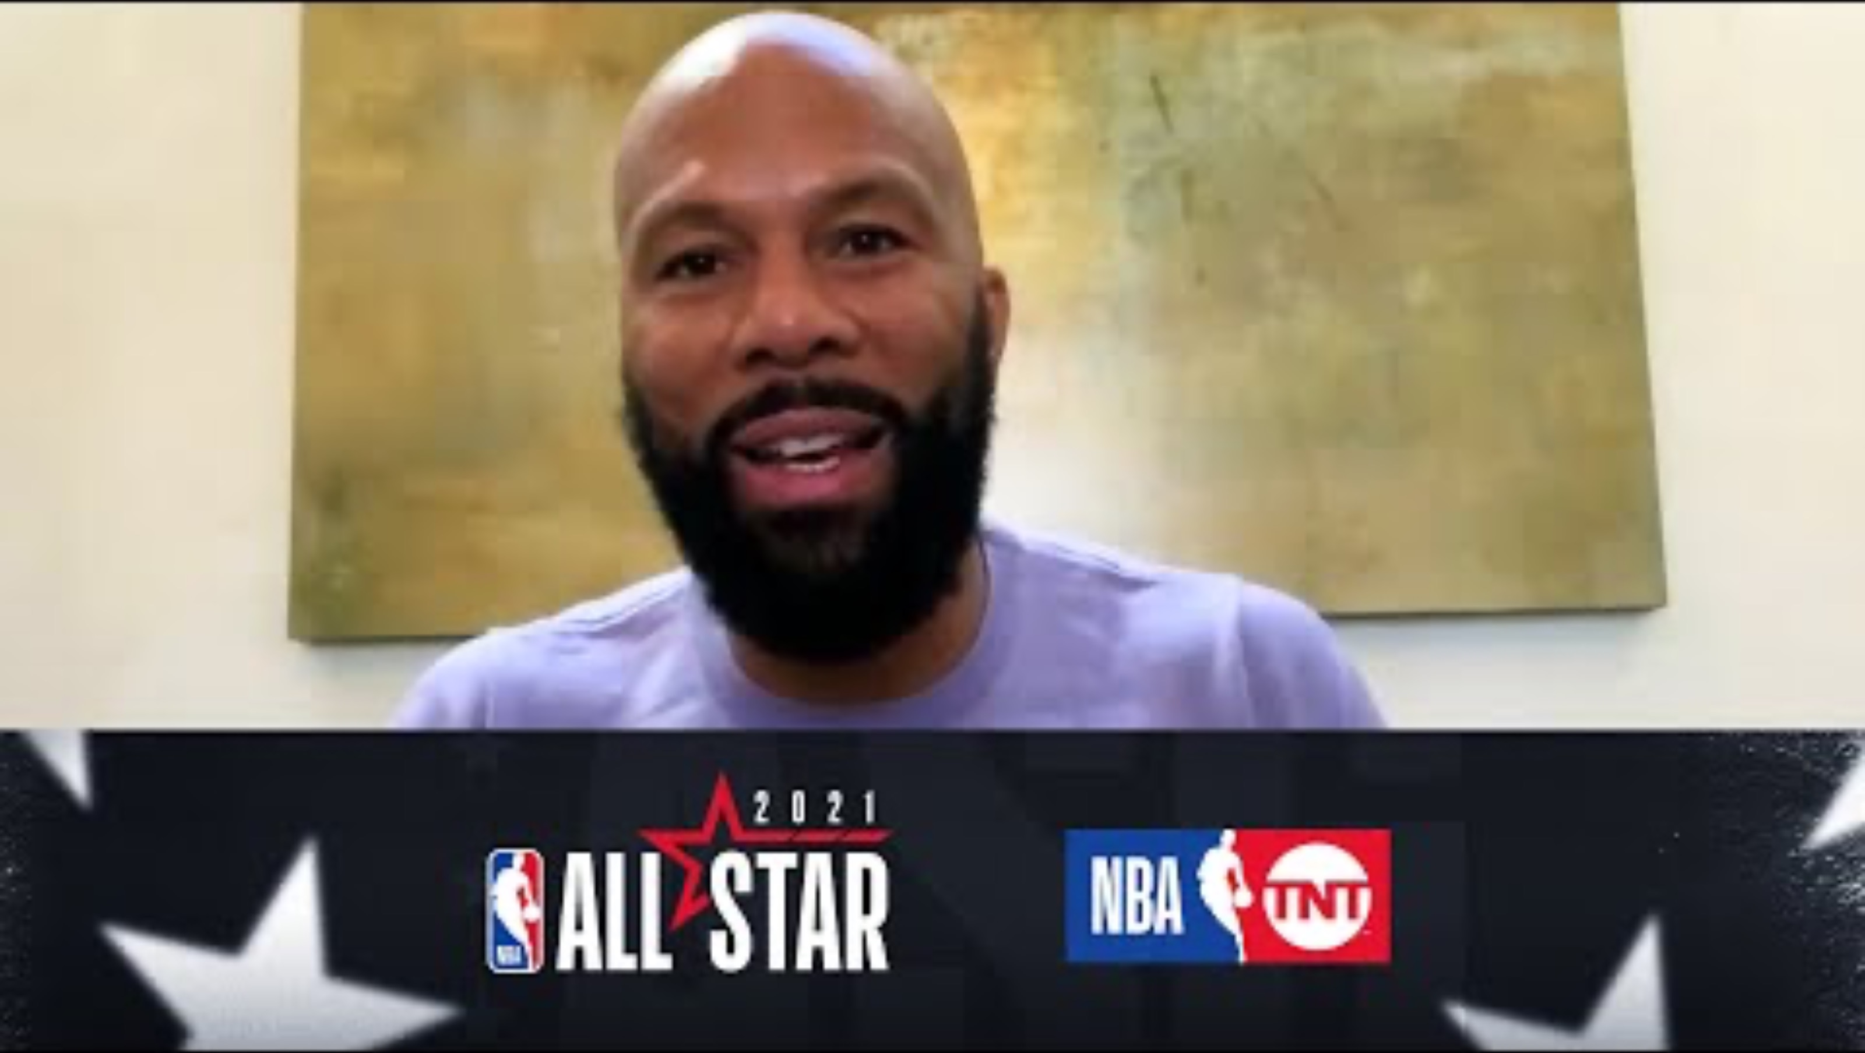
The Importance of HBCUs
Notes:
TNT Sports US. (2021, March 7). Spike Lee, Common, 2-Chainz & More Discuss the Importance of HBCUs: NBA All-Star 2021 [Video]. YouTube. https://youtu.be/RMohxcEn-dw?si=BqqRXP5OTncpBmQe

Slide 14

Stop and Jot
As you read through the handout “The Rise of HBCUs,” stop and jot down a brief summary of each section.
Be sure to include all information important to the understanding of that section.
Notes:
K20 Center. (n.d.). Stop and jot. Strategies. https://learn.k20center.ou.edu/strategy/168

Slide 15
HBCUs Research Project
With your group, you will select one Historically Black College and University to research to gain more information.
Go to the following website: https://k20.ou.edu/hbculist
    Select the “HBCU list tab” to find the list of different institutions.
From the list, select one institution. Once you have selected your school, answer the questions on the Research Project Handout.

Slide 16

One-Pager
Using the information from your research, create a visual representation, a “one-pager” to represent your institution.
Use Canva, Google slides/Google Draw, or poster paper.
The Research Handout includes the expectations. Review the “One-Pager Instructions & Requirements” for specific details.
Notes:
K20 Center. (n.d.). One-pager. Strategies. https://learn.k20center.ou.edu/strategy/72

Slide 17

Elevator Speech
With your group, develop an elevator speech to convince others your institution should be a school they visit.
Select a spokesperson to deliver the speech.
Keep it between 60-90 seconds.
Notes:
K20 Center. (n.d.). Elevator speech. Strategies. https://learn.k20center.ou.edu/strategy/57

Slide 18

Exit ticket
Answer the following questions:
Which institution aside from your own appeal to your interests the most? Explain why.
How is equal access and opportunity supported in higher education?
Notes:
K20 Center. (n.d.). Bell ringers and exit tickets. Strategies. https://learn.k20center.ou.edu/strategy/125

