Slide 2
Getting to Know Your TI-Nspire
Learn the essential mechanics of the calculator

Slide 3
Essential Question
Which mechanics of the TI-Nspire are essential for me to know?

Slide 4
Learning Objectives
Explore the TI-Nspire mechanics for calculations, graphs, geometric conceptual development, and data analysis.
Demonstrate the use of technology to enhance the learning of mathematics in the classroom.

Slide 5
Magnetic Statements
When each statement displays
Move to the side of the room that you agree with more.
Discuss your choice in your group.
Share why your group was attracted to the statement.

Slide 6
I got my first calculator in
Middle School
High School

Slide 7
Calculators are best for
Graphing
Computing

Slide 8
I need a calculator
Always
Sometimes

Slide 9
Calculators support my understanding
Always
Sometimes

Slide 10
I am more comfortable using
My phone
My TI-Nspire

Slide 11
TI-Nspire Scavenger Hunt
Complete the steps in the TI-NSPIRE CX II scavenger hunt.
Choose the graphing calculator task card that aligns with your content area.
Pre-Algebra & Algebra I
Geometry
Algebra II
Precalculus
Work through the task card to learn more specific functions for your content.
If time allows, try another task card!

Slide 12
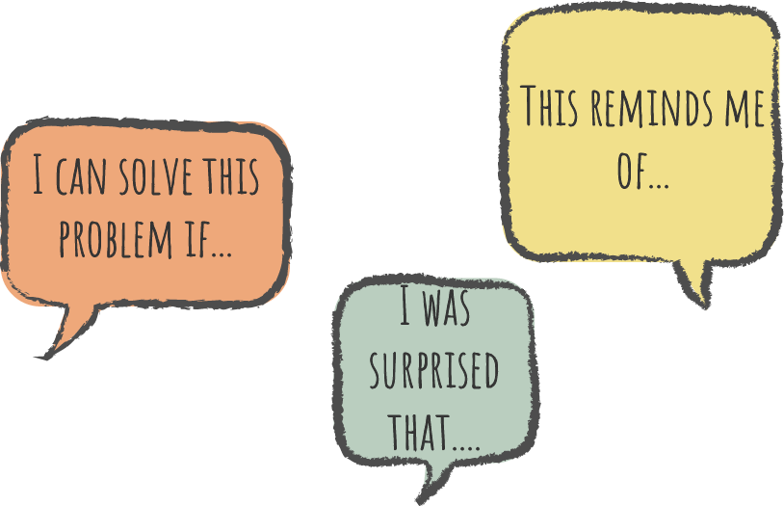
Say Something!
Share something about the TI-Nspire
My favorite feature is…
I found these calculator commands are similar to a computer…
This is different than my phone calculator in that…
I think I may need help with…
I was surprised by…
I wish I knew how to…

Slide 13
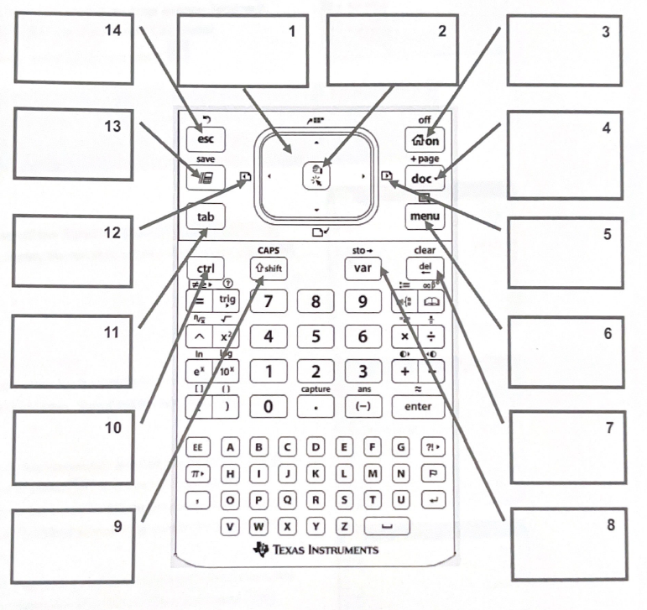

Slide 14
On Home
Escape
Touchpad
Left click
Scratch pad Quick calc
Stored
Docs
Previous Insert Point
Next Insert Point
Navigate between lines math quickly
Menu
Access blue controls
Backspace Delete
Define and store Variables
Capitalize letters

Slide 15
Say Something!
Share something about the TI-Nspire
I think this will help me…
One thing I find complicated is…
I think the most useful feature will be…
I don’t know when I’d use…
I’d like to learn more about…

Slide 16
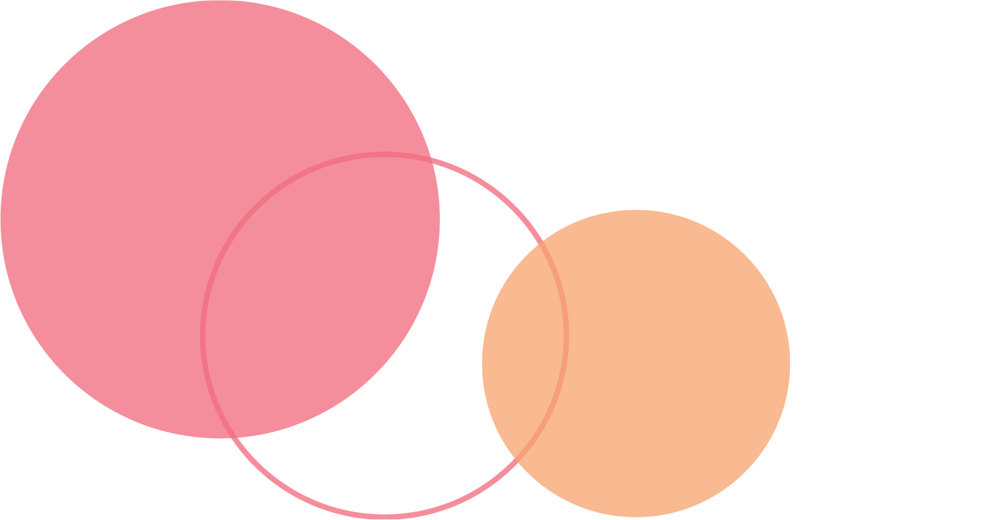
Find someone who can…
Circle any spaces for each task you already know how to complete.
Collaborate with those around you to mark out un-circled spaces on the card.

Slide 17
Muddiest Point
What do you find most confusing or difficult about the TI-Nspire?
Which tasks to you still need help with?

Slide 18
Commit and Toss
Write down
One thing you learned
One thing you still want to know
Toss your response in the container

