Slide 2
Is That Necessary?
The Eisenhower Matrix
Notes:
eisenhowerme. (2012, September 2). The Eisenhower Matrix: How to manage your tasks with Eisenhower [Video]. YouTube. Retrieved September 8, 2022, from https://www.youtube.com/watch?v=tT89OZ7TNwc

Slide 3
Essential Questions
How can we make the best use of our time?

Slide 4
Learning Objectives
Reflect on the tasks students need to complete in a week.
Analyze if those tasks are necessary or time sensitive.
Revise plans based on analysis.

Slide 5
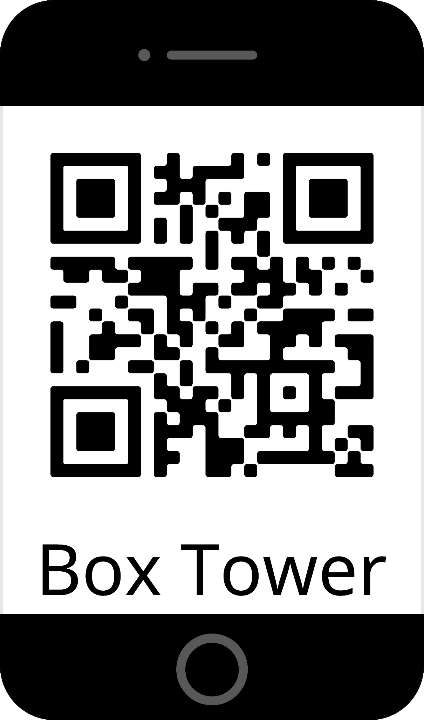
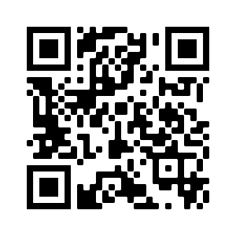
Build a Tower
Scan the QR code on the right or go to k20.ou.edu/play-box-tower
Try to build the tallest tower you can!
Keep your best score to share at the end.
You have 3 minutes!
Notes:
K20 Center. (2021, September 21). K20 Center 3 minute timer [Video]. YouTube. Retrieved September 2, 2022, from https://www.youtube.com/watch?v=iISP02KPau0 CBC Canada. (n.d.). Box Tower. CBC Kids. Retrieved September 8, 2022, from https://www.cbc.ca/kids/games/play/box-tower

Slide 6
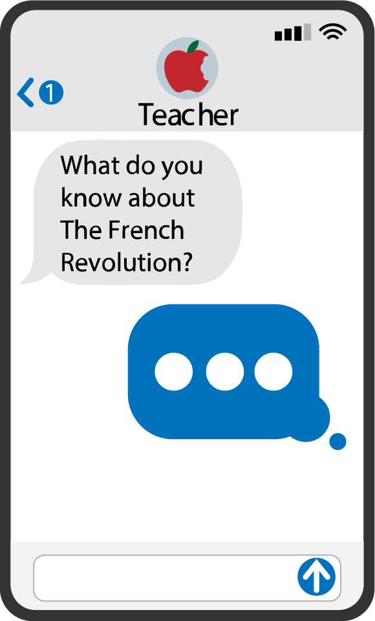
Quick Write
Think about all the tasks you need to manage over the next week.
Make a list of all the big and small tasks you know need complete or attend during the week.
Notes:
K20 Center. (2021, September 21). K20 Center 2 minute timer [Video]. YouTube. Retrieved September 8, 2022, from https://www.youtube.com/watch?v=HcEEAnwOt2c
K20 Center. (n.d.). Quick Write. Strategies. https://learn.k20center.ou.edu/strategy/1127

Slide 7
Personal Timeline
Using your list of tasks, create a personal timeline that shows when your tasks take place or need to be completed.

Slide 8
Timeline Topics
Answer the following questions with your group:
Do we have any tasks in common?
What on your timeline is a big task?
What on your timeline is a small task?

Slide 9
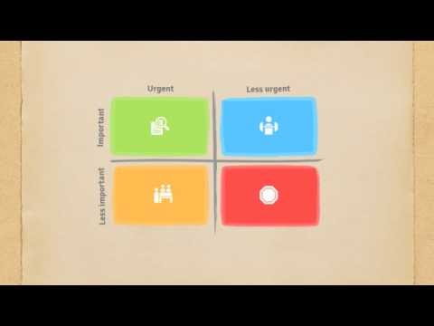
Eisenhower Matrix
Notes:
eisenhowerme. (2012, September 2). The Eisenhower Matrix: How to manage your tasks with Eisenhower [Video]. YouTube. Retrieved September 8, 2022, from https://www.youtube.com/watch?v=tT89OZ7TNwc

Slide 10
What is “delegate”?
Definition: To give, pass on, or entrust something to someone else.
What does this mean in school?
Notes:
To delegate in school means to share the responsibility for the work. No one person does all the work—it is a group effort, and each person takes responsibility of a different part of the task.

Slide 11
Eisenhower Matrix Card Sort
Cut out all the task cards.
In your group, discuss and decide where each task best fits in the matrix according to its urgency and importance.
Prepare to share why you put each task on the chosen quadrant.
Notes:
K20 Center. (n.d.). Card Sort. Strategies. https://learn.k20center.ou.edu/strategy/147

Slide 12
Fist to Five
Pay attention to where other groups put different tasks on the matrix.
Hold up one to five fingers to show how much you agree with their task placements on the matrix.
1 = Strongly disagree
2 = Disagree
3 = Neither agree nor disagree
4 = Agree
5 = Strongly agree
If you disagree, prepare to share why your group chose a different quadrant for the task.
Notes:
K20 Center. (n.d.). Fist to Five. Strategies. https://learn.k20center.ou.edu/strategy/68

Slide 13
What’s on Your Plate?
Use your personal timeline to fill your Eisenhower Matrix.
Place each task in the quadrant that fits the task best.
Think about the following:
What tasks did you have in common with your peers?
What are ways you might be able to share the work with them?

Slide 14
Creating Balance
On the back sheet of your personal timeline, create a new timeline of your week(s).
Use your Eisenhower Matrix to help you reschedule your upcoming week(s).

Slide 15
What changed?
How did your timeline change?
Did any of your tasks become more manageable?
How can this help you in the future?

Slide 16
Reflect.
“What is important is seldom urgent and what is urgent is seldom important.”
-Dwight Eisenhower
Notes:
eisenhowerme. (2012, September 2). The Eisenhower Matrix: How to manage your tasks with Eisenhower [Video]. YouTube. Retrieved September 8, 2022, from https://www.youtube.com/watch?v=tT89OZ7TNwc

