Slide 2
Breaking It Down: Task Management 101
Learn How to Manage Your Time

Slide 3
Essential Questions
How can we make our tasks more manageable?
How can we make sure we finish tasks on time?

Slide 4
Learning Objectives
Analyze a task to determine how to break it down into smaller goals.
Create a plan for completing a task.
Reflect on the success of the plan.

Slide 5
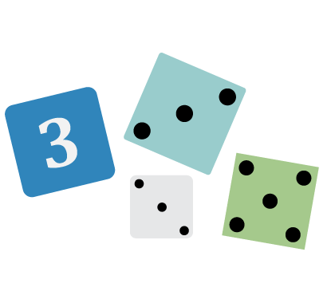
Roll the Dice!
The goal of this game is to reach 50 points first. You start with zero points.
If you roll 1-3, subtract that number of points from your score.
If you roll 4-6, add that number of points to your score.

Slide 6
How Did It Go?
How long did it take to reach 50 points?
How did it feel to have a setback when you rolled a 1-3?

Slide 7
Benefits and Barriers
What supports do you have as part of your day, week, month, or year that help you complete complicated or large tasks?
What sorts of things can keep you from completing those tasks?

Slide 8
Benefits and Barriers T-Chart
Benefits
Barriers
Which of your barriers do you have the power to change?
Which barriers are unavoidable?
Notes:
K20 Center. (n.d.) T-chart. https://learn.k20center.ou.edu/strategy/86

Slide 9
Micro-Goals
Micro-goals are small tasks that help reach the goal of completing a much larger task.
How can large tasks be broken down into smaller tasks?

Slide 10
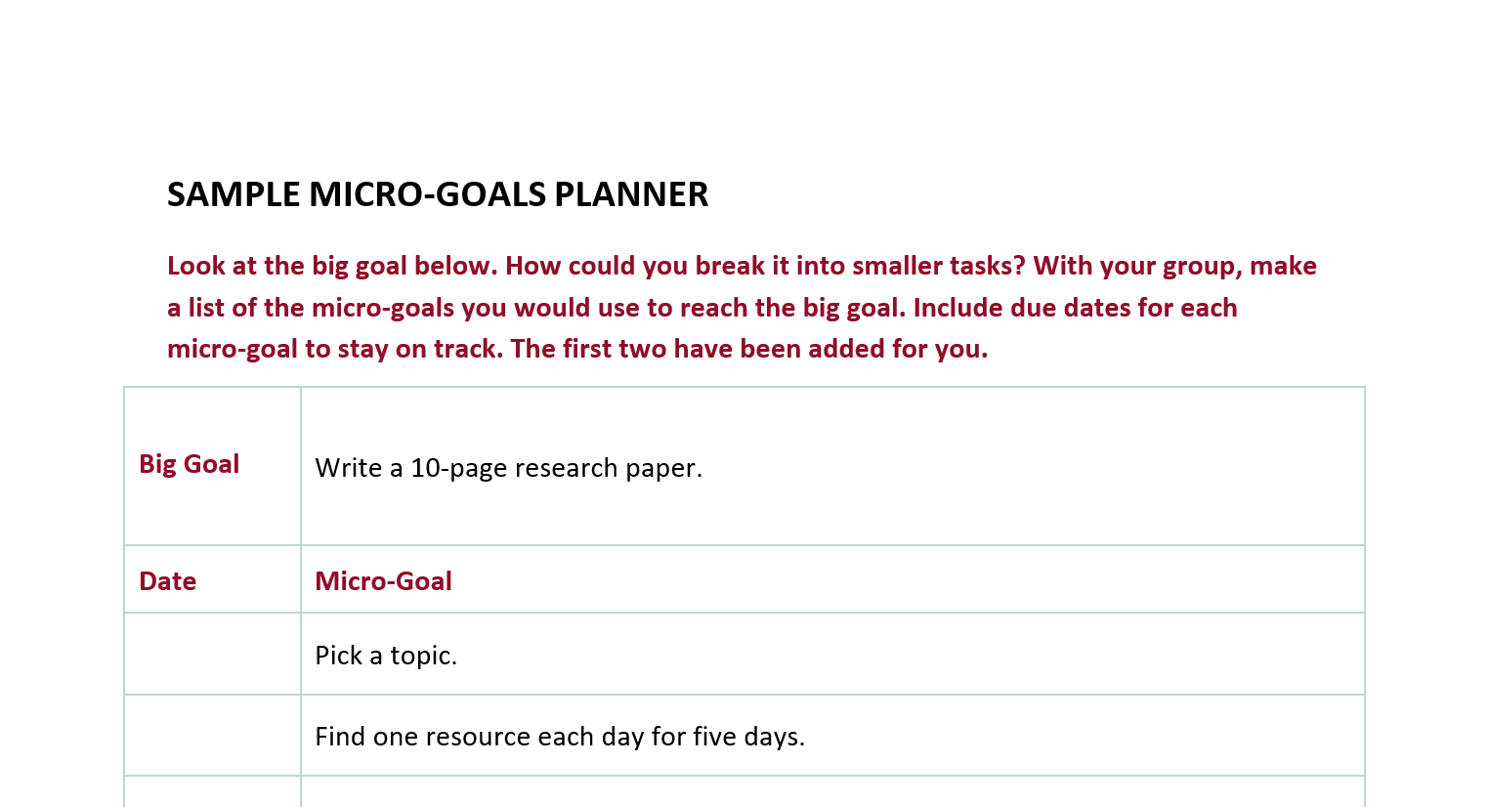
Making Micro-Goals
Notes:
other ideas: make an outline, thesis statement, determine how much to read each day, and how much to write each day.

Slide 11
What Did You Plan?
Share how you broke down the research paper into smaller tasks.
Listen to other groups’ ideas.
Reflect and revise your micro-goals.

Slide 12
What Do You Think?
How does setting micro-goals make tasks less intimidating?
How can they help us when we encounter setbacks?

Slide 13
Micro-Goal Planner
Find a big task you have coming up in the next week.
Break this task down into micro-goals.
Give each micro-goal a date for completion.
Test your micro-goals in the next week. Be ready to share at the next meeting.

Slide 14
Essential Questions
How can we make our tasks more manageable?
How can we make sure we finish tasks on time?

Slide 15
Always, Sometimes, or Never True
Micro-goals made the large task manageable.
My micro-goals were too big.
My micro-goals were too small.
I will use micro-goals again.
Notes:
K20 Center. (n.d.) Always, Sometimes, or Never True. https://learn.k20center.ou.edu/strategy/145

