Slide 2
Getting to Know the TI-84 Plus
Learn the essential mechanics of the calculator

Slide 3
Essential Question
Which mechanics of the TI-84 Plus are essential for me to know?

Slide 4
Learning Objectives
Explore the TI-84 Plus mechanics for calculations, graphs, geometric conceptual development, and data analysis.
Demonstrate the use of technology to enhance the learning of mathematics in the classroom.

Slide 5
Magnetic Statements
When each statement displays
Move to the side of the room that you agree with more.
Discuss your choice in your group.
Share why your group was attracted to the statement.

Slide 6
I got my first calculator in
Middle School
High School

Slide 7
Calculators are best for
Graphing
Computing

Slide 8
I need a calculator
Always
Sometimes

Slide 9
Calculators support student understanding
Always
Sometimes

Slide 10
I am more comfortable using
My phone
TI-84 Plus

Slide 11
TI-84 Plus Scavenger Hunt
Complete the steps in the TI-84 Plus scavenger hunt.
Choose the graphing calculator task card that aligns with your content area.
Pre-Algebra & Algebra 2
Geometry
Algebra II
Precalculus
Work through the task card to learn specific functions for your content.
If time allows, try another task card!

Slide 12
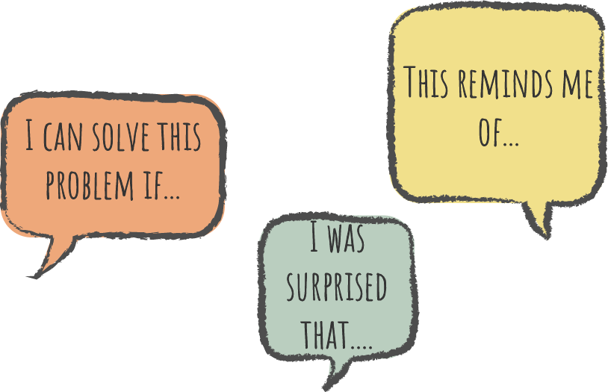
Say Something!
Share something about the TI-84 Plus
My favorite feature is…
I found these calculator commands are similar to a computer…
This is different than my phone calculator in that…
I think I may need help with…
I was surprised by…
I wish I knew how to…

Slide 13
8
7
1
6
2
5
4
3

Slide 14
8
Graphing controls
Access to Blue controls
7
1
Navigating arrows
Access to Green controls
6
2
Backspace Delete
Access to secondary menus
5
4
3
On/Off
Calculate

Slide 15
Say Something!
Share something about the TI-84 Plus
I think this will help me…
One thing I find complicated is…
I think the most useful feature will be…
I don’t know when I’d use…
I’d like to learn more about…

Slide 16
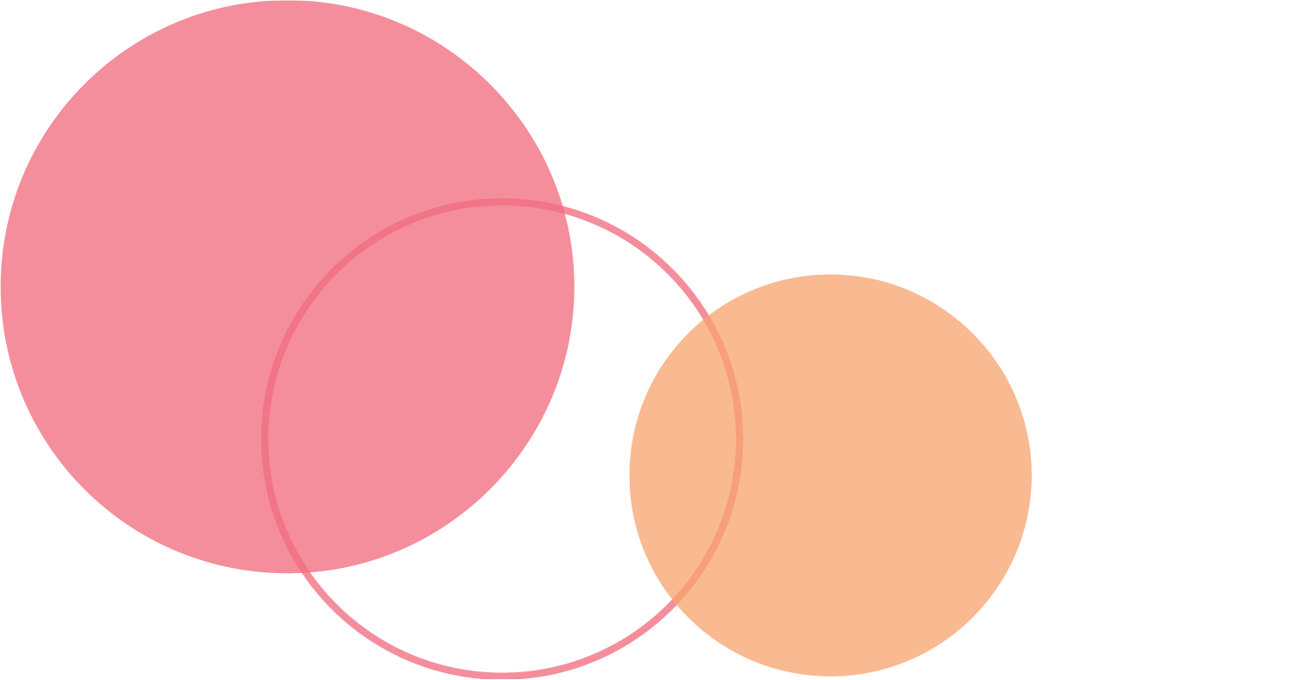
BINGO: Find Someone Who Can…
Circle any spaces for each task you already know how to complete.
Collaborate with those around you to mark out un-circled spaces on the card.

Slide 17
Muddiest Point
What do you find most confusing or difficult about the TI-Nspire?
Which tasks to you still need help with?

Slide 18
Commit and Toss
Write down
One thing you learned
One thing you still want to know
Toss your response in the container

