Slide 2
Road Trip to the Future

Slide 3
Essential Question
How is equity being supported in higher education?

Slide 4
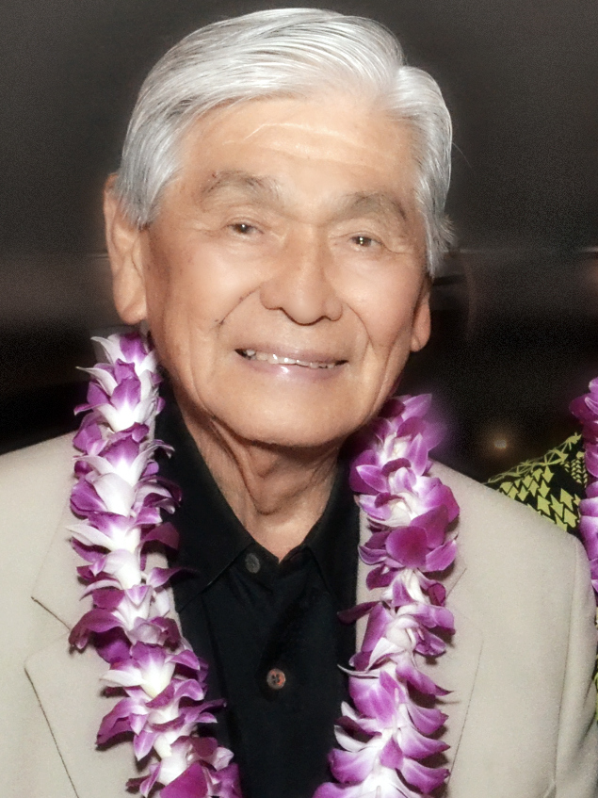
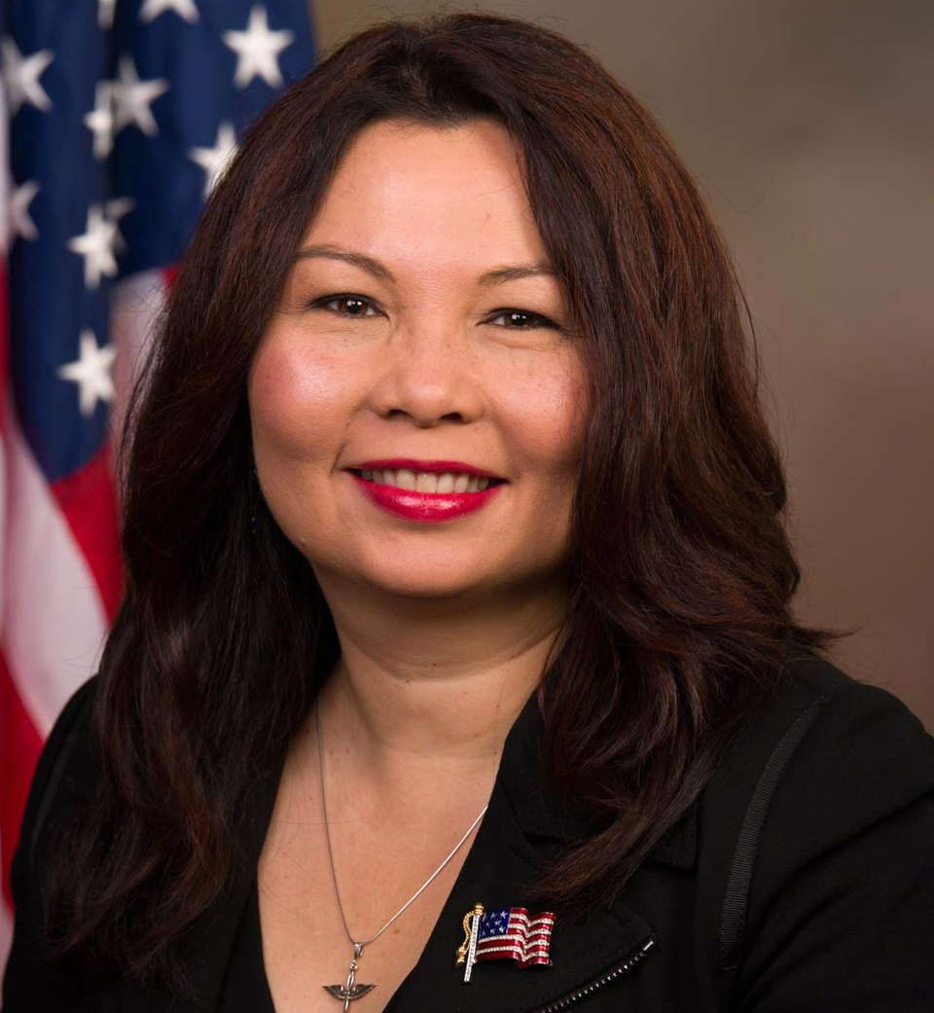
George Ariyoshi
American lawyer and politician who served as the 3rd governor of Hawaii.
First American of Asian descent to serve as a governor of any U.S. state or territory.
Hawaii’s longest-serving governor and now considered an elder statesman.
Tammy Duckworth
U.S. Senator and former member of the U.S. House of Representatives.
Retired Army National Guard lieutenant colonel, Iraq War Veteran, Purple Heart recipient.
Former Assistant Secretary of the U.S. Department of Veterans Affairs.
Notes:
Ariyoshi: University of Hawaii
File:George Ariyoshi (6341239579).JPG - Wikimedia Commons. (n.d.). https://commons.wikimedia.org/wiki/File:George_Ariyoshi_(6341239579).jpg
Duckworth: University of Hawaii File:Tammy Duckworth, Official Portrait, 113th congress (cropped).jpg ... (n.d.-b). https://commons.wikimedia.org/wiki/File:Tammy_Duckworth,_official_portrait,_113th_Congress_(cropped).jpg

Slide 5
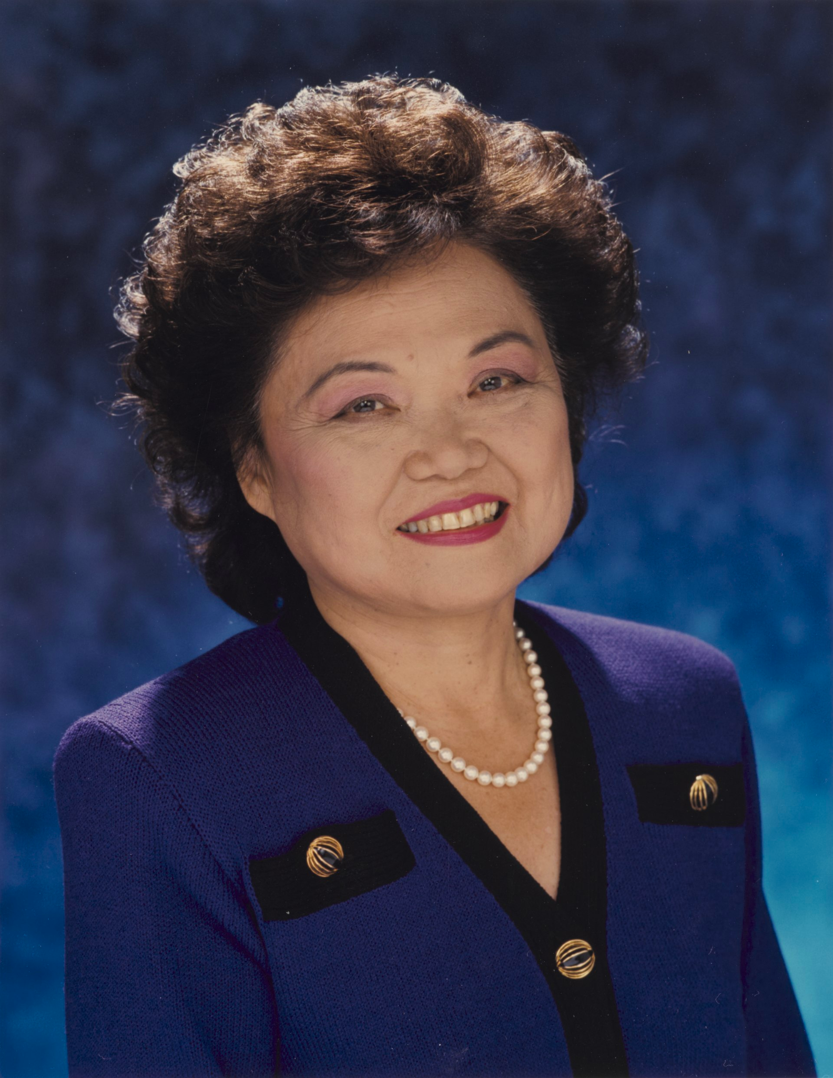
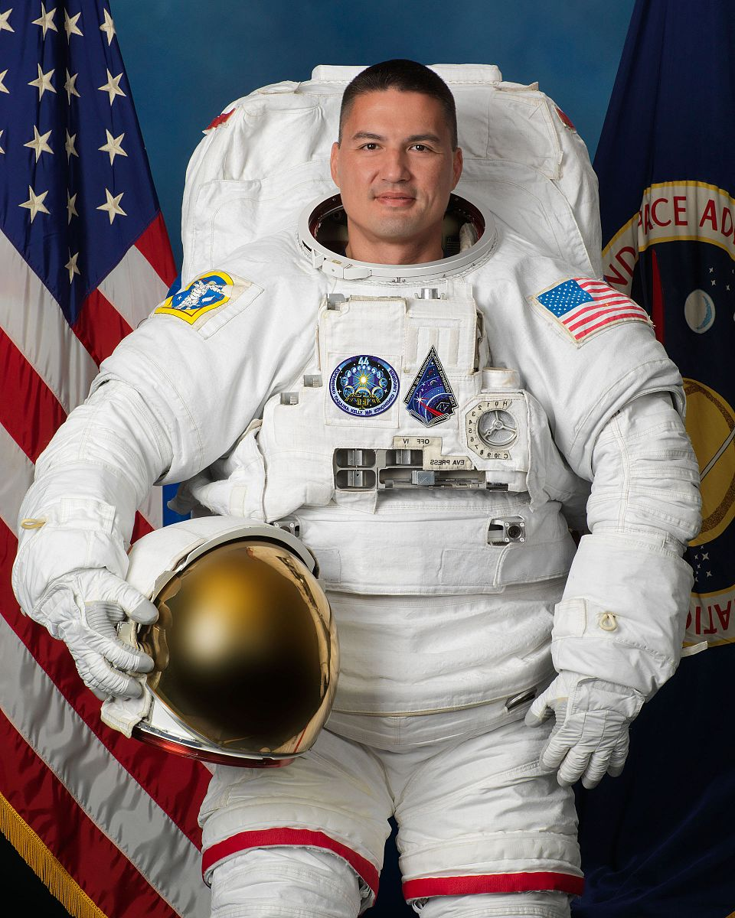
Kjell Lindgren
Taiwanese-American astronaut and member of the NASA Astronaut Group 20.
Has spent a total of 312 days, 5 hours, and 11 minutes combined in space.
Patsy Mink
American attorney and politician
First woman of color and first Asian-American to be elected to the House of Representatives.
Key author of Title IX, a law that advanced gender equality in education.
Notes:
Mink-UoH
[Congressional Portrait of congresswoman Patsy Takemoto mink]. The Library of Congress. (n.d.). https://www.loc.gov/item/2022638134/
Kjell: University of Minnesota (several other institutions)
File:astronaut Kjell Lindgren official Photo.jpg - Wikimedia Commons. (n.d.-a). https://commons.wikimedia.org/wiki/File:Astronaut_Kjell_Lindgren_Official_Photo.jpg

Slide 6
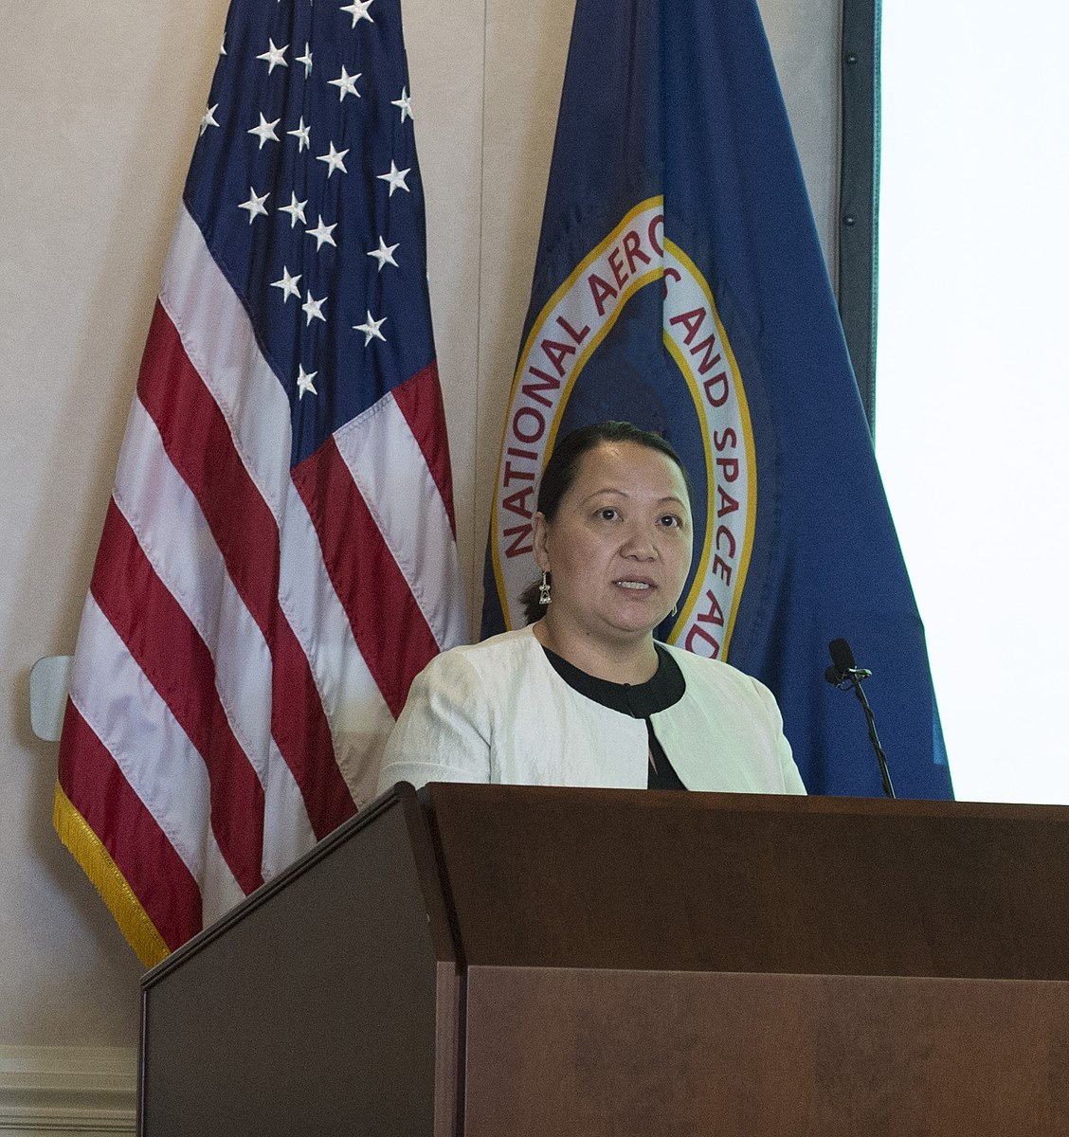
Shahid Khan
Pakistani-American billionaire, businessman and sports tycoon.
Khan is the owner of the NFL team the Jacksonville Jaguars and the Premier League’s Fulham F.C., as well as co-owner of All Elite Wrestling (AEW).
Has been listed in Forbes 400 richest Americans and is the 291st richest person in the world.
Bo Thao-Urabe
Activist, social entrepreneur and founder and former Executive Director of the Coalition of Asian American Leaders in MN.
Member of President Obama’s White House Initiative on AAPIs, and Senior Director at AAPIs in Philanthropy.
COO of RedGreen Rivers, an enterprise which connects artisan women in SE Asian to global markets.
Notes:
Khan: University of Illinois
File:Shahid Khan 2015.jpg - wikimedia commons. (n.d.-c). https://commons.wikimedia.org/wiki/File:Shahid_Khan_2015.jpg
Bo: University of Minnesota Wikimedia Foundation. (2023, January 12). Bo Thao-Urabe. Wikipedia. https://en.wikipedia.org/wiki/Bo_Thao-Urabe

Slide 7
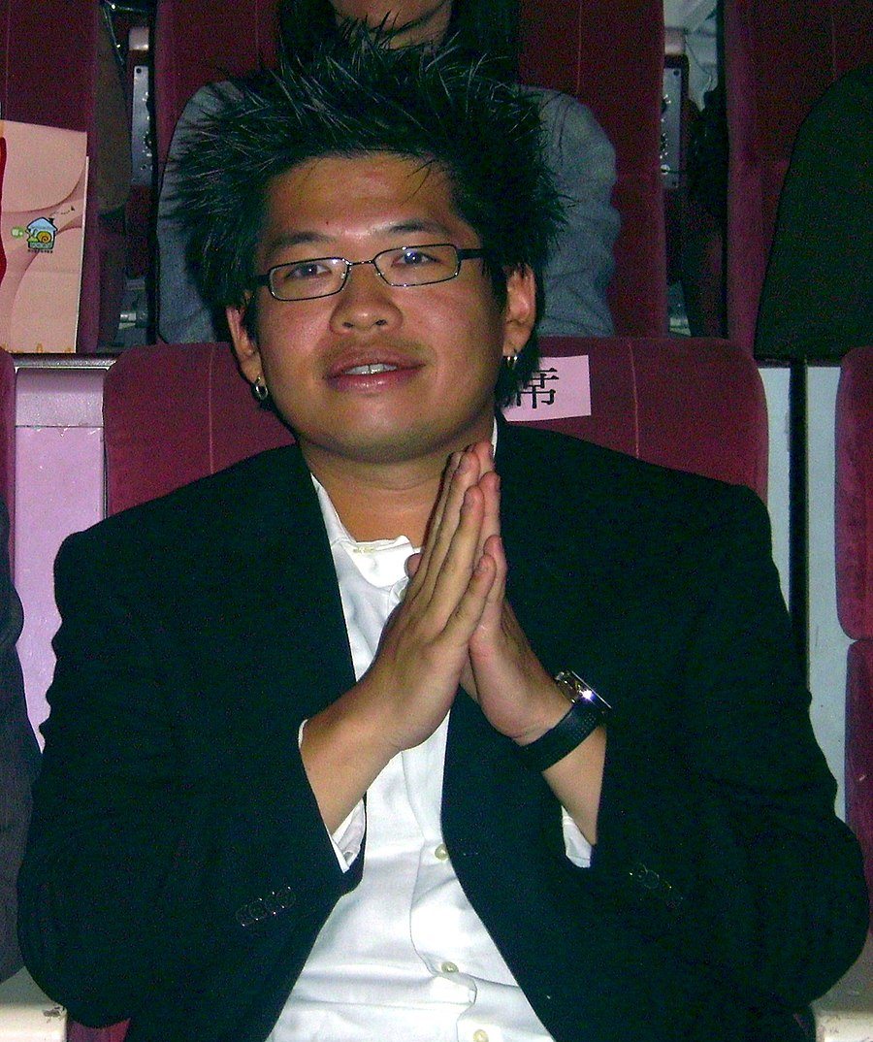
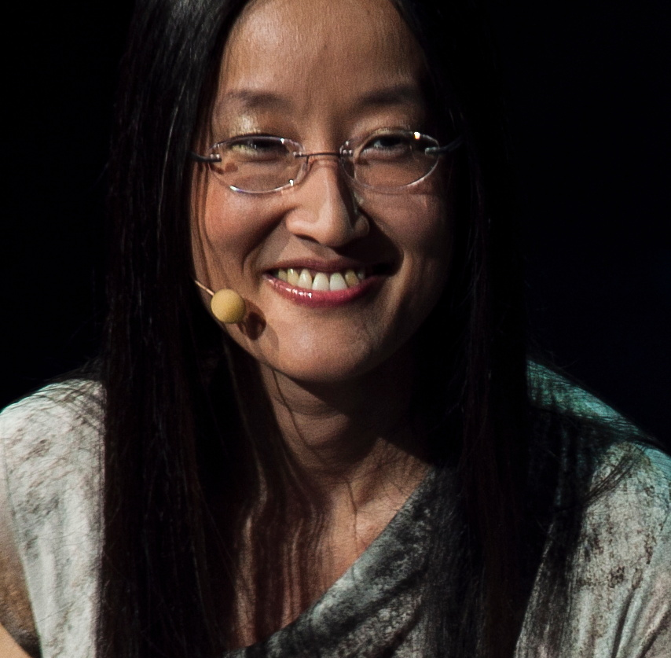
Steve Chen
Taiwanese-American entrepreneur.
Co-founder of Youtube and previously served as its Chief Technology Officer.
Founder of internet company AVOS Systems and video-sharing app MixBit.
Jennifer Yuh Nelson
South Korean-born American story artist, character designer, TV director, illustrator, and film director.
Has directed such films as Kung Fu Panda 2, Kung Fu Panda 3, and the Darkest Minds.
Has worked as a story artist for Spirit: Stallion of the Cimarron, Sinbad:Legend of the Seven Seas, Madagascar, etc.
First woman to solely direct, and first Asian American to direct a major American animated film.
Notes:
Nelson: California State University:Long Beach
File:Jennifer Yuh Nelson, 2012, Montreal.jpg - Wikimedia Commons. (n.d.-c). https://commons.wikimedia.org/wiki/File:Jennifer_Yuh_Nelson,_2012,_Montreal.jpg
Chen:University of Illinois
File:ecdaily 40Y youtubeforum SteveChen.jpg - Wikimedia Commons. (n.d.-b). https://commons.wikimedia.org/wiki/File:ECDaily_40y_YouTubeForum_SteveChen.jpg

Slide 8
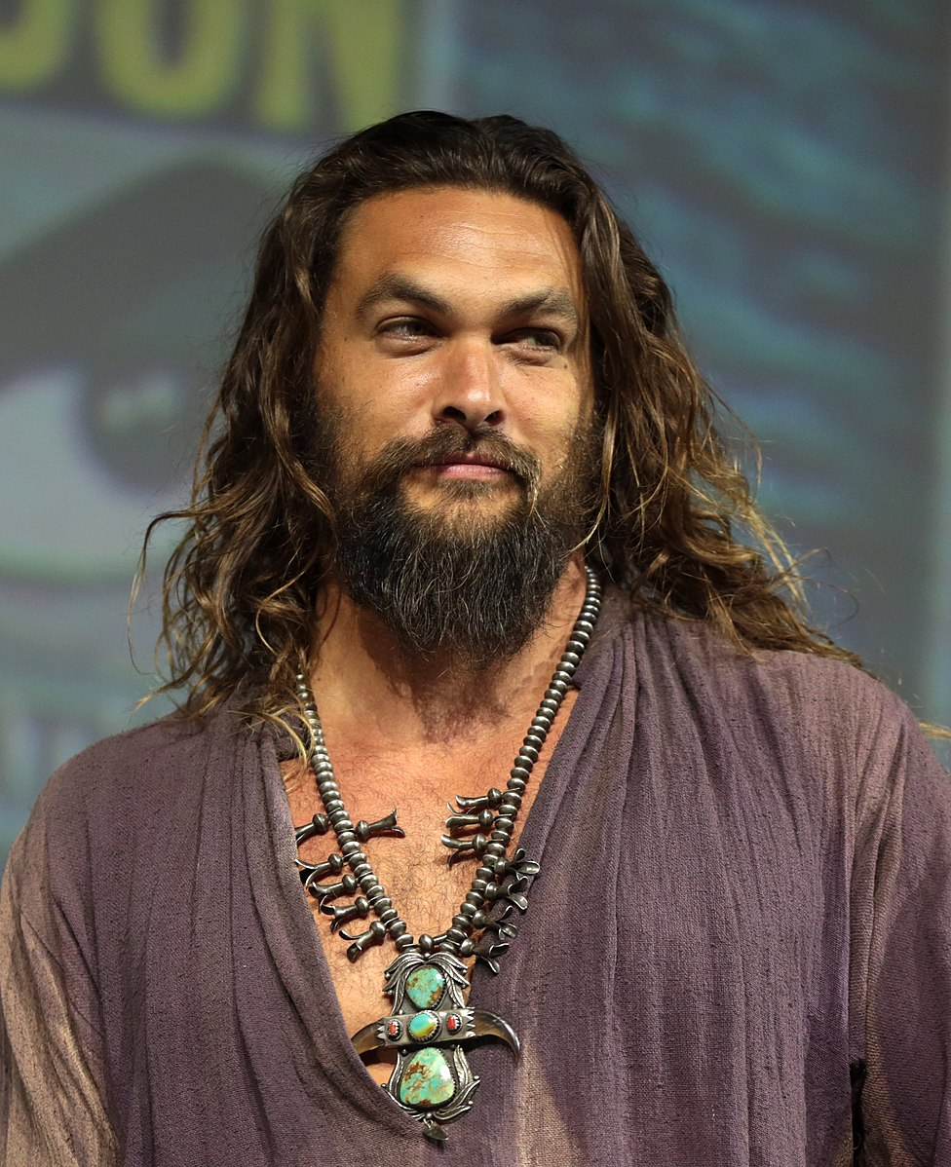
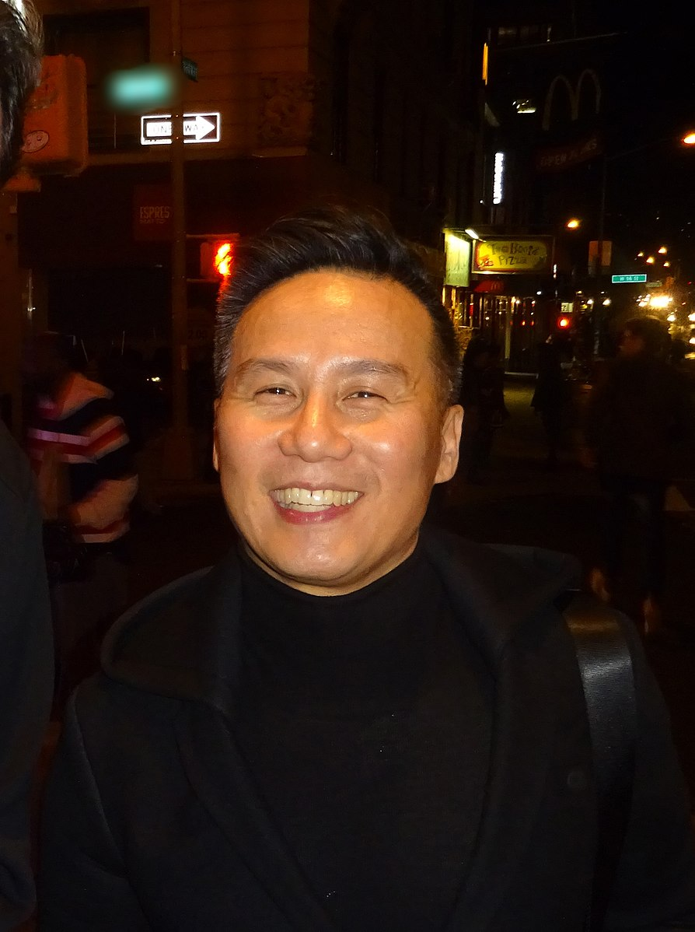
Bradley Darryl Wong
Emmy nominated and Tony award winning American actor.
His work includes roles in Father of the Bride, Law & Order:SVU, OZ, Jurassic Park franchise.
Has voices roles in Mulan, Mulan II, and video game Kingdom Hearts II.
Jason Momoa
American TV and film actor and producer.
Known for popular roles, including Aquaman, Game of Thrones, Justice League, Batman v Superman: Dawn of Justice, Dune and several more.
Notes:
Momoa: University of Hawaii
File:Jason Momoa (43055621224) (cropped).jpg - wikimedia commons. (n.d.-d). https://commons.wikimedia.org/wiki/File:Jason_Momoa_(43055621224)_(cropped).jpg
Wong: San Francisco State University File:BD Wong (30703712021).JPG - wikimedia commons. (n.d.-b). https://commons.wikimedia.org/wiki/File:BD_Wong_(30703712021).jpg

Slide 9
Tell Me Everything
From politicians to entertainers to entrepreneurs, what might all these successful individuals have in common?
Notes:
K20 Center. (n.d.). Tell me everything. Strategies. Retrieved from https://learn.k20center.ou.edu/strategy/107

Slide 10
AANAPISI Programs
All of these individuals have graduated college/university from an Asian American Native American Pacific Islander-Serving Institution (AANAPISI).
AANAPISIs are institutions that serve to support universities with 10% or more of AANAPI students.
AANAPISIs develop innovative programs and practices that increase student success through wide range of academic and culturally relevant co-curricular offerings.
Notes:
https://apiascholars.org/wp-content/uploads/2022/09/AANAPISI_GrowthImpactReport_2022.pdf

Slide 11
Lesson Objectives
Students will analyze the background of Asian American Native American Pacific Islander Serving-Institution (AANAPISI).
Students will collaborate to research AANAPISIs to identify which school best meets their personal and academic goals.

Slide 12
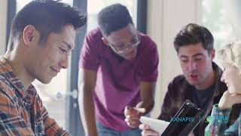
The Importance of AANAPISIs
Notes:
YouTube. (2022, September 8). 15 years of AANAPISI. YouTube. https://www.youtube.com/watch?v=Nx7irzWSS8U&t=1s

Slide 13
Stop and Jot
As you read through the handout “Stop and Jot: The Rise of AANAPISIs,” stop and jot down a brief summary of each section.
Be sure to include all information important to the understanding of that section.
Notes:
K20 Center. (n.d.). Stop and jot. Strategies. Retrieved from https://learn.k20center.ou.edu/strategy/d9908066f654727934df7bf4f5077921

Slide 14
Essential Question
Why is there a greater need for Asian American Native American Pacific Islander Serving-Institutions (AANAPISIs)?

Slide 15
AANAPISI Research Project
In groups, you will research an AANAPI College or University to gain more information about the school.
Use the following link to go directly to the list of schools: http://k20.ou.edu/aanapisis
As a group, select a college/university and using the Research Project Handout follow along with the questions.

Slide 16
Anchor Chart
In your groups you will create an Anchor Chart to represent the school you researched.
The chart must be visually strong and include a mixture of words and pictures.
Refer to the Anchor Chart Instructions and Requirements on the Research Handout for the list of everything to include.
Notes:
K20 Center. (n.d.). Anchor Charts. Strategies. https://learn.k20center.ou.edu/strategy/58

Slide 17
Gallery Walk
Select a spokesperson to speak on behalf of your school.
All other group members rotate to other charts to learn about the different Colleges/Universities.
As you rotate, think of which school interests you the most and come up with one question you’d ask if you were to visit.
Once you have written your question, post it on that school’s chart.
Notes:
K20 Center. (n.d.). Gallery walk / carousel. Strategies. Retrieved from https://learn.k20center.ou.edu/strategy/118

