Slide 2

Power UP: Science ACT Prep, Week 1
Goal Setting

Slide 3
Essential Question
How can I raise my ACT score?

Slide 4
Learning Objectives
Understand the purpose of the ACT and the importance of the science section.
Evaluate current ACT performance and set a realistic goal for the overall test and the science component.

Slide 5

ACT Advice From Students #1

Slide 6

Point of Most Significance
What is your main takeaway from the video?
Which suggestion did you find most valuable?

Slide 7
ACT Student Login
Using a personal device, access the ACT website at https://my.act.org/account/signin
Or type act.org into a web browser.
  Click MyACT Sign In in the top right corner.

Slide 8
Goal Setting: Where I Am
Fill in the power bar to your current composite score on the Goal Setting handout.
Fill in the power bar to your current science score on the handout.

Slide 9

Oklahoma College Admission and Scholarships

Slide 10
Science Score Chart
Science Score | Answers Correct
1 | 0
2 | —
3 | 1
4 | 2
5 | —
6 | 3
7 | 4
8 | 5
9 | 6
Science Score | Answers Correct
10 | 7
11 | 8
12 | 9
13 | 10
14 | 11
15 | 12
16 | 13
17 | 15
18 | 17
Science Score | Answers Correct
19 | 19
20 | 20
21 | 22
22 | 23
23 | 25
24 | 26
25 | 28
26 | 30
27 | —
Science Score | Answers Correct
28 | 31
29 | 32
30 | 33
31 | —
32 | 34
33 | 35
34 | 36
35 | 37
36 | 38

Slide 11
Calculating Percentage Correct
Divide the number of questions you need to answer correctly by the total number of questions on the science test, which is 40.
Multiply the result by 100.
Write this number on the handout in the percentage correct box.

Slide 12
Goal Setting
Choose at least one action to increase your science score.
Add the action to the handout.
Refer back to the action and add the dates you practiced your goal.

Slide 13

ACT Fee Waivers
ACT Fee Waivers
Notes:
Video: ACT. (2019, June 5). How to Apply for an ACT Fee Waiver. [Video]. YouTube. https://youtu.be/8KVRiyY6h0I
ACT Fee Waivers Website: https://www.act.org/content/act/en/products-and-services/the-act/registration/fees/fee-waivers.html

Slide 14
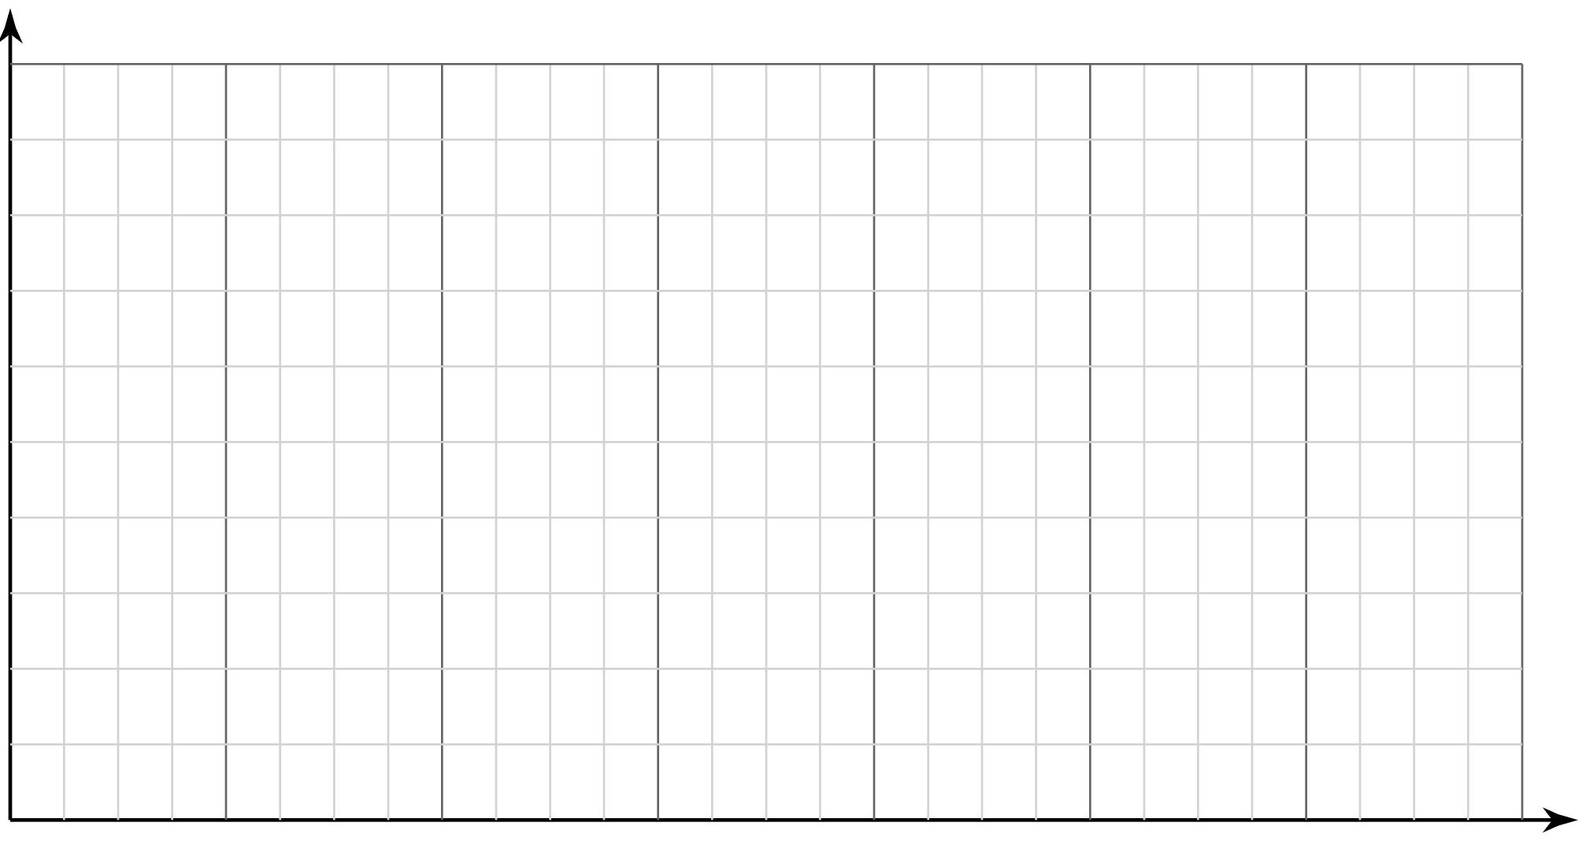

Sticky Bars: Which Action Did You Pick?
Write your name on a sticky note.
Place your note above the action number you selected.
1
2
3
4
5
6
Notes:
K20 Center. (n.d.). Sticky Bars. Strategies. https://learn.k20center.ou.edu/strategy/129

