Slide 2
Power UP: Science ACT Prep, Week 2
Vocabulary

Slide 3
Essential Question
How can I increase my ACT score?

Slide 4
Learning Objectives
Understand the content expectations for the science test
Make connections between science terms and concepts

Slide 5
Mixed Up Science:
Pirjetu’s gamtenic field interacts with the talsy noace and produces a second gamtenic field around Roepau. A craft has found evidence of this second gamtenic field.
Based on the information above, which of the following materials must be present on Roepau for a gamtenic field to be present?
Frozen H20
Pirjetu
c) Talsy
d) Lava
Notes:
Passage adapted from: https://www.act.org/content/act/en/products-and-services/the-act/test-preparation/science-practice-test-questions.html?page=0&chapter=0

Slide 6
Mixed Up Science:
Pirjetu’s gamtenic field interacts with the talsy noace and produces a second gamtenic field around Roepau. A craft has found evidence of this second gamtenic field.
Based on the information above, which of the following materials must be present on Roepau for a gamtenic field to be present?
Frozen H20
Pirjetu
c) Talsy
d) Lava
Notes:
Passage adapted from: https://www.act.org/content/act/en/products-and-services/the-act/test-preparation/science-practice-test-questions.html?page=0&chapter=0

Slide 7
Anchor Chart
What clues did you use to figure out the right answer?

Slide 8
Science Word Sort
Sort the cards by grouping the words.
You decide the rules for how you group them.

Slide 9
Elbow Partners
Find an elbow partner.
Compare your card groupings.
Make any adjustments you want to your cards.

Slide 10
Science Definitions Sort
Sort the cards by grouping the definitions in a way you think go together.

Slide 11
Science Words & Definitions
Celsius | A measurement of temperature in which water freezes at 0 degrees and boils at 100 degrees
Control Group | The group that does not experience a change in an experiment
Control Variable | A variable that is intentionally not changed in an experiment
Correlation | An observation that as one thing increases another decreases or that they both increase or decrease together
Dependent Variable | The variable that is observed to see if it experiences change as a result of an experiment
Experimental Group | The group that has some variable change in an experiment
Hypothesis | A predicted outcome as a result of an experiment
Independent Variable | A variable changed by an experimenter to test a hypothesis
pH | Measure of the amount of dissolved hydrogen ion found in pure water: base, acid, or neutral
Product | Compound that is formed after a chemical reaction
Reactant | Something that exists before a reaction takes place
Solute | A substance that is dissolved in a liquid
Solution | A homogenous mixture of one or more substances dissolved in a liquid
Solvent | A liquid that dissolves other substances
Wavelength | The distance between peak to peak of a wave

Slide 12
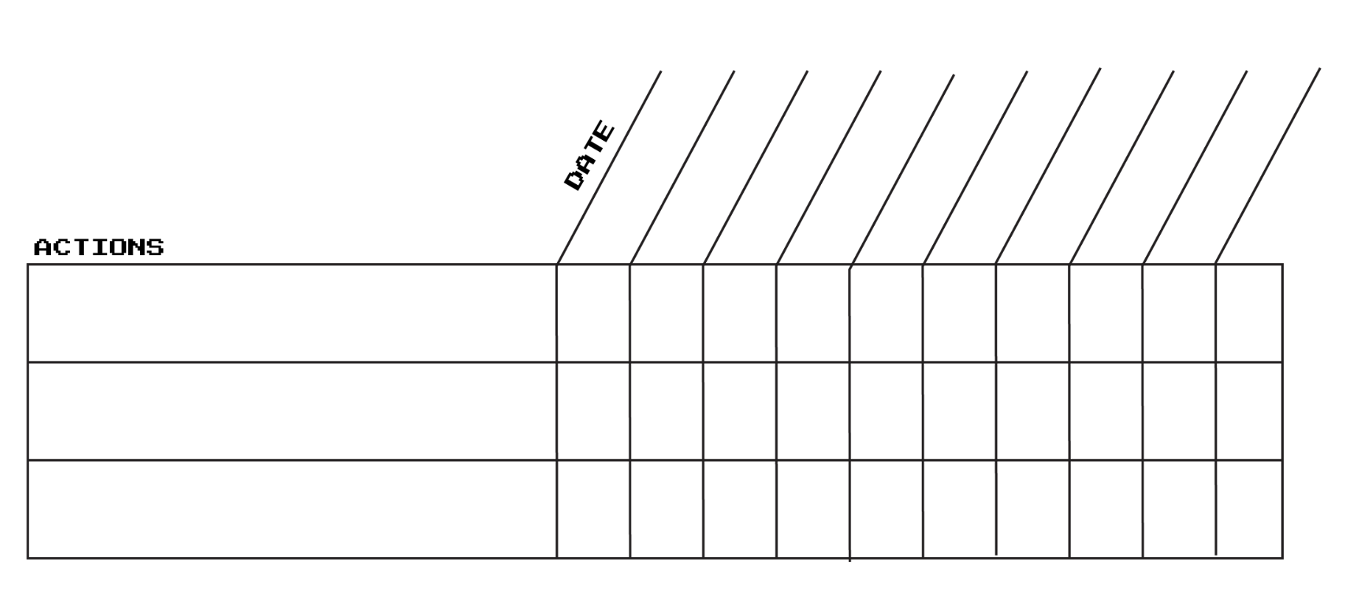
Goal Setting
Have you worked on your selected actions?
What new goals do you have?

Slide 13
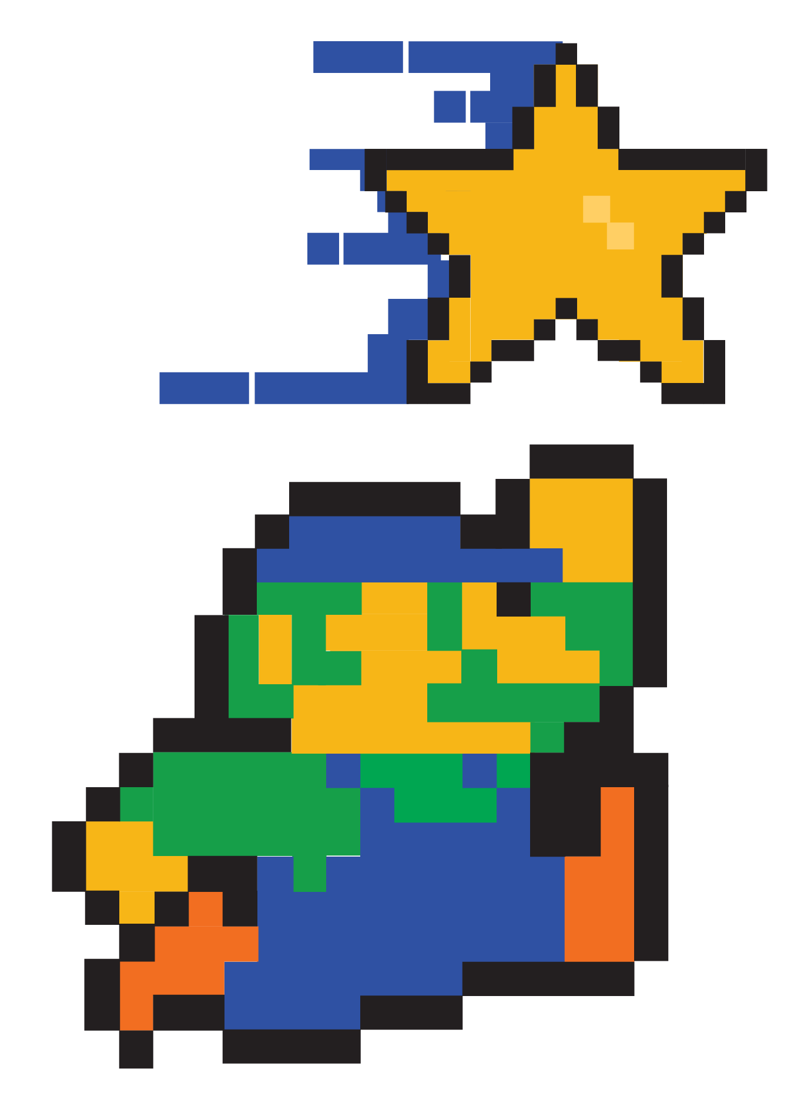
You Powered Up!

