Slide 2
Power Up: Math ACT Prep, Week 3
Perimeter and Area

Slide 3
Essential Question
How can I increase my ACT score?

Slide 4
Learning Objectives
Compute the area and perimeter of a rectangle.
Apply the understanding of area and perimeter to solve problems.

Slide 5

Collective Brain Dump: Perimeter
Describe how to find the perimeter of a rectangle.
Notes:
K20 Center. (n.d.). Collective Brain Dump. Strategies. https://learn.k20center.ou.edu/strategy/111

Slide 6
Collective Brain Dump: Area
Describe how to find the area of a rectangle.
Notes:
K20 Center. (n.d.). Collective Brain Dump. Strategies. https://learn.k20center.ou.edu/strategy/111

Slide 7
ACT Prep: Questions 1-2
Work with a partner to solve questions 1-2.
Use the resources that you think would be helpful.
  Calculator
  Graph Paper
  Coloring Utensils

Slide 8

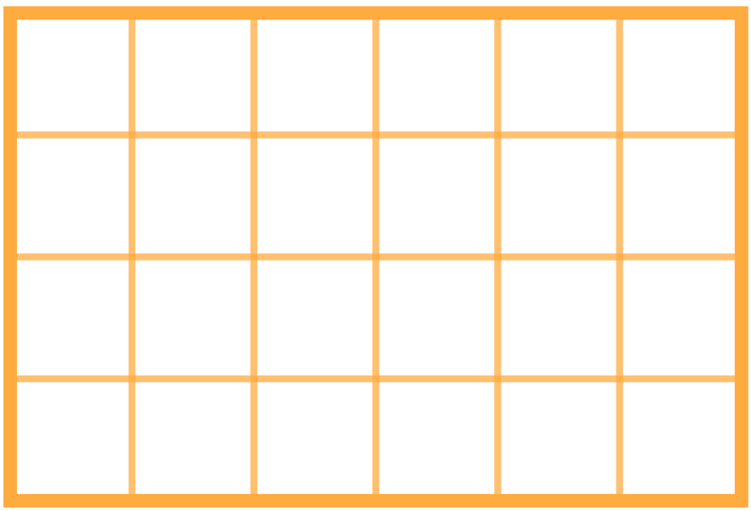

Efficiency
Is there a faster way to approach these problems?

Slide 9

ACT Prep: Question 1
In the following figure, all angles are right angles and the given side lengths are in feet. What is the area, in square feet, of the figure?

Slide 10



ACT Prep: Question 1 (Solution)
In the following figure, all angles are right angles and the given side lengths are in feet. What is the area, in square feet, of the figure?
A₁ = 4(5) = 20
A₂ = 3(10) = 30
Area = A₁ + A₂ = 50

Slide 11
ACT Prep: Question 2
The following rectangle was drawn on a grid of ½ inch by ½ inch squares. Find the perimeter and area of that rectangle.

Slide 12
ACT Prep: Question 2 (Solution)
The following rectangle was drawn on a grid of ½ inch by ½ inch squares. Find the perimeter and area of that rectangle.
Area = (Base)(Height)
A = (3)(2) = 6
Perimeter = 2 (Base + Height)
P = 2(3 + 2) = 10

Slide 13
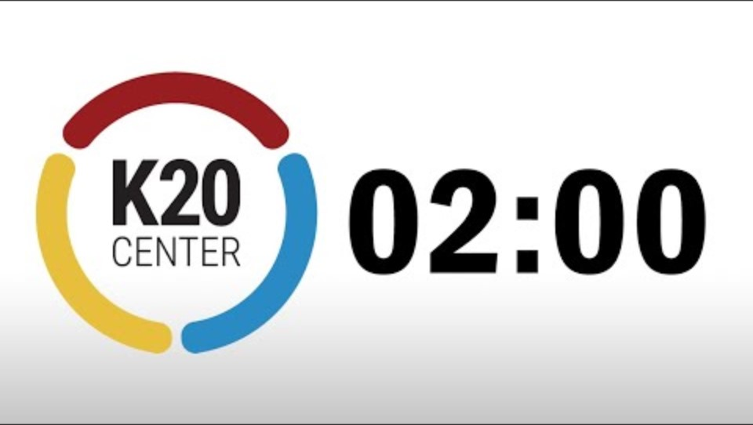
ACT Prep: Questions 3-4
Apply what you have learned to questions 3-4.
Remember, you only have 60 seconds per question.
2-Minute Timer

Slide 14
ACT Prep: Question 3
One side of square KLMN has a length of 13 cm. Rectangle ABCD has the same area and a length of 10 cm. What is the width of the rectangle (in centimeters)?

Slide 15



ACT Prep: Question 3 (Solution)
One side of square KLMN has a length of 13 cm. Rectangle ABCD has the same area and a length of 10 cm. What is the width of the rectangle (in centimeters)?

Slide 16
ACT Prep: Question 4
A rectangular field is 300 feet long and 150 feet wide. What is the area, in square yards, of this field?

Slide 17
ACT Prep: Question 4 (Solution)
A rectangular field is 300 feet long and 150 feet wide. What is the area, in square yards, of this field?

Slide 18
ACT Prep: Question 5
Julio has 44 feet of fencing to enclose a portion of his yard for a pen for his pet pot-bellied pig. What is the area, in square feet, of the largest rectangular region Julio can enclose?

Slide 19
ACT Prep: Question 5 (Solution)

Slide 20


ACT Prep: Question 5 (Solution)
This looks like a quadratic equation:
Where is the maximum of this type of function?
So the maximum area is when the side length is 11.
The maximum area is 121 square feet.

Slide 21

Exit Ticket
Leave your paper face down until the timer starts.
2-Minute Timer

Slide 22
Exit Ticket (Answers)
D
G

Slide 23

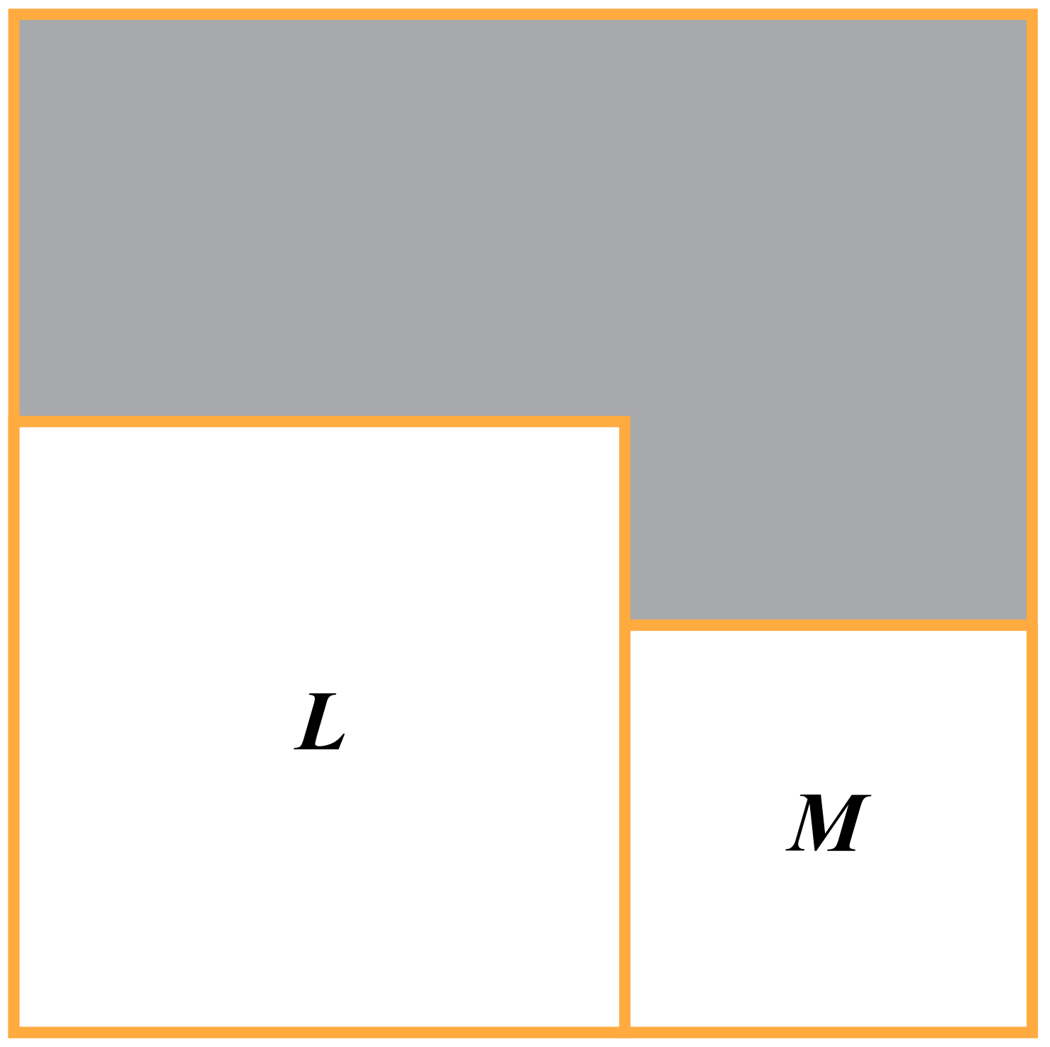



Exit Ticket (Solution 1)
The outer square in the given figure contains square L and square M. If square L has an area of 9 square units and square M has an area of 4 square units, what is the perimeter of the shaded region?
P = 5 + 2 + 3 + 1 + 2 + 3 = 16

Slide 24

Exit Ticket (Solution 2)
The ratio of the perimeters of two squares is 3:4. If the area of the larger square is 400 square feet, what is the length, in feet, of the side of the smaller square?

Slide 25

You Powered Up!
Achievement Unlocked:
Perimeter and Area

