Slide 2
Power Up: Math ACT Prep,
Week 4
Probability

Slide 3

Bell Ringer: Question 1
What is the likelihood of guessing correctly on a
question from the math portion of the ACT?
Notes:
K20 Center. (n.d.). Bell Ringers and Exit Tickets. Strategies. https://learn.k20center.ou.edu/strategy/125

Slide 4
Bell Ringer: Question 2
What is the likelihood of guessing incorrectly on a
question from the math portion of the ACT?
Notes:
K20 Center. (n.d.). Bell Ringers and Exit Tickets. Strategies. https://learn.k20center.ou.edu/strategy/125

Slide 5
Bell Ringer: Question 3
Does the probability of guessing correctly
increase or decrease if you are guessing
from fewer choices?
In other words, if you could eliminate some options, would the probability of guessing correctly increase or decrease?
Notes:
K20 Center. (n.d.). Bell Ringers and Exit Tickets. Strategies. https://learn.k20center.ou.edu/strategy/125

Slide 6
Essential Question
How can I increase my ACT score?

Slide 7
Learning Objectives
Determine the probability of an event and the probability of its complement.
Use a Venn diagram to calculate probability.
Apply the concept of probability to unique situations.

Slide 8
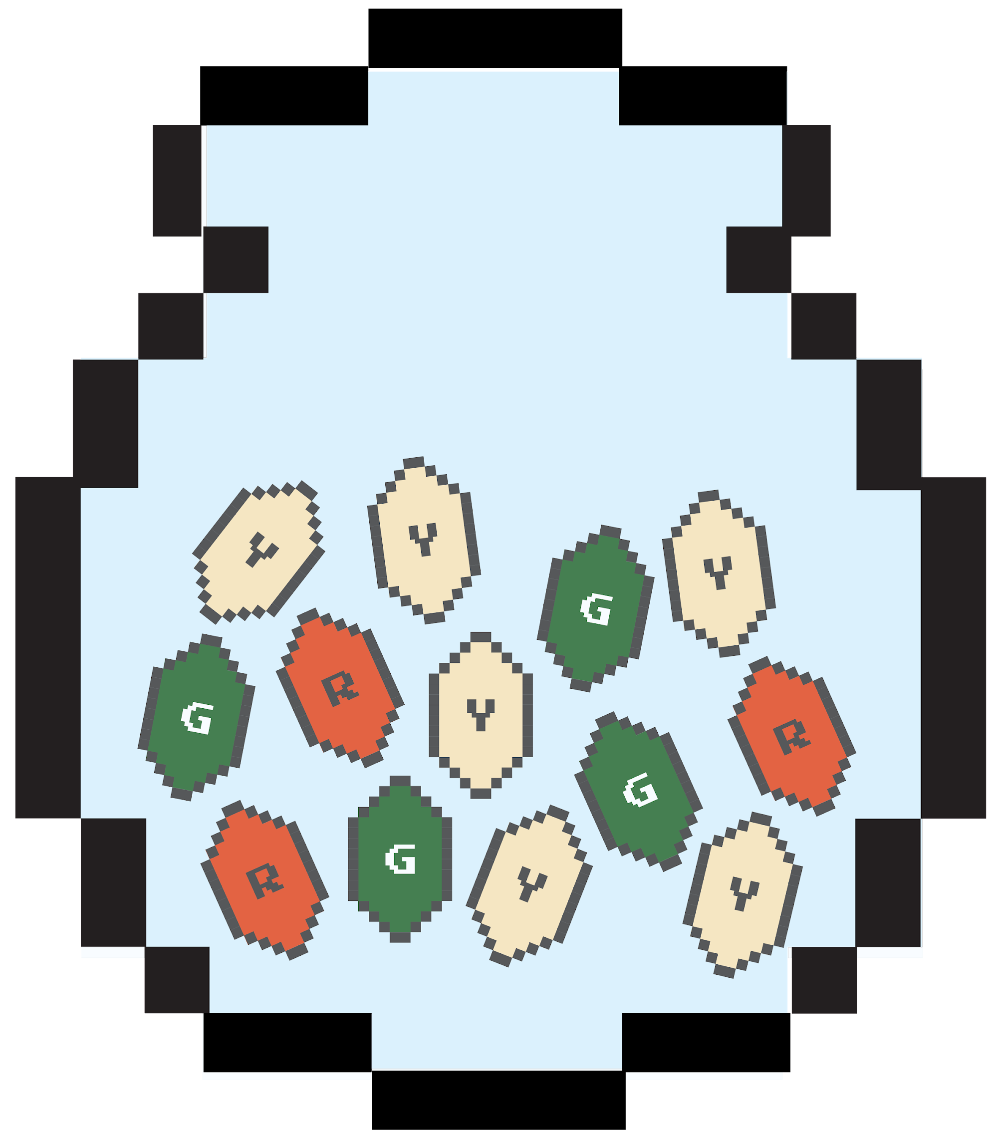
Probability: The Scientific Study of Uncertainty
outcomes: the results of an experiment
  example: drawing a gem from a bag

Slide 9
Probability: The Scientific Study of Uncertainty
event: a collection of outcomes; usually represented with capital letters
  example: Y = drawing yellow gems from a bag

Slide 10

Probability: The Scientific Study of Uncertainty
probability: the likelihood an event will happen
  example: The likelihood of drawing a yellow gem, P(Y), from a bag is 6/13.

Slide 11
Probability: The Scientific Study of Uncertainty
Events are mutually exclusive if the events cannot occur at the same time.
  Can you draw one gem from the bag that is both green and red? No.

Slide 12



Mutually Exclusive Events
Let G = drawing a green gem from the bag.
How many ways can each event occur? (drawing each colored gem)

Slide 13

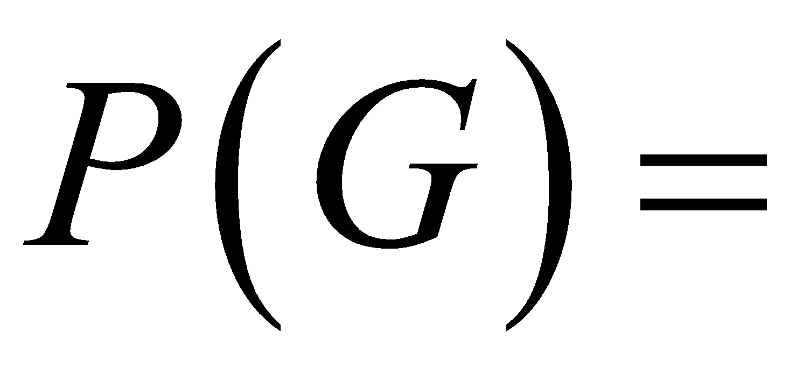
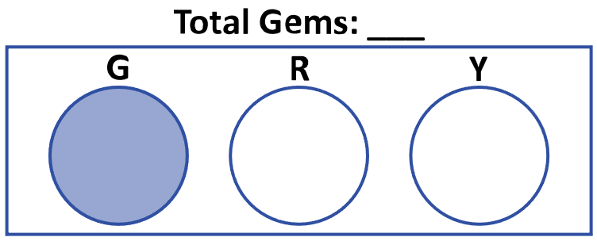
Mutually Exclusive Events
Probability of Event A
What is the probability of drawing a green gem?

Slide 14
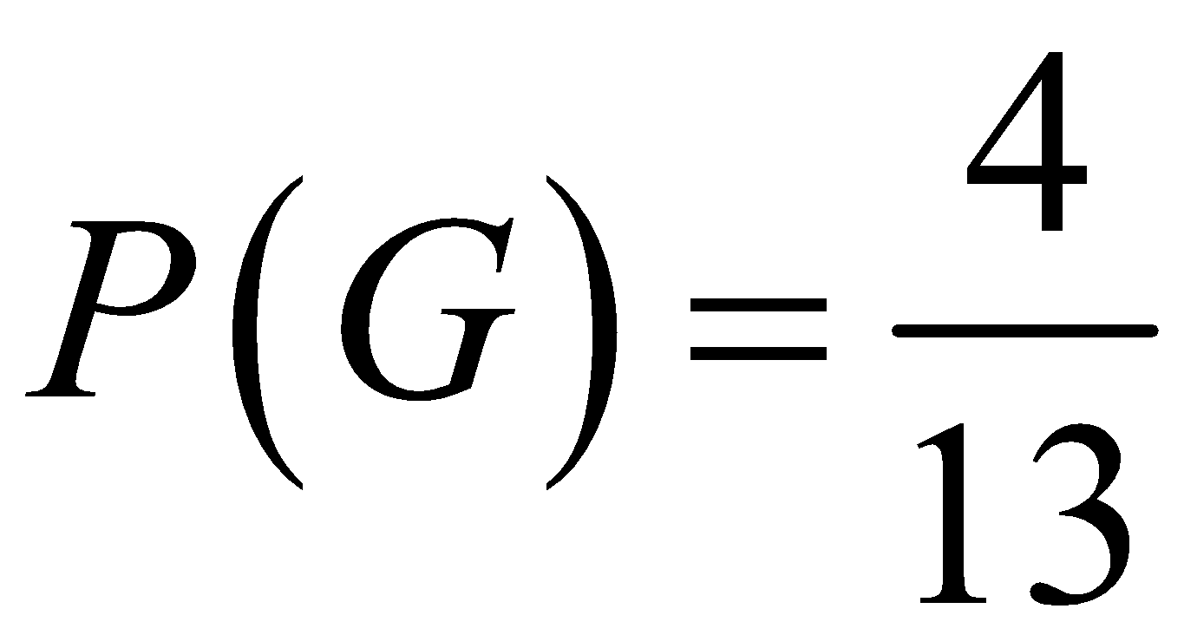




Mutually Exclusive Events
Probability of Event A
What is the probability of drawing a green gem?

Slide 15

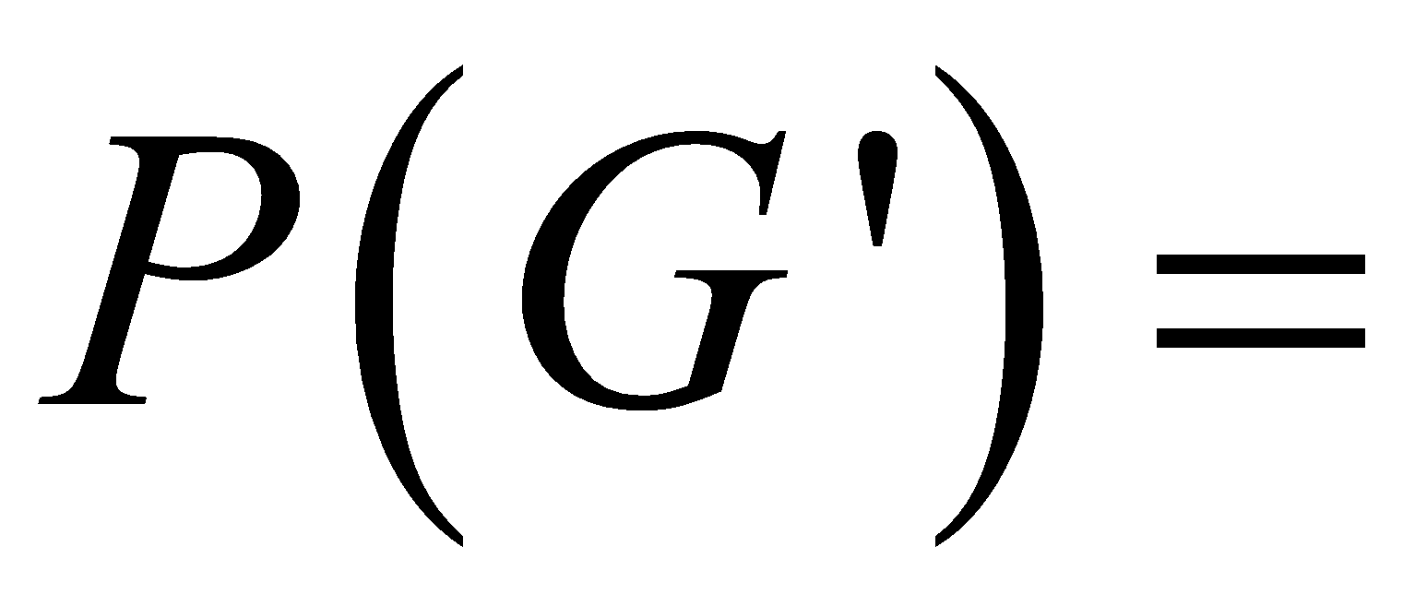
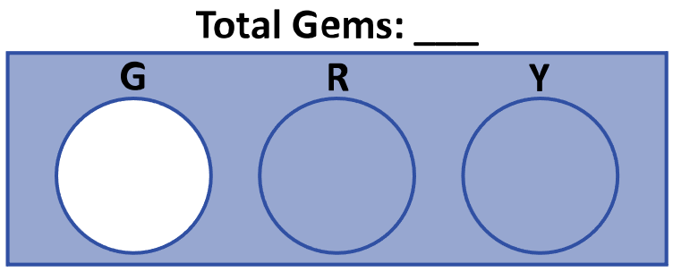
Mutually Exclusive Events
Probability of the complement of event A
What is the probability of drawing a gem that is not green?

Slide 16
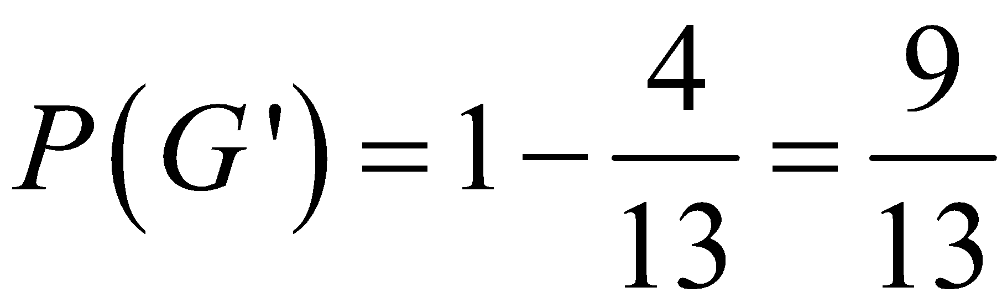
Mutually Exclusive Events
Probability of the Complement of Event A
What is the probability of drawing a gem that is not green?

Slide 17

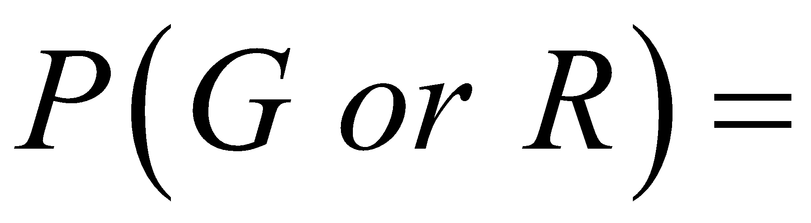
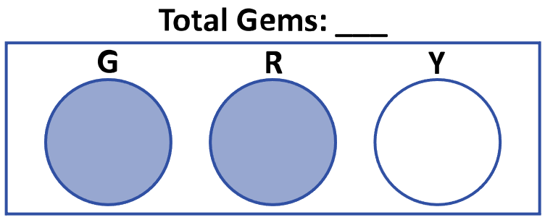
Mutually Exclusive Events
Probability of Event A or Event B
What is the probability of drawing a green or red gem?

Slide 18
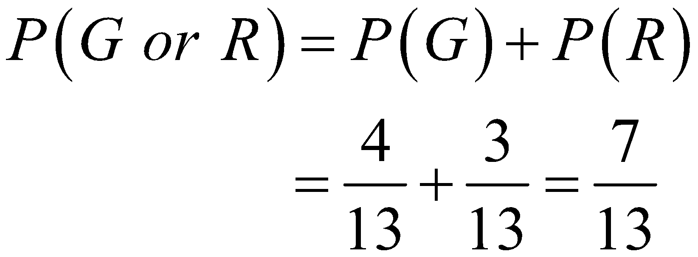
Mutually Exclusive Events
Probability of Event A or Event B
What is the probability of drawing a green or red gem?

Slide 19
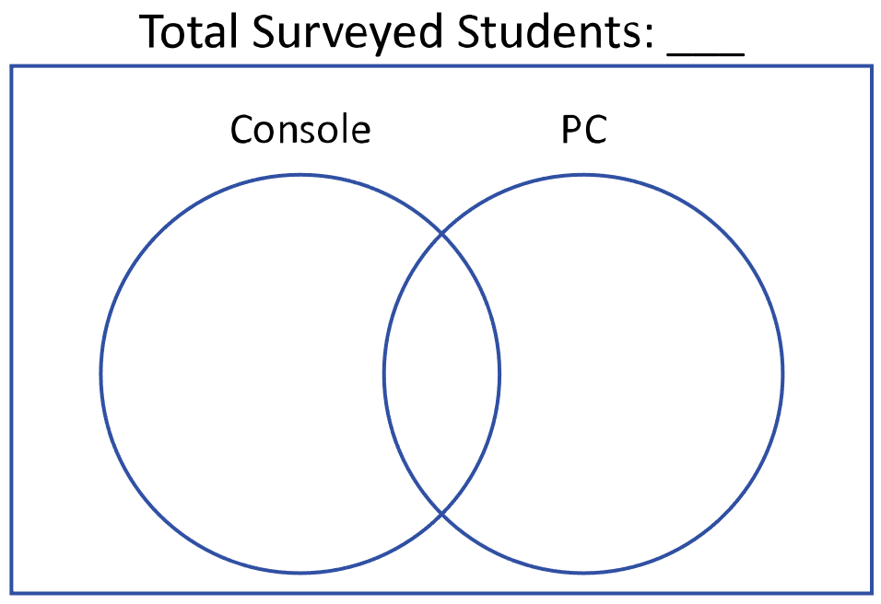
NOT Mutually Exclusive Events
A survey asked 100 students on what device they played video games. The results showed that 50 students play video games on their console, 45 students play video games on their PC, and 15 students play video games on their console and PC.

Slide 20


NOT Mutually Exclusive Events
A survey asked 100 students on what device they played video games. The results showed that 50 students play video games on their console, 45 students play video games on their PC, and 15 students play video games on their console and PC.

Slide 21

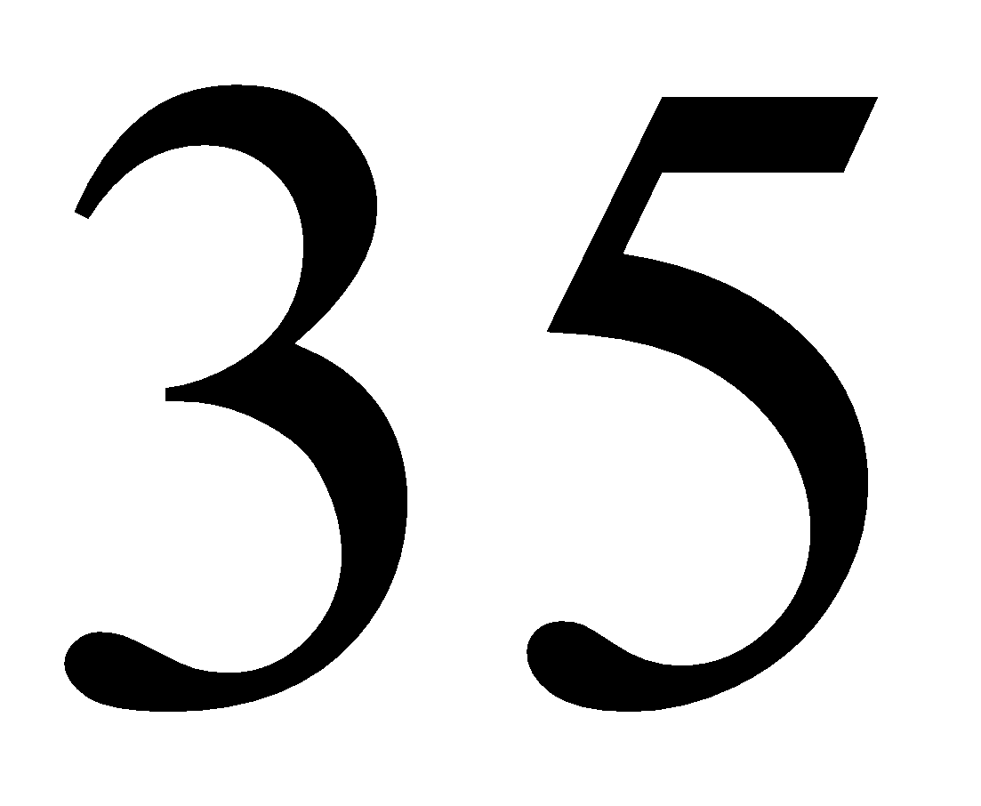

NOT Mutually Exclusive Events
A survey asked 100 students on what device they played video games. The results showed that 50 students play video games on their console, 45 students play video games on their PC, and 15 students play video games on their console and PC.

Slide 22

NOT Mutually Exclusive Events
…probability …neither …console nor PC?

Slide 23

NOT Mutually Exclusive Events
…probability …either
…console or PC?

Slide 24

NOT Mutually Exclusive Events
…probability …either console or PC, but
not both?

Slide 25

NOT Mutually Exclusive Events
…probability …not …console?

Slide 26

Test-Taking Tip
What should my final answer look like?
Glance at the multiple-choice options:
  Is the test asking for a decimal,
  a fraction, a percentage, etc.?
  Do I need to simplify my work?

Slide 27


Exit Ticket
Leave your paper face down until the timer starts.
5-Minute Timer
Notes:
K20 Center. (n.d.). Bell Ringers and Exit Tickets. Strategies. https://learn.k20center.ou.edu/strategy/125
K20 Center. (2021, September 21). K20 Center 5 minute timer. [Video]. YouTube. https://youtu.be/EVS_yYQoLJg?si=fJvuvFWH3vJ3B0z9

Slide 28
Exit Ticket (Answers)
C
G
E
H
E
Remember, it is 100% okay to not get 100% of the questions right on the ACT.
What was your percentage goal from week 1?
Notes:
K20 Center. (n.d.). Bell Ringers and Exit Tickets. Strategies. https://learn.k20center.ou.edu/strategy/125

Slide 29

Exit Ticket (Solution 1)
A jar contains 20 tokens, 2 red, 8 yellow, 4 green, and 6 blue. What is the probability of randomly selecting 1 token that is not yellow?
Notes:
K20 Center. (n.d.). Bell Ringers and Exit Tickets. Strategies. https://learn.k20center.ou.edu/strategy/125

Slide 30




Exit Ticket (Solution 2)
A bag contains 8 blue marbles, 5 green marbles, and 9 purple marbles. How many additional blue marbles must be added to the 22 marbles already in the bag so that the probability of randomly drawing a blue
marble is
Notes:
K20 Center. (n.d.). Bell Ringers and Exit Tickets. Strategies. https://learn.k20center.ou.edu/strategy/125

Slide 31
Exit Ticket (Solution 3)
The probability of Event R will occur is 0.4. The probability that Event T will occur is 0.5. Given that Events R and T are mutually exclusive, what is the probability that Event R or Event T will occur?
Notes:
K20 Center. (n.d.). Bell Ringers and Exit Tickets. Strategies. https://learn.k20center.ou.edu/strategy/125

Slide 32

Exit Ticket (Solution 4)
A 52-card deck contains 4 suits: 13 hearts, 13 diamonds, 13 clubs, and 13 spades. Which of the following expressions gives the probability of drawing, at random and without replacement, a heart on the 1st draw, a club on the 2nd draw, and a heart on the third draw?
Notes:
K20 Center. (n.d.). Bell Ringers and Exit Tickets. Strategies. https://learn.k20center.ou.edu/strategy/125

Slide 33

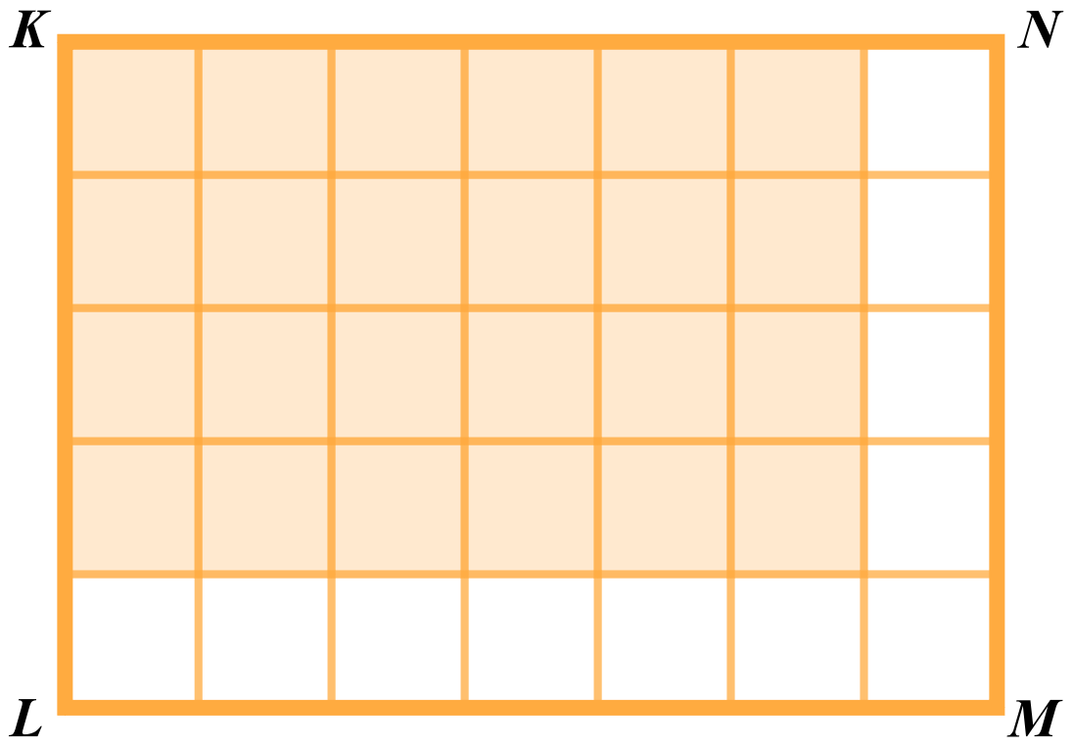


Exit Ticket (Solution 5)
In the figure, all of the small squares are equal in area, and the area of rectangle KLMN is 1 square unit. If a ball were thrown at rectangle KLMN and all of the small squares have the same probability of being hit, what is the probability of the ball hitting the shaded region?
Notes:
K20 Center. (n.d.). Bell Ringers and Exit Tickets. Strategies. https://learn.k20center.ou.edu/strategy/125

Slide 34

You Powered Up!
Achievement Unlocked:
Probability

