Slide 2
Power Up: Math ACT Prep, Week 5
Pacing and Reflecting

Slide 3
Essential Question
How can I increase my ACT score?

Slide 4
Learning Objectives
Analyze why you might guess on an ACT question.
Evaluate current performance regarding accuracy and pacing.

Slide 5

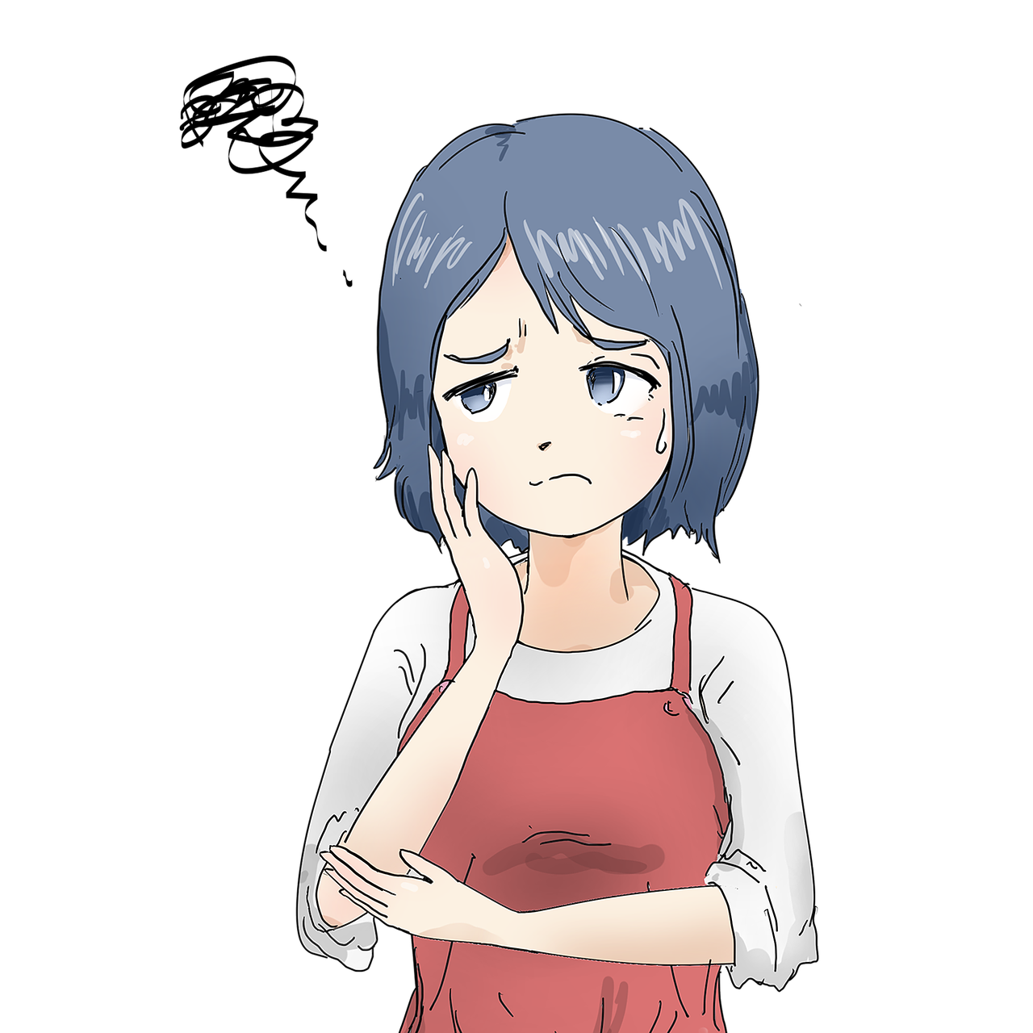
Feelings Towards the Math Portion of the ACT
Notes:
dadaworks. (2019, February 14). Mobile. [Illustration]. Pixabay. https://pixabay.com/illustrations/mobile-information-mobile-phone-3998332/
dadaworks. (2019, February 23). Doubt. [Illustration]. Pixabay. https://pixabay.com/illustrations/doubt-mystery-apron-to-think-about-4017807/

Slide 6
Attitude Makes a Difference
“Whether you think you can or think you can’t,
you’re right.”
– Henry Ford

Slide 7

Checkpoint Challenge
Leave your paper face down until the timer starts.
10-Minute Timer
Notes:
K20 Center. (2021, September 21). K20 Center 10 minute timer. [Video]. YouTube. https://youtu.be/9gy-1Z2Sa-c?si=kU9BOsDBn5tXYBWd

Slide 8

GUS Method
Next to each question, write the letter or symbol that best represents your feelings towards your answer.
  G—Guessed
  U—Unsure
  S—Sure
Notes:
K20 Center. (n.d.). GUS Method. Strategies. https://learn.k20center.ou.edu/strategy/76

Slide 9
Checkpoint Challenge (Answers)
A
F
E
A
G
G
B
J
H
E
Notes:
K20 Center. (n.d.). Bell Ringers and Exit Tickets. Strategies. https://learn.k20center.ou.edu/strategy/125

Slide 10
What or How?
Reflect on why you missed what you missed or why you guessed.
Were you unsure of WHAT the question was asking for?
Were you unsure of HOW to do the math?

Slide 11
Checkpoint Challenge: Question 1
What is the probability of randomly drawing a card that is NOT blue and is NOT yellow?
WHAT in this problem tells us what it is was asking for?
HOW do we find the probability of a complement?

Slide 12

Checkpoint Challenge: Question 2
For what value of k does the quadratic equation x² – x + k = 0 have solutions of x = –3 and x = 4?
WHAT in this problem tells us what it is was asking for?
HOW do we find the
constant of a quadratic
if we know the solutions?

Slide 13

Checkpoint Challenge: Question 3
Given the function g defined as g(x) = 6 – 2x has a domain
{–2, 0, 1}, what is the range of g?
WHAT in this problem tells us what it is was asking for?
HOW do we find the range?

Slide 14

Checkpoint Challenge: Question 4
Data Set A: 32, 39, 48, 50, 50, 61
How will the mean and the median of Data Set B compare to the median and mean of Data Set A?
WHAT in this problem tells us what it is was asking for?
HOW do we find the mean
or median?

Slide 15
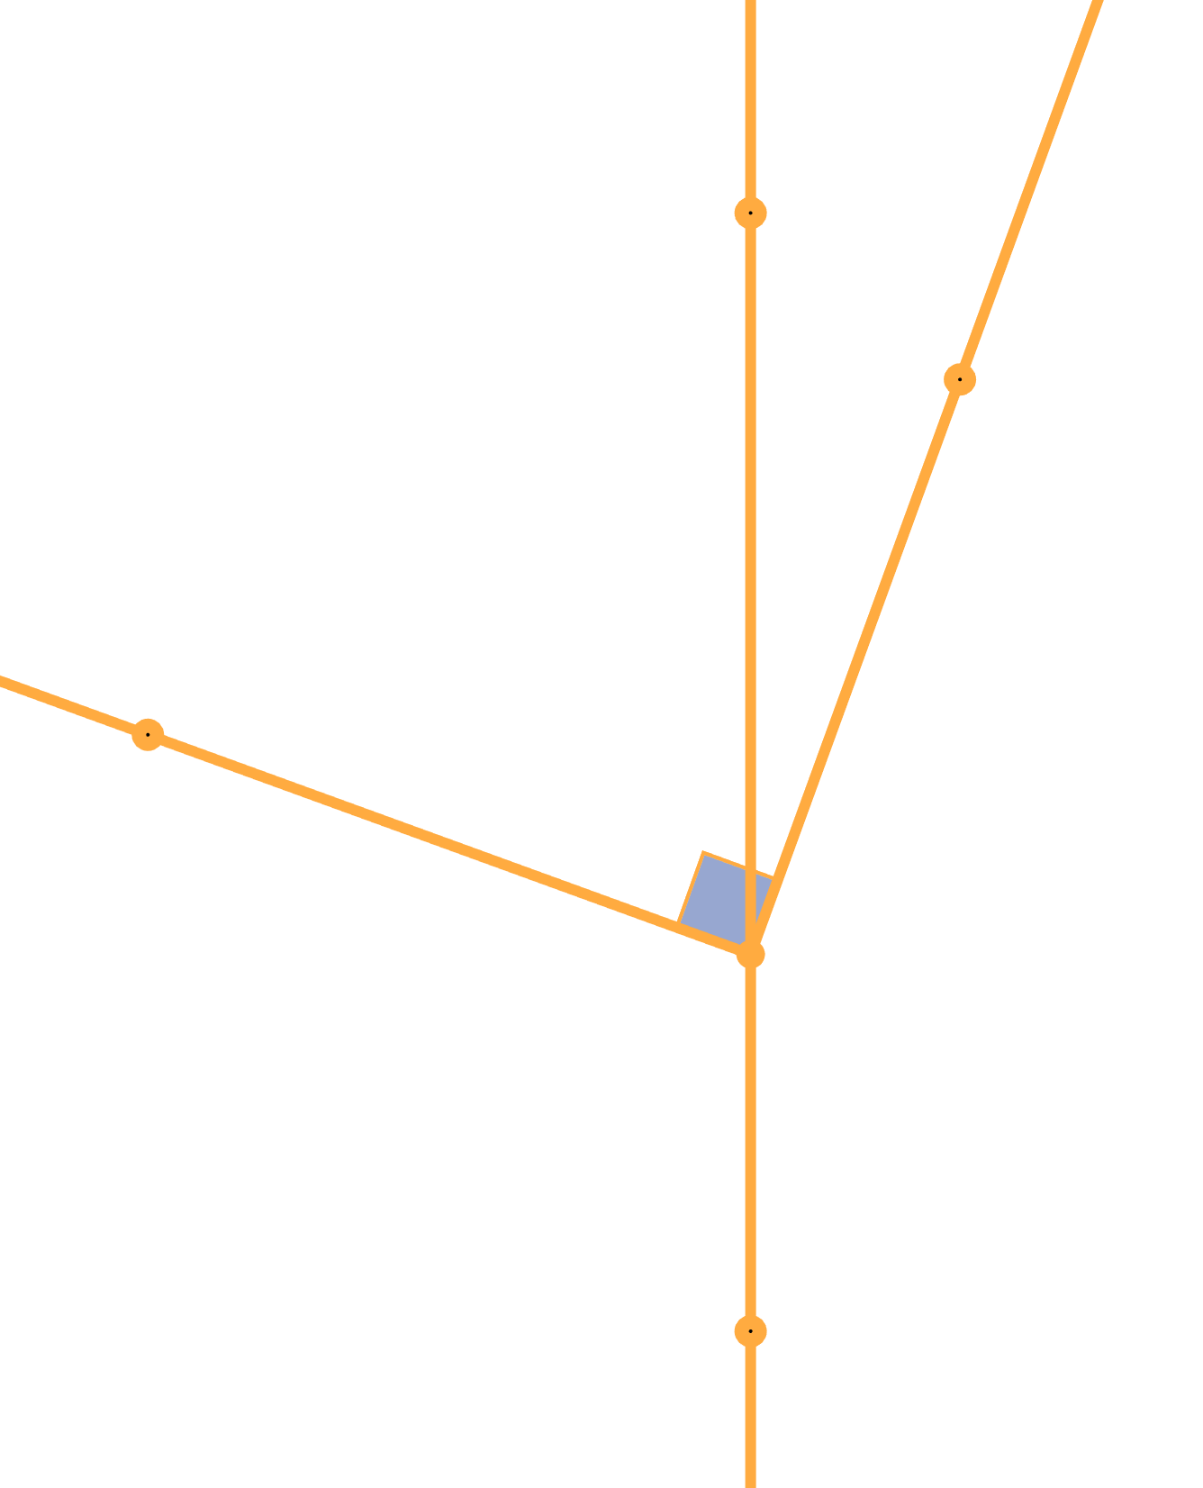
Checkpoint Challenge: Question 5
If it can be determined, what is the measure of ∠AKL?
WHAT in this problem tells us what it is was asking for?
HOW do we find the unknown angle?

Slide 16




Checkpoint Challenge: Question 5

Slide 17

Checkpoint Challenge: Question 6
The statement 2(x + 7) – x = 10 – (x – 14) is true for which of the following?
WHAT in this problem tells us what it is was asking for?
HOW do we solve for x?

Slide 18

Checkpoint Challenge: Question 7
In terms of x, what is the area, in square inches, of the figure?
WHAT in this problem tells us what it is was asking for?
HOW do we find the area of a composite figure?

Slide 19

Checkpoint Challenge: Question 7

Slide 20

Checkpoint Challenge: Question 8
For all values of a such that a < –1,
which of the following expressions
has the greatest value?
WHAT in this problem tells us
what it is was asking for?
HOW do we compare values?

Slide 21

Checkpoint Challenge: Question 9
The solution to the equation 15 = 7v + 20 is which of the types of numbers listed below?
WHAT in this problem tells us what it is was asking for?
HOW do we solve for v?

Slide 22

Checkpoint Challenge: Question 10
What is the area of the shaded region?
WHAT in this problem tells us what it is was asking for?
HOW do we find the area of a composite figure?

Slide 23

Checkpoint Challenge: Question 10

Slide 24

Take Action
When you guessed, were you mostly unsure due to the WHAT or the HOW of the question(s)?
WHAT: this likely indicates that you need to work on reading more carefully
HOW: this likely indicates that you need to study in areas that you do not easily recall

Slide 25
Take Action
Choose one new action to increase your math score.
Add the new action to your handout.
Over the next few weeks, practice your action and add the dates you practiced to your handout to keep track of your progress.

Slide 26

You Powered Up!
Achievement Unlocked:
Pacing

