Slide 2
Power Up: Math ACT Prep, Week 7
Practice Test

Slide 3
Essential Question
How can I increase my ACT score?

Slide 4
Learning Objectives
Practice and reflect on pacing to increase the number of questions answered on the math portion of the ACT.
Navigate efficiently through TestNav during a practice test.

Slide 5
Let’s Get Ready
Find your calculator, device, and scratch paper.

Slide 6
TestNav: Getting Started
Navigate to home.testnav.com. Then click “The ACT” button.
OR
Open the TestNav application on your school device.

Slide 7
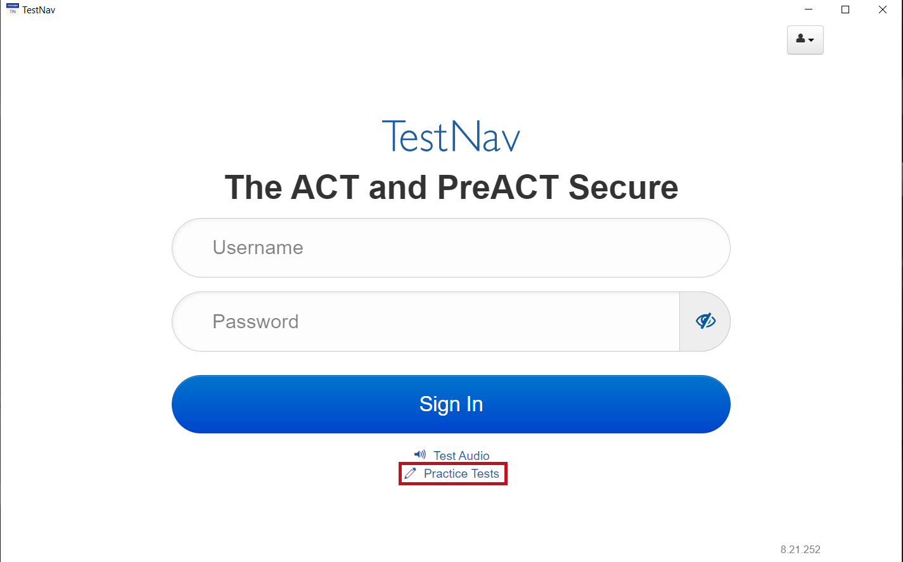
TestNav: Selecting the Right Test
Click “Practice Tests.”
Notes:
TestNav. (2023). Login screen. [Screenshot].

Slide 8
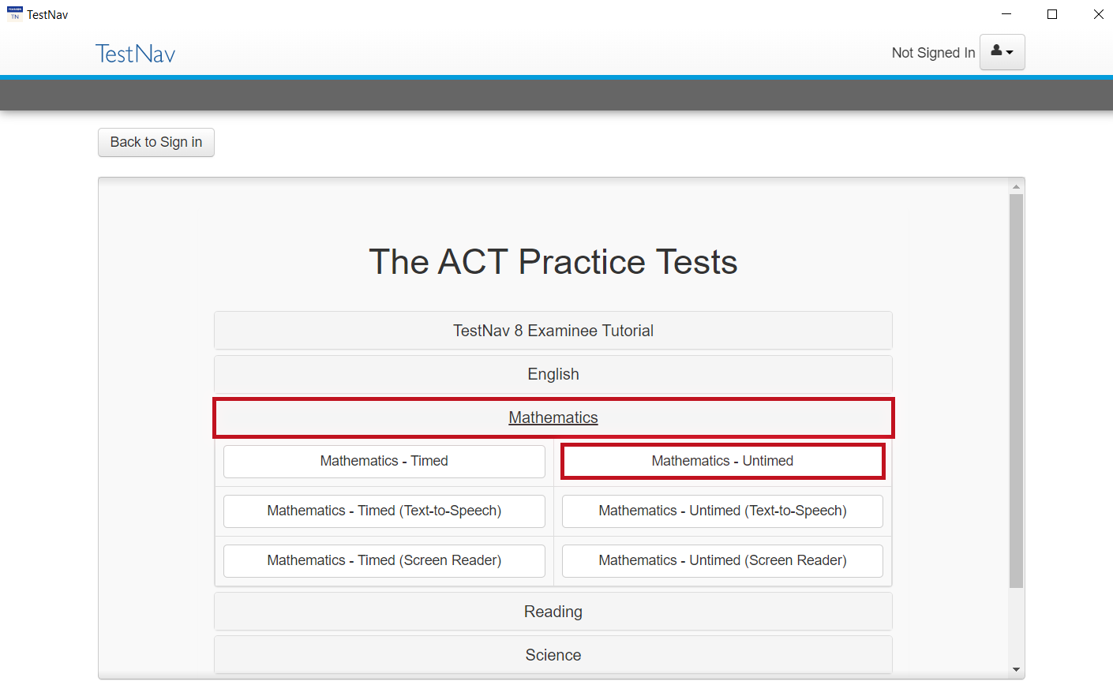
TestNav: Selecting the Right Test
Click “Mathematics.”
Select “Mathematics - Untimed.”
Notes:
TestNav. (2023). Select practice test. [Screenshot].

Slide 9
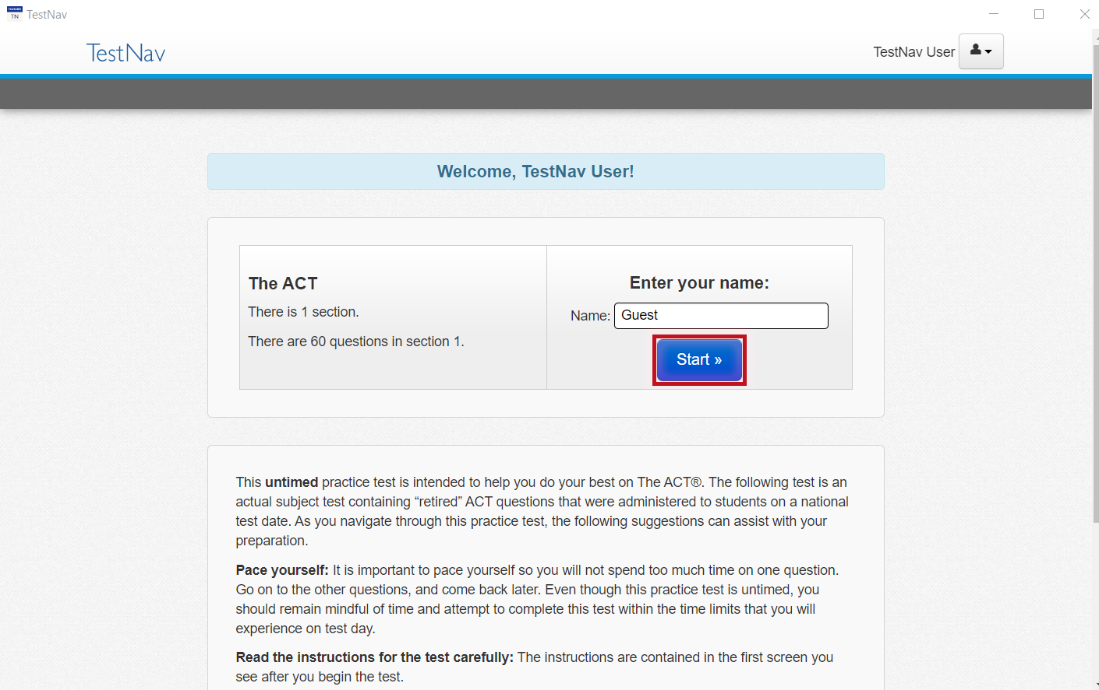
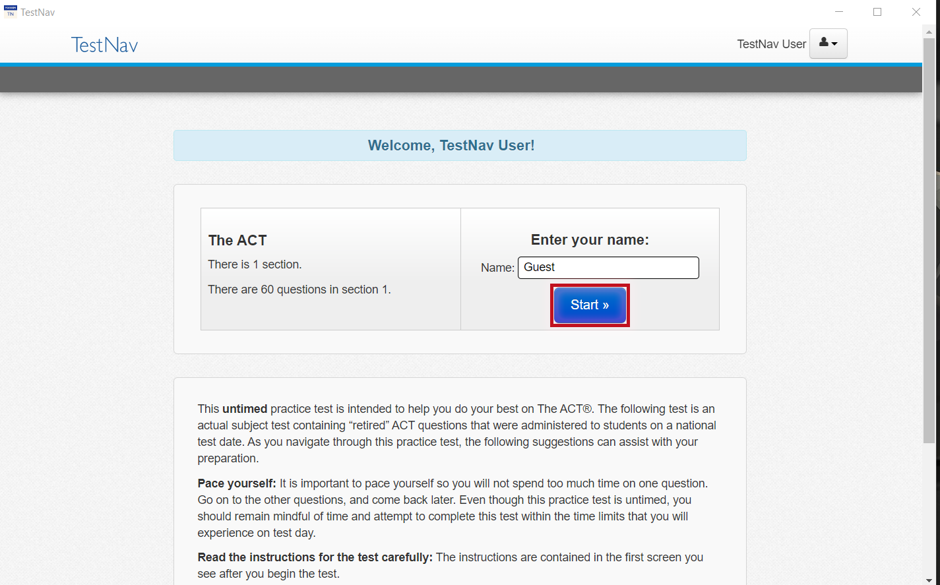
TestNav: Advice
Read the directions.
Press the “Start” button.
Notes:
TestNav. (2023). Welcome, TestNav user. [Screenshot].

Slide 10
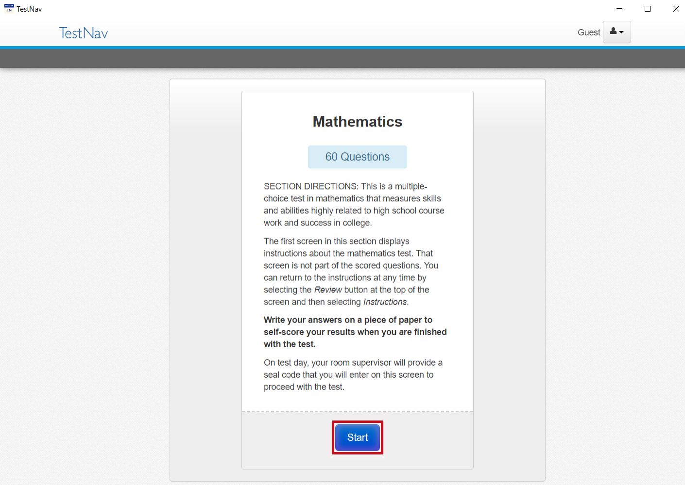
TestNav: Online Math Section Directions
Read the directions.
Press the “Start” button.
Notes:
TestNav. (2023). Online directions. [Screenshot].

Slide 11
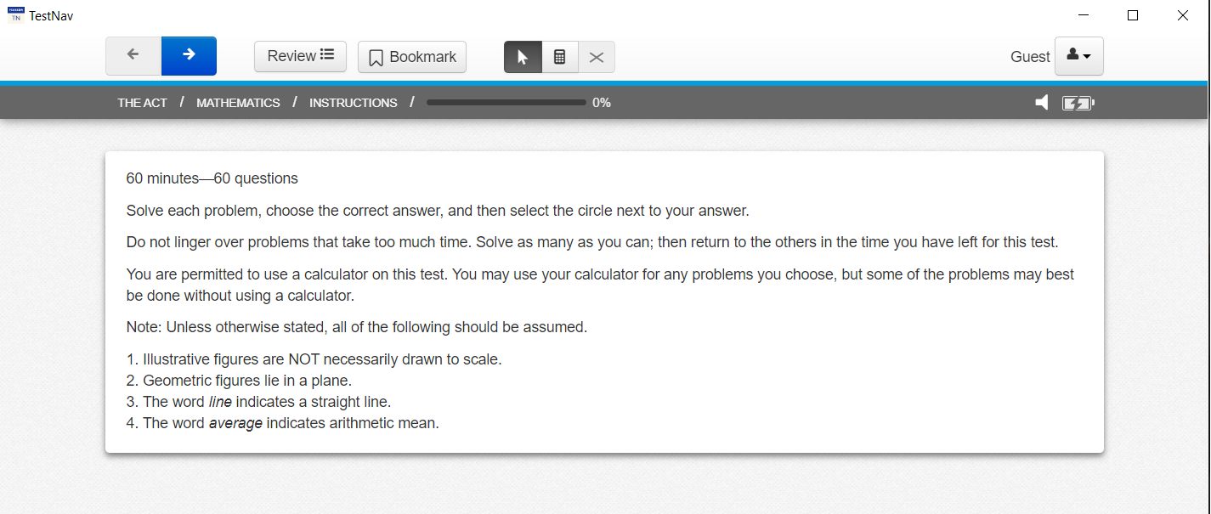
The ACT: General Math Section Directions
Read the directions.
Read these now so that you do not spend time on the actual ACT reading these same directions.
You will be given 25 minutes to answer the first 25 questions.
Notes:
TestNav. (2023). General directions. [Screenshot].

Slide 12
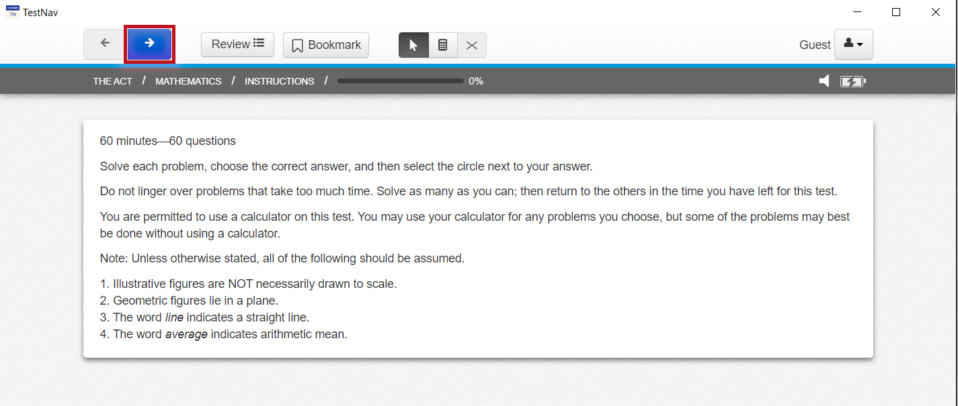
Begin Your Practice Test
Press the “Next” (arrow) button at the top of the screen to begin.
Notes:
TestNav. (2023). General directions. [Screenshot].

Slide 13
Start and End Times
Write the start and end times on the board.
Example:
Start at 9:00 am
End at 9:25 am

Slide 14
5-Minute Warning
When students are not using the full time to take a full practice test, they will not see the usual reminder indicating that 5 minutes remains.
Alert students that there are 5 minutes remaining.

Slide 15
TestNav: End the Practice Test
Navigate to the “End of the Section.”
Click the “Submit Final Answers” button.

Slide 16
Congratulations!
You completed your test.
Make note of how many questions you answered correctly.
Remember, you were only given enough time to answer 25 questions, not all of them.

Slide 17
You Powered Up!
Achievement Unlocked: Ready for the Real Test

