Slide 2
Power Up: Math ACT Prep, Week 8
Introduction to Story Problems

Slide 3
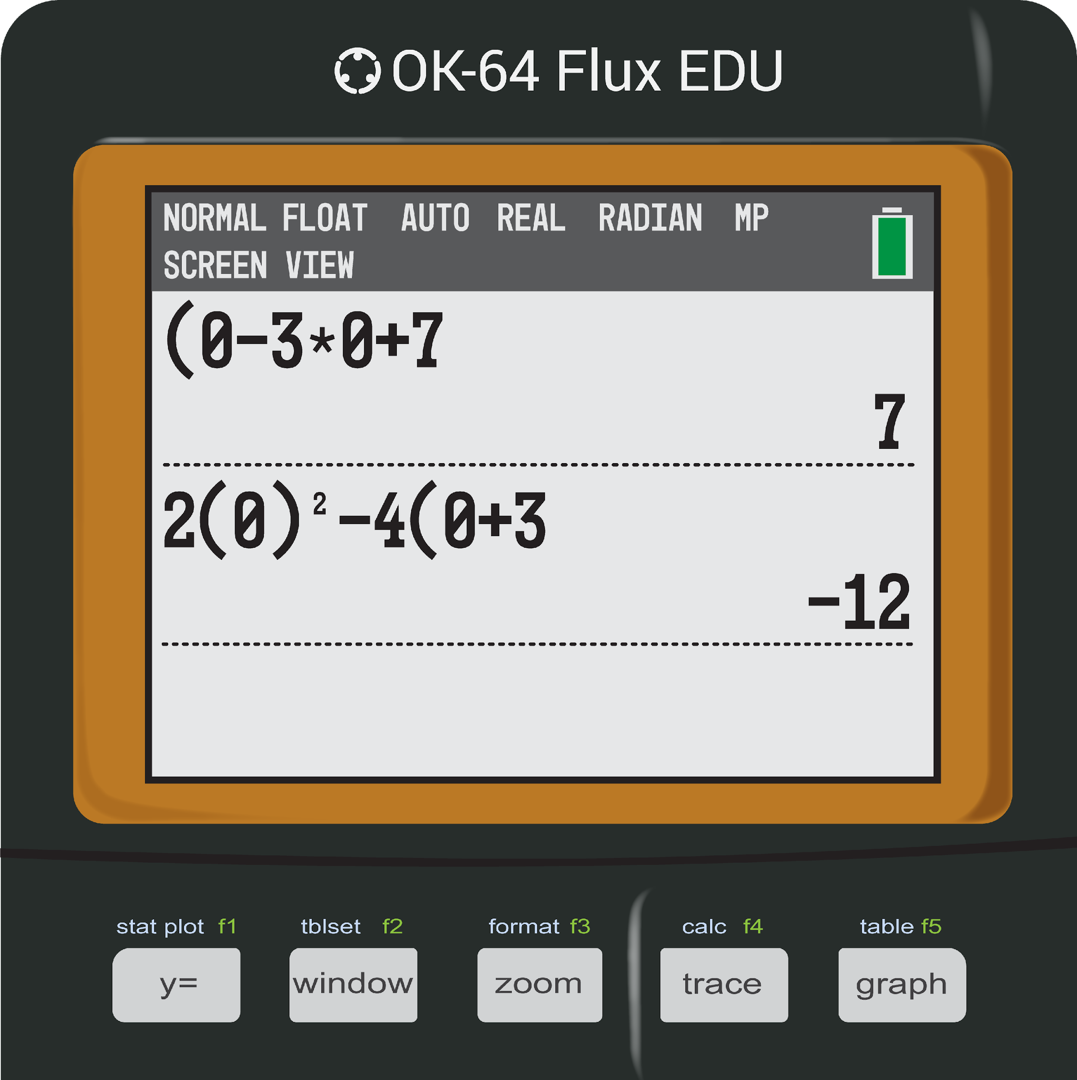
Error Analysis: What Went Wrong?
Consider the graphs of g(x) = (x – 3)(x + 7) and h(x) = 2x² – 4x + 3. What is the sum of their y-intercepts?
Notes:
K20 Center. (n.d.). Bell Ringers and Exit Tickets. Strategies. https://learn.k20center.ou.edu/strategy/125

Slide 4
Essential Question
How can I increase my ACT score?

Slide 5
Learning Objectives
Identify and algebraically represent critical information from a story problem.
Apply problem-solving skills.

Slide 6
Making Story Problems Less Scary
Math problems hidden in a paragraph can feel quite intimidating; however, that is how and where we see math in the real-world.
There are not many equations floating around, so we need to be problem-solvers and to be able to look at a situation and identify the critical information.

Slide 7
Steps to Solving Story Problems
Draw a Quick Sketch?
Label the Known.
Label the Unknown.
Write an Equation.

Slide 8
Steps to Solving Story Problems
As you read a story problem, is a shape being described? As you read, draw a quick sketch of the shape.
Maybe draw arrows indicating the direction being described.
Every problem does not need a drawing.
Draw a Quick Sketch?
Label the Known.
Label the Unknown.
Write an Equation.

Slide 9
Steps to Solving Story Problems
Underline or label any key information given.
For example, if you read the width of a rectangle is 5 cm, then write w = 5 cm.
Identify and label information as you read. The goal is to not re-read the problem.
Draw a Quick Sketch?
Label the Known.
Label the Unknown.
Write an Equation.

Slide 10
Steps to Solving Story Problems
What is the question asking?
This information is often in the last sentence, but not always. For example, if you read find the area of a rectangle, then write A = ?.
Identify and label this unknown information as you read.
Draw a Quick Sketch?
Label the Known.
Label the Unknown.
Write an Equation.

Slide 11
Steps to Solving Story Problems
Now that you have identified the given information (known) and what the question is asking (unknown), think about an equation that could relate the known(s) and unknown.
What equation could relate the area and width of a rectangle?
Draw a Quick Sketch?
Label the Known.
Label the Unknown.
Write an Equation.

Slide 12
Story Problems: Question 1
The diagonal of a rectangular movie theater screen is 84.1 feet. The width of the screen is 74.0 feet, and the height of the screen is 34 feet less than the width of the screen. Which of the following is the closest to the area, in square feet, of the television screen?
Would it be helpful to draw a quick sketch?

Slide 13
Story Problems: Question 1
The diagonal of a rectangular movie theater screen is 84.1 feet. The width of the screen is 74.0 feet, and the height of the screen is 34 feet less than the width of the screen. Which of the following is the closest to the area, in square feet, of the television screen?

Slide 14
Story Problems: Question 1
The diagonal of a rectangular movie theater screen is 84.1 feet. The width of the screen is 74.0 feet, and the height of the screen is 34 feet less than the width of the screen. Which of the following is the closest to the area, in square feet, of the television screen?

Slide 15
Story Problems: Question 1
The diagonal of a rectangular movie theater screen is 84.1 feet. The width of the screen is 74.0 feet, and the height of the screen is 34 feet less than the width of the screen. Which of the following is the closest to the area, in square feet, of the television screen?
84.1
74 – 34 = 40
74

Slide 16
Story Problems on the ACT
Since the ACT is a timed exam, it is important to not waste time.
There are things we think about and things we write, but we do not need to show much work on the ACT.
Let’s compare what we think and what we write for questions on the ACT.

Slide 17
Think
Write
The diagonal of a rectangular movie theater screen is 84.1 feet. The width of the screen is 74.0 feet, and the height of the screen is 34 feet less than the width of the screen. Which of the following is the closest to the area, in square feet, of the television screen?
84.1
Step 1) Draw a Picture.

Slide 18
Think
Write
The diagonal of a rectangular movie theater screen is 84.1 feet. The width of the screen is 74.0 feet, and the height of the screen is 34 feet less than the width of the screen. Which of the following is the closest to the area, in square feet, of the television screen?
84.1
74
Step 2) Label the Known.

Slide 19
Think
Write
The diagonal of a rectangular movie theater screen is 84.1 feet. The width of the screen is 74.0 feet, and the height of the screen is 34 feet less than the width of the screen. Which of the following is the closest to the area, in square feet, of the television screen?
84.1
74 – 34 = 40
74
*We might write h = w – 34.
Step 2) Label the Known.

Slide 20
Think
Write
The diagonal of a rectangular movie theater screen is 84.1 feet. The width of the screen is 74.0 feet, and the height of the screen is 34 feet less than the width of the screen. Which of the following is the closest to the area, in square feet, of the television screen?
84.1
74 – 34 = 40
74
Step 3) Label the Unknown.

Slide 21
Think
Write
The diagonal of a rectangular movie theater screen is 84.1 feet. The width of the screen is 74.0 feet, and the height of the screen is 34 feet less than the width of the screen. Which of the following is the closest to the area, in square feet, of the television screen?
84.1
74 – 34 = 40
74
*We might write A = b·h.
Step 4) Write an Equation.

Slide 22
Think
Write
Now that I have an answer, let’s look at the answer choices.
I see the answer is D.
84.1
74 – 34 = 40
74

Slide 23
Story Problems: Question 2
Of the 450 tickets to see a local artist, there are three types of tickets for sale. 8% of the tickets are VIP tickets. Of those tickets NOT reserved for VIP, 18 are general admission tickets. How many tickets are available for sale that are NOT reserved for VIP and are NOT general admission tickets?

Slide 24
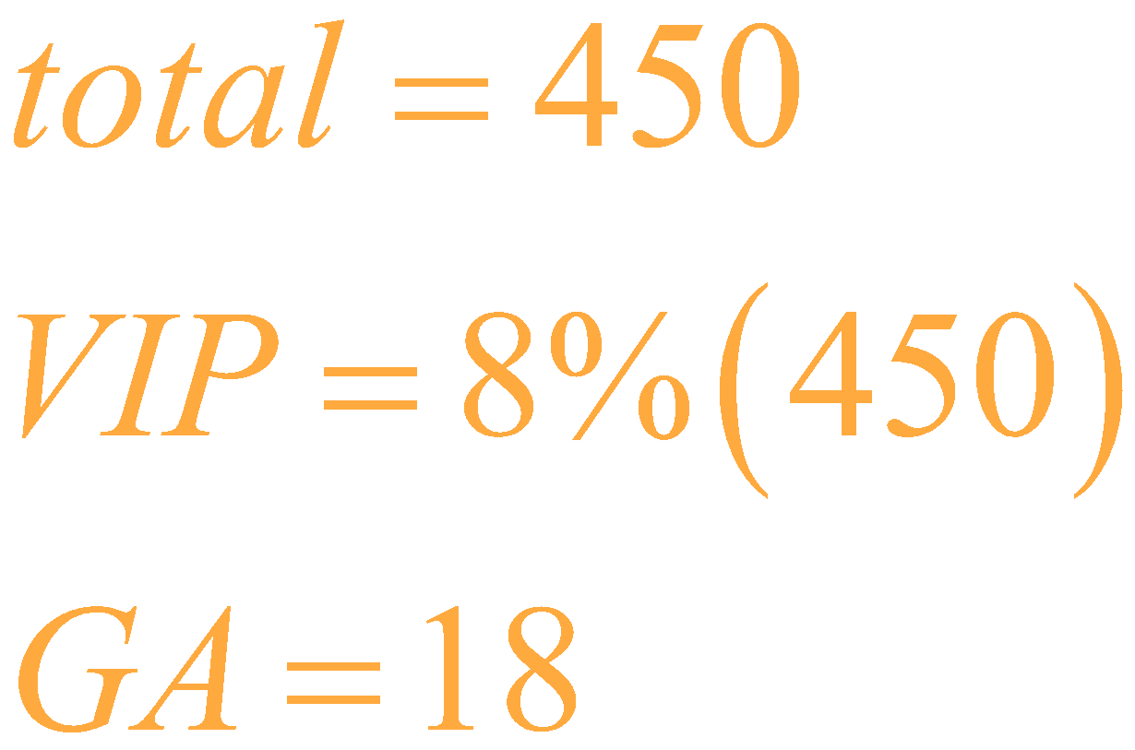
Story Problems: Question 2
Of the 450 tickets to see a local artist, there are three types of tickets for sale. 8% of the tickets are VIP tickets. Of those tickets NOT reserved for VIP, 18 are general admission tickets. How many tickets are available for sale that are NOT reserved for VIP and are NOT general admission tickets?

Slide 25
Exit Ticket
Leave your paper face down until the timer starts.
5-Minute Timer
Notes:
K20 Center. (n.d.). Bell Ringers and Exit Tickets. Strategies. https://learn.k20center.ou.edu/strategy/125
K20 Center. (2021, September 21). K20 Center 5 minute timer. [Video]. YouTube. https://youtu.be/EVS_yYQoLJg?si=fJvuvFWH3vJ3B0z9

Slide 26
Exit Ticket (Answers)
C
H
C
J
E
Remember, it is 100% okay to not get 100% of the questions right on the ACT.
Notes:
K20 Center. (n.d.). Bell Ringers and Exit Tickets. Strategies. https://learn.k20center.ou.edu/strategy/125

Slide 27
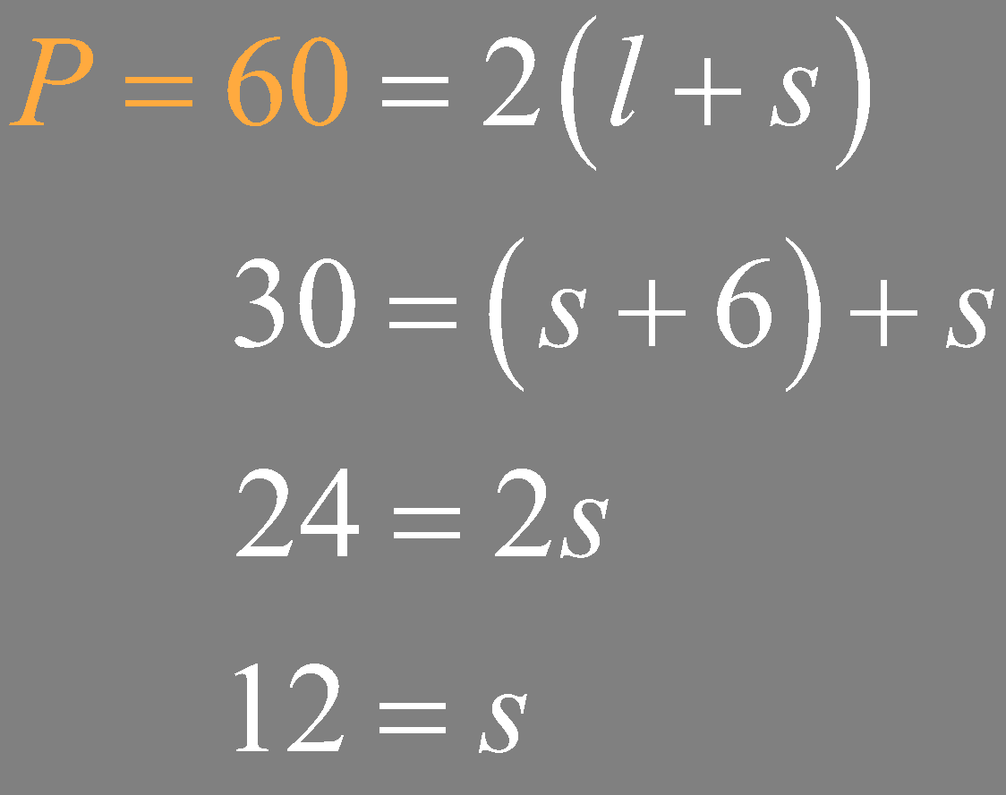
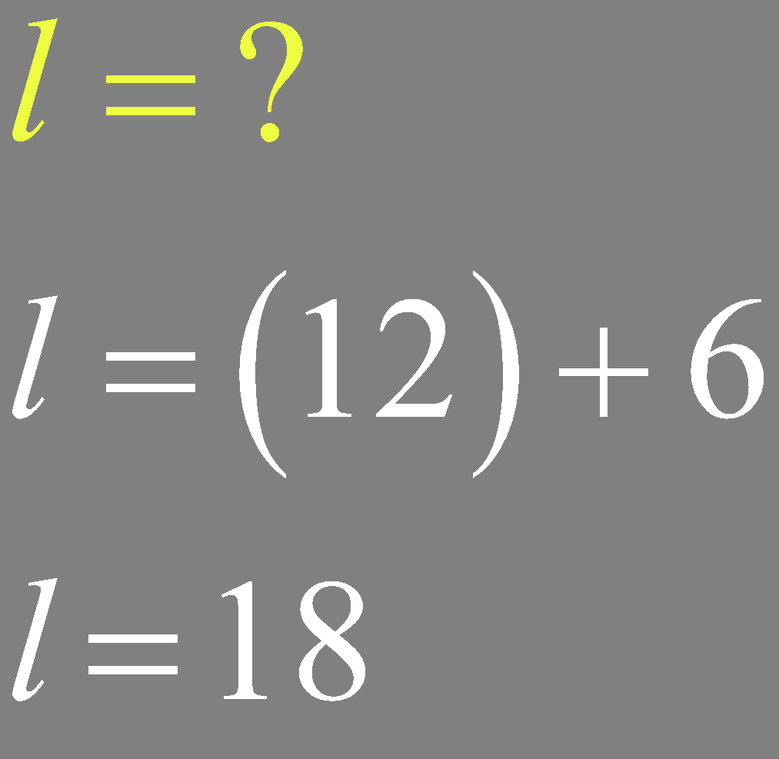
Exit Ticket (Solution 1)
The perimeter … is 60 inches. The longer sides of the rectangle are each 6 inches longer than each of the shorter sides …. What is the length … of one of the longer sides …?

Slide 28
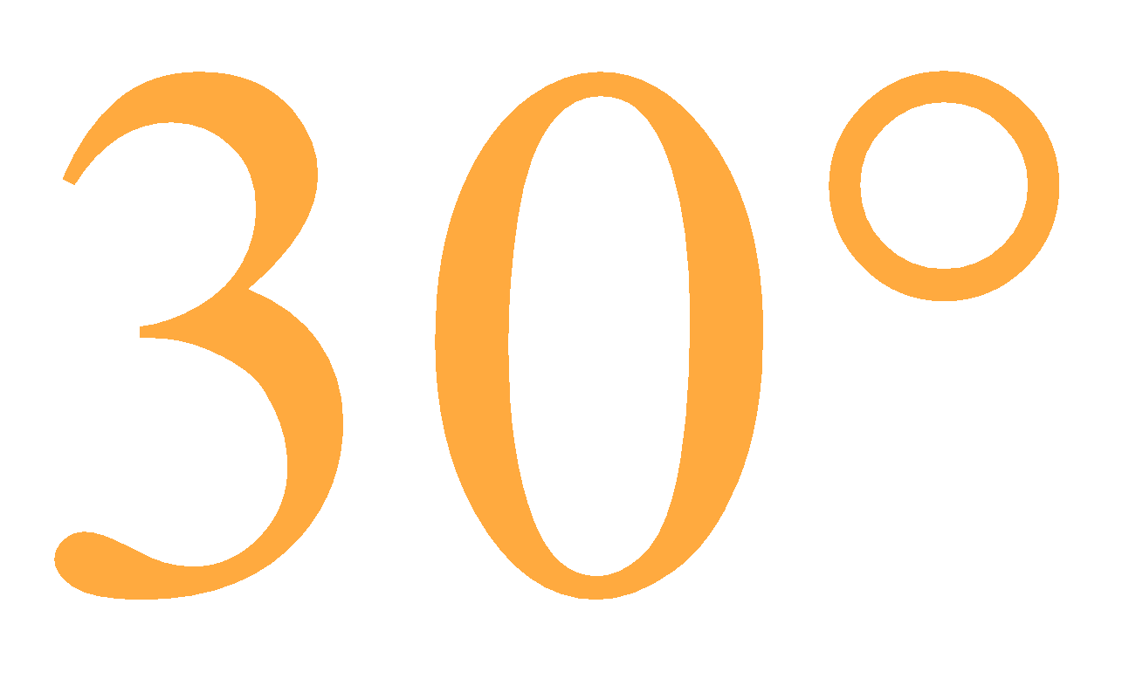
Exit Ticket (Solution 2)
Given that ∠B is in the included angle between the two congruent sides of the isosceles triangle ΔABC, and the measure of ∠B is 30°, what is the measure of ∠A?

Slide 29
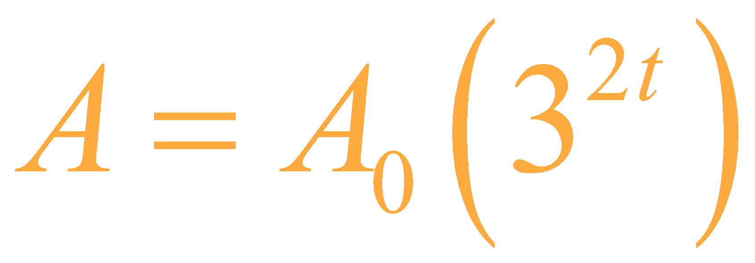
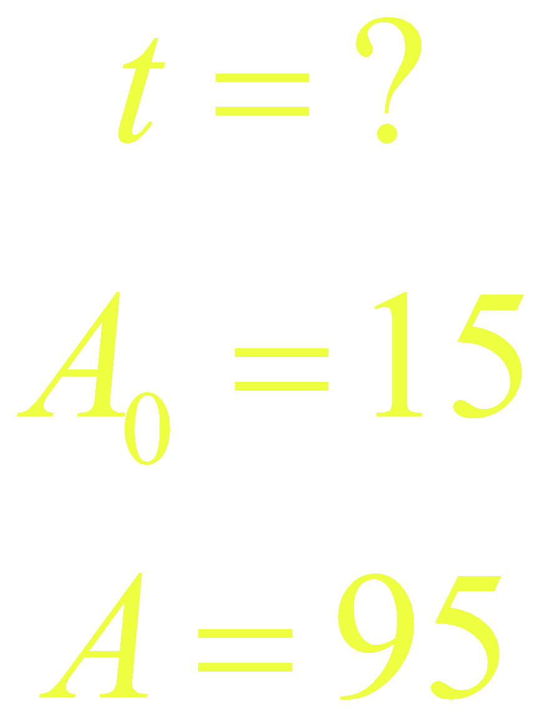
Exit Ticket (Solution 3)
The … formula A = A₀(3^{2t}), where A is the total amount … t minutes after an initial amount, A₀, … began accumulating. Which … relates the number of min. … an initial amount of 15 grams … to accumulate to 95 grams?

Slide 30
Exit Ticket (Solution 4 – Steps 1-2)
Johnny … drives … a straight road that runs east and west, … detour driving 2 miles … south, then 1 mile … east, then 4 miles … south, then 6 miles … west, then 3 miles … north, then 1 mile … west, and then 3 miles … north …

Slide 31
Exit Ticket (Solution 4 – Steps 3-4)
How many more miles did he drive by taking the detour than if he could have stayed on the highway?

Slide 32
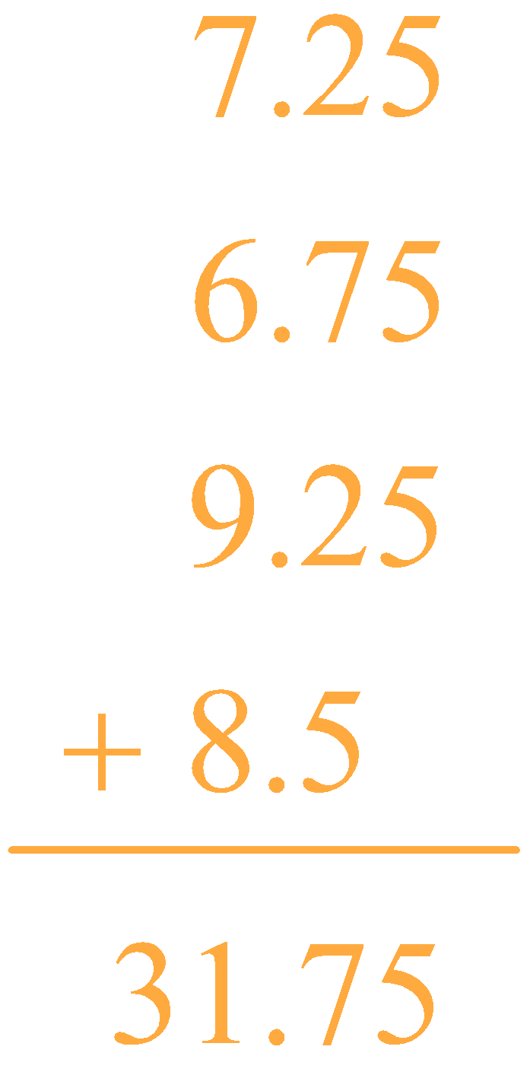
Exit Ticket (Solution 5)
… One employee earns $7.50 per hour…worked…: 7.25 hours on Mon., 6.75 hours on Tues., 9.25 hours on Thurs., and 8.5 hours on Fri. …the best estimate for the employee’s pay …?

Slide 33
You Powered Up!
Achievement Unlocked: Story Problems

