Slide 2
Power Up: Math ACT Prep, Week 9
Story Problems and Formulas

Slide 3
Bell Ringer
In the standard (x, y) coordinate plane, a line intersects the y-axis at (0, –3) and contains the point (–2, 2). What is the slope of the line?
Notes:
K20 Center. (n.d.). Bell Ringers and Exit Tickets. Strategies. https://learn.k20center.ou.edu/strategy/125

Slide 4
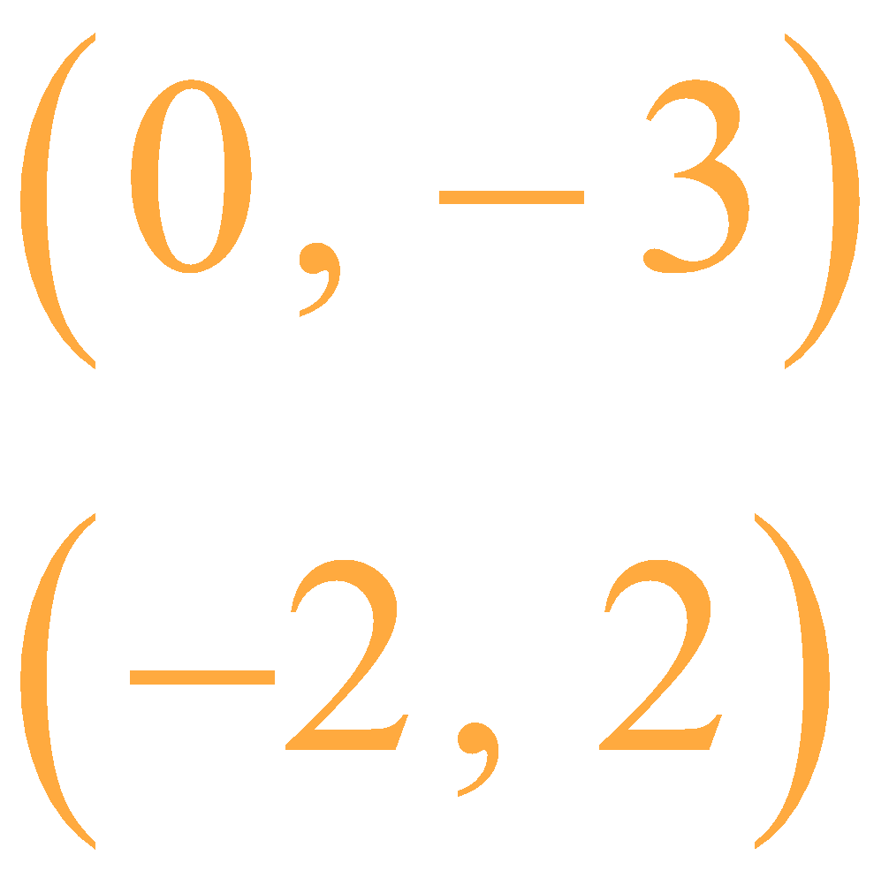
Bell Ringer (Solution)
In the standard (x, y) coordinate plane, a line intersects the y-axis at (0, –3) and contains the point (–2, 2). What is the slope of the line?
Notes:
K20 Center. (n.d.). Bell Ringers and Exit Tickets. Strategies. https://learn.k20center.ou.edu/strategy/125

Slide 5
Recall: Steps to Solving Story Problems
Draw a Quick Sketch?
Label the Known.
Label the Unknown.
Write an Equation.
What might be helpful for writing equations?

Slide 6
Essential Question
How can I increase my ACT score?

Slide 7
Learning Objectives
Identify and algebraically represent critical information from a story problem.
Apply formulas and problem-solving skills to story problems.

Slide 8
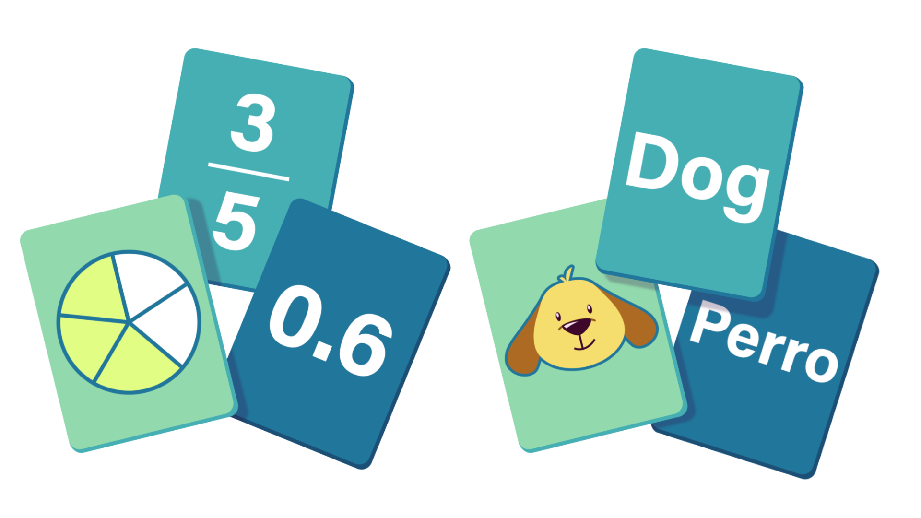
Formulas
There are a lot of formulas that you need to know for the ACT.
There are a lot of formulas that you already know!
How do you know which one to use?
Notes:
K20 Center. (n.d.). Card Matching. Strategies. https://learn.k20center.ou.edu/strategy/1837

Slide 9
Formulas: Check Your Work
Use your handout to check your work.
On your handout, highlight the part of the story problem that prompted you to use a specific formula.
Did you already know that formula?
Notes:
K20 Center. (n.d.). Card Matching. Strategies. https://learn.k20center.ou.edu/strategy/1837

Slide 10
Forgot a Formula?
Since the ACT is a timed exam, if you do not remember a formula:
Guess and select an answer choice.
Mark (bookmark) the question to return to later; maybe a later question will remind you of the needed formula.
Move on to the next question.

Slide 11
Exit Ticket
Leave your paper face down until the timer starts.
5-Minute Timer
Notes:
K20 Center. (n.d.). Bell Ringers and Exit Tickets. Strategies. https://learn.k20center.ou.edu/strategy/125
K20 Center. (2021, September 21). K20 Center 5 minute timer. [Video]. YouTube. https://youtu.be/EVS_yYQoLJg?si=fJvuvFWH3vJ3B0z9

Slide 12
Exit Ticket (Answers)
B
F
B
H
C
How well did you do?
Remember, it is 100% okay to not get 100% of the questions right on the ACT.
Notes:
K20 Center. (n.d.). Bell Ringers and Exit Tickets. Strategies. https://learn.k20center.ou.edu/strategy/125

Slide 13
Forgot a Formula?
Use the empty space at the bottom of your handout to write any formulas or math facts that you struggle to remember.

Slide 14
Exit Ticket (Solution 1)
The parallelogram below has consecutive angles with measures a° and 124°. What is the value of a?
Math Fact: Opposite angles of a parallelogram are congruent.

Slide 15
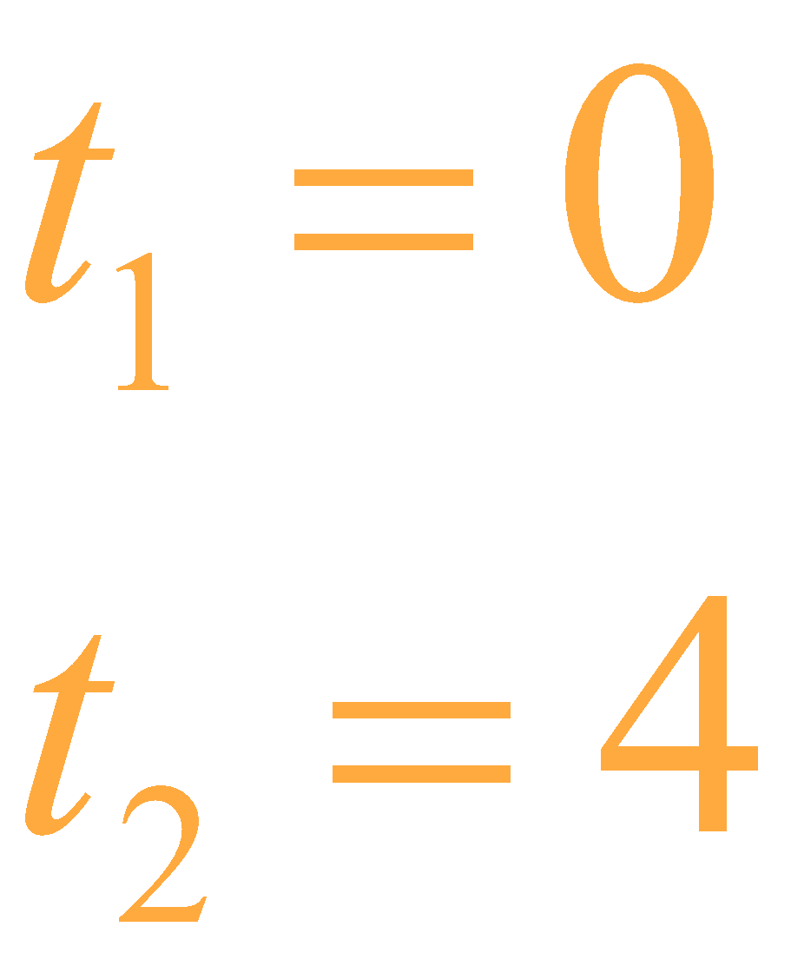
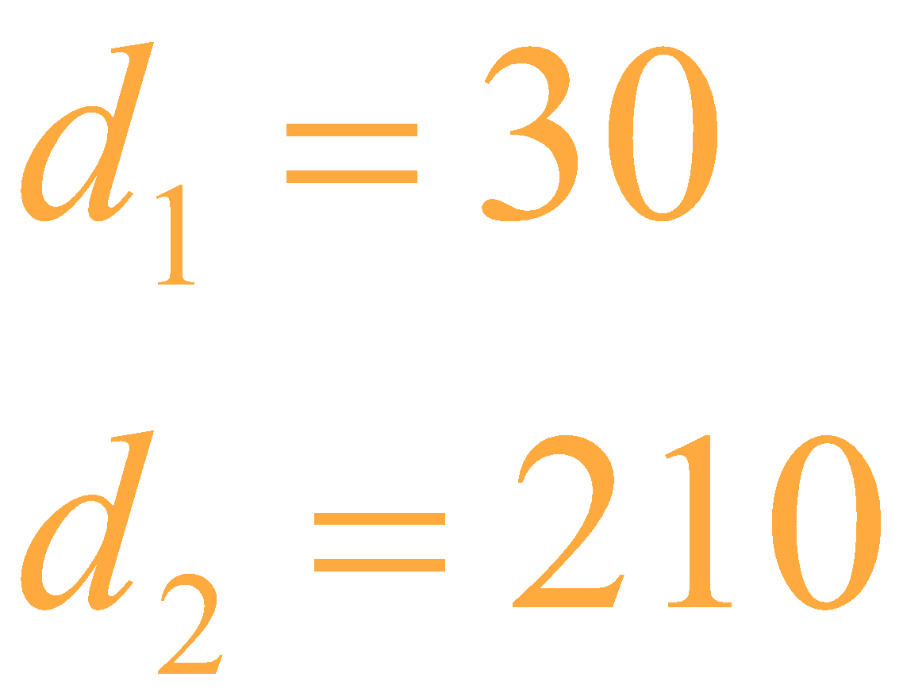
Exit Ticket (Solution 2)
… her car’s odometer read 30 miles. After Karla drove 4 hours, the odometer read 210 miles. … average driving speed, in miles per hour, during those 4 hours?
Math Facts:
Average speed = rate
rate of change = slope

Slide 16
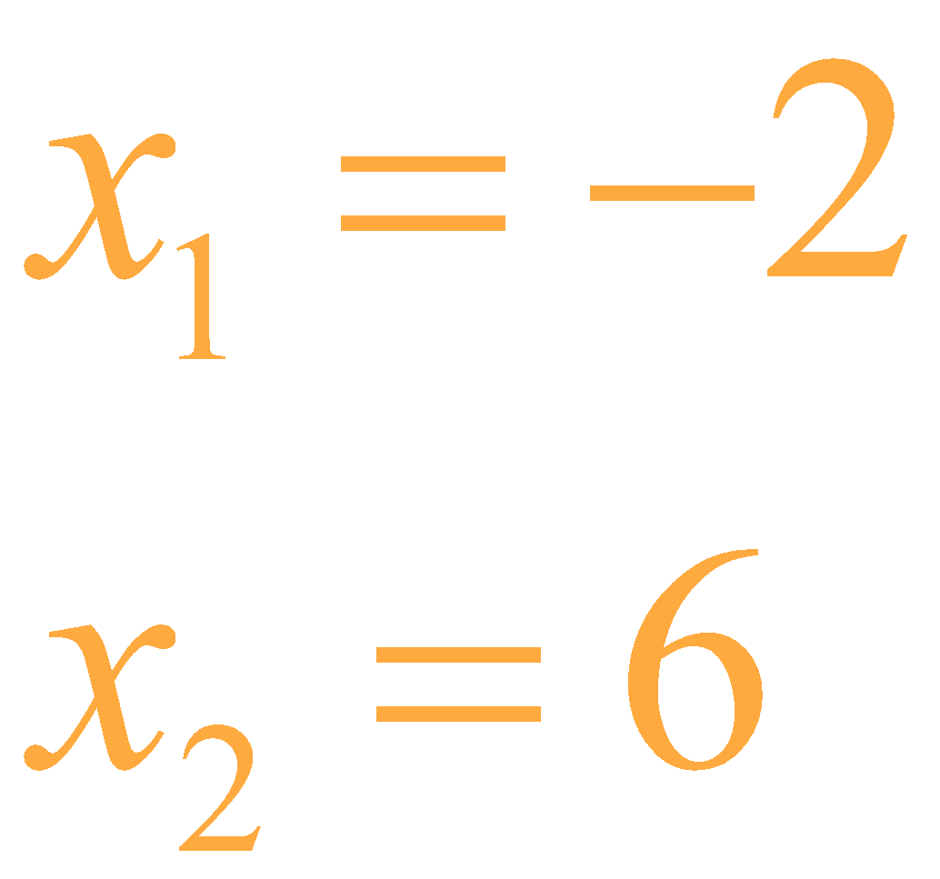
Exit Ticket (Solution 3)
… only one parabola … has x-intercepts of –2 and 6. Which of the following equations represents the axis of symmetry …?
Math Facts & Formulas: The axis of symmetry is in the middle (midpoint or average) of the two x-intercepts of a parabola.

Slide 17
Exit Ticket (Solution 3)
… only one parabola … has x-intercepts of –2 and 6. Which of the following equations represents the axis of symmetry …?
Math Facts & Formulas: The axis of symmetry is in the middle (midpoint or average) of the two x-intercepts of a parabola.

Slide 18
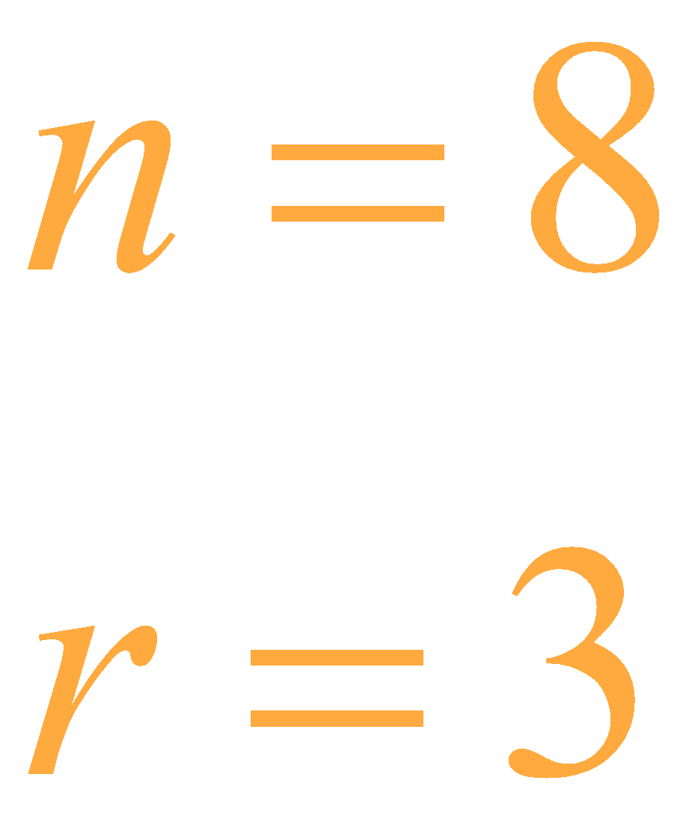
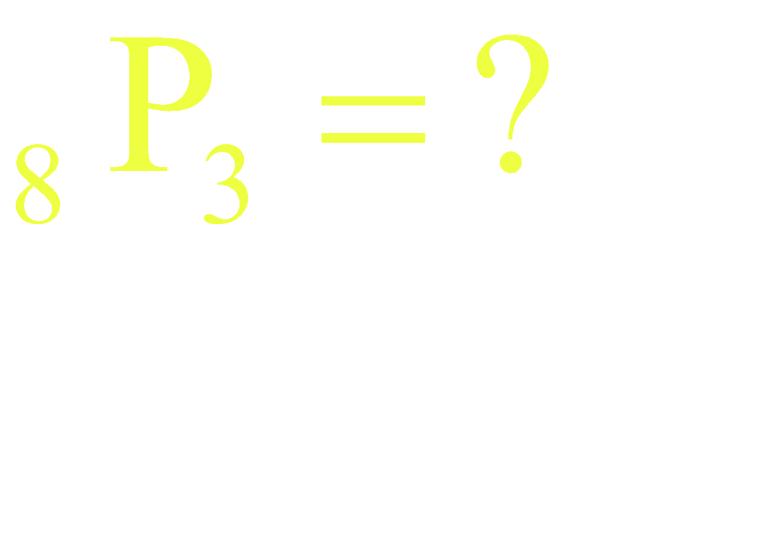
Exit Ticket (Solution 4)
… there are 3 mannequins for 1 costume each. … Lan has 8 costumes to select from, … how many possible display arrangements …? (Note: The positions of the unselected costumes do not matter.)
Formulas: The order of the chosen costumes matters, so this is a permutation.

Slide 19
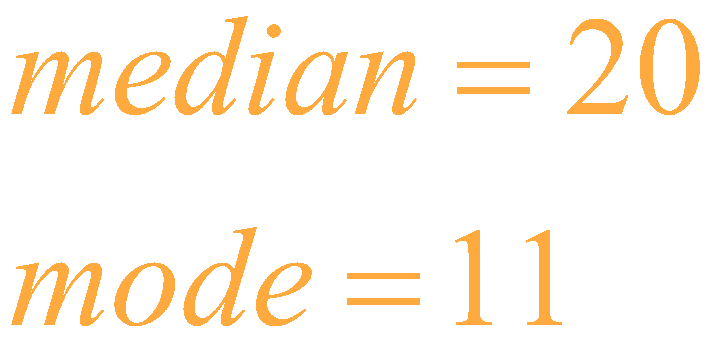
Exit Ticket (Solution 5)
The list of numbers 11, A, B, 22, 31, and 33 has a median of 20. The mode of the list of numbers is 11. To the nearest whole number, what is the mean of the list?
Formulas:
The median is the value in the middle; when there are an even number of values, find the average of the middle two values.
The mode is the most common value.
The mean is the average.

Slide 20
Exit Ticket (Solution 5…continued)
Since the mode is 11, 11 must be listed more than once.
A or B could be 11; it does not matter which.
Since the median is 20, then 22, 31, and 33 are in the second-half of the list.

Slide 21
You Powered Up!
Achievement Unlocked: Ready for the Real Test

