Slide 2
Power Up: Math ACT Prep, Week 10
Right Triangle Trigonometry

Slide 3
Essential Question
How can I increase my ACT score?

Slide 4
Learning Objectives
Express the sine, cosine, and tangent of an angle in a right triangle as a ratio of given side lengths.
Apply basic trigonometric ratios to solve right-triangle problems.

Slide 5
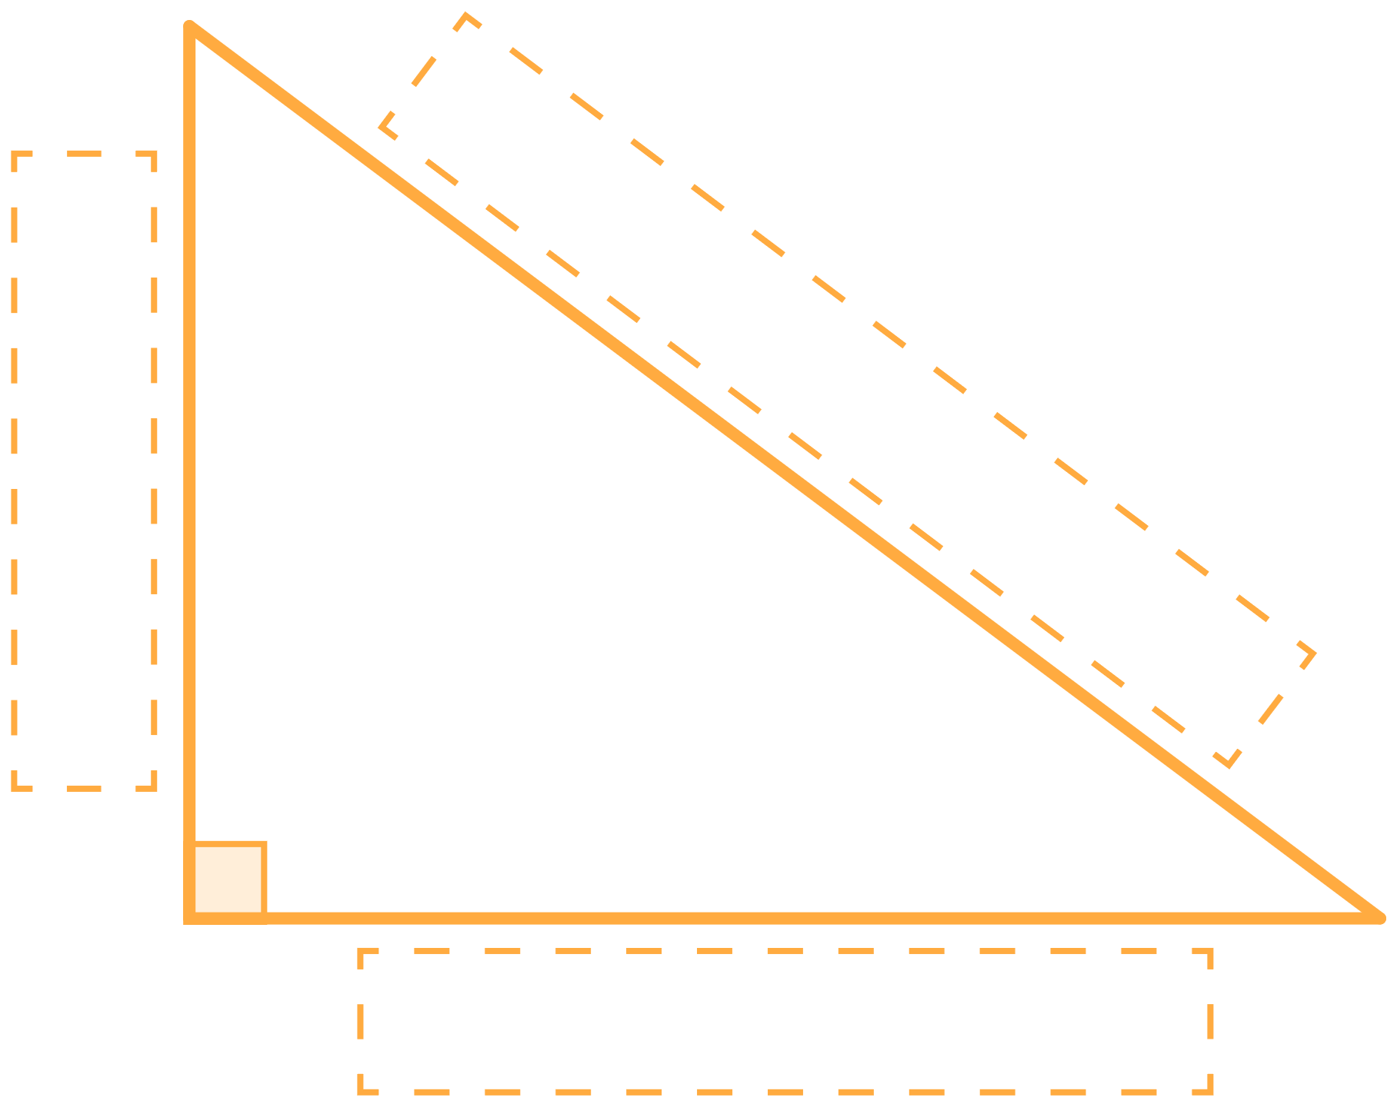
How I Know It
Label each side of each triangle using the words: opposite, adjacent, or hypotenuse.
Then write 1-2 sentences explaining how you knew which word to use.
I knew that this was the ___ side because ___.
Notes:
K20 Center. (n.d.). How I Know It. Strategies. https://learn.k20center.ou.edu/strategy/144

Slide 6
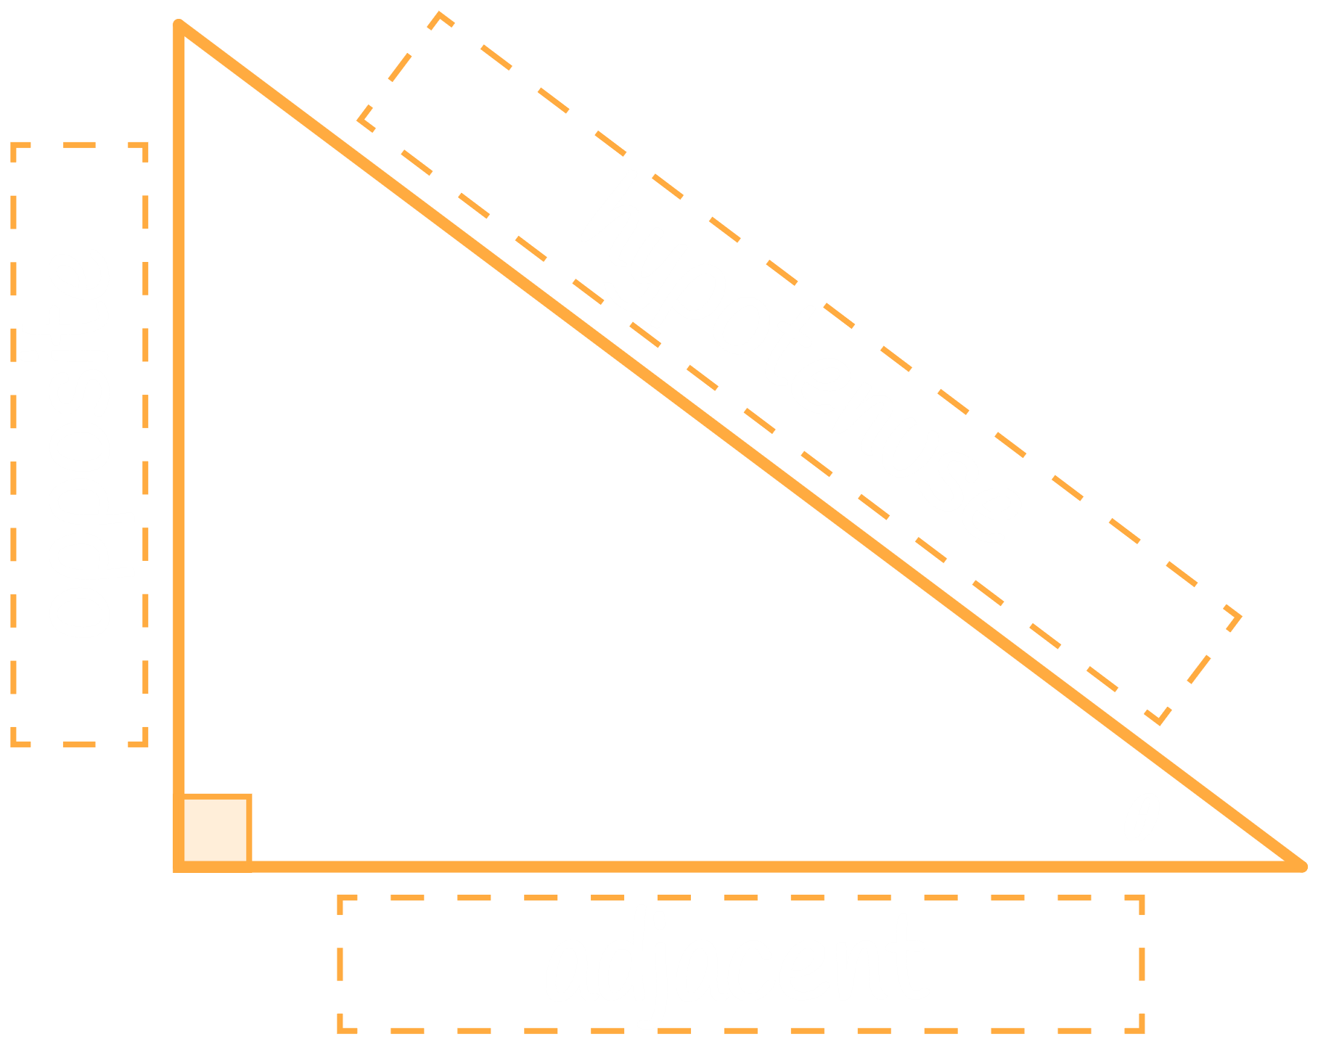
How I Know It: Triangle 1
Notes:
K20 Center. (n.d.). How I Know It. Strategies. https://learn.k20center.ou.edu/strategy/144

Slide 7
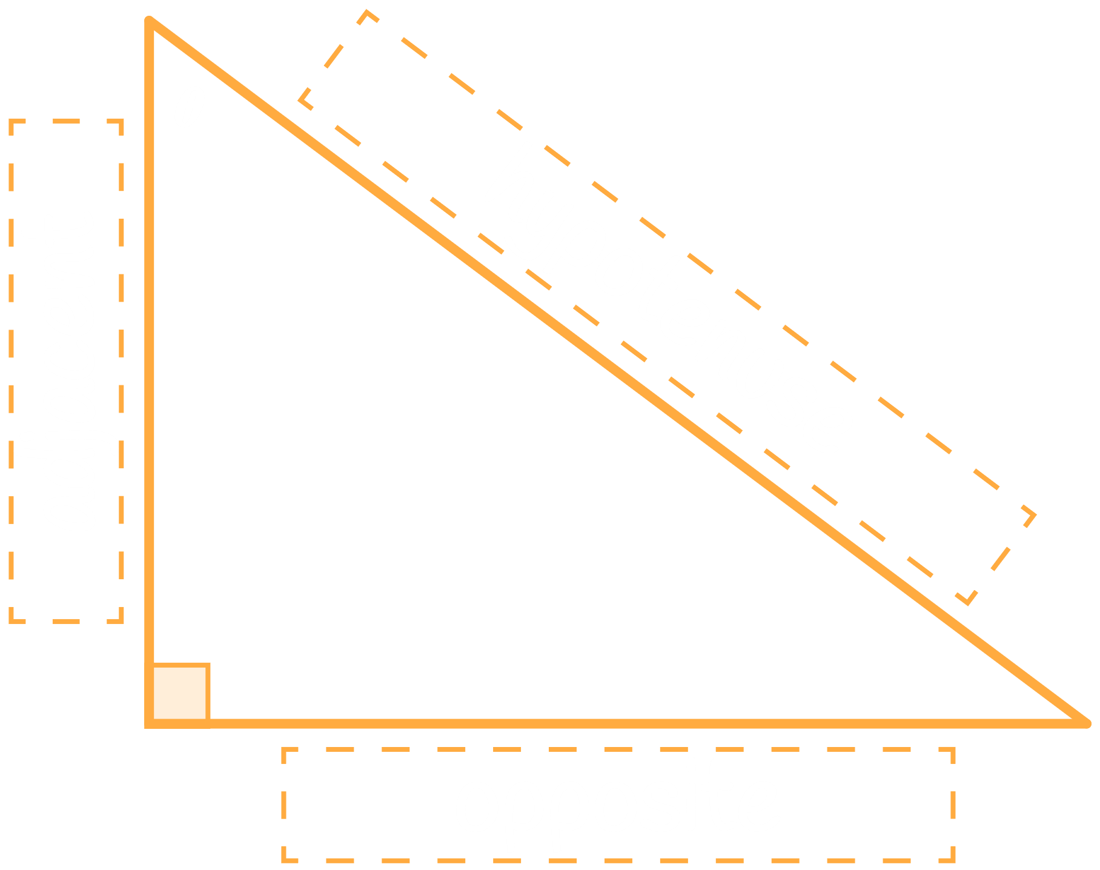
How I Know It: Triangle 2
Notes:
K20 Center. (n.d.). How I Know It. Strategies. https://learn.k20center.ou.edu/strategy/144

Slide 8
Guided Notes: Right Triangle Trigonometry
The sine of the angle is the ratio of the opposite side to the hypotenuse.

Slide 9
Guided Notes: Right Triangle Trigonometry
The cosine of the angle is the ratio of the adjacent side to the hypotenuse.

Slide 10
Guided Notes: Right Triangle Trigonometry
The tangent of the angle is the ratio of the opposite side to the adjacent side.

Slide 11
Guided Notes
Let’s complete the Guided Notes together.

Slide 12
Find the Unknown Value (Question 1)
In right triangle ΔABC, where B is the right angle, AB = 8 inches, and sinC = 4/7. What is the value of cosA?

Slide 13
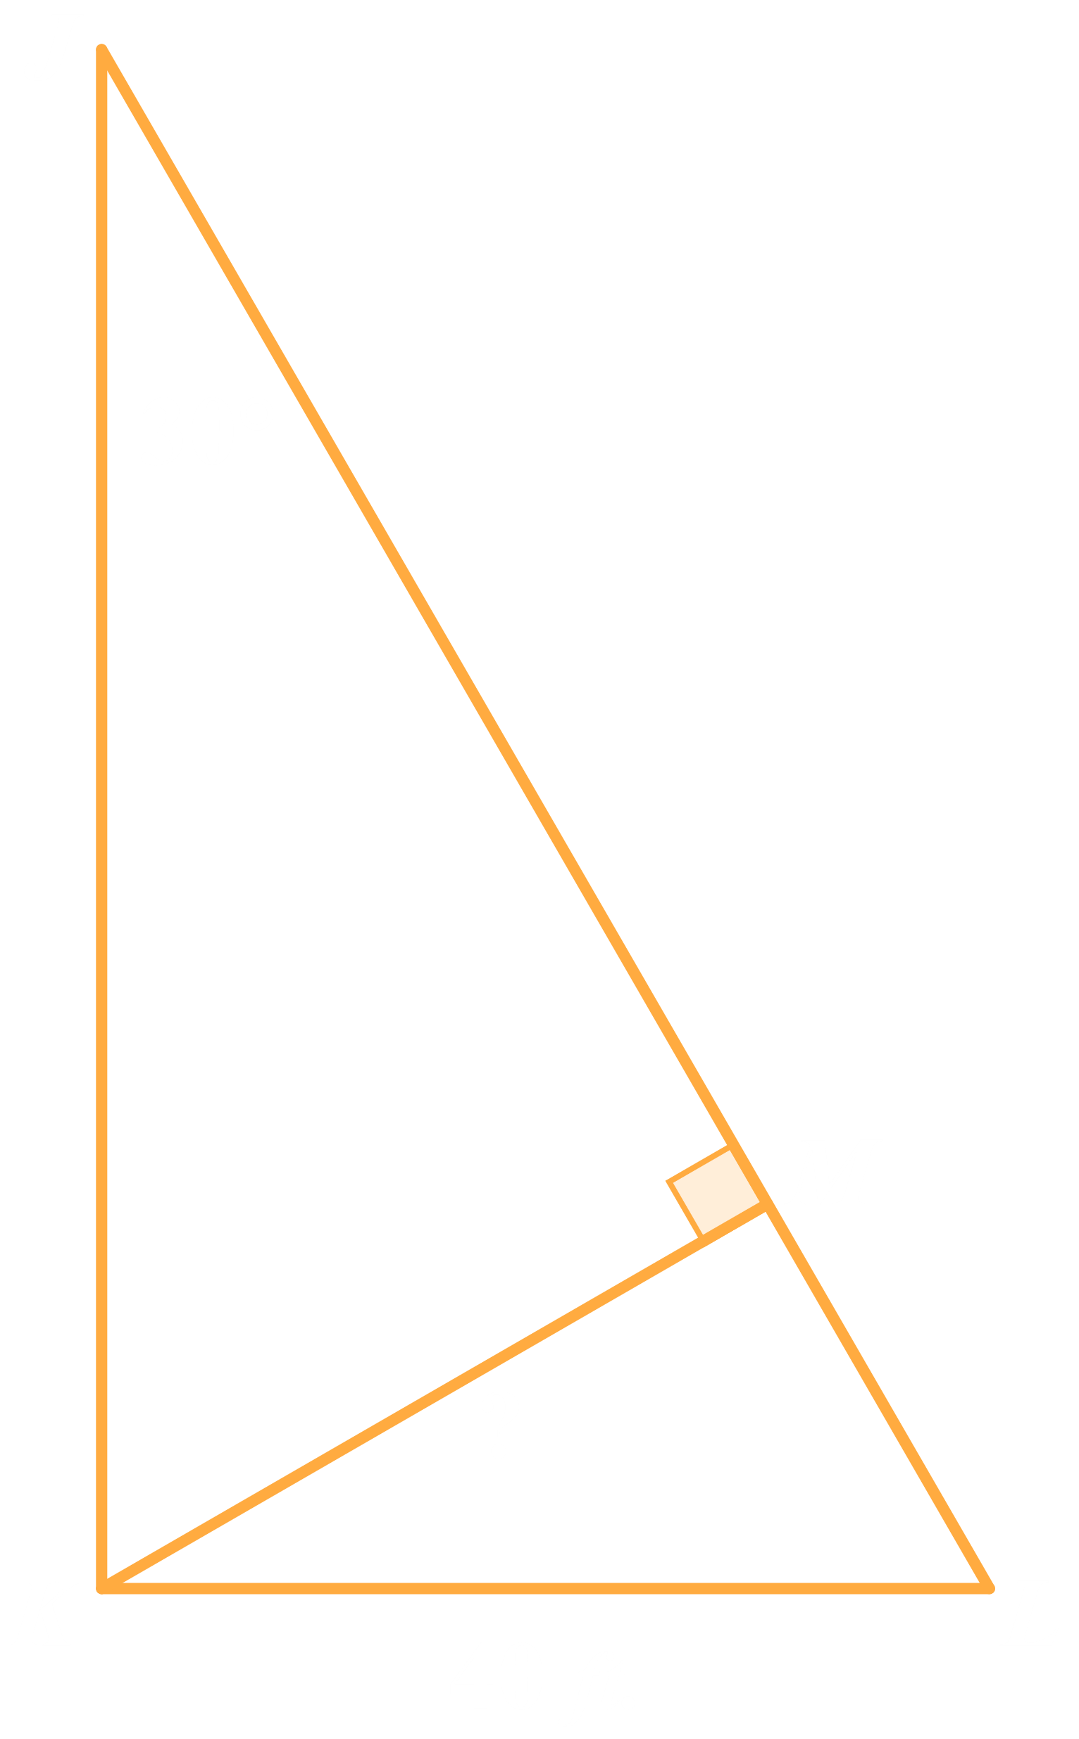
Find the Unknown Value (Question 2)
m∠JKM = 60°.
Since m∠JKL = 90°, m∠MKL = 30°.

Slide 14
Exit Ticket
Leave your paper face down until the timer starts.
5-Minute Timer
Notes:
K20 Center. (n.d.). Bell Ringers and Exit Tickets. Strategies. https://learn.k20center.ou.edu/strategy/125
K20 Center. (2021, September 21). K20 Center 5 minute timer. [Video]. YouTube. https://youtu.be/EVS_yYQoLJg?si=fJvuvFWH3vJ3B0z9

Slide 15
Exit Ticket (Answers)
E
H
D
H
E
How well did you do?
Remember, it is 100% okay to not get 100% of the questions correct on the ACT.
Notes:
K20 Center. (n.d.). Bell Ringers and Exit Tickets. Strategies. https://learn.k20center.ou.edu/strategy/125

Slide 16
Exit Ticket (Solution 1)
In ΔDEF…, cosF = 3/4 and EF is 6 cm. What is DF…?

Slide 17
Exit Ticket (Solution 2)
For an angle with measure θ in a right triangle, cosθ = 5/13 and tanθ = 12/5. What is the value of sinθ?

Slide 18
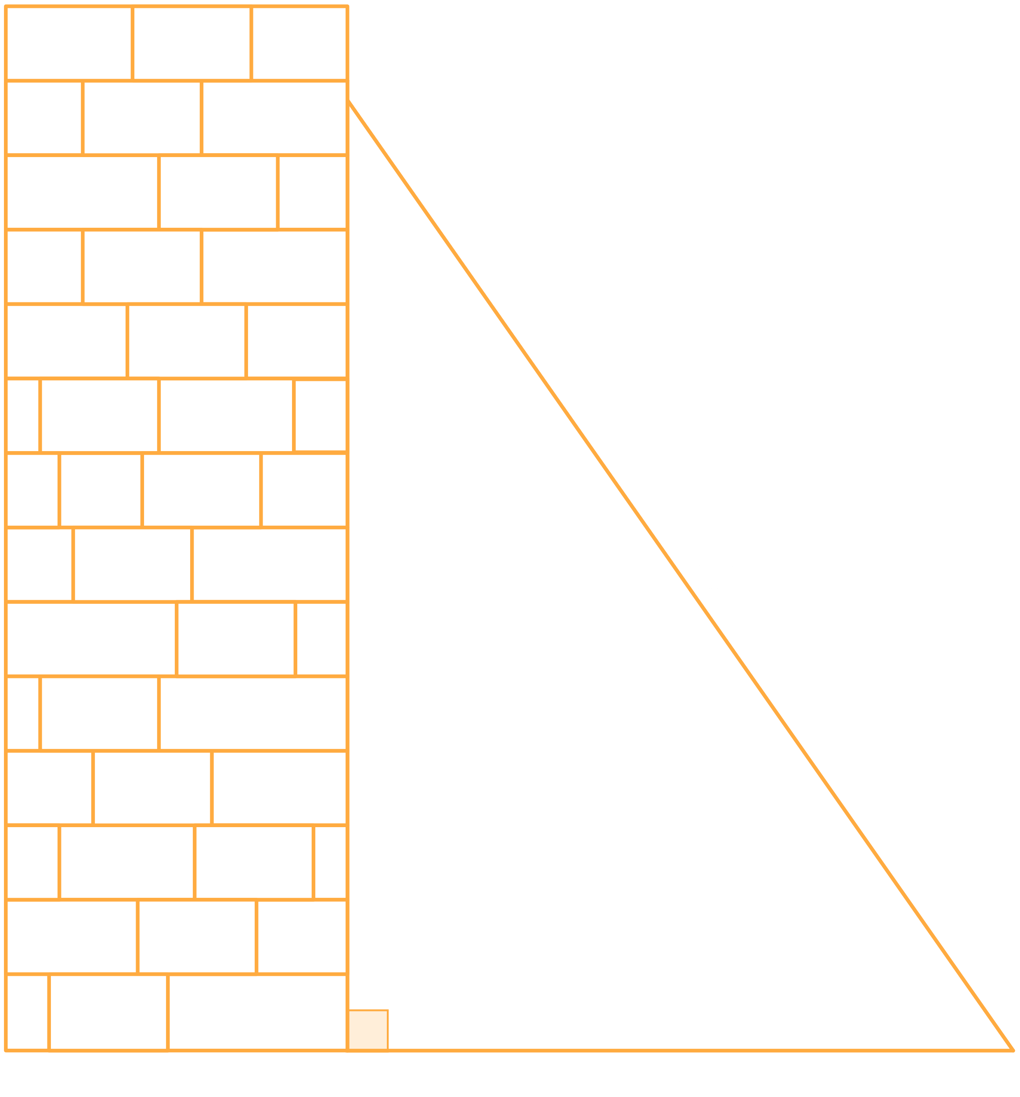
Exit Ticket (Solution 3)
…, a 12-foot ladder forms an angle of 55° with the level ground ... The distance, in feet, between the bottom of the ladder and the building …?

Slide 19
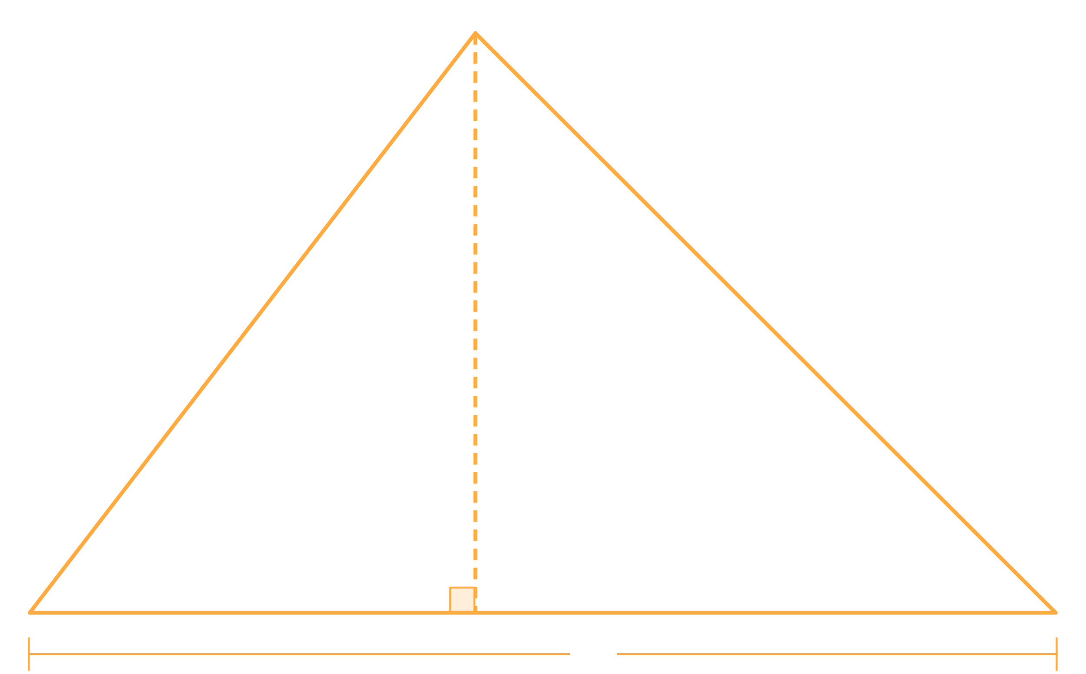
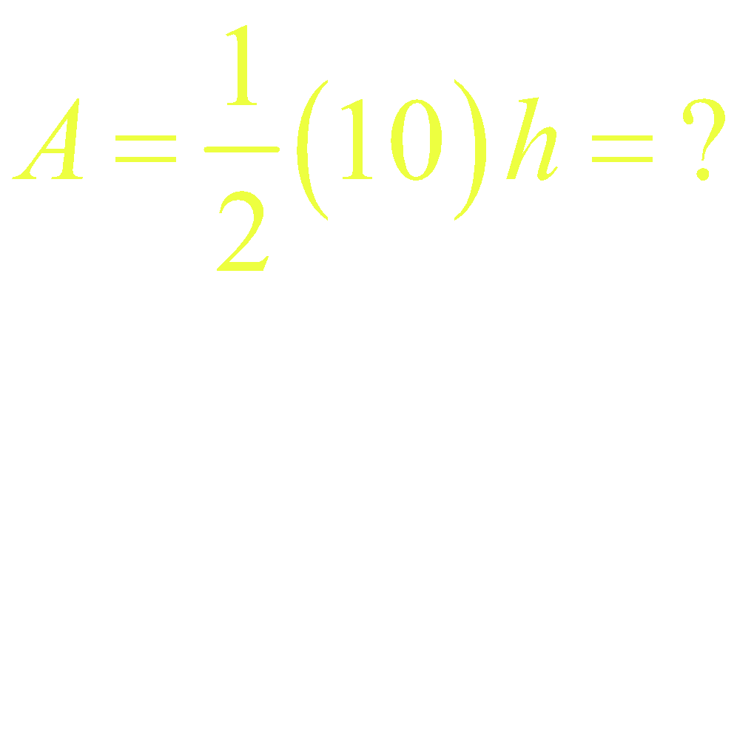
Exit Ticket (Solution 4)
…. What is the area, in square inches, of ΔJKL?

Slide 20
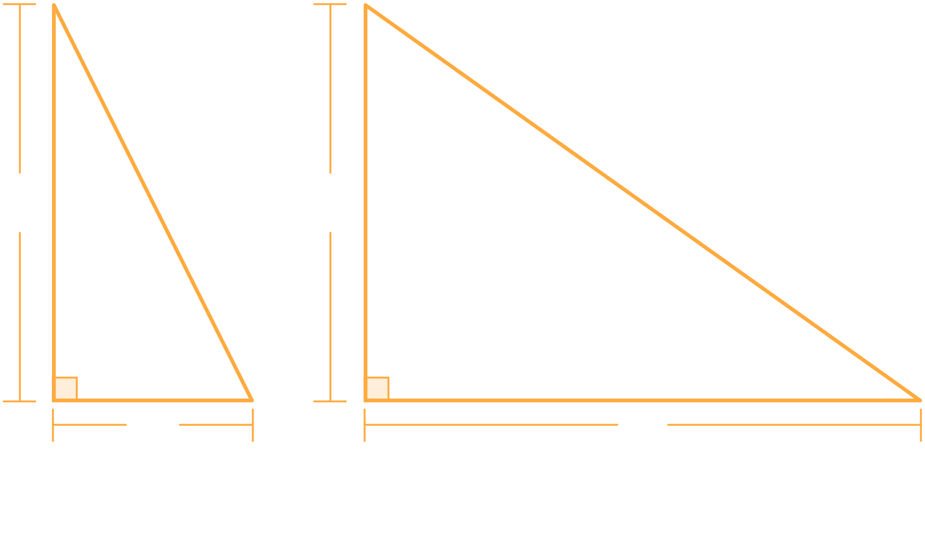
Exit Ticket (Solution 5)
A 20-foot-tall flagpole casts a shadow at 2:00 p.m. that extends 10 feet horizontally ... Then at 4:00 p.m., the shadow extends to 28 feet horizontally ... Which of the following expressions equals the positive difference in the measures of the angle of elevation from the end of the shadow to the top of the flagpole at 2:00 p.m. and at 4:00 p.m.?

Slide 21
Exit Ticket (Solution 5)

Slide 22
You Powered Up!
Achievement Unlocked: Right Triangle Trigonometry

Slide 23
ACT: State Testing and National Testing
State Testing: In states requiring high school students to take the ACT, the exam must be offered during the school day at the school.
National Testing: These are exams offered on Saturdays and are given on the same date at several locations. Sign up early to get your preferred location.

Slide 24
ACT: State Testing
Be ready for state testing in April!
Study, practice, and prepare between now and then.
Your April score can be used towards college admissions and scholarship applications. Do your best!

Slide 25
ACT: Superscoring
Why take the ACT more than once?
You can average your best scores from each subject area to create a higher composite score: a superscore!
Remember, you can unlock admission into colleges and universities and scholarships the higher you score.

Slide 26
ACT: National Testing
The ACT is offered multiple times a year at many different locations.
Search for “ACT test dates” and select the link that will send you to the official ACT website: www.act.org/....
Find the table of information about national test dates.

Slide 27
ACT: National Testing
To take this test, register by this date.
Test Date | Regular Registration Deadline | Late Registration Deadline | Photo Upload and Standby Deadline
June 14, 2025 | May 9 | May 27 | June 6
July 12, 2025 | June 6 | June 20 | July 4
… | … | … | …
Register by May 9th to take the ACT on June 14th.

Slide 28
ACT: National Testing
Tests are usually offered each year during the following months:
February
April
June
July
September
October
December
Plan ahead and don’t wait until the last minute to register. Avoid paying late registration fees!

Slide 29
ACT: National Testing
Test Information Release (TIR): This is a copy of the multiple-choice ACT with your answers and a copy of the correct answers. It can also include the prompt and grading rubric for the writing portion with your scores.
If you qualify for a fee waiver, this is free. Ask your school counselor to see if you are eligible.

