Slide 2
Power Up: English ACT Prep, Week 2
Usage

Slide 3

This Is Not Quite Right…
With a partner, discuss the memes on the
following slides.
Determine what is “not quite right” with each meme.
Write your observations on a piece of paper.
Notes:
K20 Center. (n.d.). Bell Ringers and Exit Tickets. Strategies. https://learn.k20center.ou.edu/strategy/125

Slide 4

This Is Not Quite Right…
Notes:
K20 Center. (n.d.). Bell Ringers and Exit Tickets. Strategies. https://learn.k20center.ou.edu/strategy/125

Slide 5

This Is Not Quite Right…
Notes:
K20 Center. (n.d.). Bell Ringers and Exit Tickets. Strategies. https://learn.k20center.ou.edu/strategy/125

Slide 6

This Is Not Quite Right…
Notes:
K20 Center. (n.d.). Bell Ringers and Exit Tickets. Strategies. https://learn.k20center.ou.edu/strategy/125

Slide 7
Essential Question
How can I increase my ACT score?

Slide 8
Learning Objectives
Apply rules of word usage, subject-verb agreements, verb tenses, comparatives and superlatives, and reflexive pronouns to write conventional English.
Identify when these rules are broken.

Slide 9
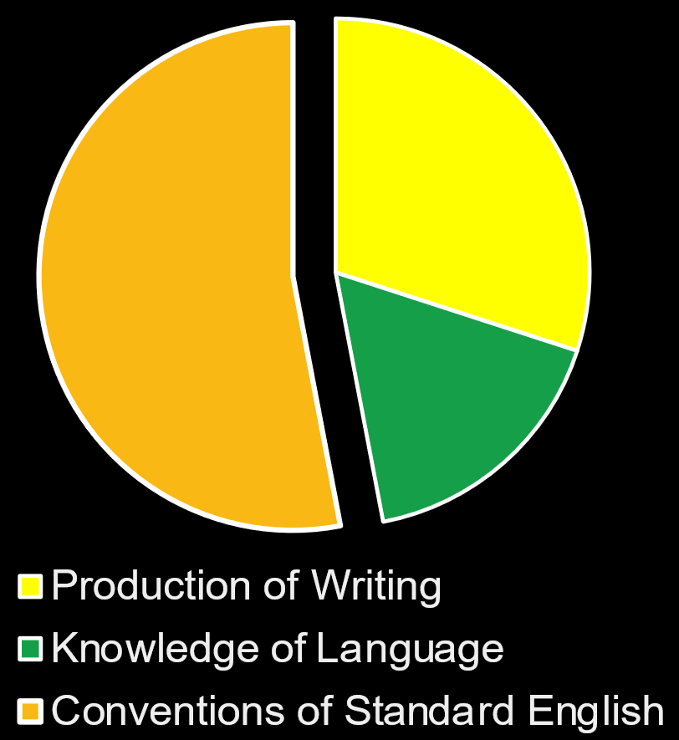
Why Does Usage Matter?
Conventions of Standard English:
Sentence Structure and Format
Punctuation
Usage
Notes:
Description of english test. ACT. (n.d.). https://www.act.org/content/act/en/products-and-services/the-act/test-preparation/description-of-english-test.html

Slide 10
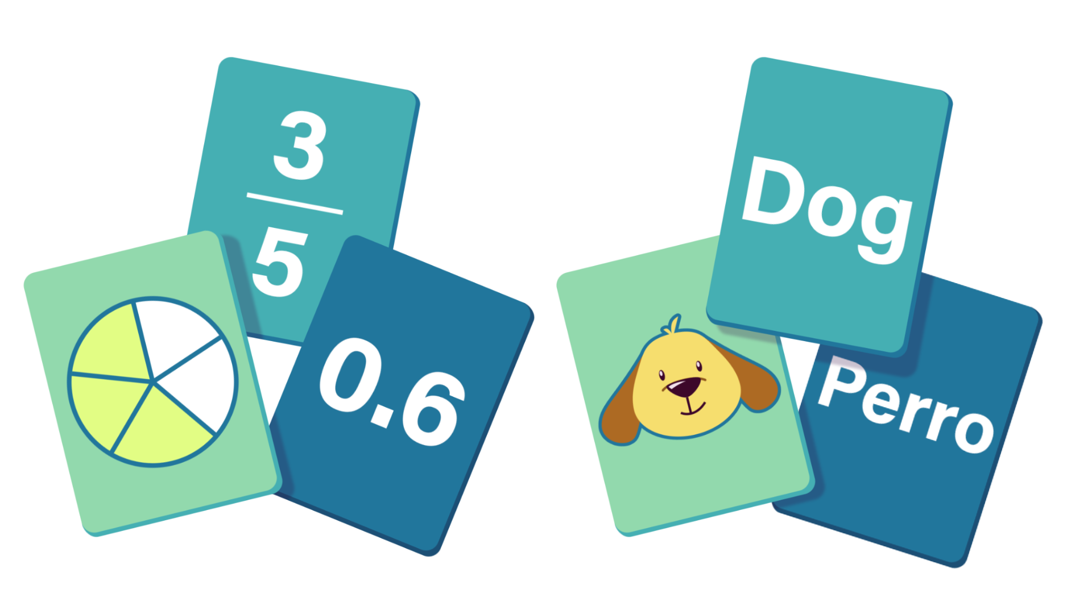
Card Matching
Go to student.desmos.com and use the session code created by your teacher to access the activity.
You do not need to sign in or create an account.
Complete the card matching activity with your partner.
After matching the cards correctly, write the example on your Skill Sets Check handout.
Notes:
K20 Center. (n.d.). Card Matching. Strategies. https://learn.k20center.ou.edu/strategy/1837
K20 Center. (n.d.). Desmos Classroom. Tech tools. https://learn.k20center.ou.edu/tech-tool/1081

Slide 11


Desmos Screen 1 | Check-In
Word Usage | There in the hills is where her dog ran.
Notes:
K20 Center. (n.d.). Card Matching. Strategies. https://learn.k20center.ou.edu/strategy/1837
K20 Center. (n.d.). Desmos Classroom. Tech tools. https://learn.k20center.ou.edu/tech-tool/1081

Slide 12
Desmos Screen 1 | Reasoning
Example | Non-Example | Rationale
There in the hills is where her dog ran. | Their in the hills is where her dog ran. | There - a place ✔️ Their - belongs to them ❌

Slide 13
Rule | Explanation | Other Examples
Word Usage | Use the appropriate word in frequently confused pairs. | To, two, too Their, there, they’re Accept, except Past, passed Effect, affect
Notes:
K20 Center. (n.d.). Card Matching. Strategies. https://learn.k20center.ou.edu/strategy/1837
K20 Center. (n.d.). Desmos Classroom. Tech tools. https://learn.k20center.ou.edu/tech-tool/1081

Slide 14
Desmos Screen 2 | Check-In
Subject-Verb Agreement | Today, they are walking to the gym after school.
Irregular Verb Patterns | He led the way to the car.
Comparatives and Superlatives | She has the best hair style.
Notes:
K20 Center. (n.d.). Card Matching. Strategies. https://learn.k20center.ou.edu/strategy/1837

Slide 15
Desmos Screen 2 | Reasoning
Example | Non-Example | Rationale
Today, they are walking to the gym after school. | Today they is walking to the gym after school. | They - plural, is - singular ❌ they - plural, are - plural ✔️
He led the way to the car. | She lead us to the waterfall. | The sentence is past tense. Led - past tense of to lead ✔️ Lead - present tense ❌
She has the best hair style. | He is the bestest puppy in the world. | Best - superlative ✔️ Bestest is not a word ❌

Slide 16
Rule | Explanation | Other Examples
Subject-Verb Agreement | If a subject is singular, use the singular form of the verb. If the subject is plural use the plural form of the verb. | The film is funny. The films are funny. A bouquet of roses is beautiful.
Irregular Verb Patterns | Verbs that do not follow the normal pattern for tense and past participle. | Base, Based, Based Sing, Sang, Sung Write, Wrote, Written
Comparatives and Superlatives | In general, comparative adjectives end in -er or use the words more or less. Superlative adjectives end in -est or use the words most and least. | Tall, taller, tallest Healthy, healthier, healthiest Good, better, best Little, less, least
Notes:
K20 Center. (n.d.). Card Matching. Strategies. https://learn.k20center.ou.edu/strategy/1837
K20 Center. (n.d.). Desmos Classroom. Tech tools. https://learn.k20center.ou.edu/tech-tool/1081

Slide 17
Desmos Screen 3 | Check-In
Who vs. Whom | Jake, who is the star athlete, asked me out.
Simple and Compound Verb Tenses | They would have gone out last night if it hadn’t rained.
Reflexive Pronouns | Joel doesn’t like his new hairstyle.
Notes:
K20 Center. (n.d.). Card Matching. Strategies. https://learn.k20center.ou.edu/strategy/1837

Slide 18
Desmos Screen 3| Reasoning
Example | Non-Example | Rationale
Jake, who is the star athlete, asked me out. | To who are you referring? | Who refers to Jake - who is subject of clause ✔️ Who refers to the person which Whom - object of clause ❌
They would have gone out last night if it hadn’t rained. | I would of gone to the dance, but I was too nervous. | Would have ✔️ Would of ❌
Joel doesn’t like his new hairstyle. | Each family and business must do their part to help the environment | Joel - singular, his - singular ✔️ Each - singular, their - plural ❌

Slide 19
Rule | Explanation | Other Examples
Who vs. Whom | Who is used as the subject of the sentence. Whom is used as the object of the sentence. | Who wants a slice of cake? Whom do you believe? Kamala, the lady to whom you wrote a letter, sent you a note.
Simple and Compound Verb Tenses | Verbs that do not follow the normal pattern for tense and past participle. | Base, Based, Based Sing, Sang, Sung
Reflexive Pronouns | When referring to the subject, use the correct reflexive pronoun, such as I ← myself we ← ourselves. | I like myself in this outfit. Rahim shook himself awake. We are learning to speak Spanish by ourselves.
Notes:
K20 Center. (n.d.). Card Matching. Strategies. https://learn.k20center.ou.edu/strategy/1837
K20 Center. (n.d.). Desmos Classroom. Tech tools. https://learn.k20center.ou.edu/tech-tool/1081

Slide 20
Desmos Screen 4| Reasoning
Example | Non-Example | Rationale
Jane, a first-time college professor, took a wrong turn and ended up on the other side of campus. | They, an environmental activist group, protests on the side of the street every day. | Jane - singular, took - singular ✔️ They - plural, protests - singular ❌
The group must sign their contracts tomorrow. | The group must present their research tomorrow. | Group - plural (each indiv together), their - plural ✔️ Group - singular (one group), their - plural ❌
I can rely on her for support. | I can count on her to support me. | Rely ✔️ Count on her ❌

Slide 21
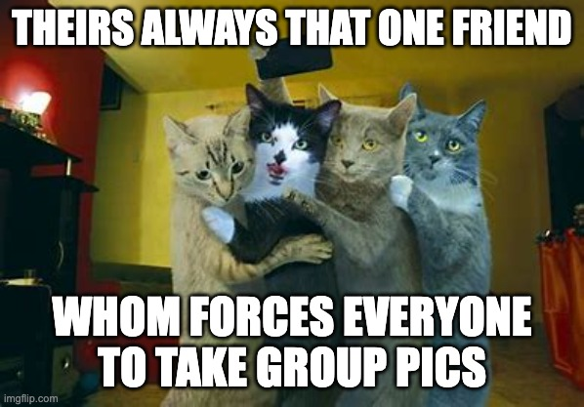
This Is Not Quite Right…

Slide 22

You Powered Up!
Side Quest: Before next time find or use who or whom properly in conversation!
Sneak Peek: Next time we will be learning about punctuation errors specifically how to use commas.

