Slide 2
Power Up: English ACT Prep Week 3
Punctuation

Slide 3
Grammar Fails…
With a partner, discuss the real-world examples on the following slides.
Determine what the “grammar fail” is with each image.
Write your observations on a piece of paper.
Notes:
K20 Center. (n.d.). Bell Ringers and Exit Tickets. Strategies. https://learn.k20center.ou.edu/strategy/125

Slide 4
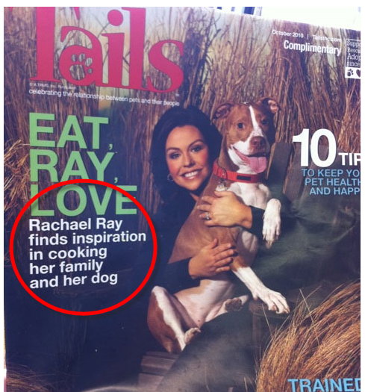
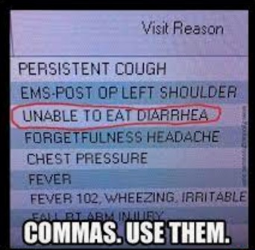
Real-World Grammar Fails
Example 1
Example 2
Notes:
A light-hearted look at how punctuation can change meaning. CyberText Newsletter. (2012, November 22). https://cybertext.wordpress.com/2012/11/22/a-light-hearted-look-at-how-punctuation-can-change-meaning/
K20 Center. (n.d.). Bell Ringers and Exit Tickets. Strategies. https://learn.k20center.ou.edu/strategy/125

Slide 5
Real-World Grammar Fails
Example 3
Example 4
Notes:
K20 Center. (n.d.). Bell ringers and exit tickets. Strategies. https://learn.k20center.ou.edu/strategy/125
Example 3: Apostrophe usage. Miss Ohl Loves Grammar. (2011, December 9). https://missohllovesgrammar.wordpress.com/apostrophe-usage/
Example 4: Rotner, J. (2017, November 15). Unnecessary commas & common comma mistakes. Elite Editing. https://eliteediting.com/resources/comma-mistakes/

Slide 6
Essential Question
How can I increase my ACT score?

Slide 7
Learning Objectives
Apply proper use of apostrophes, commas, colons, and semicolons in real-world scenarios.
Identify when these rules are broken.

Slide 8
Why Does Punctuation Matter?
Conventions of Standard English:
Sentence Structure and Format
Punctuation
Usage
Notes:
Description of english test. ACT. (n.d.). https://www.act.org/content/act/en/products-and-services/the-act/test-preparation/description-of-english-test.

Slide 9
Check your work
Extra Commas | ✔️Randy likes, cake.
Items in a series | ✔️I like cooking, my family, and my pets.
Misplaced Commas | ✔️Joe plays soccer, because he’s fast.

Slide 10
Check your work
Apostrophes ≠ Plurals | ✔️She collects button’s.
Introductory Elements | ✔️When she was a little girl, Josie played football.
Parenthetical Elements | ✔️Megan, my best friend, is a senior in high school.

Slide 11
Check your work
Colons ( : ) | ✔️These are my favorite colleges: BYU, OU, and OSU.
Semicolons ( ; ) | ✔️The shoe is red, the sock is blue.
;

Slide 12
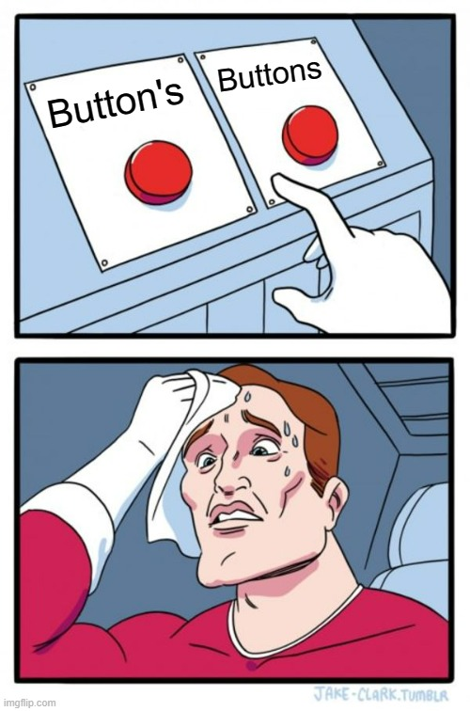
What Do You Meme? Overview
Create a meme breaking your assigned rule.
Upload your meme and rationale to Padlet.
Use peers’ memes to complete your Skill Sets Check handout.
Notes:
K20 Center. (n.d.). What Do You Meme?. Strategies. https://learn.k20center.ou.edu/strategy/984

Slide 13
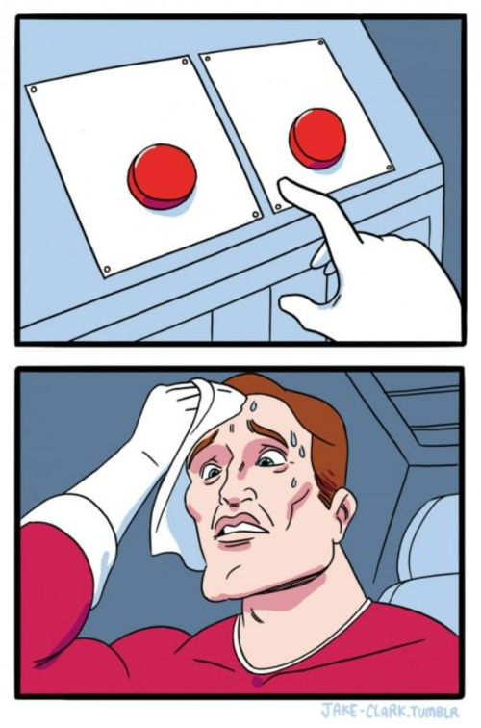
What Do You Meme?
Independently create a meme that breaks your assigned rule.
Choose a template.
Either go to
imgflip.com/memegenerator/Two-Buttons
imgflip.com/memegenerator/Ancient-Aliens
Write text that illustrates your rule being broken.
Notes:
K20 Center. (n.d.). What Do You Meme?. Strategies. https://learn.k20center.ou.edu/strategy/984
K20 Center. (n.d.). Padlet. Tech Tool. https://learn.k20center.ou.edu/tech-tool/1077

Slide 14
What Do You Meme?
Now upload your meme on Padlet.
On imgflip, click Generate Meme.
Copy Image Link.
Go to <insert Padlet URL> or scan the QR code.
Notes:
K20 Center. (n.d.). What do you meme?. Strategies. https://learn.k20center.ou.edu/strategy/984
K20 Center. (n.d.). Padlet. Tech Tool. https://learn.k20center.ou.edu/tech-tool/1077

Slide 15
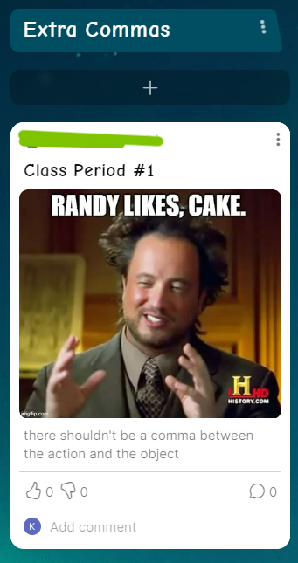
What Do You Meme?
Click the + button.
Click the button to add your image link.
Add text before you post:
Subject = Class Period
Caption = Your Rationale
Drag you post and add under your assigned rule.
Notes:
K20 Center. (n.d.). What Do You Meme?. Strategies. https://learn.k20center.ou.edu/strategy/984
K20 Center. (n.d.). Padlet. Tech Tool. https://learn.k20center.ou.edu/tech-tool/1077

Slide 16
What Do You Meme?
Add your non-example sentence to your Skill Sets Check handout in the “examples” column next to your assigned rule.
Fix the non-example by marking out or adding the correct punctuation as needed.
Find other non-examples from the Padlet to add in other blank spaces and fix them.
Notes:
K20 Center. (n.d.). What Do You Meme?. Strategies. https://learn.k20center.ou.edu/strategy/984
K20 Center. (n.d.). Padlet. Tech Tool. https://learn.k20center.ou.edu/tech-tool/1077

Slide 17
ACT English Subject Test Tip
Instructions - Read the adapted instructions now so that you don’t waste time during the actual test!
Become familiar with how the instructions are worded.
Ask questions now if you don’t understand what it’s asking for so you don’t struggle on test day.
*Note: The instructions provided on the handout are not verbatim of those on the ACT. They do capture the same information.

Slide 18
Test Your Skills!
You have 5 minutes to read and answer the questions in the provided passage.
K20 5 Minute Timer
Notes:
K20 Center. (2021, September 21). K20 Center 5 minute timer. YouTube. https://youtu.be/EVS_yYQoLJg?si=wcujcbaPeJerW46d

Slide 19
“Anita Garibaldi” | Reflection
Question | Correct Answer | Explanation
1 | D | Use punctuation in straightforward situations, such as simple items in a series.
2 | F | Use commas to set off simple parenthetical elements.
3 | C | Delete commas that markedly disturb sentence flow.
4 | J | Delete commas that create basic sense problems.

Slide 20
“Anita Garibaldi” | Reflection
Question | Correct Answer | Explanation
5 | C | Delete apostrophes used incorrectly to form plural nouns.
6 | F | Delete commas that markedly disturb sentence flow.
7 | C | Recognize and correct inappropriate uses of colons and semicolons.

Slide 21
You Powered Up!
Side Quest: Before next time fill in the remaining example spaces on your Skill Sets Check handout!
Sneak Peek: Next time we will focus on Sentence Structure, Fragments, and Verb Tense Shifts.

