Slide 2
Power Up: English ACT Prep Week 4
Sentence Structure + Format

Slide 3
Essential Question
How can I raise my ACT score?

Slide 4
Learning Objectives
Categorize different instances of fragments, verb tense shifts, and sentence structure errors.
Identify when fragments, verb tense shifts, and sentence structure rules are broken.

Slide 5
Why Does Punctuation Matter?
Conventions of Standard English:
Sentence Structure and Format
Punctuation
Usage
Notes:
Description of English test. ACT. (n.d.). https://www.act.org/content/act/en/products-and-services/the-act/test-preparation/description-of-english-test.

Slide 6
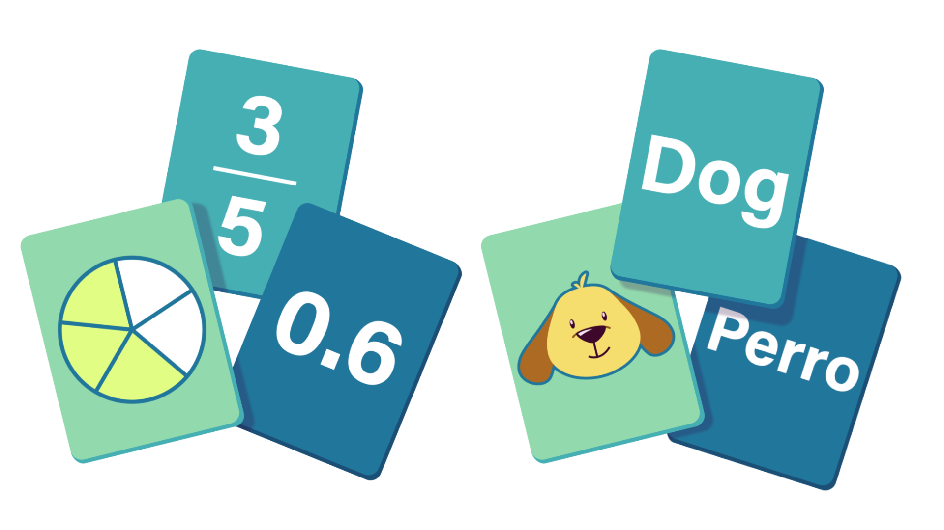
Card Matching
Read your given card.
Create a small group with matching cards:
Explanation card
Example(s) card(s)
Which rule applies to your group? Stand next to your rule.
Fragments
Verb Tense
Sentence Structure
Notes:
K20 Center. (n.d.). Card Matching. Strategies. https://learn.k20center.ou.edu/strategy/1837

Slide 7
Find Your Group + Rule
K20 Center 3 Minute Timer
Notes:
K20 Center. (2021, September 21). K20 Center 3 minute timer. YouTube. https://youtu.be/iISP02KPau0?feature=shared

Slide 8
Rule: Fragments
Watch the video.
Write notes on the rule.
Check to see if you are in the right group.
Fragments
Notes:
Stop at 2:40.
Kevin Spaans. (2021). Sentences, Fragments, & Run-Ons. YouTube. https://www.youtube.com/watch?v=GJZzAaexLd4.

Slide 9
Rearrange Yourself as Needed
K20 Center 3 Minute Timer
Notes:
K20 Center. (2021, September 21). K20 Center 3 minute timer. YouTube. https://youtu.be/iISP02KPau0?feature=shared

Slide 10
Rule: Verb Tense Shifts
Watch the video.
Write notes on the rule.
Check to see if you are in the right group.
Verb Tense Shifts
Notes:
We suggest changing the speed from “normal” to “0.75” to help students follow along easier.
FYC at USF. (2013). CC-Style & Grammar | Verb Tense Shifts. YouTube. https://youtu.be/mkAbVuuXVcQ?feature=shared.

Slide 11
Rearrange Yourself as Needed
K20 Center 2 Minute Timer
Notes:
K20 Center. (2021, September 21). K20 Center 2 minute timer. YouTube. https://youtu.be/HcEEAnwOt2c?feature=shared

Slide 12
Rule: Sentence Structure
Watch the video.
Write notes on the rule.
Check to see if you are in the right group.
Sentence Structure
Notes:
Stop the video at 3:16.
Chegg. (2017). ACT English: Sentence Structure. YouTube. https://youtu.be/o-3bu54h4EU?feature=shared&t=48.

Slide 13
Answers | Fragments
Explanations | Examples
Noun participial phrase fragments often begin with a word ending in “ing” or “ed,” which results in a missing main clause. | ❌Jumping over the puddle. ✔️Children are jumping over the puddle.
Fix awkward-sounding fragments or run-ons with correct punctuation or conjunctions. | ❌The pin is hers, the hat is mine. ✔️The pin is hers, and the hat is mine.

Slide 14
Answers | Verb Tense
Explanations | Examples
Make sure verb tense and voice between simple clauses, simple adjoining sentences, and entire sentences match the subject (s). | ❌Yesterday, I went to Sarah's place and I take an Uber. ✔️Yesterday, I went to Sarah's place and I took an Uber.
Use consistent and logical verb tense and pronoun references throughout the entire work. | ❌School dress codes were not adopted in the US until 1969, but the basic idea for such a system has been proposed years earlier. ✔️School dress codes were not adopted in the US until 1969, but the basic idea for such a system had been proposed years earlier.

Slide 15
Answers | Sentence Structure
Explanations | Examples
A misplaced modifier is placed too far from the word(s) it adds meaning to. | ❌She wore a bicycle helmet on her head that was too large. ✔️She wore a bicycle helmet that was too large for her head.
Parallelisms repeat grammatical elements (like noun/verb phrases) to create and emphasize memorable phrases and flow. | ❌Strategy for developing speaking skills includes using minimal response, how to recognize scripts, and using language to discuss language. ✔️Strategy for developing speaking skills includes using minimal response, recognizing scripts, and using language to discuss language.

Slide 16
Answers | Sentence Structure
Explanations | Examples
Join simple sentences with punctuation or conjunctions. | ❌I’m looking forward to meeting you. I hope it will be fun. ✔️I’m looking forward to meeting you and I hope it will be fun.
Put adjectives in this order: opinion-size-age-shape-color-origin-material-purpose. | ❌The blue square, large box is mine. ✔️The large square, blue box is mine.
Pronoun agreement must match the noun it replaces in number, place, and gender. | ❌Alice, that does my hair, has moved to another hairdresser. ✔️Alice, who does my hair, has moved to another hairdresser.

Slide 17
Answers | Sentence Structure
Explanations | Examples
Dangling modifiers are words, phrases, or clauses that describe something that has been left out of the sentence. | ❌While walking to work, a taxi ran a stop sign. ✔️While walking to work, I saw a taxi ran a stop sign.
Coordination links words, clauses, or sentences of equal type/importance, while subordination emphasizes which are most important. | ❌LaTosha enjoyed those special moments when a group of students who also came from Northern Oklahoma visited her dorm, which was lonely for most of the school year. ✔️Because LaTosha’s dorm was lonely most of the school year, she enjoyed those special moments when a group of students who also were from Northern Oklahoma would visit.

Slide 18
Extras | Answer Key
Rule | Explanations | Examples
Fragments | Noun participial phrase fragments | ❌Went to dinner after the game. ✔️We went to dinner after the game. ❌Swimming in the crystal-clear water. ✔️We went swimming in the crystal-clear water. ❌Dancing under the stars. ✔️We are dancing under the stars.
 | Fix awkward-sounding fragments or run-ons | ❌After the tennis match, Jamal celebrated with his family, he also hung out with friends. ✔️After the tennis match, Jamal celebrated with his family and hung out with friends. ❌I wanted to go to the store for groceries I also wanted to get some snacks for the party tonight. ✔️I wanted to go to the store for groceries, but I also wanted to get some snacks for the party tonight.

Slide 19
Extras | Answer Key
Rule | Explanations | Examples
Verb Tense Shifts | Use consistent and logical verb tense throughout a work | ❌I detangle my hair, and I screamed. ✔️I detangled my hair, and I screamed. ❌Derek always neglects the trash, so his wife dragged the can to the curb. ✔️Derek always neglects the trash, so his wife drags the can to the curb. ❌She will visit her grandmother tomorrow, who she see every weekend. ✔️She will visit her grandmother tomorrow, who she has seen every weekend. ❌They have went to the store. ✔️They have gone to the store.

Slide 20
Extras | Answer Key
Rule | Explanations | Examples
Sentence Structure | Parallelism | ❌She likes cooking, jogging, and to read. ✔️She likes cooking, jogging, and reading.
 | Join simple sentences | ❌We ate pasta for dinner. We also ate salad. ✔️We ate pasta and salad for dinner. ❌He wanted to go for a walk, he couldn't find his shoes. ✔️He wanted to go for a walk, but he couldn't find his shoes. ❌I love chocolate. I also enjoy vanilla ice cream. ✔️I love chocolate, but I also enjoy vanilla ice cream.
 | Order of adjectives | ❌They stayed at a luxurious European old hotel. ✔️They stayed at a luxurious old European hotel.

Slide 21
ACT English Subject Tips
Answer Choices
It’s okay to choose “NO CHANGE” as it is just as likely to be correct as any other option.
If you’re running out of time or just don’t know the answer, make an educated guess. “Often, the most concise answer is the correct one” compared to the longer wordier answer choices.
Notes:
Description of English test. ACT. (n.d.). https://www.act.org/content/act/en/products-and-services/the-act/test-preparation/description-of-english-test.html
Sult, E. P., & Piqosity. (2021, October 20). ACT English Strategies. Piqosity. https://www.piqosity.com/act-english-strategies-tips/#:~:text=The%20first%20answer%20to%20many,least%20some%20of%20the%20answers.
Sult, E. P., & Piqosity. (2021, October 20). ACT English Strategies. Piqosity. https://www.piqosity.com/act-english-strategies-tips/#:~:text=The%20first%20answer%20to%20many,least%20some%20of%20the%20answers.

Slide 22
Test Your Skills!
You have 7 minutes to read and answer the questions in the provided passage.
K20 Center 7 Minute Timer
Notes:
K20 Center. (2021, September 21). K20 Center 7 minute timer. YouTube. https://youtu.be/gWwvdLxwV9c?feature=shared

Slide 23
You Powered Up!
Side Quest: Listen for sentence fragments in everyday speech, posts, or other forms of communication. Write down the corrected form.
Sneak Peek: Next time we will be reviewing all that we have learned about the Conventions of Standard English. So be sure to bring your Skill Sets Check handouts!

Slide 24
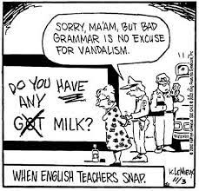
Side Quest Example
Side Quest: Listen for sentence fragments in everyday speech, posts, or other forms of communication. Write down the corrected form.
WARNING: Correcting people aloud or virtually may cause unforeseen hardships for you!

