Slide 2
Power Up: English ACT Prep, Week 5
Review

Slide 3
“White Water Worrier” | Reflection
Question | Correct Answer | Explanation
1 | B | Sentence Structure: This is a comma splice, and one way to fix a comma splice is to make it two separate sentences using the correct punctuation.
2 | E | Punctuation: The colon was used incorrectly. It should be a semi-colon, which connects two independent clauses into one sentence.
3 | C | Punctuation: The colon was used incorrectly. Colons are used to list items or to introduce a quote.
4 | G | Usage: The verb tense in is incorrect. It should be “want.”

Slide 4
“White Water Worrier” | Reflection
Question | Correct Answer | Explanation
5 | B | Sentence Structure: A dependent phrase that begins with “because” must connect to an independent clause for it to be a full sentence.
6 | F | Sentence Structure: This is a comma splice. It should be separated into two complete sentences using the correct punctuation.
7 | C | Sentence Structure: This is a run-on. Separate the sentences into two using the correct punctuation.

Slide 5
Essential Question
How can I increase my ACT score?

Slide 6
Learning Objectives
Recognize the type of question on the English portion of the ACT.
Understand what the type of question is asking for to more quickly answer questions.
Notes:
The types of questions will all be Conventions of Standard English: sentence structure and formation, punctuation, and usage, see slide 7.

Slide 7
LEVEL UP!
Conventions of Standard English:
Sentence Structure and Format
Punctuation
Usage
Notes:
Description of English test. ACT. (n.d.). https://www.act.org/content/act/en/products-and-services/the-act/test-preparation/description-of-english-test.

Slide 8
How Are You Feeling?
Reflect on your progress and give one of the following to indicate how you feel about what you have learned so far.
Thumbs up - “I got this!”
Thumbs sideways - “I think I got this”
Thumbs down - “I don’t got this”

Slide 9
Rose, Bud, and Thorn
Review your Skill Sets Check handouts from Power Up weeks 2, 3, and 4. Find an example of each of the following:
Rose - This rule is beautifully easy to understand.
Bud - I’m starting to blossom with this rule.
Thorn - This rule is painful to grasp!
Notes:
K20 Center. (n.d.). Rose, Bud, And Thorn. Strategies. https://learn.k20center.ou.edu/strategy/2224

Slide 10
ACT English Subject Tip
Answer Choices
Use the answer choices to figure out what the question is asking for.
For example, if all the answer choices have a common grammar pattern (i.e. they all have commas in different places) try to remember all that you learned about that specific grammar rule.
Notes:
Description of English test. ACT. (n.d.). https://www.act.org/content/act/en/products-and-services/the-act/test-preparation/description-of-english-test.html
Sult, E. P., & Piqosity. (2021, October 20). ACT English Strategies. Piqosity. https://www.piqosity.com/act-english-strategies-tips/#:~:text=The%20first%20answer%20to%20many,least%20some%20of%20the%20answers.

Slide 11
Categorical Highlighting
Annotate the “Inflation A” handout by using three highlighters.
Highlight the following in different colors:
Usage questions
Punctuation questions
Sentence Structure questions
Write notes next to the highlighted portions that explain your reason for highlighting.
Notes:
K20 Center. (n.d.). Categorical Highlighting. Strategies.
https://learn.k20center.ou.edu/strategy/192

Slide 12
Category: Usage
Question | Explanation
1 | This question is testing when to use contractions.
3 | This question is asking about proper use of subject-verb agreement.
4 | This question is concerning subject-verb agreement.
7 | This question asks readers to choose an appropriate replacement for the word “consumers” without changing the meaning of the sentence.
Notes:
K20 Center. (n.d.). Categorical Highlighting. Strategies.
https://learn.k20center.ou.edu/strategy/192

Slide 13
Category: Punctuation
Question | Explanation
2 | This question is testing your knowledge of whether a comma is extra or used correctly.
5 | This question is concerning introductory phrases and commas.
Notes:
K20 Center. (n.d.). Categorical Highlighting. Strategies.
https://learn.k20center.ou.edu/strategy/192

Slide 14
Category: Sentence Structure
Question | Explanation
6 | This question asks about verb tense shifts.
Notes:
K20 Center. (n.d.). Categorical Highlighting. Strategies.
https://learn.k20center.ou.edu/strategy/192

Slide 15
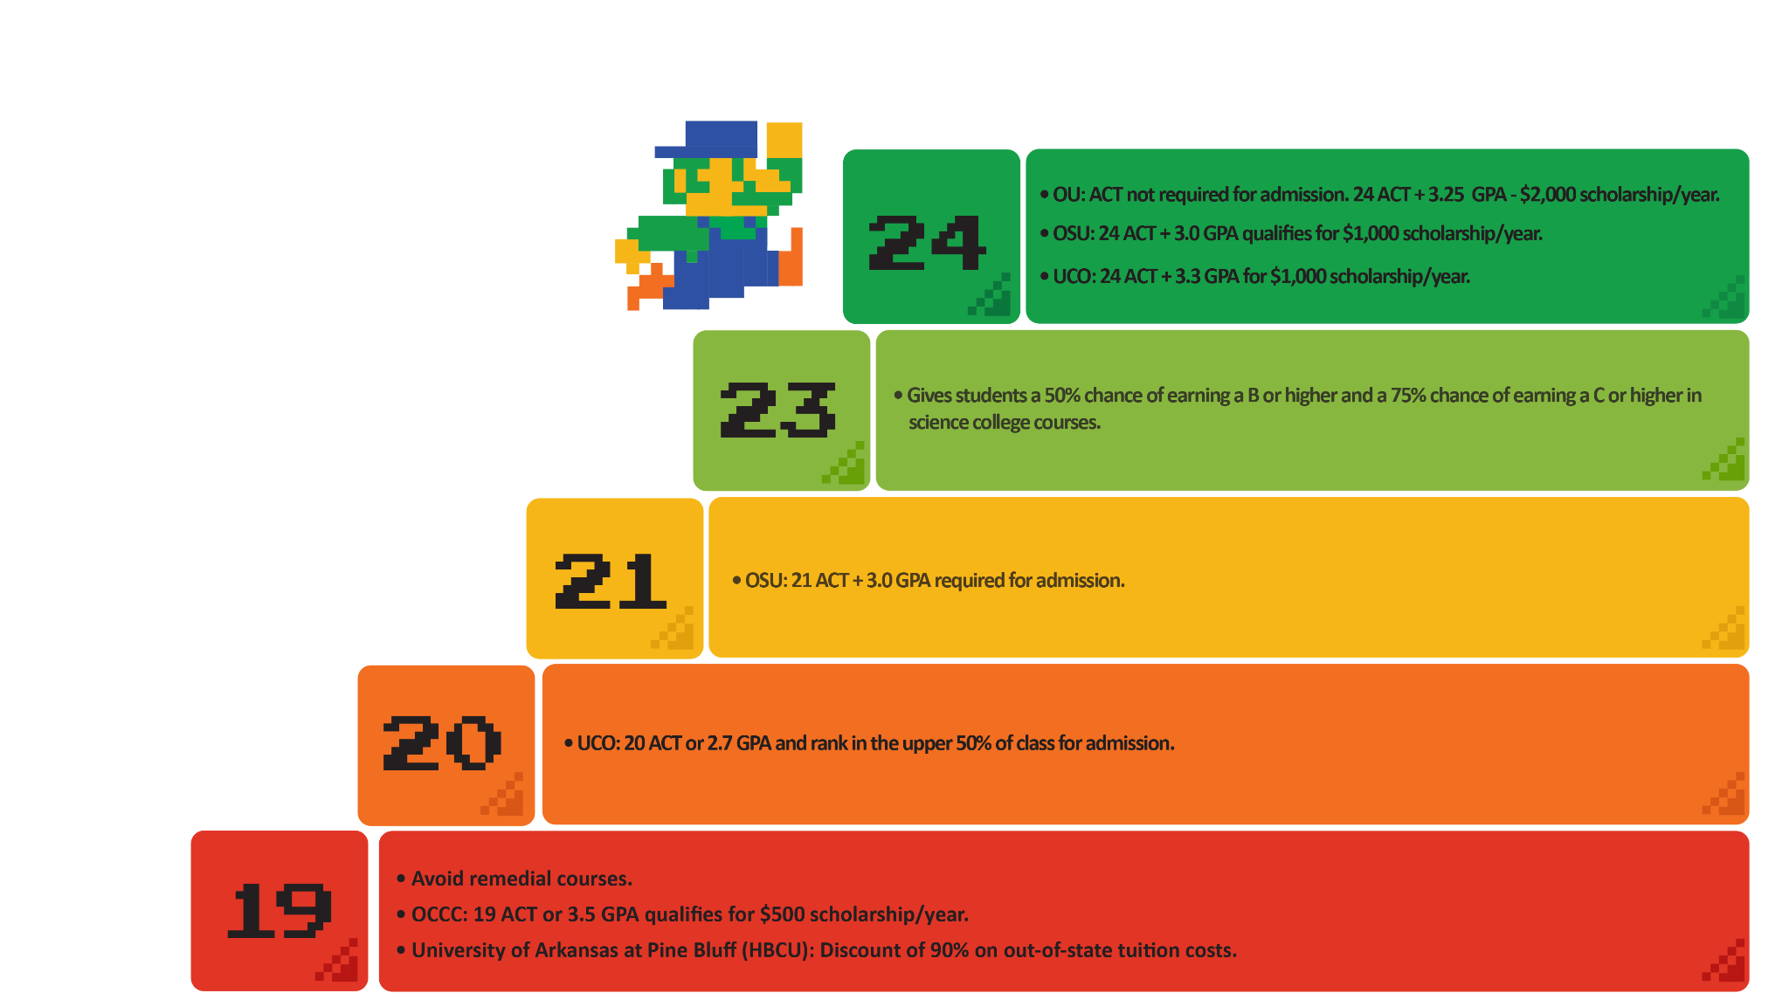
College ACT Requirements

Slide 16
English Score Chart
“
English Score | Answers Correct | Percentage Correct
16 | 32-33 | ≈ 43%
17 | 34-35 | ≈ 46%
18 | 36-37 | ≈ 49%
19 | 38-39 | ≈ 51%
20 | 40-42 | ≈ 55%
21 | 43-45 | ≈ 59%
22 | 46-48 | ≈ 63%
23 | 49-51 | ≈ 67%
24 | 52-54 | ≈ 71%
If I want to avoid remedial classes I just need to get about 51% correct!
“
I have a chance at receiving scholarships when I get close to 71% correct!

Slide 17
Revisit Goal Setting
Take out your Goal Setting handout again and update your action!
Choose at least one NEW action from the provided list to increase your English score.
Add the action to the handout in the table provided.
You may write it out completely
Or you may just use the number.
Refer back to the action and add the dates you practiced your action throughout the rest of the school year.

Slide 18
You Powered Up!
Side Quest: Try your skills and answer the questions on the Inflation A passage you just annotated.
Sneak Peek: Next time we will be learning about a new section of the ACT English subject focused on Organization and Topic Development.

