Slide 2
Power Up: Reading ACT Prep Week 4
Identifying Comparative Relationships

Slide 3
Essential Question
How can I increase my ACT score?

Slide 4
Learning Objectives
Analyze how to approach the paired passages section of the ACT reading test.
Identify comparative relationships.

Slide 5
ACT Reading Test
How many passages are on the reading section of the ACT?

Slide 6
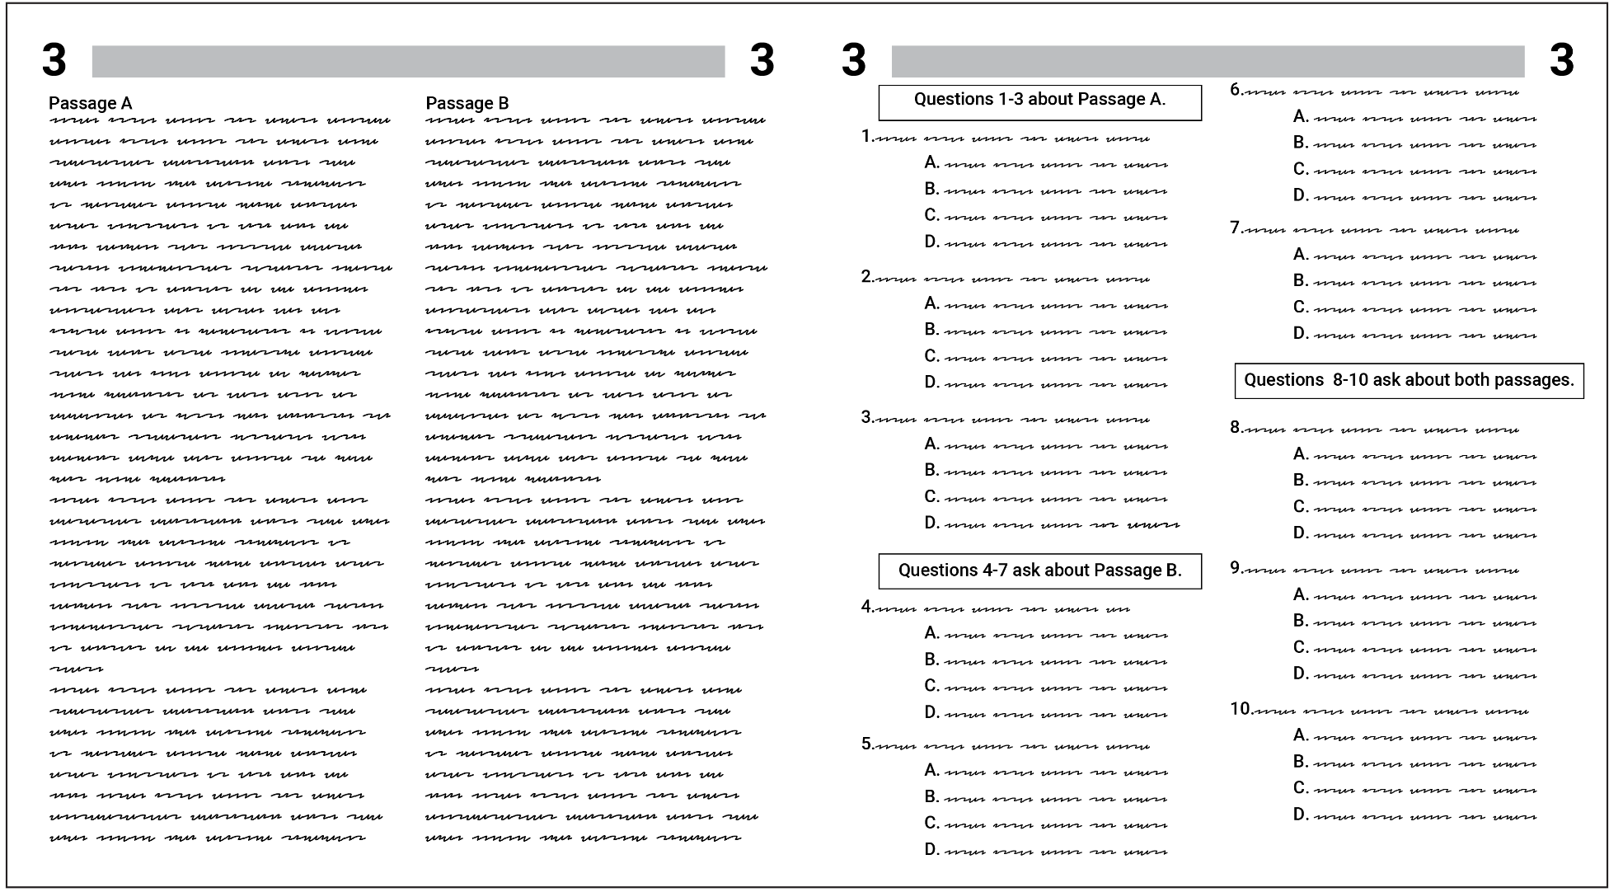

Slide 7
Point of Most Significance
View the video about the paired passages section of the ACT reading test.
As you view, think of the most important tip that stood out to you.

Slide 8
ACT Reading Practice: How to Handle Dual Passages
Notes:
The Princeton Review. (20187, July 8). ACT reading practice: How to handle dual passages | The Princeton Review. [Video]. YouTube. https://www.youtube.com/watch?v=jRuqs4OL8pQ

Slide 9
Approaching a Paired Passage
There are two passages, labeled A and B.
There are ten questions, some about Passage A, some about Passage B, and some about both.
Practice using what you have learned from the video.
Don’t begin until the timer starts.

Slide 10
Passage A
Read Passage A.
Answer the questions that correspond to Passage A.
You have 4 minutes to complete this portion.
4-Minute Timer
Notes:
K20 Center 4 minute timer. YouTube. (2021c, September 21) https://www.youtubeeducation.com/watch?v=kpCsfuvzQeY

Slide 11
Passage B
Read Passage B.
Answer the remaining questions.
You have 5 minutes to complete this task.
5-Minute Timer
Notes:
K20 Center 5 minute timer. YouTube. (2021c, September 21) https://www.youtubeeducation.com/watch?v=EVS_yYQoLJg

Slide 12
Paired Passage Reflection
How did the tips from the video help with completing the questions in the allotted time?
If on the actual ACT, Passage B has more questions than Passage A, what would the best approach be?

Slide 13
Answers
1. B 6. G
2. F 7. C
3. C 8. G
4. F 9. B
5. B 10. F

Slide 14
You Powered Up!

