Slide 2
Power Up: Reading ACT Prep Week 5
Identifying Cause and Effect Relationships

Slide 3
Essential Question
How can I increase my ACT score?

Slide 4
Learning Objectives
Identify cause and effect relationships.
Reflect on new knowledge about the ACT reading test.

Slide 5
ACT Reading Tips
Read the passage first. Don’t skip straight to the questions.
If you can’t quickly answer the question, skip it.
Skip “except” or “not” questions for last.
Return to the questions you skipped after answering the rest of the questions related to the passage.
Stick to the time limit for each passage, approximately nine minutes, so that you get to all four passages.

Slide 6
ACT Reading Tips and Strategies
As you view the video, think about the best tip or strategy that stood out to you.
After the video, write down the tip or strategy on the sticky note.
Notes:
K20 Center. (n.d.). Commit and Toss. Strategies. https://learn.k20center.ou.edu/strategy/119

Slide 7
Top 3 ACT Reading Tips
Notes:
Best ACT Prep. (2014, March 14). 3 best act reading tips and strategies to raise your act reading score. [Video]. YouTube. https://www.youtube.com/watch?v=sf5GbCgjnnM

Slide 8
The Cold War Reading Passage
Read the passage and answer the questions in ten minutes.
Use at least one tip from the video.
Aim for five minutes to read and five minutes to answer the questions.
10-Minute Timer
Notes:
K20 Center. (2021, September 21). K20 Center 10 minute timer. [Video]. https://youtu.be/9gy-1Z2Sa-c?si=ecoyxq_yQ8BC8xhG

Slide 9
Answers
B
G
B
G
C
H
B
G
C
F

Slide 10
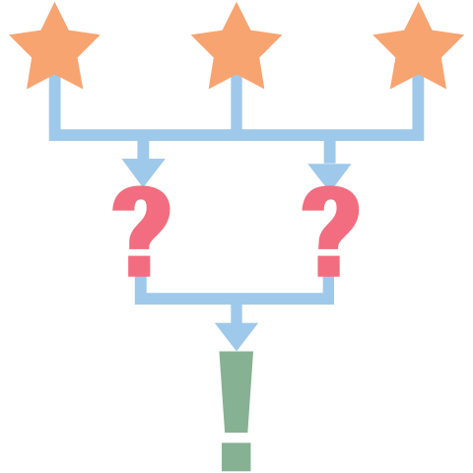
3-2-1 Reflection
Week 5 is the halfway point of the 10-week ACT prep activities. Think about then record:
3 important details you have learned about the ACT reading section.
2 skills you can use on the ACT reading section.
1 goal you have for the ACT reading section.
Notes:
K20 Center. (n.d.). 3-2-1. Strategies. https://learn.k20center.ou.edu/strategy/117

Slide 11
You Powered Up!

