Slide 1
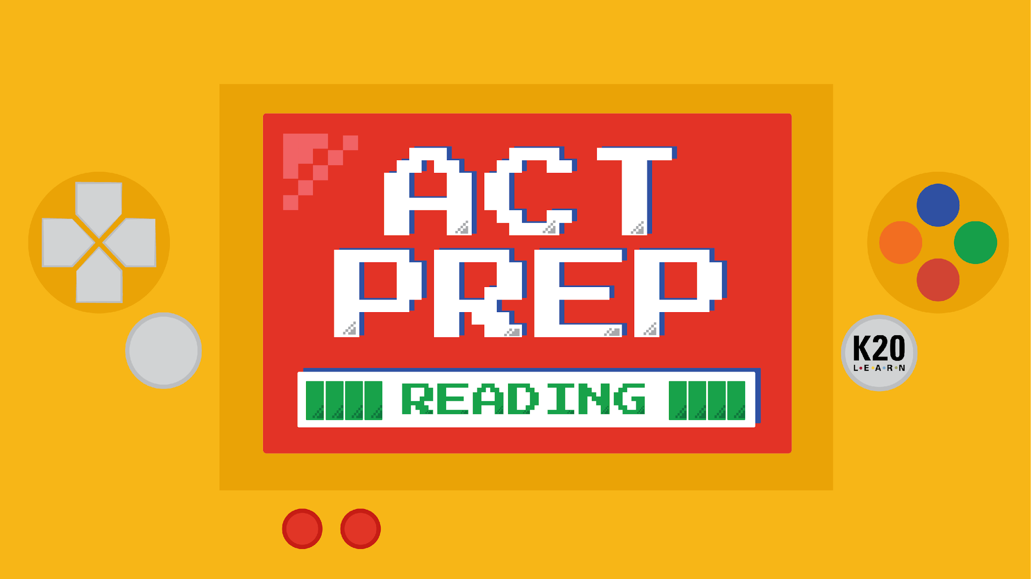

Slide 2
Power Up: Reading ACT Prep Week 6
TestNav Tools

Slide 3
Essential Question
How can I increase my ACT score?

Slide 4
Learning Objectives
Understand how to navigate TestNav for the online ACT reading test.
Explore available tools for the online ACT reading test.

Slide 5

Online ACT Tools
What tools do you think would be helpful for an online ACT test?
Notes:
K20 Center. (n.d.). Preflections. Strategies. https://learn.k20center.ou.edu/strategy/191

Slide 6
Online ACT Tools
Built-in timer that calculates how much time is left on each section.
When a question is directly related to text from the passage, the text in the passage is highlighted.

Slide 7
TestNav Tasks
Using a personal device, navigate to home.testnav.com.
Navigate to a practice test by following these steps:
  Click the “The ACT” button.
  Click “Practice Tests” at the bottom.
  Click “Reading.”
  Click “Reading - Untimed.”

Slide 8
TestNav Tasks
Complete each task on the handout.
Take notes about each tool.
  What does each tool do?
  How can each tool be useful on the ACT?

Slide 9
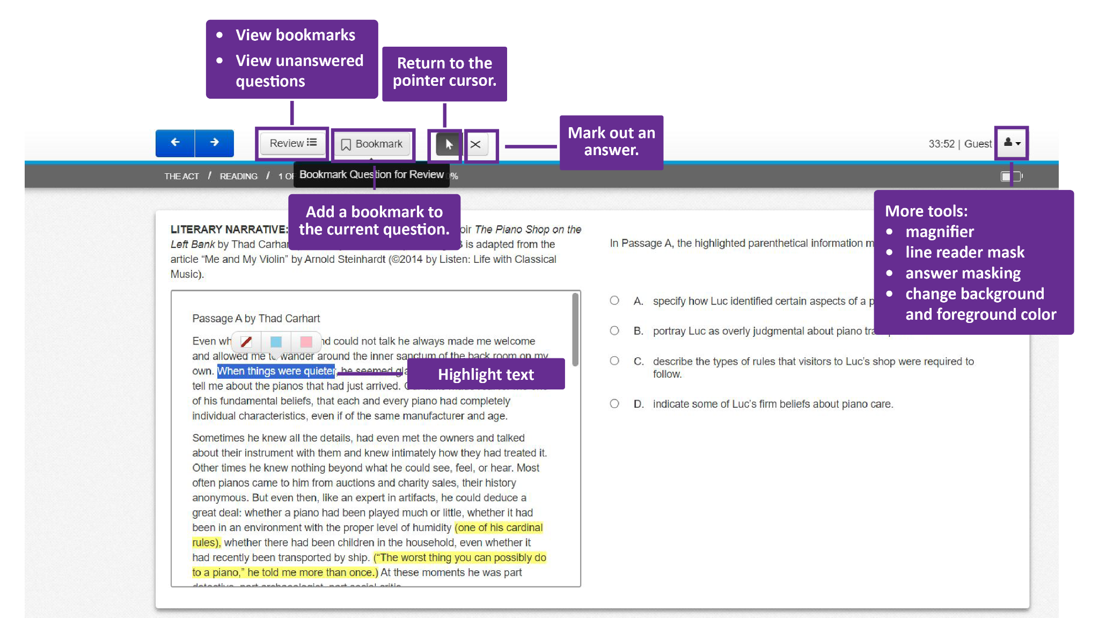

Slide 10

ACT Practice Questions
Locate question 31 of the practice test.
Spend ten minutes reading the passage and responding to questions 31–40.
10-Minute Timer
Notes:
K20 Center. (2021, September 21). K20 Center 10 minute timer. [Video]. YouTube. https://youtu.be/9gy-1Z2Sa-c?si=a7h75m0FduaHBSsU

Slide 11
Online ACT Tools
What tools does the online ACT have that can help you on the test?

Slide 12
Extra ACT Practice
Looking for more practice questions?
ACT provides a free practice question each day.
Login to your ACT account at my.act.org.
Click the “Question of the Day” button at the bottom of the main page.

Slide 13

You Powered Up!

