Slide 1


Slide 2
Power Up: Reading ACT Prep, Week 8
Vocabulary

Slide 3
Essential Question
How can I increase my ACT score?

Slide 4
Learning Objective
Understand how to interpret vocabulary in the context of an ACT reading passage.

Slide 5
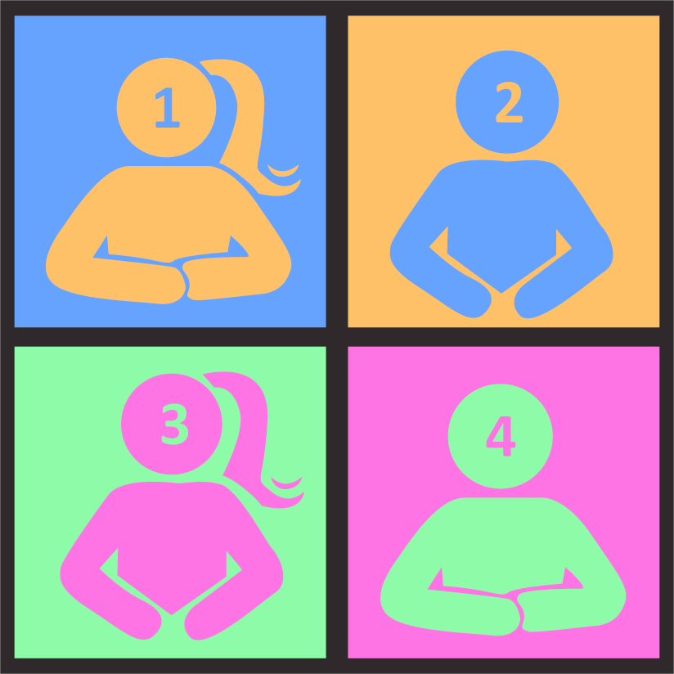
Unknown Words: Sentence 1
There was a pile of smoalter dishes in the sink so I had to load the dishwasher.
Notes:
K20 Center. (n.d.) Numbered Heads Together.Strategies. https://learn.k20center.ou.edu/strategy/2476

Slide 6
Unknown Words: Sentence 2
I do not have enough frindle to go to the movies so I will ask my mom for some.
Notes:
K20 Center. (n.d.) Numbered Heads Together.Strategies. https://learn.k20center.ou.edu/strategy/2476

Slide 7
Unknown Words: Sentence 3
A local teen won a quibberdoo for rescuing a drowning dog.
Notes:
K20 Center. (n.d.) Numbered Heads Together.Strategies. https://learn.k20center.ou.edu/strategy/2476

Slide 8
Unknown Words: Sentence 4
I took a glitchlett class so I can prepare to get my learner’s permit.
Notes:
K20 Center. (n.d.) Numbered Heads Together.Strategies. https://learn.k20center.ou.edu/strategy/2476

Slide 9
Unknown Words
What strategies did you use to give a definition for the unknown words?
How can the strategies applied to the previous sentences be used on the ACT reading test?

Slide 10
ACT Reading Tips and Tricks
Review the tips and tricks for the ACT reading test.
Mark each tip you are already using when preparing for the ACT.
Identify one tip you are not using and try it out.

Slide 11

Civil Rights: Reading Passage
Read the passage and answer the questions in ten minutes.
Aim for four minutes to read and six minutes to answer the questions.
10-Minute Timer
Notes:
K20 Center. (2021, September 21). K20 Center 10 minute timer. [Video]. YouTube. https://www.youtube.com/watch?v=9gy-1Z2Sa-c

Slide 12
Civil Rights: Answers
B
E
A
G
C
G
D
E
C

Slide 13
Goal Setting
Review the goals and actions you set for yourself during the first week of ACT reading prep.
Reflect on your progress throughout the last eight weeks, have you practiced the actions?
Add a new action you can do to prepare for the next time you take the ACT.

Slide 14

You Powered Up!

