Slide 2
Power UP: Science ACT Prep, Week 3
Tables, Figures, and Graphs

Slide 3
Essential Question
How can I increase my ACT score?

Slide 4
Learning Objectives
Understand the pacing of the science test
Analyze components of figures, tables and graphs to understand what information they convey

Slide 5
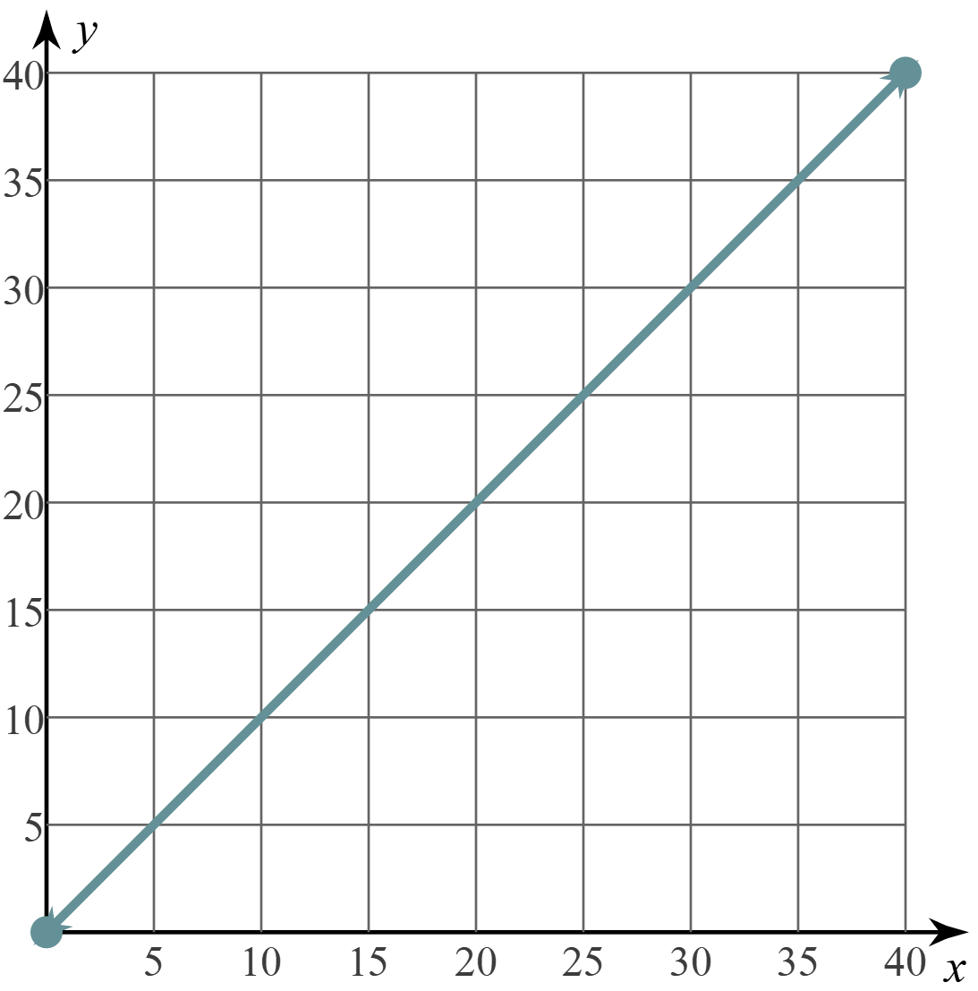
Graph Data
What clues do you see that could let us know what the data is showing?
Questions
Minutes

Slide 6
Graph Data
Science ACT Questions Answered
What is the maximum time?
What is the maximum number of questions?
How many questions should be answered by X minutes into the test?
How might the graph change if someone takes less time to finish?
Questions
Minutes

Slide 7
Categorical Highlighting
Science ACT Questions Answered.
For each table, graph, and figure, highlight the following
Titles in yellow
Legends in blue
Independent
variables in green
Dependent variables in pink
Circle any other key information
Questions.
Minutes.

Slide 8
Question 1
A beam of light from flames has a wavelength of 480nm. What color is the light?
Red
Blue
Green
Violet

Slide 9
Question 1
A beam of light from flames has a wavelength of 480nm. What color is the light?
Red
Blue
Green
Violet

Slide 10
Question 2
How many members in the Fugate family tree had the recessive mm trait?
11
13
7
24

Slide 11
Question 2
How many members in the Fugate family tree had the recessive mm trait?
11
13
7
24

Slide 12
Question 3
The largest average leaf area in Georgia using fertilization was larger than the average leaf area in Florida for which treatment type?
Control
Reduction
Fertilization
FR combined

Slide 13
Question 3
The largest average leaf area in Georgia using fertilization was larger than the average leaf area in Florida for which treatment type?
Control
Reduction
Fertilization
FR combined

Slide 14
Anchor Chart
Have you discovered any new strategies for the science test?

Slide 15
Exit Ticket: Create a Graph
Sketch a graph showing the following data:
As the average low temperature for a location increases, the average accumulated snowfall for that area decreases.
Include a title, trend line, and x- and y-axis.

Slide 16
You Powered Up!

