Slide 2
Power UP: Science ACT Prep, Week 4
TestNav Tools

Slide 3
Essential Question
How can I increase my ACT score?

Slide 4
Learning Objectives
Explore the available tools for use when taking the computer-based science ACT
Reflect on the usefulness of each tool to the timely completion of the science ACT
Evaluate when it is best to annotate on the screen and when to make notes on scratch paper

Slide 5
TestNav
Websites and apps use icons and design patterns to make it simple for people who are using the app for the first time.
Look at the icons on TestNav.
Hover over buttons to see if additional text displays.
Do the icons and text provide clues about what the buttons can do?

Slide 6
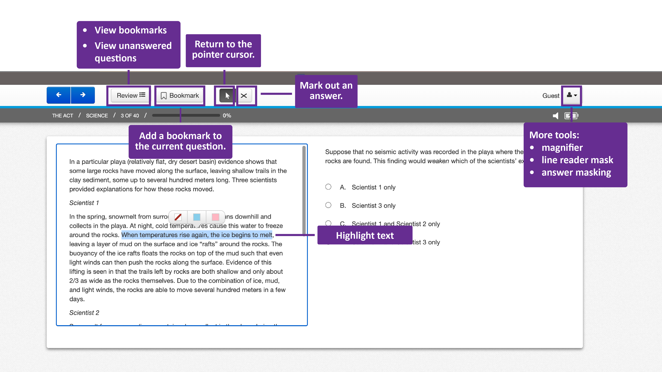
TestNav

Slide 7
Scratch Paper
Turn over your Science Test Tool Hunt
Find question 7 of the Science test in TestNav
You do not need to read the passage, but need to know:
A rock trail is about ⅔ the size of an actual rock.
The question asks:
If the trail is 33cm wide about how wide was the rock?
Notes:
Bookmark, X out, highlight, magnifier, line reader mask, answer mask

Slide 8
Rocks and Trails
2/3x = 33
2x = 99
x = 49.5
Answer: C. 50 cm

Slide 9
You Powered Up!
Achievement Unlocked: TestNav Tools

