Slide 1


Slide 2
Power Up: Science ACT Prep, Week 5
Trends in Graphs and Tables

Slide 3
Essential Questions
How can I increase my ACT score?

Slide 4
Learning Objectives
Analyze tables and graphs to understand trends
Evaluate data to answer a question
Build testing stamina to power through the test

Slide 5
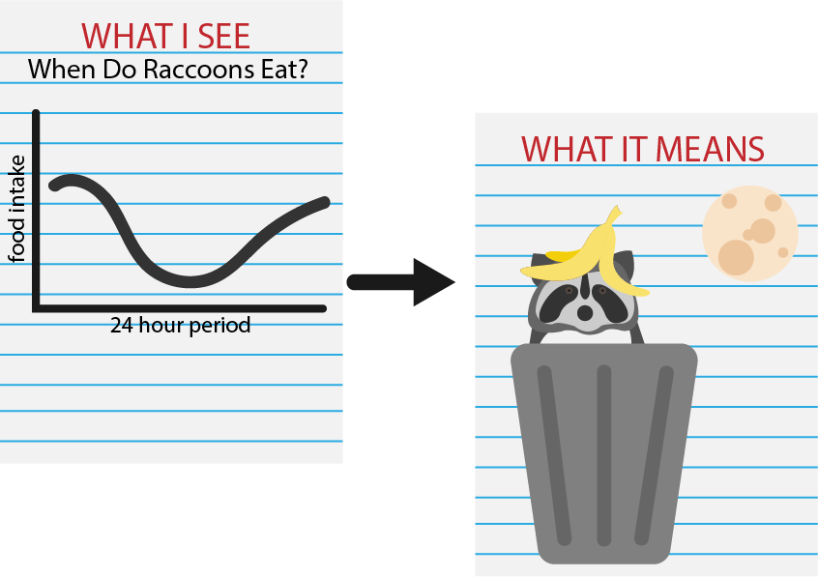
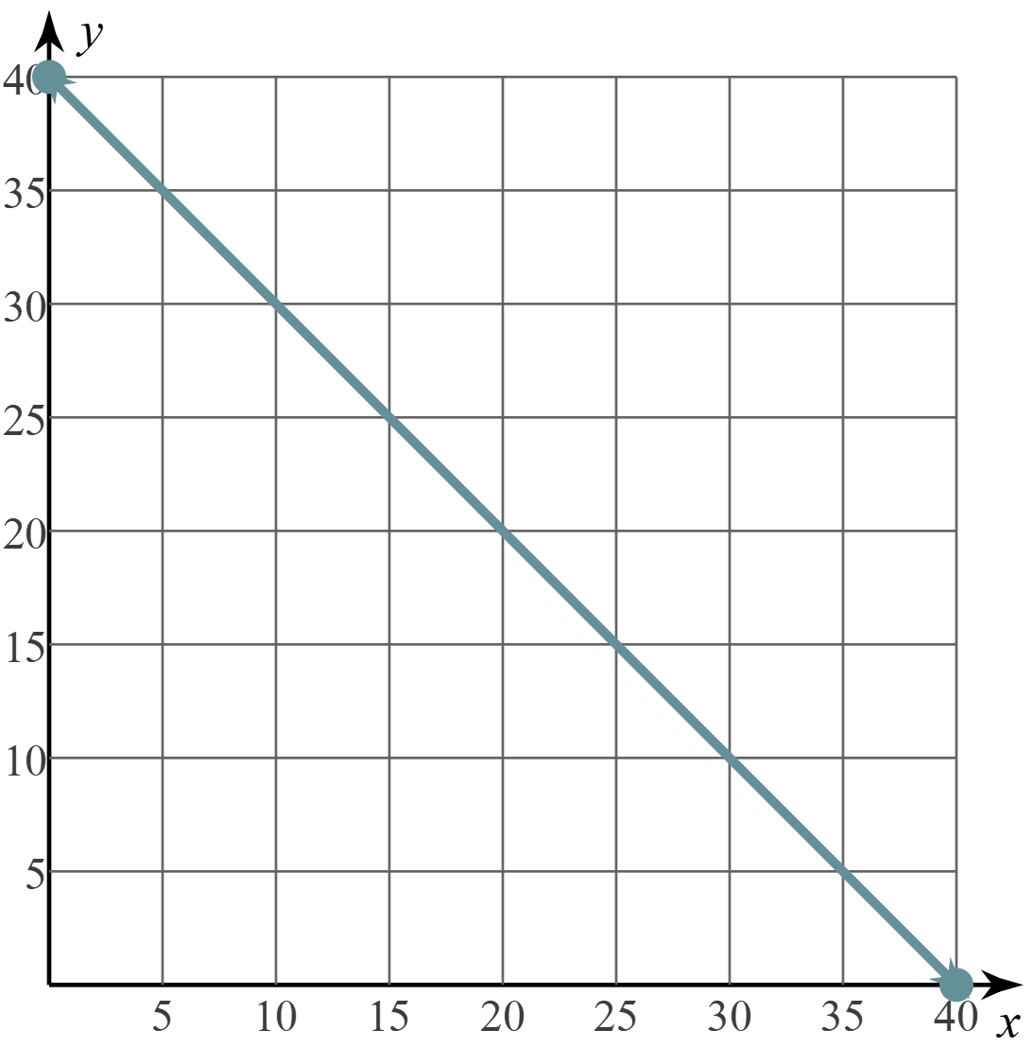
WIS-WIM
What I See
What It Means
Time for Questions
Time Spent Reading Passages

Slide 6
Science Section Instructions
40 minutes—40 questions
There are several passages in this test. Each passage is followed by several questions. After reading a passage, using the scroll bar to see the entire passage, choose the best answer to each question, and select the circle next to your answer. You may refer to the passages as often as necessary.
You are NOT permitted to use a calculator on this test.

Slide 7
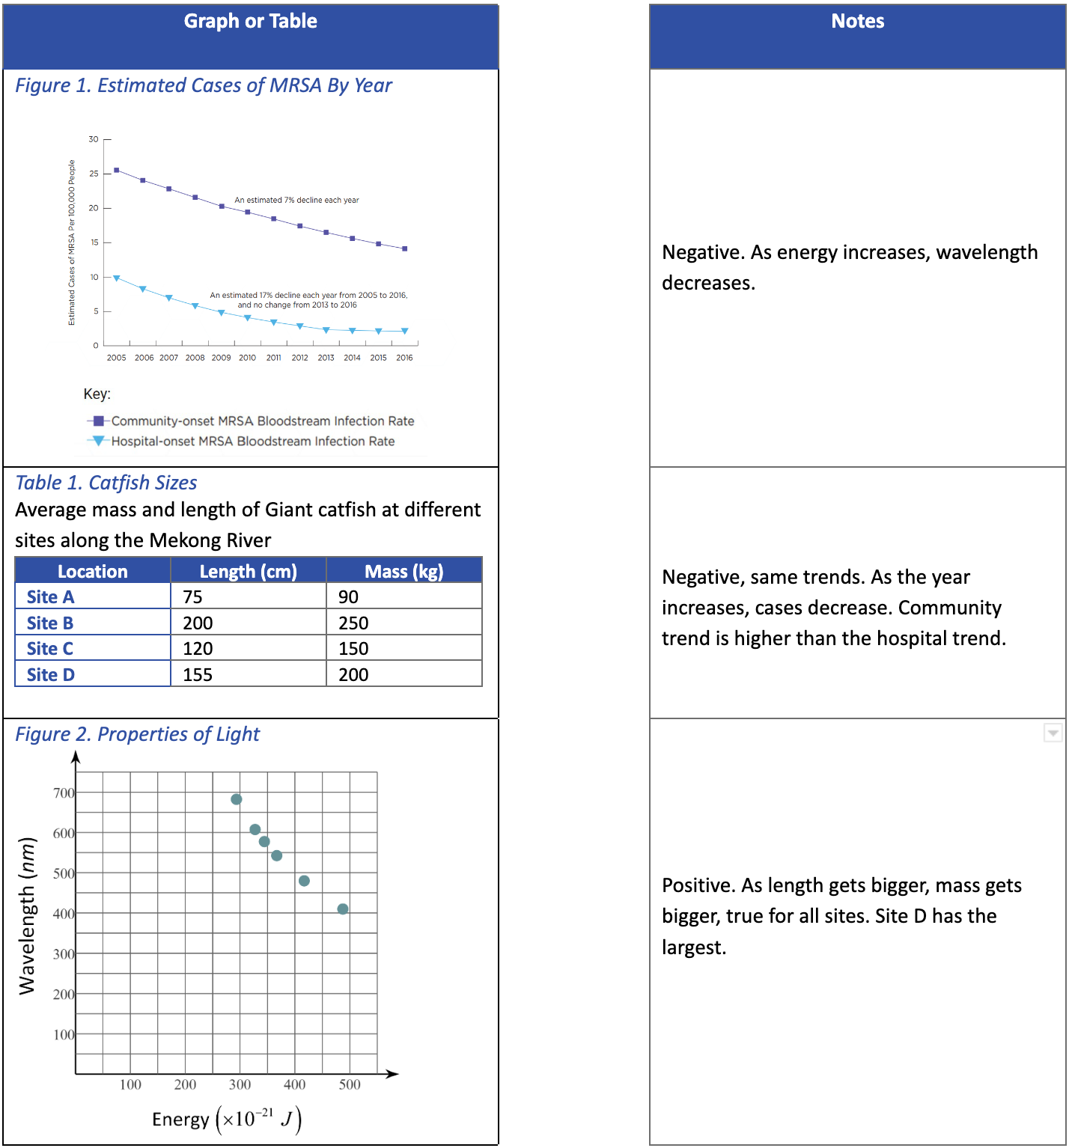
What’s Trending? Key
Figure 1. Cases of MRSA = Negative, same trends.
Table 1. Catfish Sizes = Positive
Figure 2. Properties of light = Negative

Slide 8

Time to Practice
Today you’ll have 5 minutes to answer 5 questions.
You may begin when the timer starts.
5-Minute Timer
Notes:
https://youtu.be/EVS_yYQoLJg?si=-4kXYdSSYNYqLA1B

Slide 9

Question 1
Based on Figure 1, what is the difference between the study that accounted for water purity and the study that did not at 15 degrees Celsius?
0.05
-0.09
-0.20
-0.35

Slide 10
Question 2
According to Table 1 and Figure 1, what is the maximum melting point for a H2O-NaCl solution?
9.08℃
14.87℃
19.38℃
21.9℃

Slide 11
Question 3
Which substance is considered the solvent in the solution for this experiment?
salt
water
melting point
water purity

Slide 12
Question 4
If another study accounted for additional factors that could affect water quality or the quality of the NaCl, the greatest differences in findings would more likely occur at which melting point?
5 ℃
8 ℃
15 ℃
22 ℃

Slide 13
Question 5
The melting point for a solution was 10.2 degrees Celsius. What is a possible salinity for this solution?
4.32
9.07
13.65
15.76

Slide 14

You Powered Up!

