Slide 1


Slide 2
Power Up: English ACT Prep Week 6
Topic Development and Organization

Slide 3
Essential Question
How can I increase my ACT score?

Slide 4
Learning Objectives
Determine the appropriate transition word to use in a sentence.
Identify how thesis statements, claims, pieces of evidence, and statements of reasoning play a role in the structure of a passage, paragraph, or an essay.
Apply understanding of transition words and roles of sentences to order paragraphs in an essay accurately.

Slide 5

I Notice, I Wonder
Review the basic structure and complete the handout.
What do you Notice about the structure of this essay?
What do you Wonder about the structure of this essay?
Notes:
K20 Center. (n.d.). I notice, I wonder. Strategies. https://learn.k20center.ou.edu/strategy/180

Slide 6
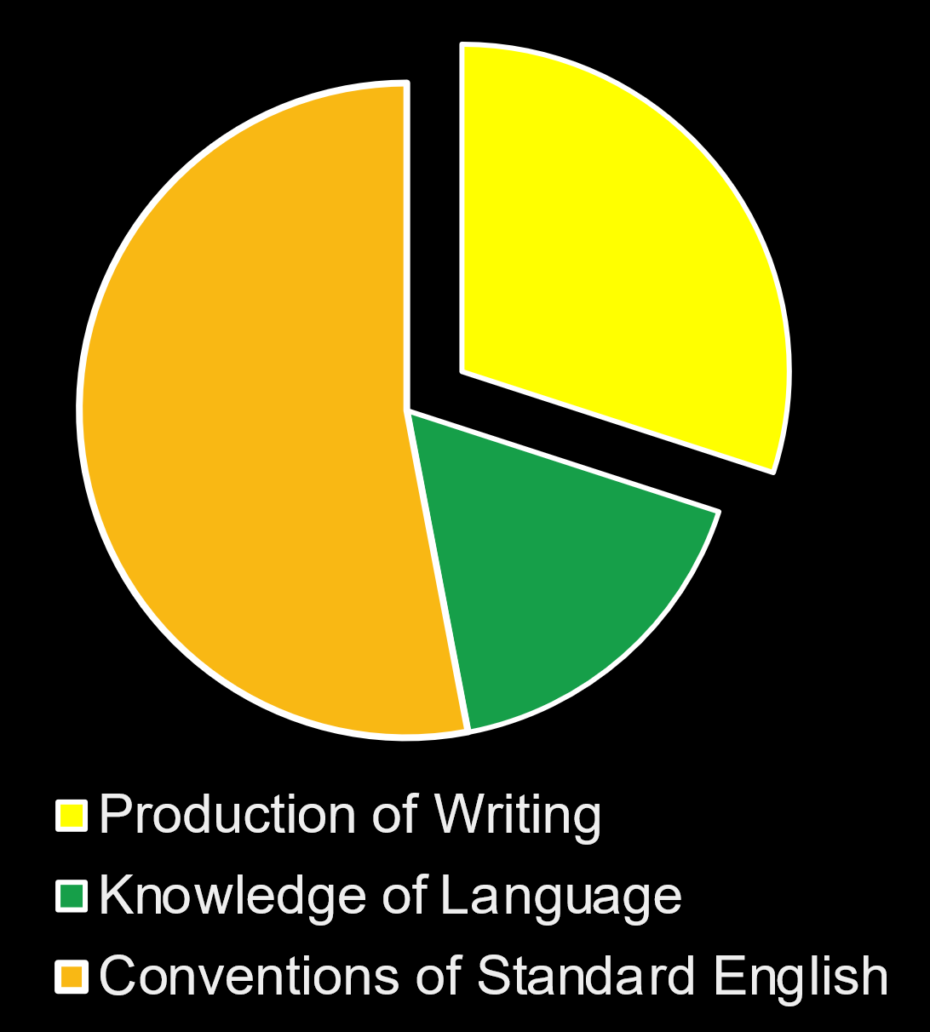
Why Does Writing Matter?
Production of Writing:
Topic Development
Organization
Notes:
Description of English test. ACT. (n.d.). https://www.act.org/content/act/en/products-and-services/the-act/test-preparation/description-of-english-test.

Slide 7
Skill Sets Check
Transition Words and Sentences:
  These help connect one idea to the next and help with the logical flow of a text.
Parts of a Paragraph
  What is the role of the sentence?
Leave the Examples column (right column) blank for now.

Slide 8

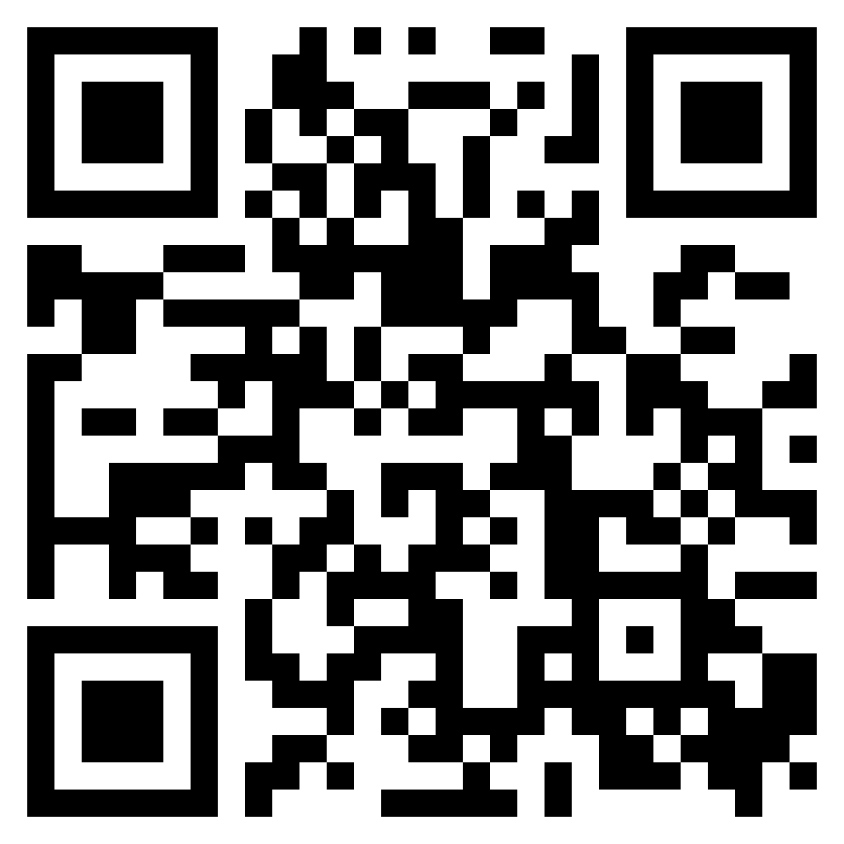
Production of Writing Activity
Go to k20.ou.edu/production-of-writing.
Or scan the QR code:
Read the table of contents then click the “Begin” button.

Slide 9
Add Transitions | Page 1/2
Directions
Complete the fill-in-the-
blank with the appropriate transition word or phrase.
  Use your Skill Sets Check handout as a guide.
Answer the inference questions.
Discussion
What do you think the main idea or focus of the full essay might be?

Slide 10
Select the best word from each column to fill in the blank.
Blank 1 | Blank 2 | Blank 3 | Blank 4
For example | On the other hand | Next | Furthermore
Secondly | Subsequently | For example | Additionally
Additionally | Also | Also | Coincidentally
Next | However | Indeed | Clearly
What do you think the main idea or focus of the full essay might be?

Slide 11
Select the best word from each column to fill in the blank.
Blank 1 | Blank 2 | Blank 3 | Blank 4
For example | On the other hand | Next | Furthermore
Secondly | Subsequently | For example | Additionally
Additionally | Also | Also | Coincidentally
Next | However | Indeed | Clearly
What do you think the main idea or focus of the full essay might be?

Slide 12
Parts of a Paragraph | Page 2/2
Directions
Read the paragraph.
Identify the role of
each sentence:
  Claim
  Evidence
  Reasoning
Discussion
Why do you think it is important to identify the role of a sentence?
Notes:
K20 Center. (n.d.). Claim, evidence, reasoning (CER). Strategies. https://learn.k20center.ou.edu/strategy/d9908066f654727934df7bf4f506fc09

Slide 13
Sort the Essay | The Great Gatsby
Discussion
For the sake of logic, which paragraph is the introduction?
How did you know?
Directions
Rearrange the essay according to clarity and organization.

Slide 14

Test Tip - The “Box” Questions
1
The “Box” question is about choosing the best answer that is consistent with what is already present in the passage.
  For example, notice how other sentences are formatted or worded in that section and choose the answer that matches their same structure.

Slide 15
Test Tip - The “Box” Questions
2
Select the option that continues to develop the main idea already established and continues the flow of the passage.
  For example, if the passage is about the dangers of bungee jumping and the extra paragraph or sentence is about boating accidents, then it might not connect completely to the passage unless the topic is about “dangers of extreme sports.”

Slide 16
You Powered Up!
Side Quest: Fill in the “examples” column of your Skill Sets Check handout by listening to a conversation and identifying the various parts of the essay.
Sneak Peek: Next time we will learn about pacing and how to annotate the test.

