Slide 1
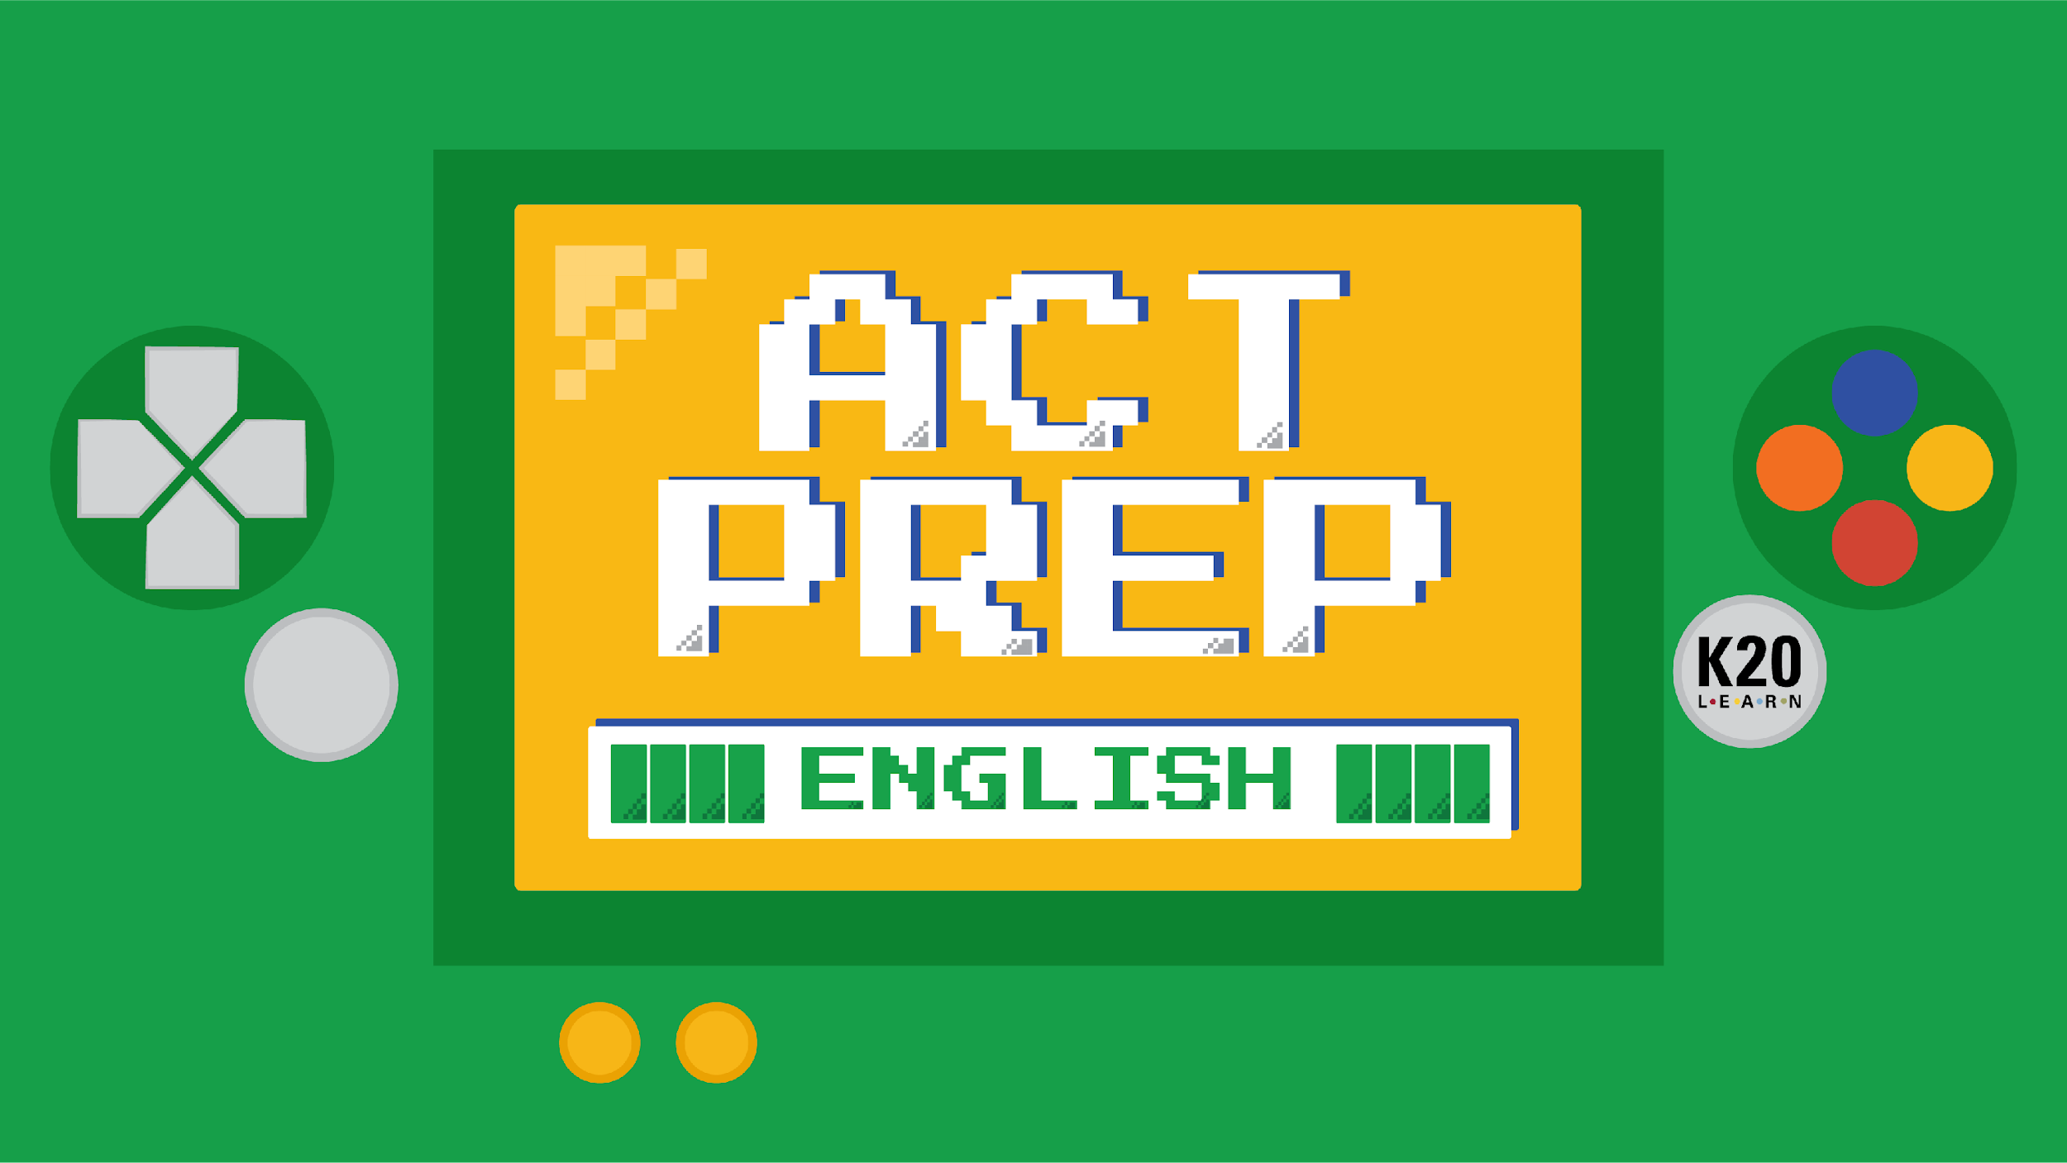

Slide 2
Power Up: English ACT Prep Week 7
Annotating the Test and Pacing

Slide 3
Essential Question
How can I increase my ACT score?

Slide 4
Learning Objectives
Explore the annotation tools available through TestNav.
Apply pacing skills to increase the number of questions answered.

Slide 5
TestNav Tasks
Using a personal device, navigate to home.testnav.com.
Navigate to a practice test by following these steps:
Select the “The ACT” button.
Select “Practice Tests” at the bottom.
Select “English.”
Select “English - Untimed.”
Notes:
TestNav. (n.d.). Where do you want to go?. https://home.testnav.com/

Slide 6
TestNav Tasks
Complete each task on the handout.
Take notes over each tool.
  What does each tool do?
  How can each tool be useful on the ACT?
Notes:
TestNav. (n.d.). Where do you want to go?. https://home.testnav.com/

Slide 7
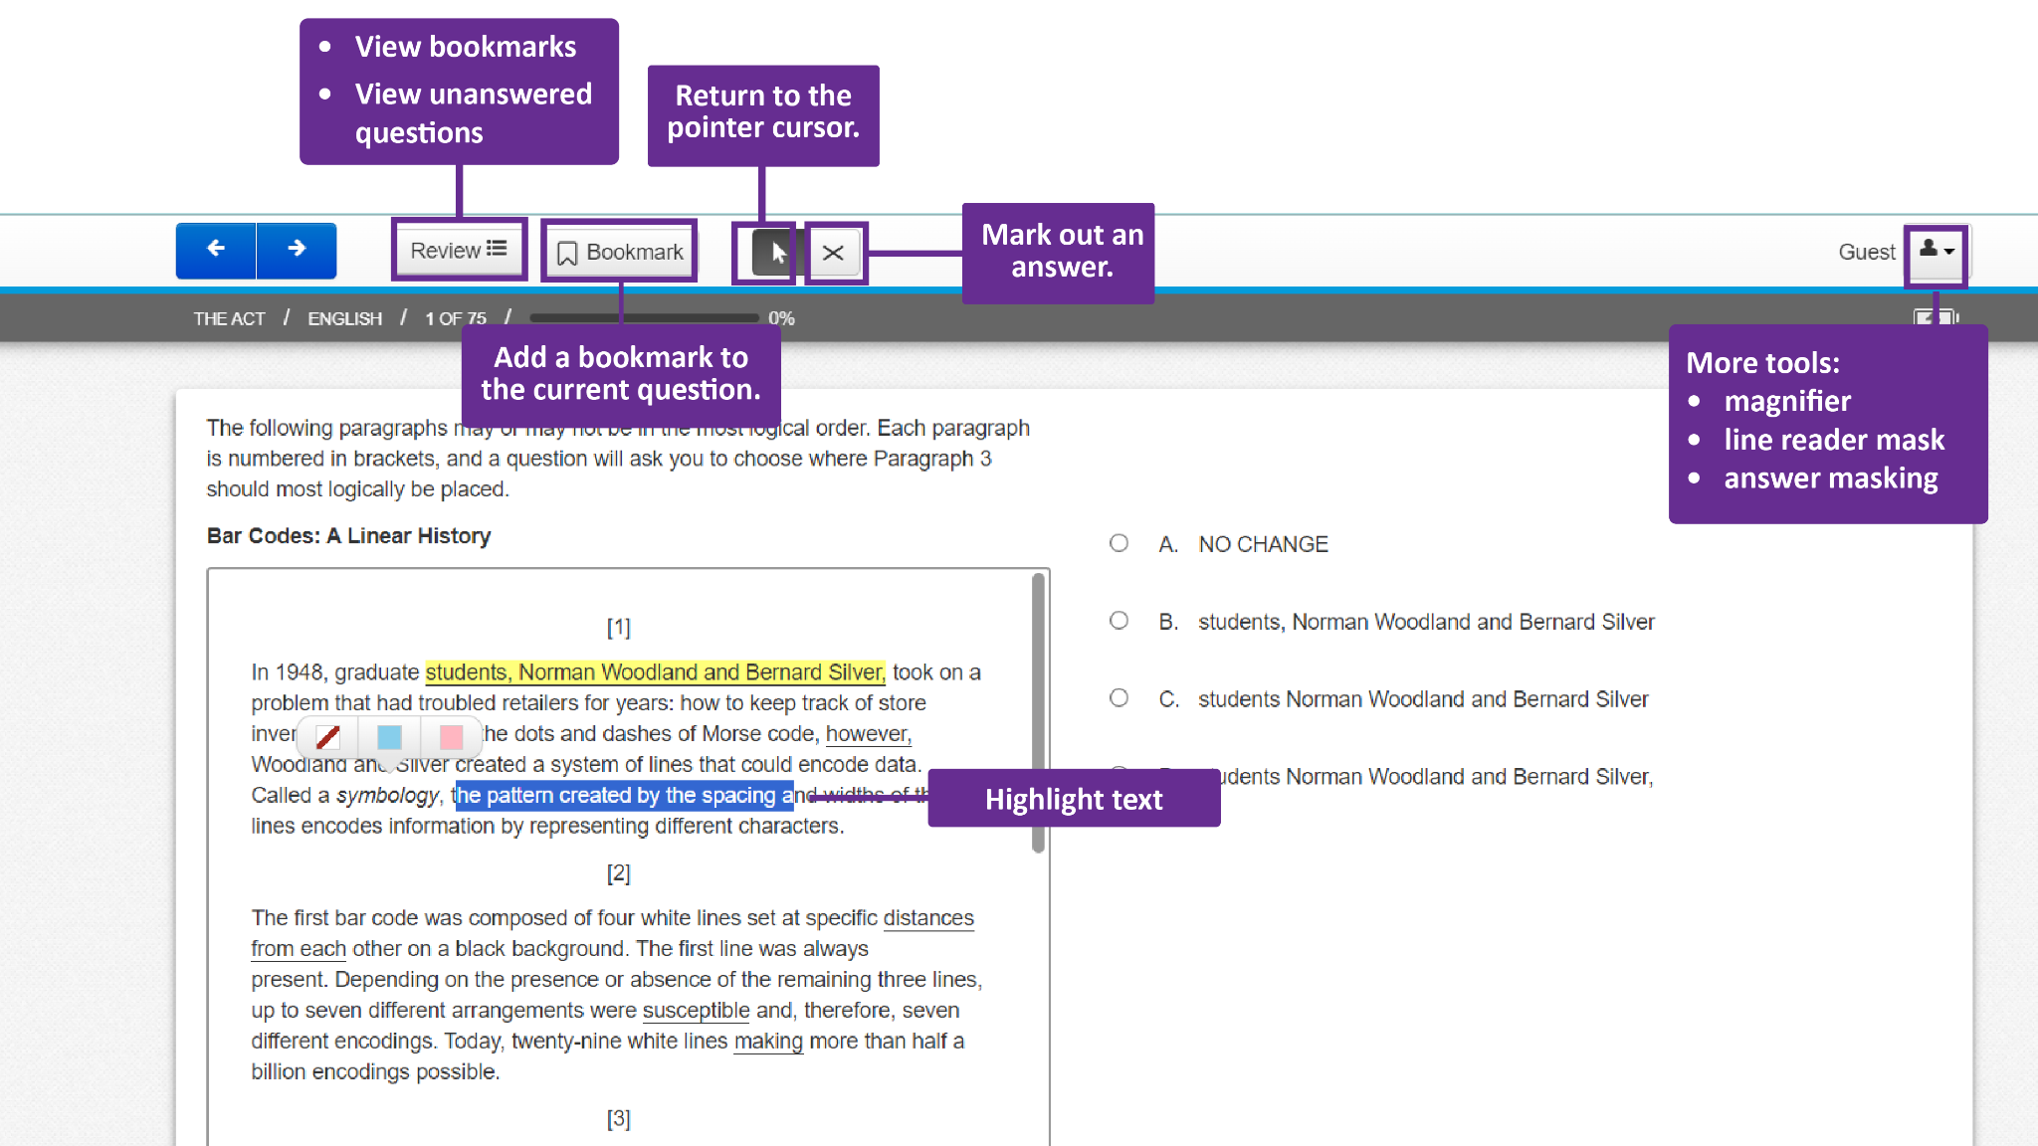
Notes:
TestNav. (n.d.). Where do you want to go?. https://home.testnav.com/

Slide 8

ACT English Tip: Pacing
With so many questions and only 45 minutes for this section, it is recommended to only spend 9 minutes per passage.
As you encounter questions in the reading, pause and answer the corresponding questions.
Number of Passages | Number of Questions | Number of Minutes
5 | 75 | 45
Notes:
Description of English test. ACT. (n.d.). https://www.act.org/content/act/en/products-and-services/the-act/test-preparation/description-of-english-test.html
Sult, E. P., & Piqosity. (2021, October 20). ACT English Strategies. Piqosity. https://www.piqosity.com/act-english-strategies-tips/#:~:text=The%20first%20answer%20to%20many,least%20some%20of%20the%20answers.

Slide 9

Inflation B
Read the passage and answer the questions.
K20 Center 9-minute Timer
Notes:
K20 Center. (2021, September 21). K20 Center 2 minute timer. [Video]. https://youtu.be/ZvN435zg2zE?si=sLiunjRMVdk3HTc6

Slide 10
Inflation B | Reflection
Question | Correct Answer | Explanation
1 | A | In this instance, the apostrophe in it’s reflects a contraction of it is rather than an indication of possession. In this case, it’s reflects the correct punctuation to indicate the present contraction.
2 | J | The sentence makes more sense without the underlined words. The underlined words are unnecessarily separating the subject and the verb.
3 | A | This sentence helps build the topic development.
4 | J | The proposed sentence contains only information that is already relayed in the rest of the passage and you want to avoid repetition.

Slide 11
Inflation B | Reflection
Question | Correct Answer | Explanation
5 | B | This question concerns subject-verb agreement. The subject is inflation, which is singular, so the verb needs to be singular as well. Occurs is the singular verb.
6 | G | The information given after deflation acts as its definition; this is called an appositive. Separate appositives that give extra information with commas.
7 | A | This is a pronoun for the action in the previous sentence.
8 | F | The question is asking which is the best verb tense. It should be present tense, so happens is correct.

Slide 12
Inflation B | Reflection
Question | Correct Answer | Explanation
9 | A | This choice is correct because all the proposed pronoun alternatives to the underlined phrase would become vague pronouns with an unclear antecedent.
10 | H | When beginning a sentence with a transition phrase, separate it with a comma.
11 | B | This question is about verb tense agreement. Since the sentence used rise, which is present tense, and the next part of the sentence is talking about the future, the correct answer is will rise.

Slide 13
Inflation B | Reflection
Question | Correct Answer | Explanation
12 | G | This question is asking about the correct word choice. Citizens best replaces consumers because it reflects all parties rather than individual parties concerned.
13 | C | This question is asking which sentence is best.
14 | F | This essay discusses different types of inflation.
15 | C | Paragraph 4 is about deflation. Since it begins with a transition phrase, it is responding to something previously discussed. The opposite of deflation is inflation, so it goes after paragraph 2.

Slide 14

What? So What? Now What?
What? Think about what you learned today.
So What? Discuss with a partner why you
think you explored the tools from TestNav.
Now What? Share what tools you think you might use
(or what tools you might avoid using) on the real ACT.
Notes:
K20 Center. (n.d.). What? So What? Now What?. Strategies. https://learn.k20center.ou.edu/strategy/95

Slide 15

You Powered Up!
Side Quest: In English class, choose a paragraph from any reading and identify the purpose of each sentence: topic sentence, claim, evidence, reasoning, and transitions.
Sneak Peek: Next time we will be taking an online Practice Test!

