Slide 2
Power Up: English ACT Prep, Week 8
Practice Test

Slide 3
Essential Question
How can I increase my ACT score?

Slide 4
Learning Objectives
Practice pacing for the English portion of the ACT.
Navigate efficiently through TestNav during a practice test.

Slide 5
Let’s Get Ready
Find your device.

Slide 6
TestNav: Getting Started
Navigate to home.testnav.com. Then click “The ACT” button.
OR
Open the TestNav application on your school device.

Slide 7
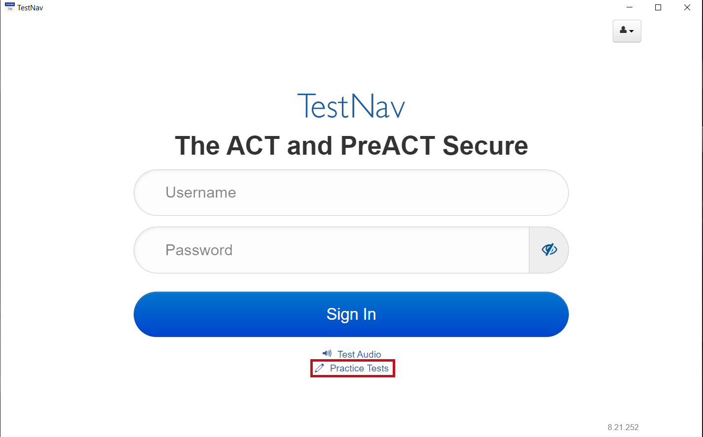
TestNav: Selecting the Right Test
Click “Practice Tests.”
Notes:
TestNav. (2023). Login screen. [Screenshot].

Slide 8
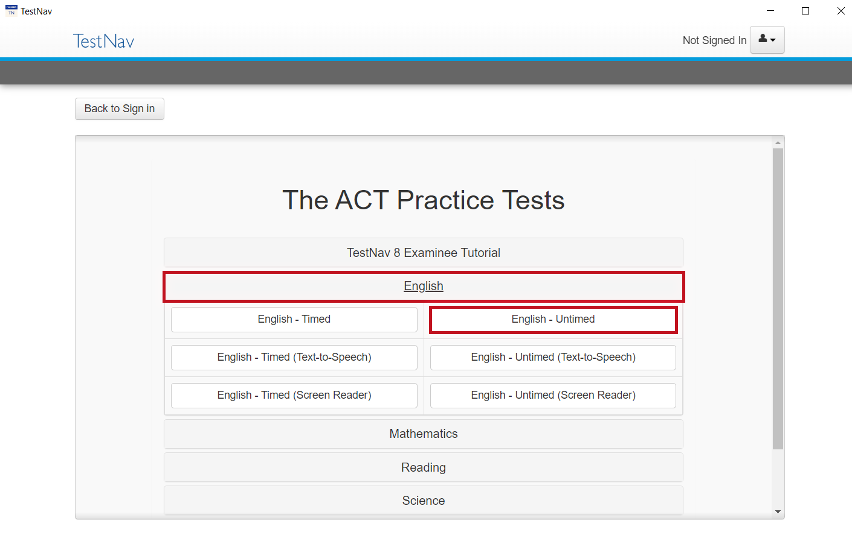
TestNav: Selecting the Right Test
Click “English.”
Select “English - Untimed.”
Notes:
TestNav. (2023). Select practice test. [Screenshot].

Slide 9
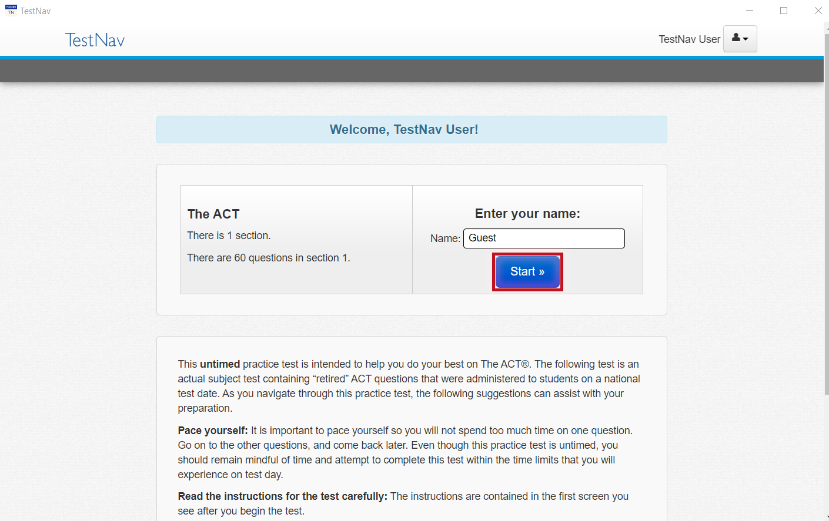
TestNav: Advice
Read the directions.
Press the “Start” button.
Notes:
TestNav. (2023). Welcome, TestNav user. [Screenshot].

Slide 10
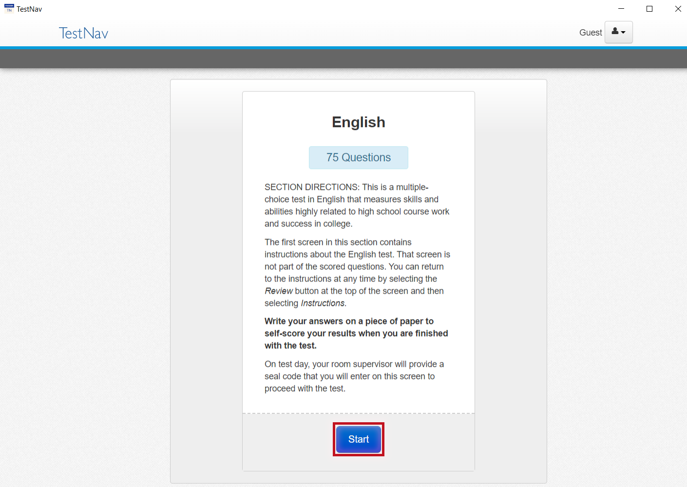
TestNav: Online English Section Directions
Read the directions.
Press the “Start” button.
Notes:
TestNav. (2023). Online directions. [Screenshot].

Slide 11
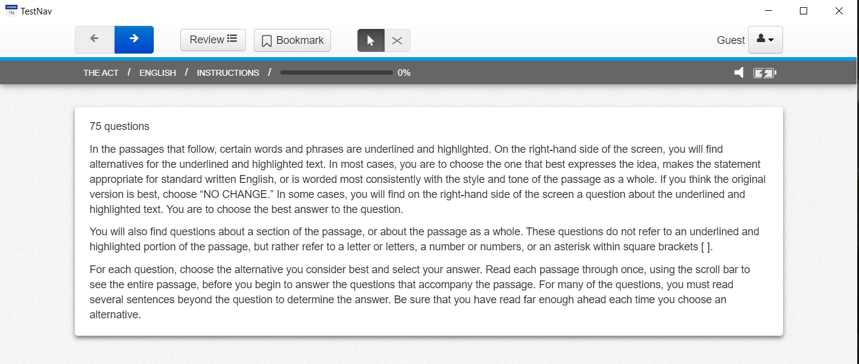
The ACT: General English Section Directions
Read the directions.
Read these now so that you do not spend time on the actual ACT reading these same directions.
You will be given 27 minutes to answer questions for the first 3 passages.
Notes:
TestNav. (2023). General directions. [Screenshot].

Slide 12
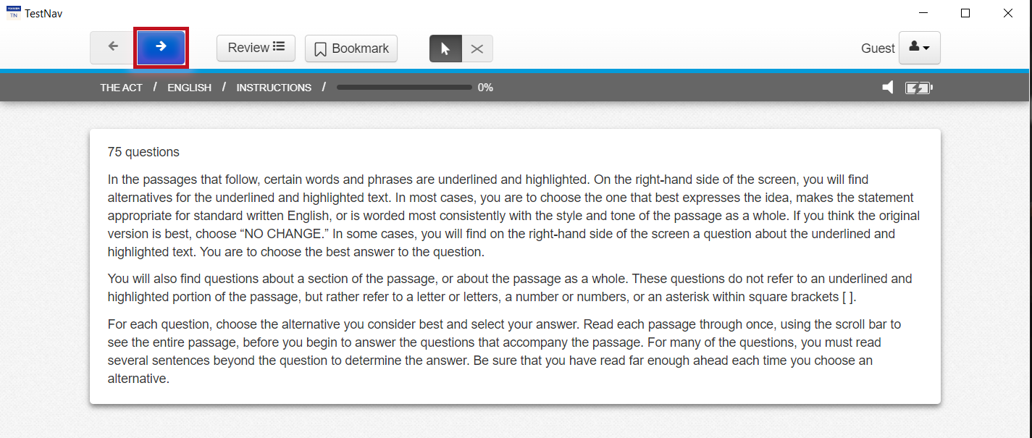
Begin Your Practice Test
Press the “Next” (arrow) button at the top of the screen to begin.
Notes:
TestNav. (2023). General directions. [Screenshot].

Slide 13
Start and End Times
Write the start and end times on the board.
Example:
Start at 9:00 am
End at 9:27 am

Slide 14
5-Minute Warning
Since students are not using the full time to take a full practice test, they will not see the usual reminder indicating that 5 minutes remains.
Alert students that there are 5 minutes remaining.

Slide 15
TestNav: End the Practice Test
Navigate to the “End of the Section.”
Click the “Submit Final Answers” button.

Slide 16
Congratulations!
You completed your test.
Make note of how many questions you answered correctly.
Remember, you were only given enough time to answer questions from the first 3 passages, not all 75 questions.

Slide 17
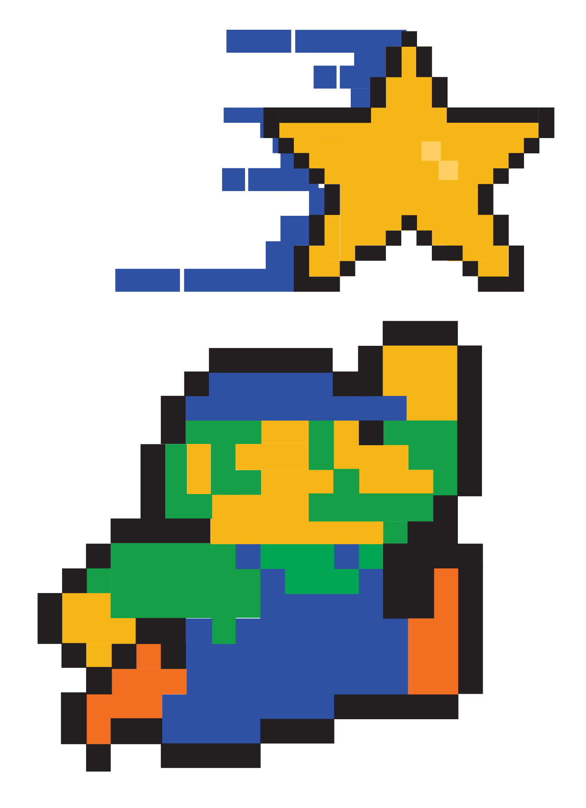
You Powered Up!!
Side Quest: Before next time reflect on how well you paced yourself during the practice test today. What actions could you take to increase the number of questions answered for next time?
Sneak Peek: Next time we will be learning about how to revise for conciseness.

