Slide 1
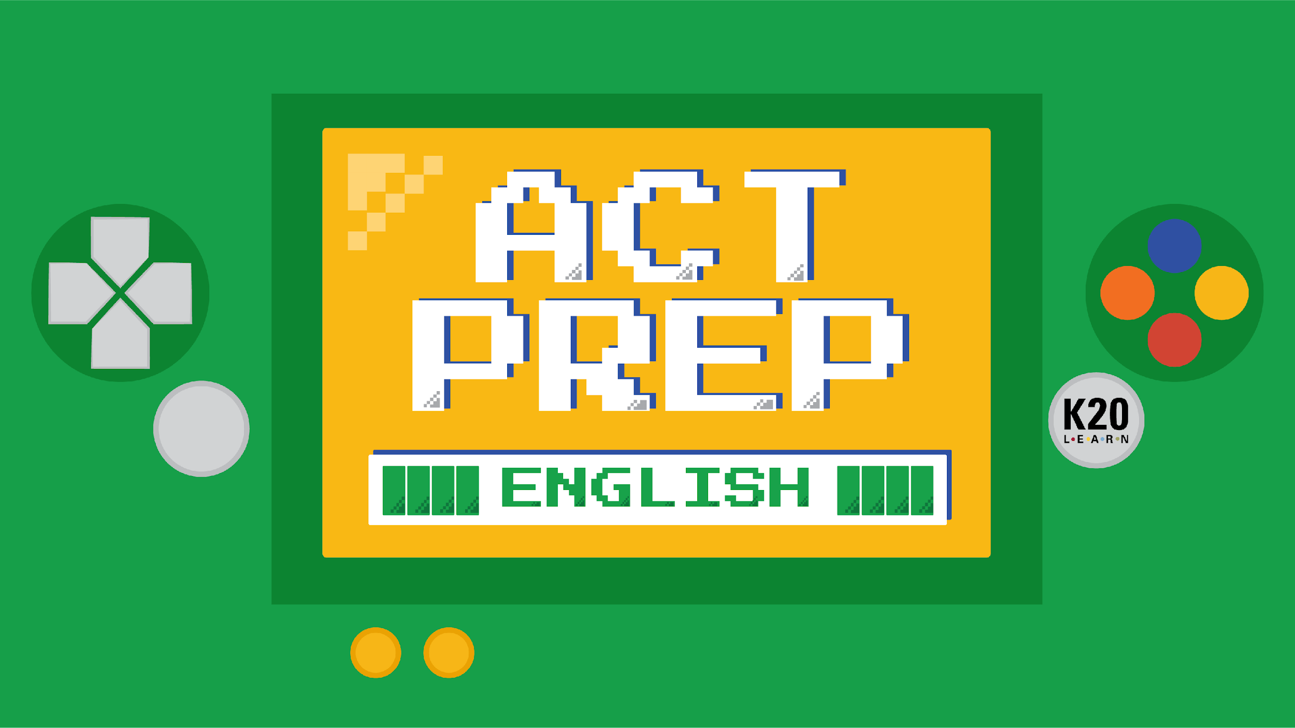

Slide 2
Power Up: English ACT Prep Week 9
Knowledge of Language

Slide 3
Essential Question
How can I increase my ACT score?

Slide 4
Learning Objective
Revise writing for conciseness, clarity, and meaning using the ARMS acronym.

Slide 5
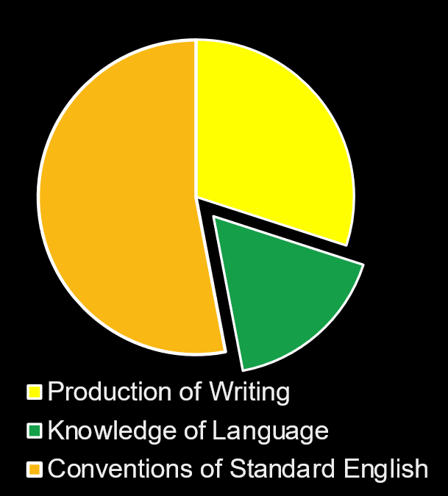
Why Does Knowledge of Language Matter?
Knowledge of Language
  Revision
  Conciseness

Slide 6
ARMS for Writing
A = ADD. Add any words, phrases, or sentences that are needed to make the meaning clear.
R = REMOVE. Delete any words, phrases, or sentences that are needed to make the paragraph concise.
M = MOVE. Move any words, phrases, or sentences to make the meaning clear.
S = SUBSTITUTE. Revise vague, clumsy, confusing, and wordy material. Use the word or phrase that is the most appropriate.

Slide 7
Quizizz
Once the Quizizz screen is up:
  Scan the QR code
  OR type in joinmyquiz.com; then type in the code provided
Use A.R.M.S to answer the questions
Notes:
K20 Center. (n.d.).Quizizz. Tech Tools. https://learn.k20center.ou.edu/tech-tool/2444

Slide 8
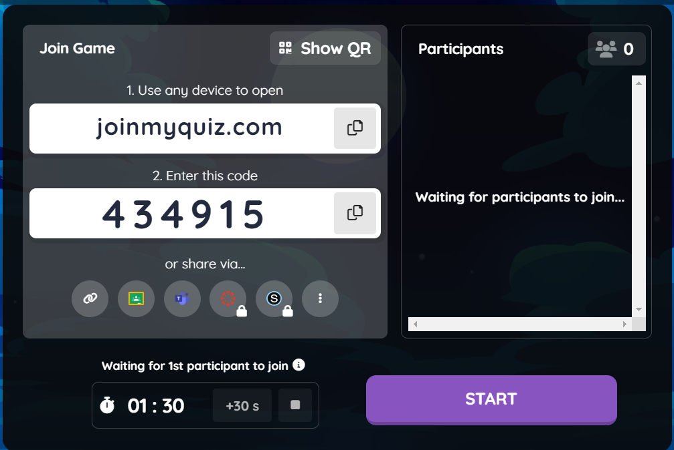
Quizizz
Once the Quizizz screen is up:
  Scan the QR code.
  OR type in joinmyquiz.com; then type in the code provided.
Use your notes on A.R.M.S to answer the questions.
Notes:
K20 Center. (n.d.).Quizizz. Tech Tools. https://learn.k20center.ou.edu/tech-tool/2444

Slide 9

Test Tip - Revising for Clarity and Conciseness
Most of the ACT questions focus on “choose the best answer,” so make sure to choose the most concise sentence that DOES NOT change the meaning of the sentence.

Slide 10

Complete the “A Perfect Night to Hunt” handout.
K20 Center 9 Minute Timer
Notes:
K20 Center. (2021, September 21). K20 Center 9 minute timer. YouTube. https://www.youtube.com/watch?v=ZvN435zg2zE&list=PL-aUhEQeaZXLMF3fItNDxiuSkEr0pq0c2&index=12

Slide 11
“A Perfect Night to Hunt” | Reflection
Question | Correct Answer | Explanation
1 | A | NO CHANGE is correct because the introductory material should be set apart from the main sentence using a comma.
2 | G | “The plow horse” is an appositive or another name for “old George.” If the appositive is extra information, then it should be set apart using commas.
3 | B | Two independent clauses that are connected in a sentence using a conjunction “and” must have a comma before the conjunction.
4 | H | The sentences should be combined using an adverbial phrase “because” since they both talk about the same subject.

Slide 12
“A Perfect Night to Hunt” | Reflection
Question | Correct Answer | Explanation
5 | C | This question concerns verb tense. The sentence primarily uses past tense verbs, so the verb “talk” should also be past tense.
6 | J | When the sentence begins with an adverbial phrase, it should be separated from the main sentence with a comma.
7 | D | This sentence was wordy, so the best choice was the sentence that was clear and concise and did not change the meaning of the original sentence.
8 | H | The original sentence was a fragment because it lacked a subject.

Slide 13
“A Perfect Night to Hunt” | Reflection
Question | Correct Answer | Explanation
9 | A | This choice is about plurals. To make a word a plural, add -s. No apostrophe or semicolon needed.
10 | H | This sentence is about verb tense. “Drive” is present tense, which is wrong since the narrator is remembering back to the what her dad would do.
11 | D | The original sentence uses the wrong verb tense. It should be “made their way,” not “making their way.”
12 | G | This question asks about what correct reflexive pronoun to use. Since “the dogs” is plural, “them” is correct.

Slide 14
“A Perfect Night to Hunt” | Reflection
Question | Correct Answer | Explanation
13 | D | This sentence is concerned with verb tense. The verb should be “increased,” which is past tense and no comma is needed.
14 | G | This sentence includes a misplaced modifier and should be moved next to the item it modifies, which is after “retrieved the horns.”
15 | D | This paragraph should be removed because it doesn’t add to the main idea of the essay.

Slide 15
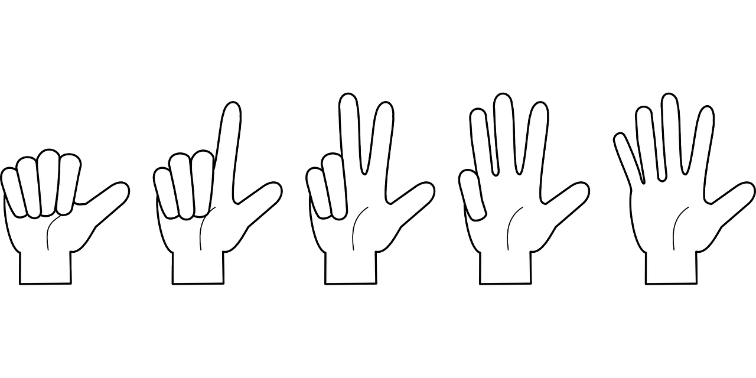
Fist to Five
How do you feel about answering ACT questions over revision and conciseness?
“I’m still confused.”
“I’m slightly confused.”
“I think I’ve got it.”
“I’ve got this and don’t need any help.”
“I’ve got this and can help others.”
Notes:
K20 Center. (n.d.). Fist to five. Strategies. Retrieved from https://learn.k20center.ou.edu/strategy/7b4de59085f566aa097814b8c0003b4a

Slide 16

You Powered Up!
Side Quest: On a writing assignment or an assignment that includes writing, try to be as concise as possible without losing the meaning of your original sentence.
Sneak Peek: Next time, we will be reviewing the entire English section of the ACT.

