Slide 1
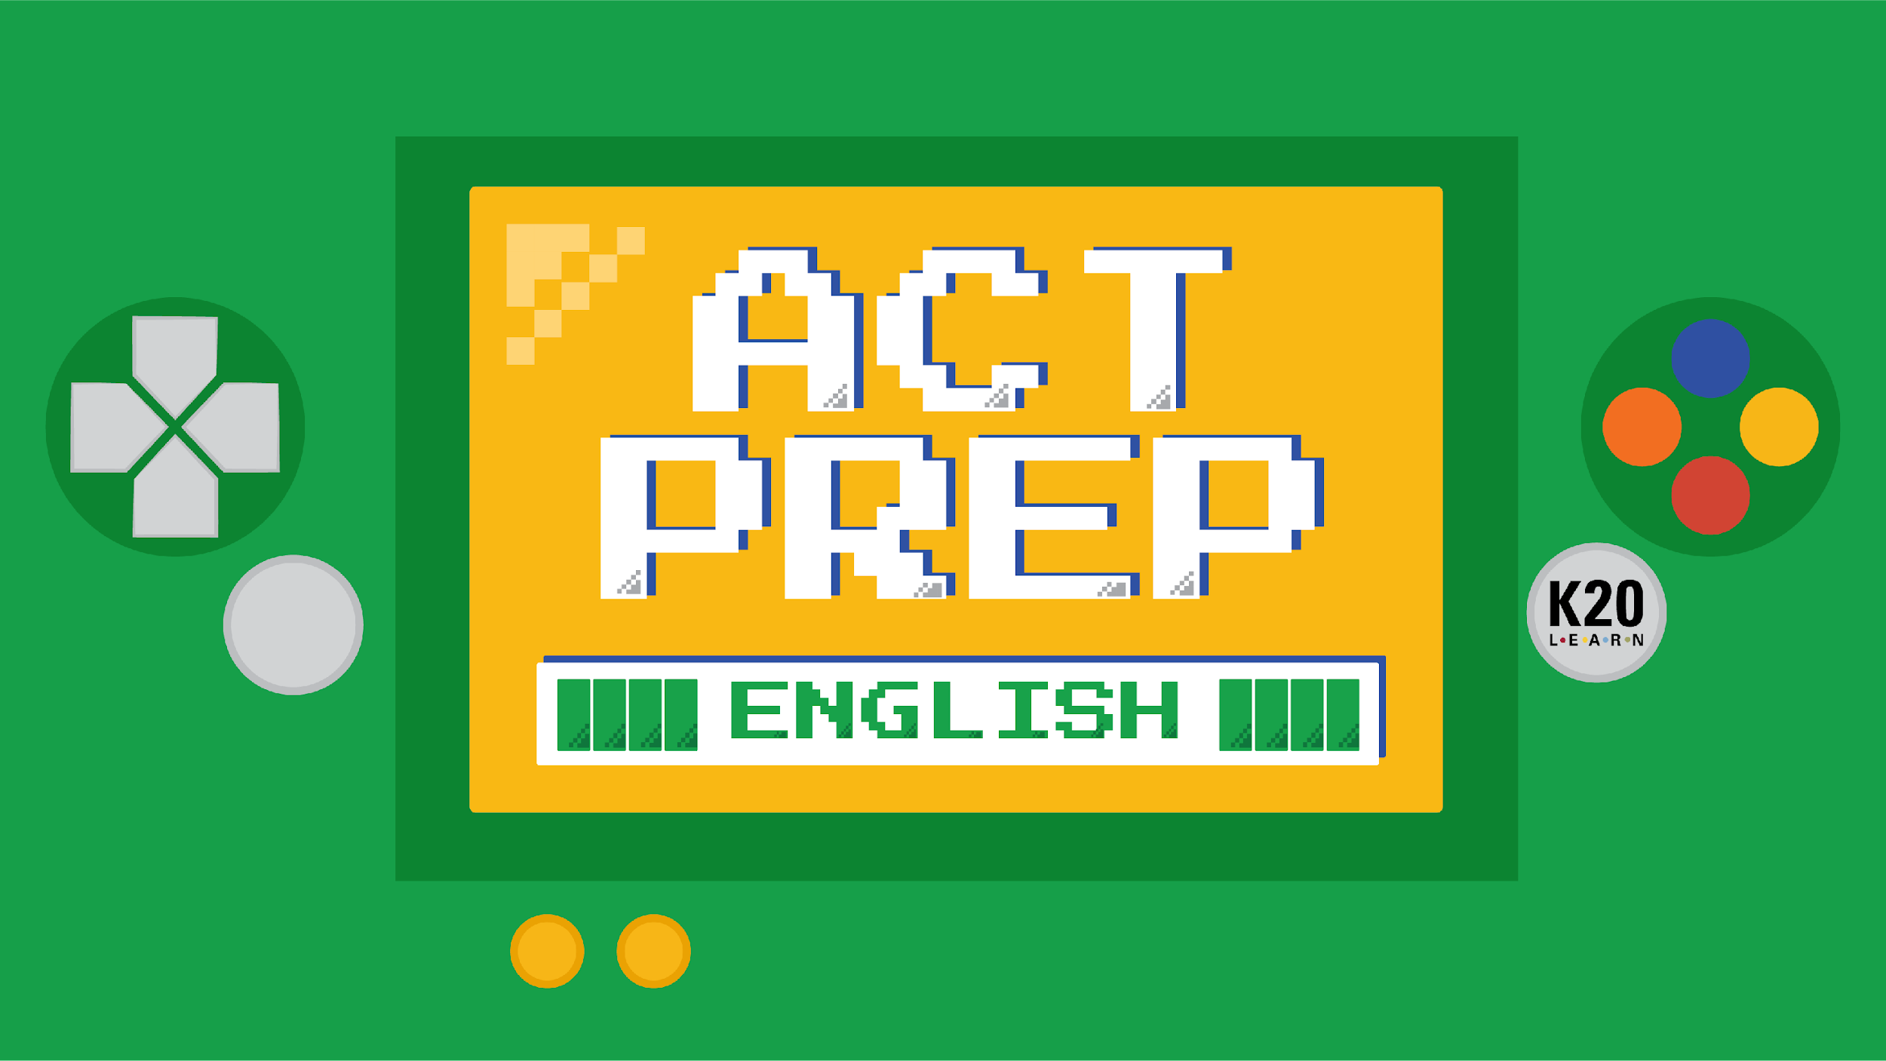

Slide 2
Power Up:
English ACT Prep, Week 10
Review

Slide 3

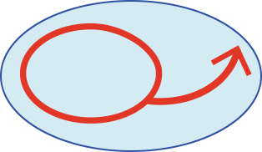
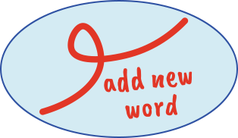
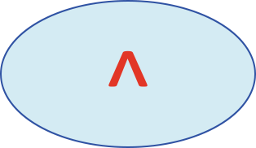
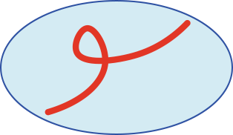
Bell Ringer
Use your Skill Sets Check handout
to review the A.R.M.S. acronym.
Read through the example
annotated paragraph.
Identify which revision symbol goes
with which A.R.M.S. word and why.
Draw one of the symbols next to each A.R.M.S.
word: Add, Remove, Move, or Substitute.
Notes:
K20 Center. (n.d.). Bell ringers and exit tickets. Strategies. https://learn.k20center.ou.edu/strategy/125

Slide 4
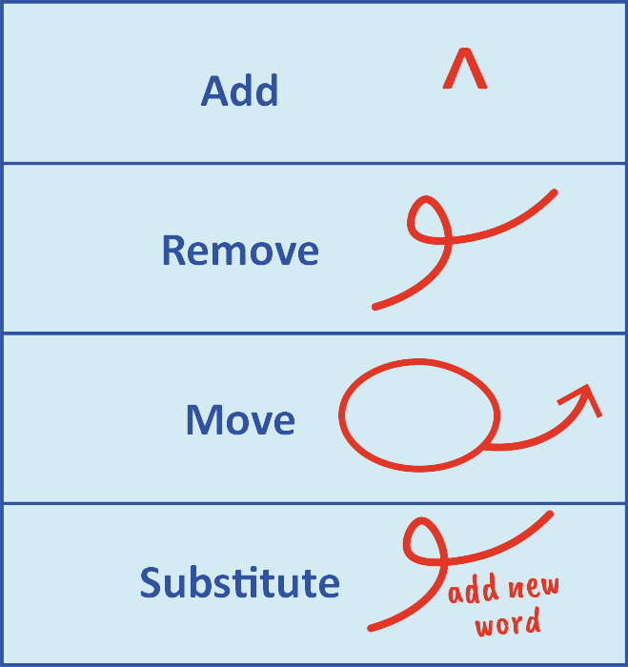
Bell Ringer
Notes:
K20 Center. (n.d.). Bell ringers and exit tickets. Strategies. https://learn.k20center.ou.edu/strategy/125

Slide 5
Essential Question
How can I increase my ACT score?

Slide 6
Learning Objective
Practice and reflect on grammar and revision skills to increase the number of questions answered correctly on the English portion of the ACT.

Slide 7


Sentence Structure and Format
Organization, Unity, Cohesion
Production of Writing
Topic Development
Conventions
of Standard English
Usage
Knowledge of
Language
Revision
Punctuation
Conciseness

Slide 8
5 Skill Sets Check handouts
Retrieve your 5 handouts and review them:
Week 2: Usage
Week 3: Punctuation
Week 4: Sentence Structure and Formation
Week 6: Organization and Topic Development
Week 9: Revision and Conciseness

Slide 9

Muddiest Point
After reviewing the 5 Skill Sets Check handouts, identify what is your muddiest point:
  What topic is the most confusing?
Write your muddiest point on your
ACT Guided Practice handout.
Notes:
K20 Center. (n.d.). Muddiest point. Strategies. Retrieved from https://learn.k20center.ou.edu/strategy/109

Slide 10
ACT Guided Practice
Find the passage that has the most questions about your Muddiest Point.
Put a star or mark next to that passage.
Notes:
K20 Center. (n.d.). Muddiest point. Strategies. Retrieved from https://learn.k20center.ou.edu/strategy/109

Slide 11
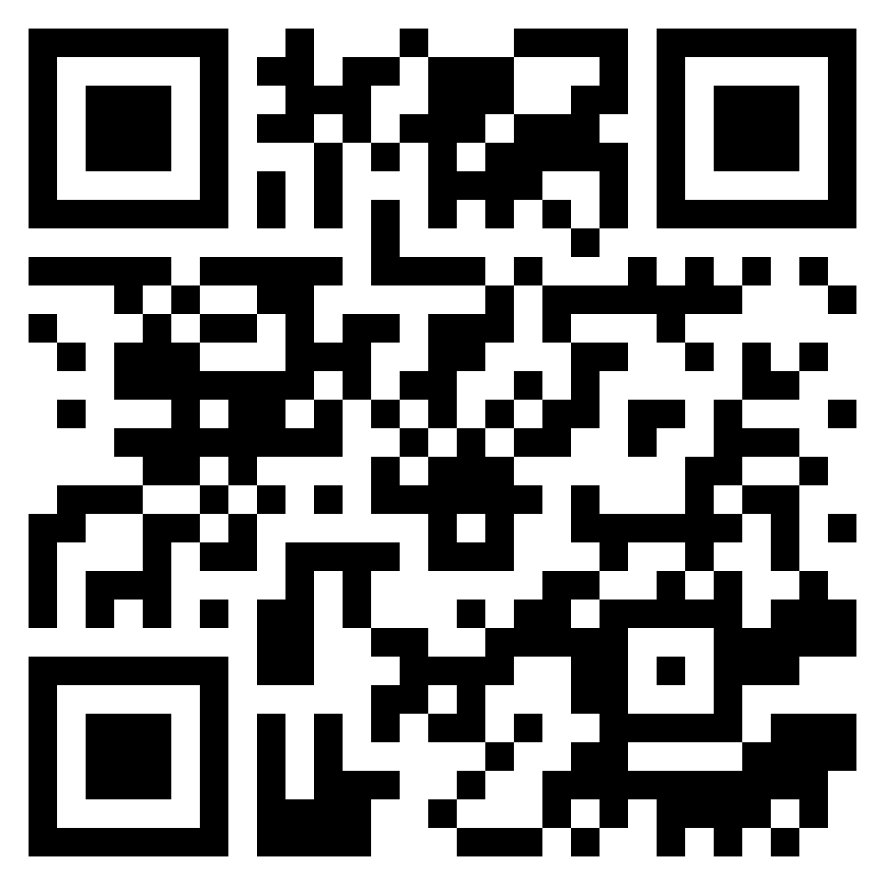
Magoosh
Access Magoosh Practice Test
Go to: act.magoosh.com/act-practice-test
OR
Scan the QR code:

Slide 12
Magoosh Practice Test
Navigate to the page of the practice test that has the passage number that your marked on your handout.
Passage I: Begin on page 3
Passage II: Begin on page 5
Passage III: Begin on page 7
Passage IV: Begin on page 10
Passage V: Begin on page 12

Slide 13
Magoosh Practice Test
Once you found your passage, number your notebook paper, read the passage, and record your answers on your paper.
Passage I: Starts with question 1
Passage II: Starts with question 16
Passage III: Starts with question 31
Passage IV: Starts with question 46
Passage V: Starts with question 61

Slide 14
Magoosh Practice Test
Navigate to page 54.
Click the VIEW EXPLANATIONS button.
Notes:
Magoosh: https://act.magoosh.com/practice-test-pdf-explanations?utm_source=PracticeTestPDF&utm_medium=Explanations

Slide 15
Magoosh Practice Test
Select a question number.
Select your answer choice.
  Remember the order of the options:
A E
B F
C G
D H
Click the “Submit Answer” button.
Notes:
Magoosh: https://act.magoosh.com/practice-test-pdf-explanations?utm_source=PracticeTestPDF&utm_medium=Explanations

Slide 16
Magoosh Practice Test
If you missed the question, scroll down and read or watch the explanation.
  If you watch the video, be mindful of your classmates and use headphones.
Repeat this for other questions.
Remember, you can use this practice outside of class.
Notes:
Magoosh: https://act.magoosh.com/practice-test-pdf-explanations?utm_source=PracticeTestPDF&utm_medium=Explanations

Slide 17
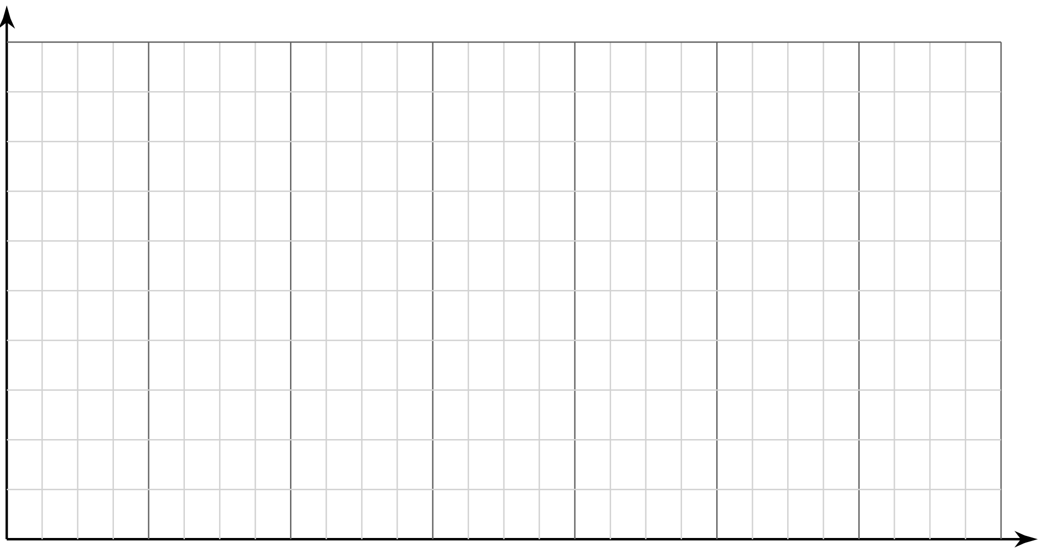

Sticky Bars
Let’s see what actions everyone is working on!
Write your name on a sticky note.
Place your note above the action you have selected for the English subject test.
1
2
3
4
5
6
Notes:
K20 Center. (n.d.). Sticky Bars. Strategies. https://learn.k20center.ou.edu/strategy/129

Slide 18
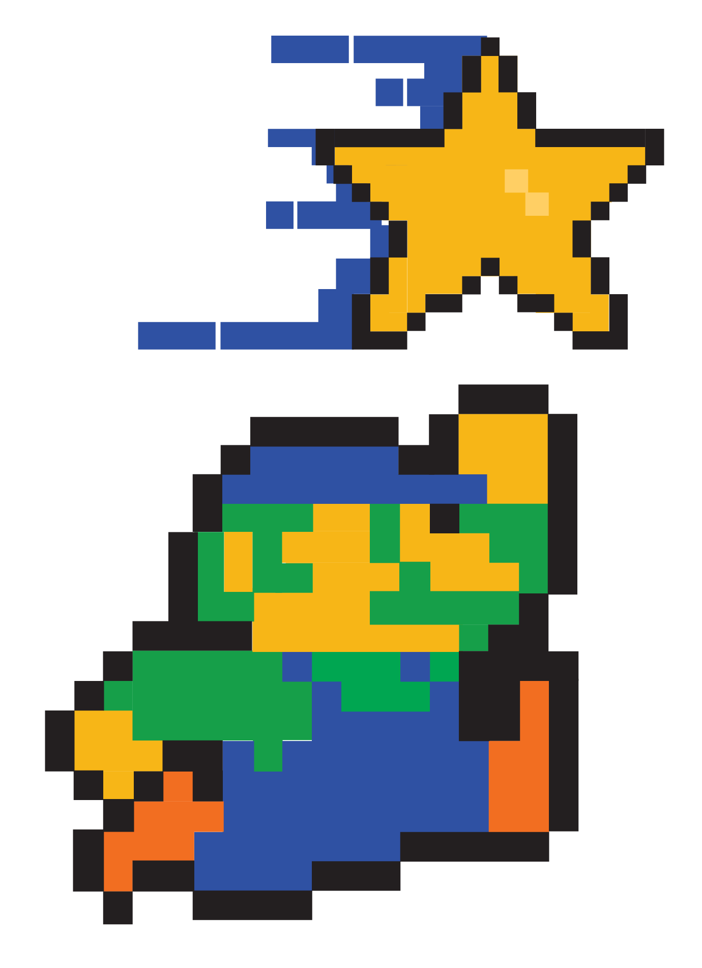
You Powered Up!
Congratulations!
You have completed your 10 week English ACT Prep challenge!
Side Quest: Try a full, 45-minutes, English ACT practice test on your own.
You may use Magoosh, Khan Academy, or MyACT.org for free.

