Slide 2
Power Up: Science ACT Prep, Week 7
Scientific Method

Slide 3
Essential Question
How can I improve my ACT score?

Slide 4
Learning Objectives
Identify steps in the scientific method.
Evaluate experiments for whether they follow the scientific method.

Slide 5
Scientific Method
Analyze the Data
Ask a Question
Conduct the Experiment
Design an Experiment
Draw Conclusions
Make a Hypothesis

Slide 6
Scientific Method
Ask a Question
Make a Hypothesis
Design an Experiment
Conduct the Experiment
Analyze the Data
Draw Conclusions

Slide 7

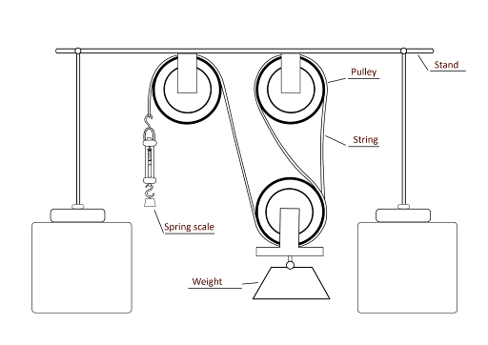
Fiction in the Facts
Part 1: A student wants to learn how using a pulley changes the force needed to move an object.
Part 2: He sets up an experiment as illustrated on the right, adding a new pulley each time, and uses the spring scale to measure and record the force. He then creates a bar graph to analyze the data, finding that using the pulley system results in using less force to move the weight.
Part 3: He hypothesizes that more pulleys require less force.

Slide 8
Fiction in the Facts
Part 1: A student wants to learn how using a pulley changes the force needed to move an object.
Part 2: He sets up an experiment as illustrated on the right, adding a new pulley each time, and uses the spring scale to measure and record the force. He then creates a bar graph to analyze the data, finding that using the pulley system results in using less force to move the weight.
Part 3: He hypothesizes that more pulleys require less force.

Slide 9
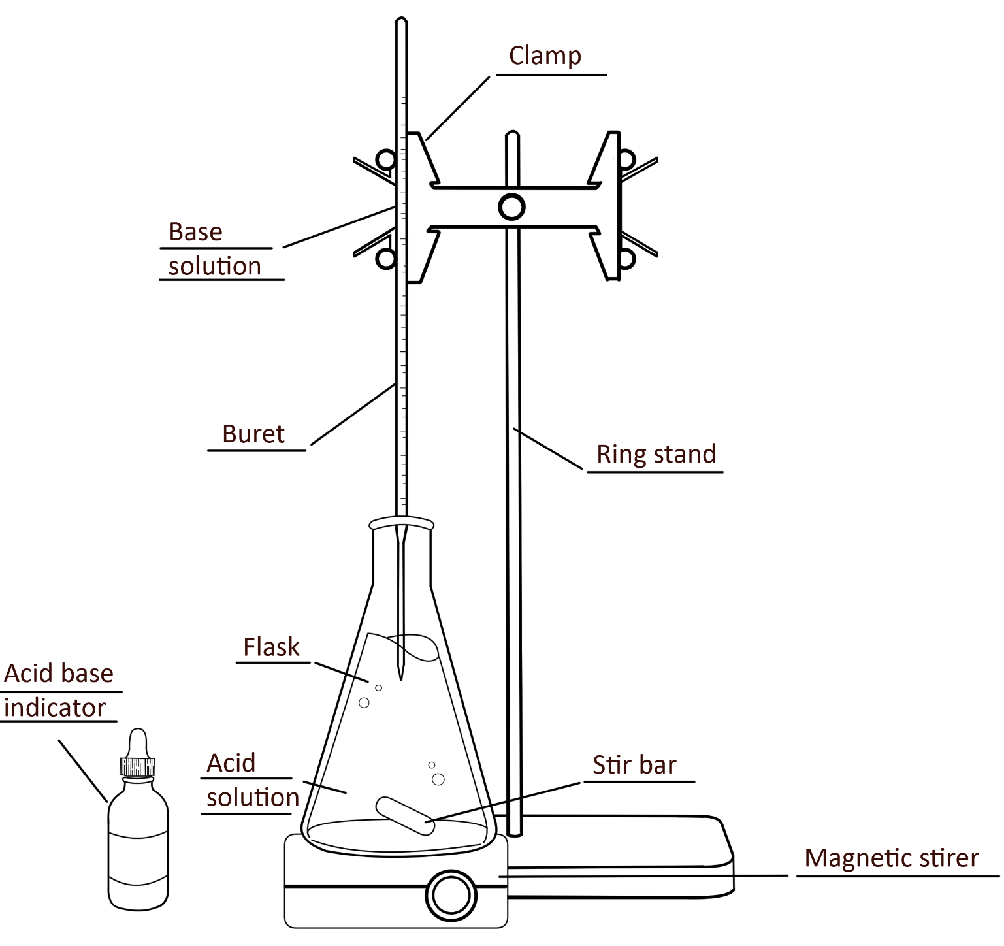
Fiction in the Facts
Part 1: A scientist sets up an experiment as illustrated on the right. He hypothesizes that if he adds a known base he can determine the acid content by when the solution is neutralized.
Part 2: Then he uses the buret to slowly add the base to the acid. He wants to determine the concentration of an acid.
Part 3: He notes the volume of the base that is required to neutralize the acid. He uses this volume to determine the acidity of the original solution.

Slide 10
Fiction in the Facts
Part 1: A scientist sets up an experiment as illustrated on the right. He hypothesizes that if he adds a known base he can determine the acid content by when the solution is neutralized.
Part 2: Then he uses the buret to slowly add the base to the acid. He wants to determine the concentration of an acid.
Part 3: He notes the volume of the base that is required to neutralize the acid. He uses this volume to determine the acidity of the original solution.

Slide 11
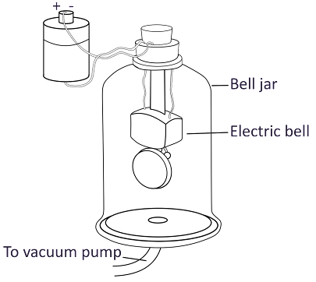
Fiction in the Facts
Part 1: A scientist wonders how a vacuum affects sound. She hypothesizes that without air, you will not hear sound.
Part 2: She concludes sound needs something to travel through.
Part 3: She turns on the bell, followed by the vacuum, to remove air from the bell jar. As the air is removed, the sound becomes more faint and then stops.

Slide 12
Fiction in the Facts
Part 1: A scientist wonders how a vacuum affects sound. She hypothesizes that without air, you will not hear sound.
Part 2: She concludes sound needs something to travel through.
Part 3: She turns on the bell, followed by the vacuum, to remove air from the bell jar. As the air is removed, the sound becomes more faint and then stops.

Slide 13
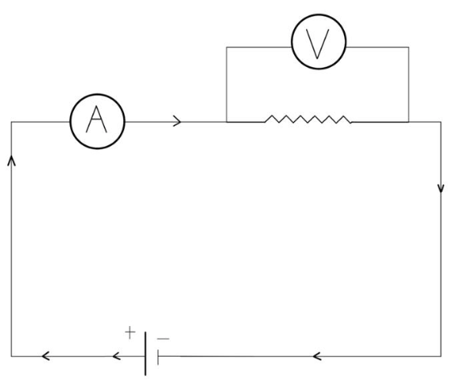
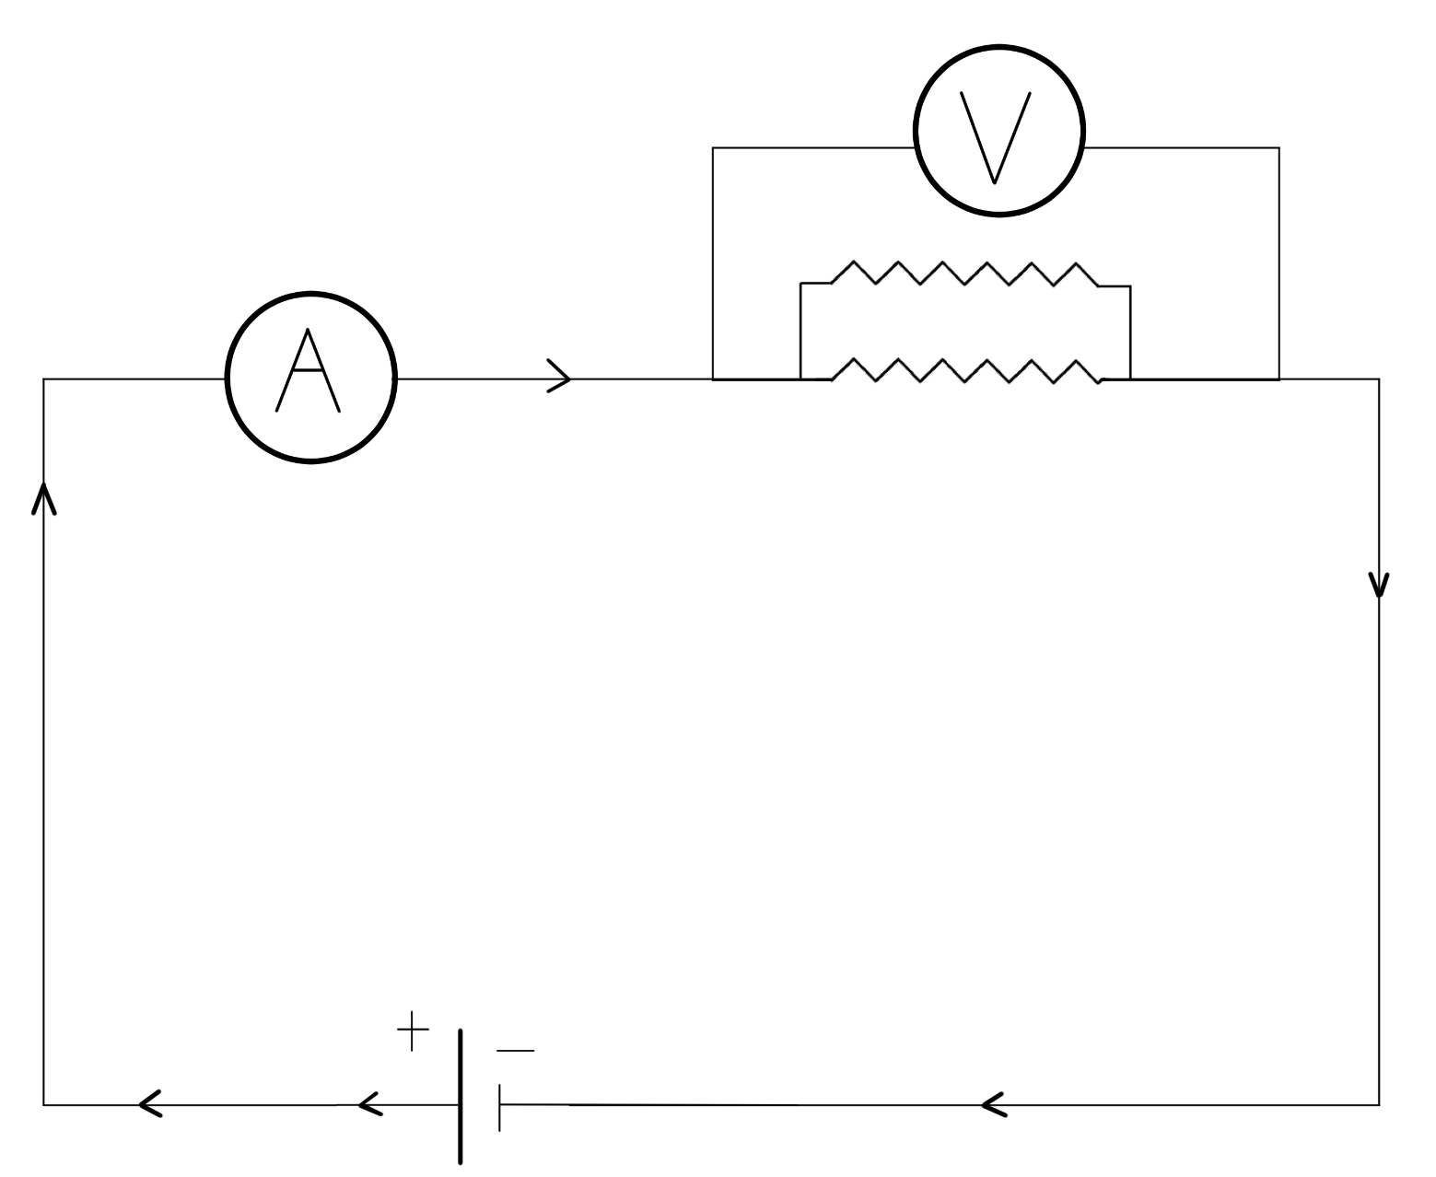
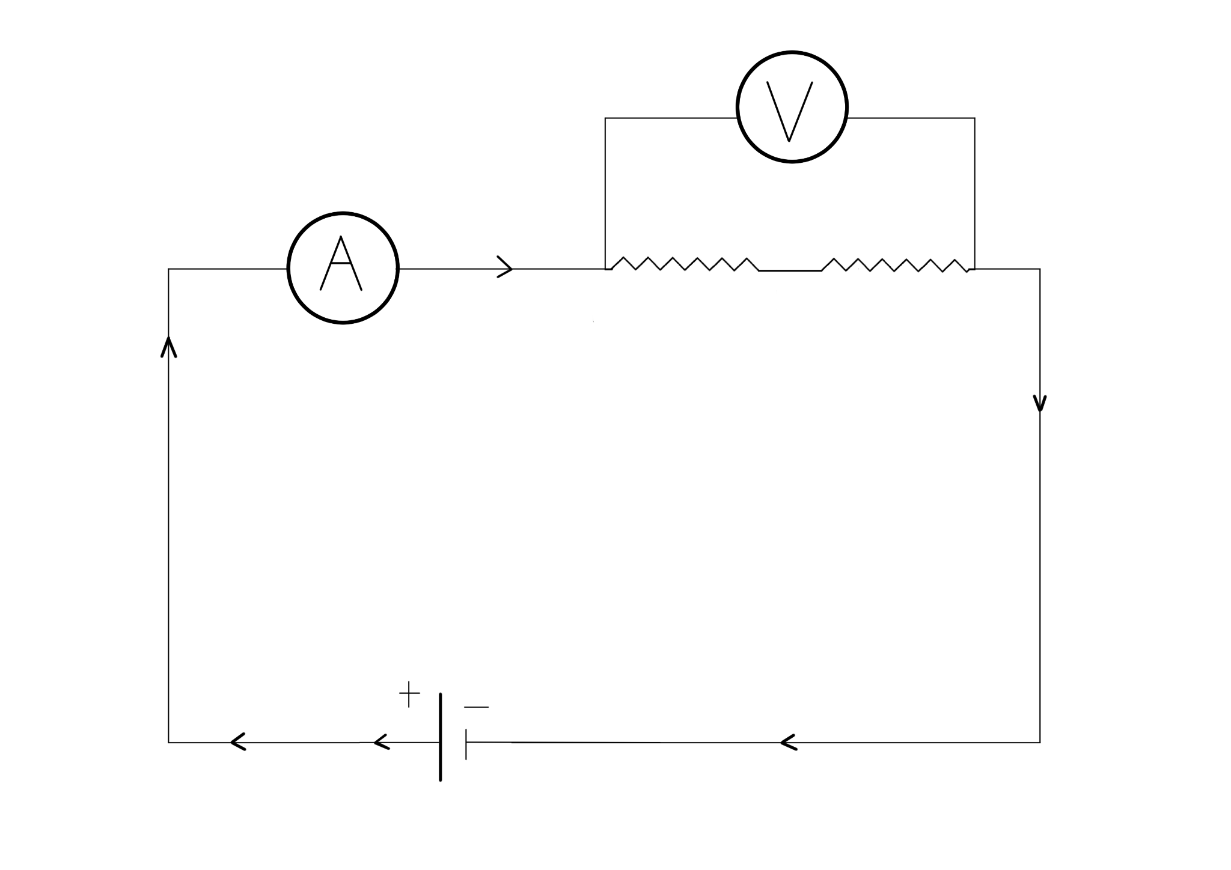
It’s Electrifying! - Answer Key
Figure 1
Table 1
Replacing the Resistors |  |  | Parallel Resistors
Resistance (ohms) | Current (amps) | Power (volts) | Resistance (ohms) | Current (amps) | Power (volts)
10 | 0.9 | 9 | 10 & 10 | 1.8 | 9
20 | 0.45 | 9
Figure 2

Slide 14
It’s Electrifying! - Answer Key
B
E
C

Slide 15

Pacing Practice
10-Minute Timer
Notes:
https://youtu.be/9gy-1Z2Sa-c?si=GYt0FDbfJm9v86hY

Slide 16

You Powered Up!

