Slide 1
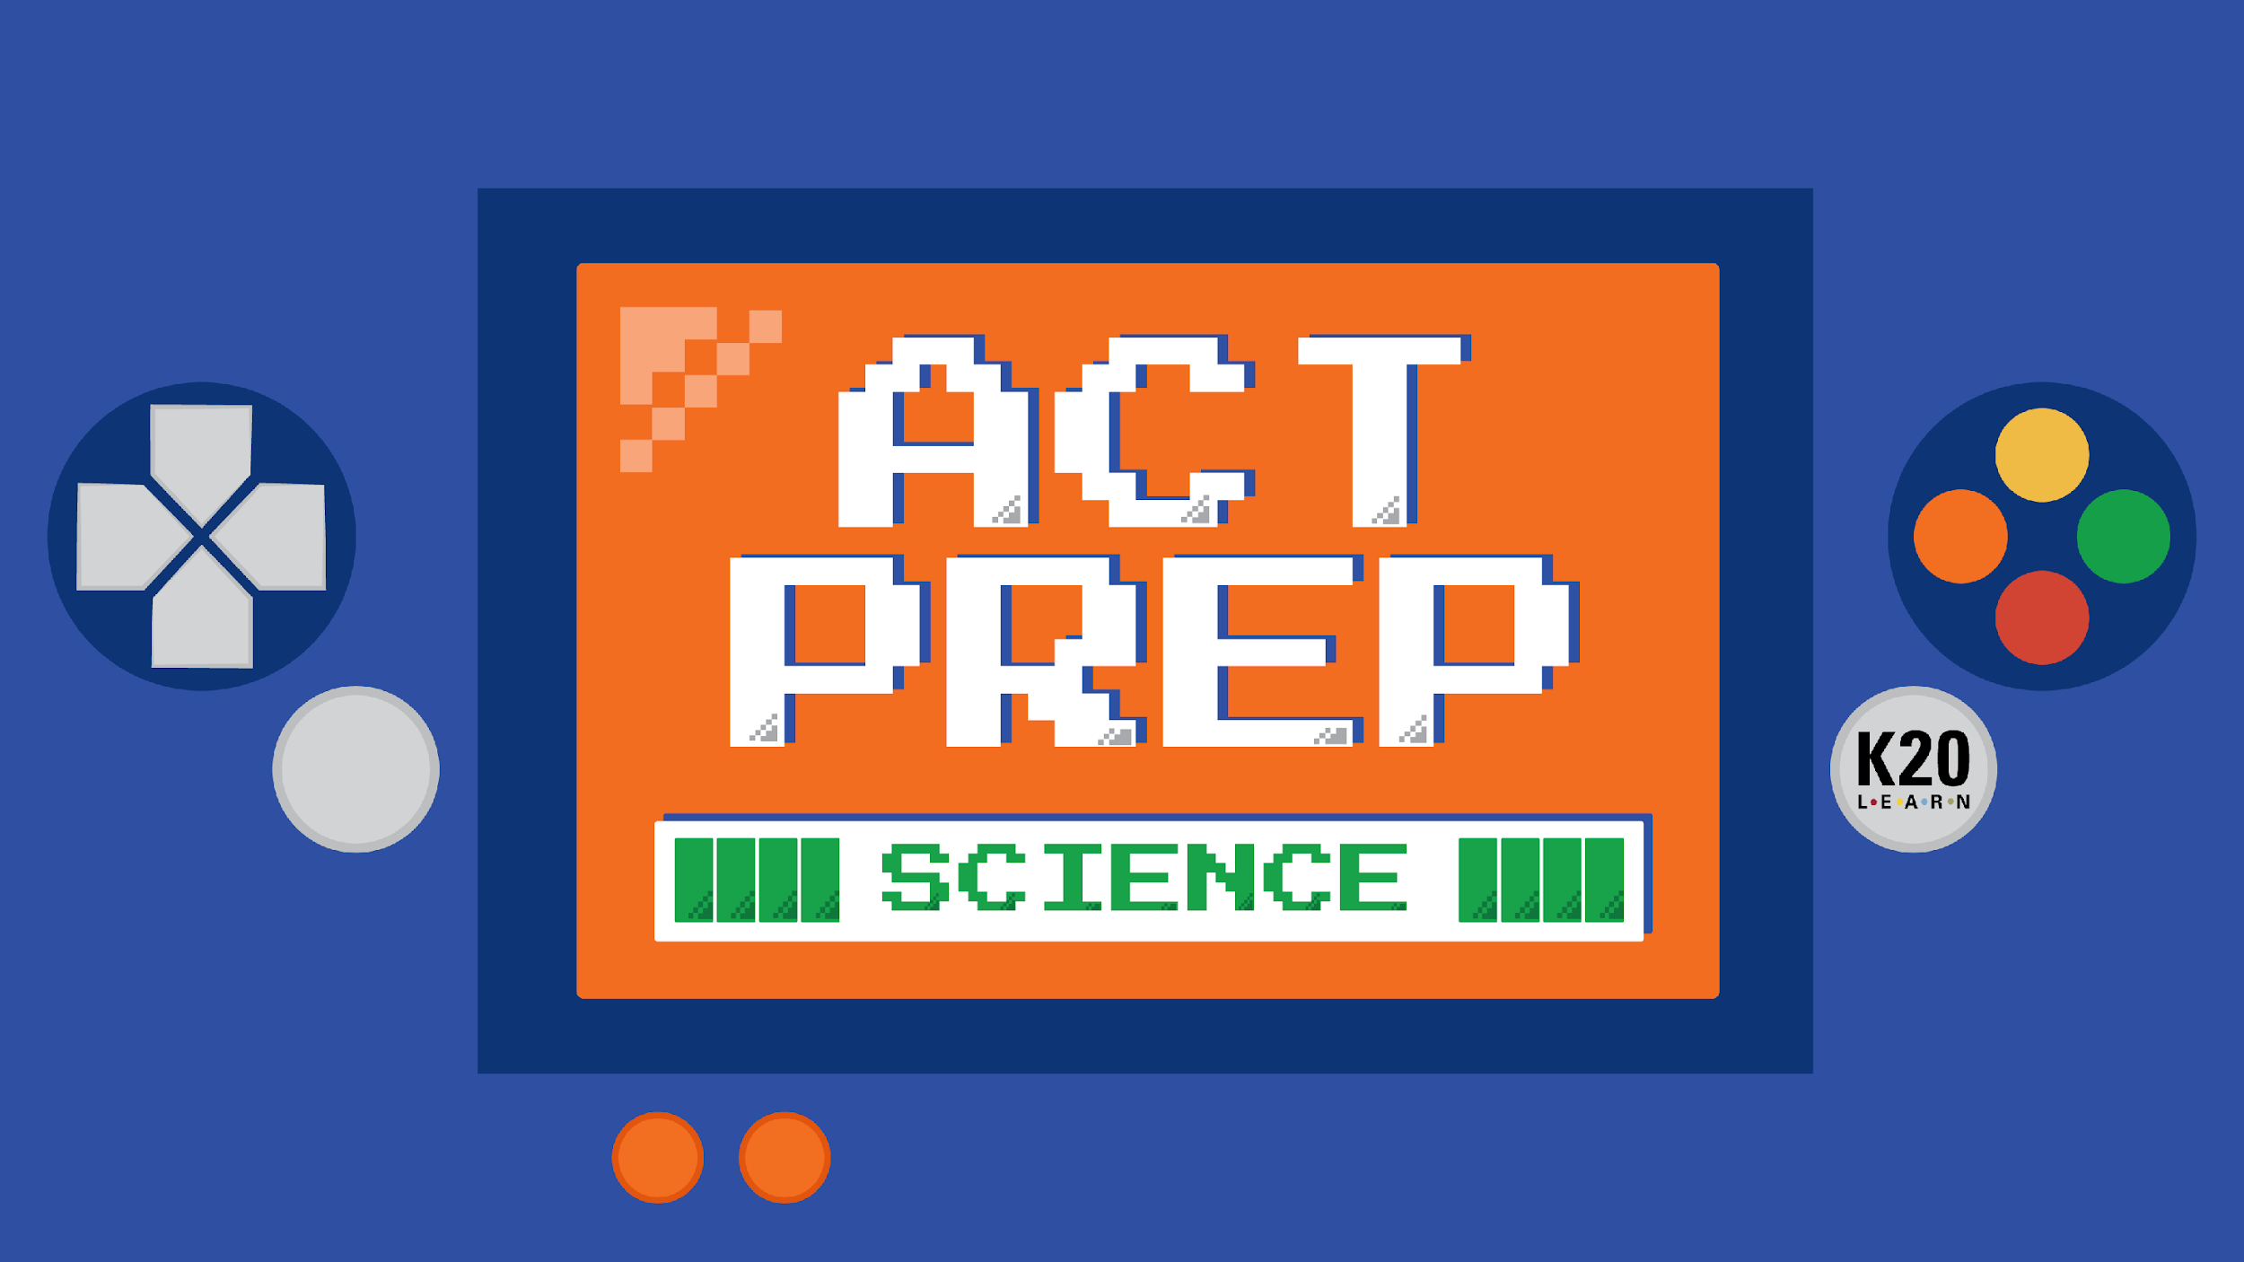

Slide 2
Power Up: Science ACT Prep, Week 8
Constants and Variables

Slide 3
Essential Question
How can I improve my ACT score?

Slide 4
Learning Objectives
Identify the constant and variables in an experiment.
Evaluate experiments based on a knowledge of constants and variables.

Slide 5
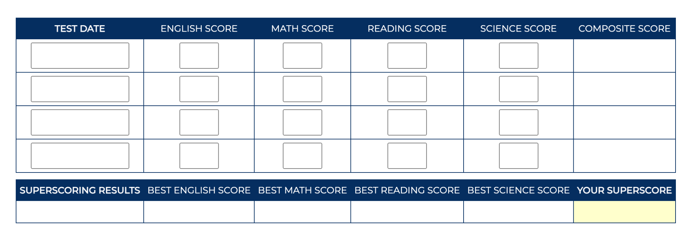
ACT Superscore Calculator
http://k20.ou.edu/superscore
Notes:
https://cloud.e.act.org/superscore-calculator?utm_term=&utm_campaign=Google%7CP-Max%7CFull+Funnel%7CB2C%7CCPC%7CDecember+ACT+2023%7C10/11/2023-11/17/2023%7CDesktop&utm_source=adwords&utm_medium=ppc&hsa_acc=5799955628&hsa_cam=20649464771&hsa_grp=&hsa_ad=&hsa_src=x&hsa_tgt=&hsa_kw=&hsa_mt=&hsa_net=adwords&hsa_ver=3&gad_source=1&gclid=CjwKCAiA9dGqBhAqEiwAmRpTCxPp9OafTD6vbnasb-Yfo6AibzdliXHGV4TDseQ4hGN18Ough_D_vBoCliYQAvD_BwE

Slide 6
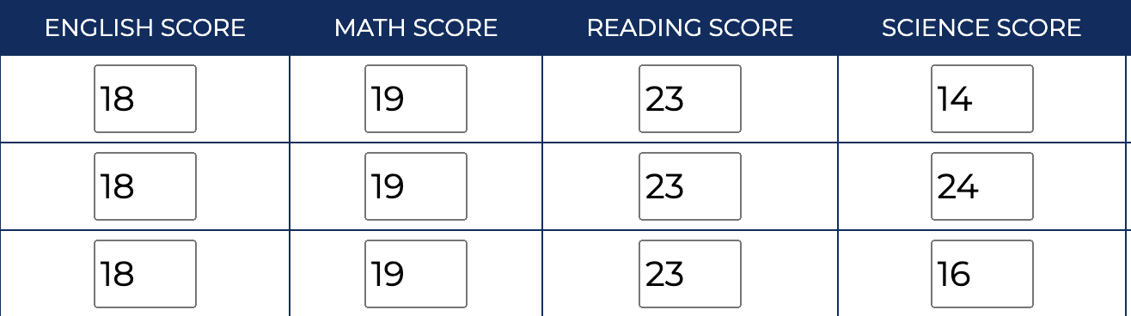
Constants and Variables
Constant - What doesn’t change during an experiment
Variable - Something that can be changed in an experiment

Slide 7
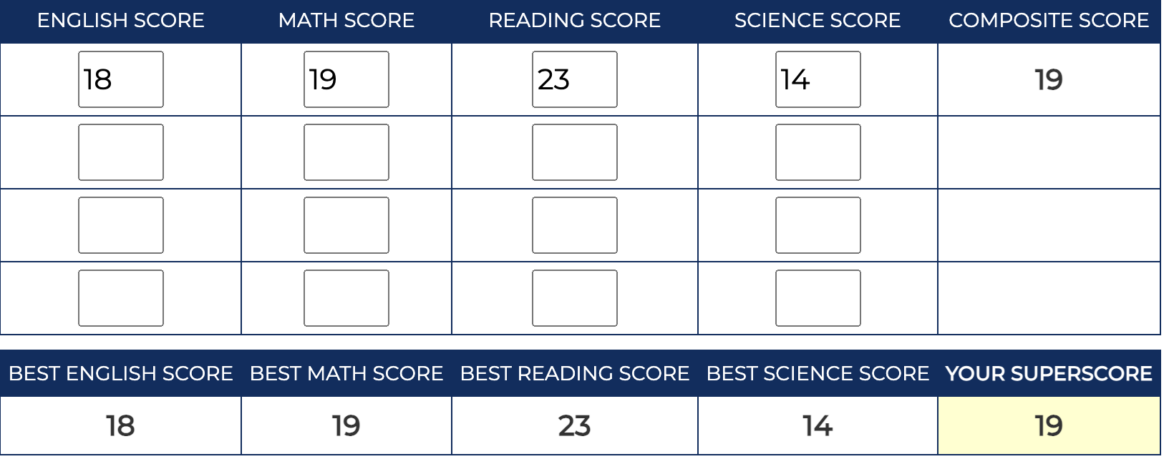

Slide 8
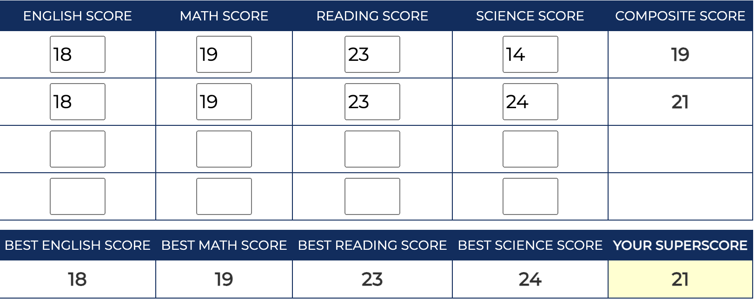

Slide 9
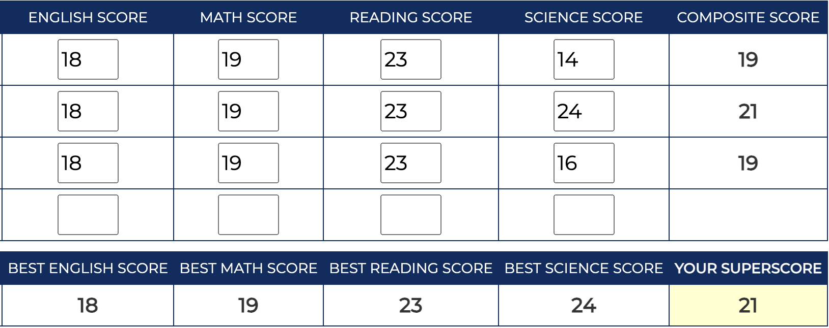

Slide 10

Chat Stations: Constants and Variables
Number off 1-4.
Visit the Chat Station that matches your assigned number.
Work together to identify the constants and variables at your station.

Slide 11
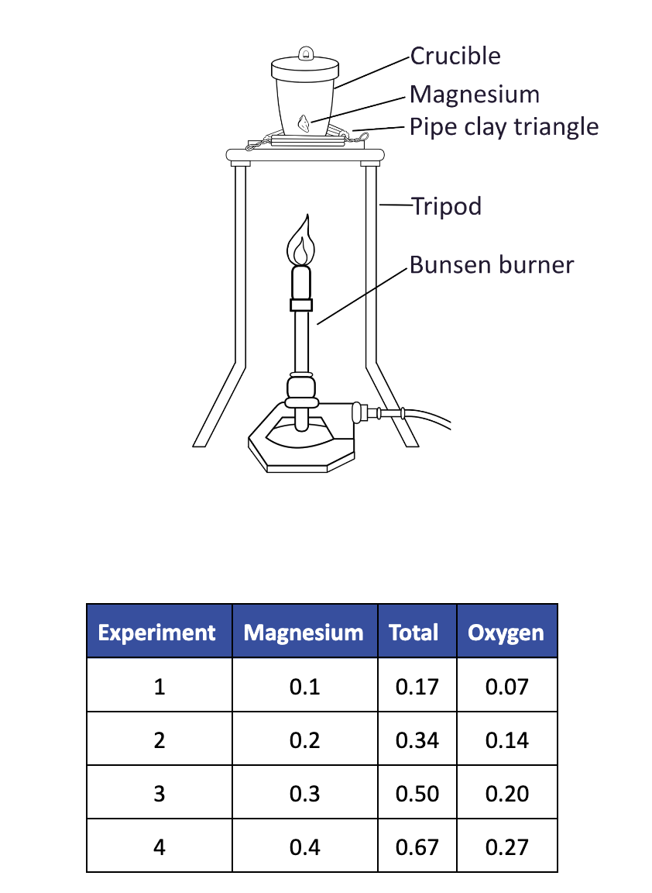
Chat Stations: Constants and Variables

Slide 12
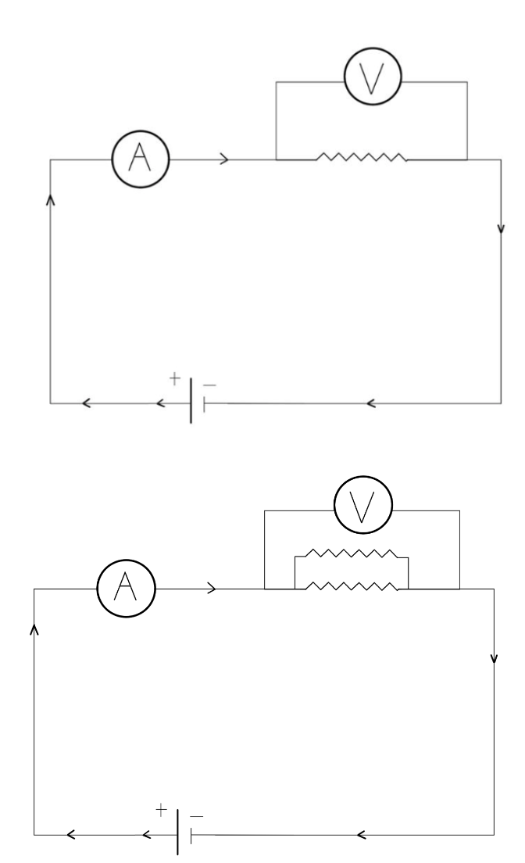
Chat Stations: Constants and Variables

Slide 13
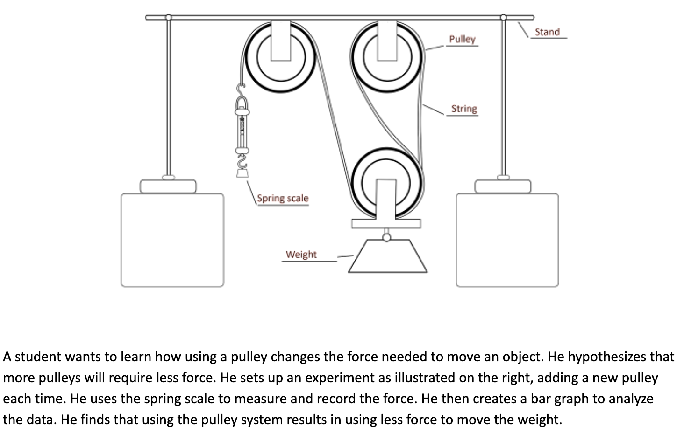
Chat Stations: Constants and Variables

Slide 14
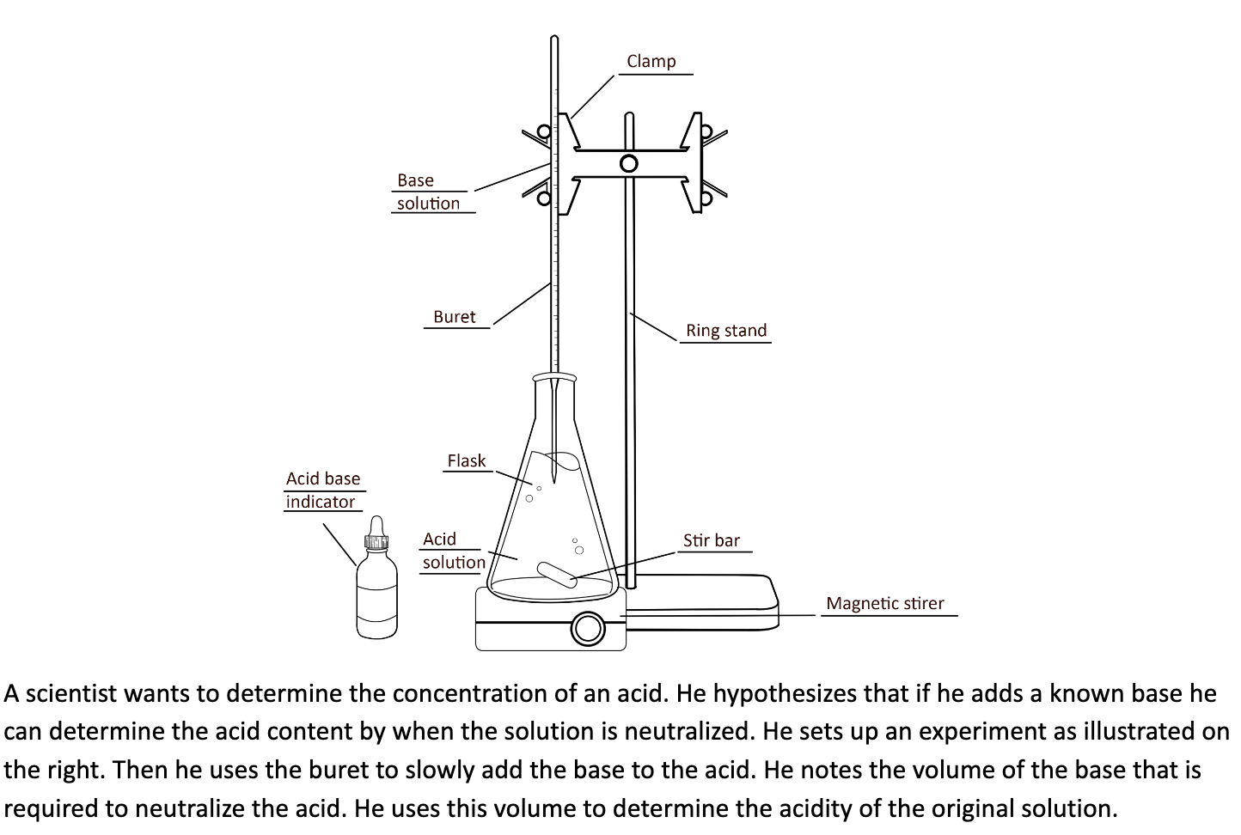
Chat Stations: Constants and Variables

Slide 15

Practice Passages
15-Minute Timer
Notes:
https://youtu.be/m3zT2IxZQaw?si=yKa8S7ytgprtMyaf

Slide 16
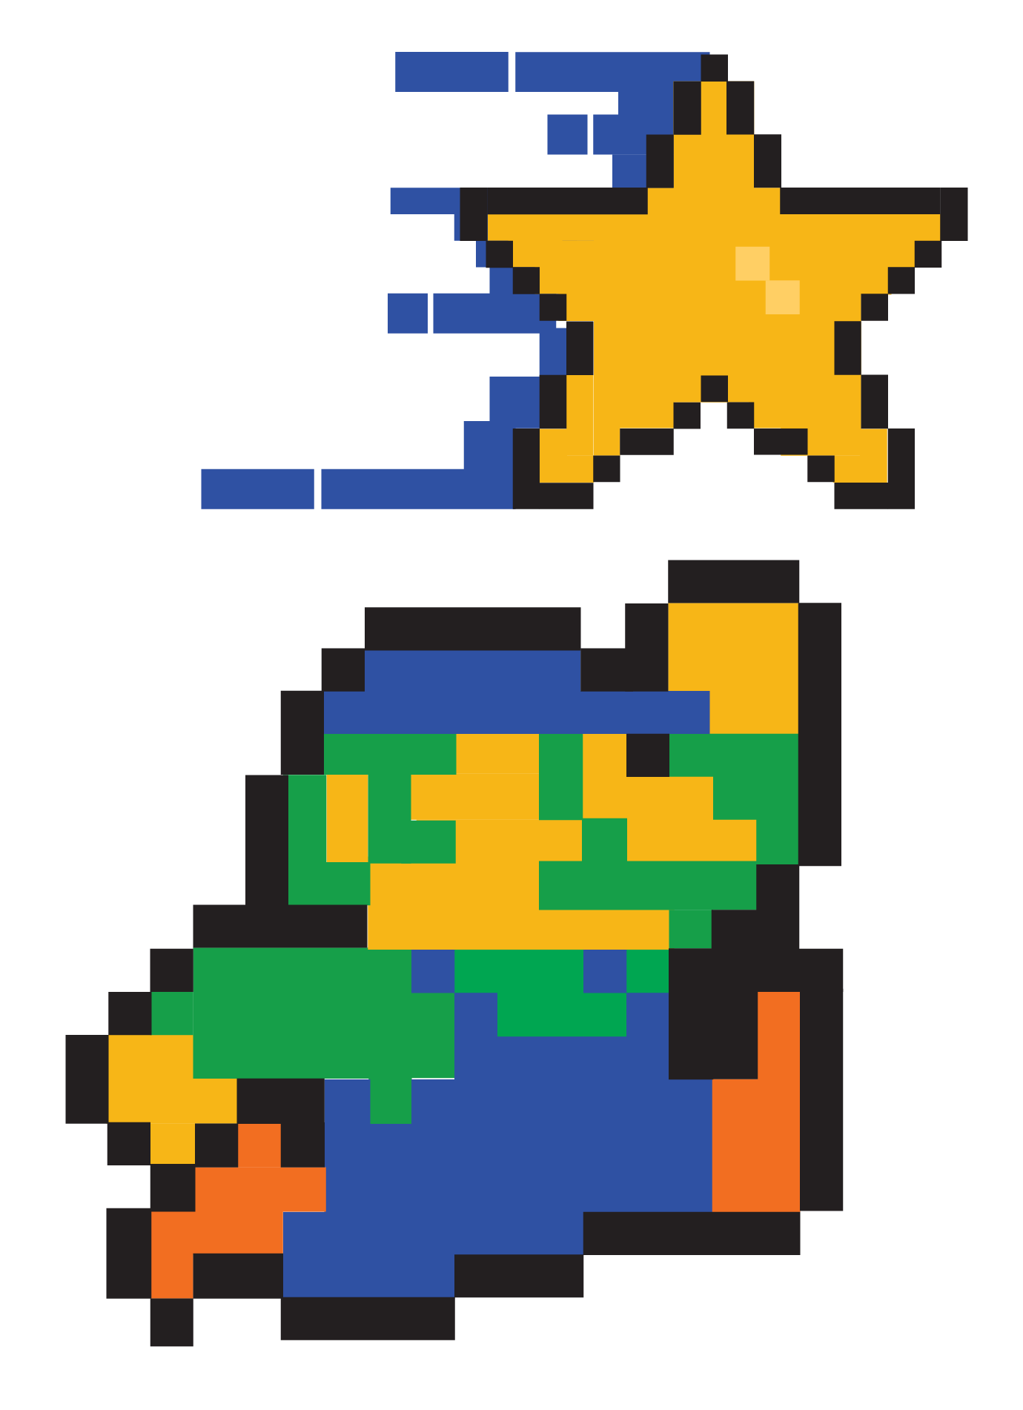
You Powered Up!

