Slide 2
Power Up: Science ACT Prep, Week 10
Practice Test

Slide 3
Essential Question
How can I improve my ACT score?

Slide 4
Learning Objectives
Practice and reflect on pacing to increase the number of questions answered on the science portion of the ACT.
Navigate efficiently through TestNav during a practice test.

Slide 5



Let’s Get Ready
Find your device and scratch paper.

Slide 6
TestNav: Getting Started
Navigate to home.testnav.com. Then click “The ACT” button.
OR
Open the TestNav application on your school device.

Slide 7
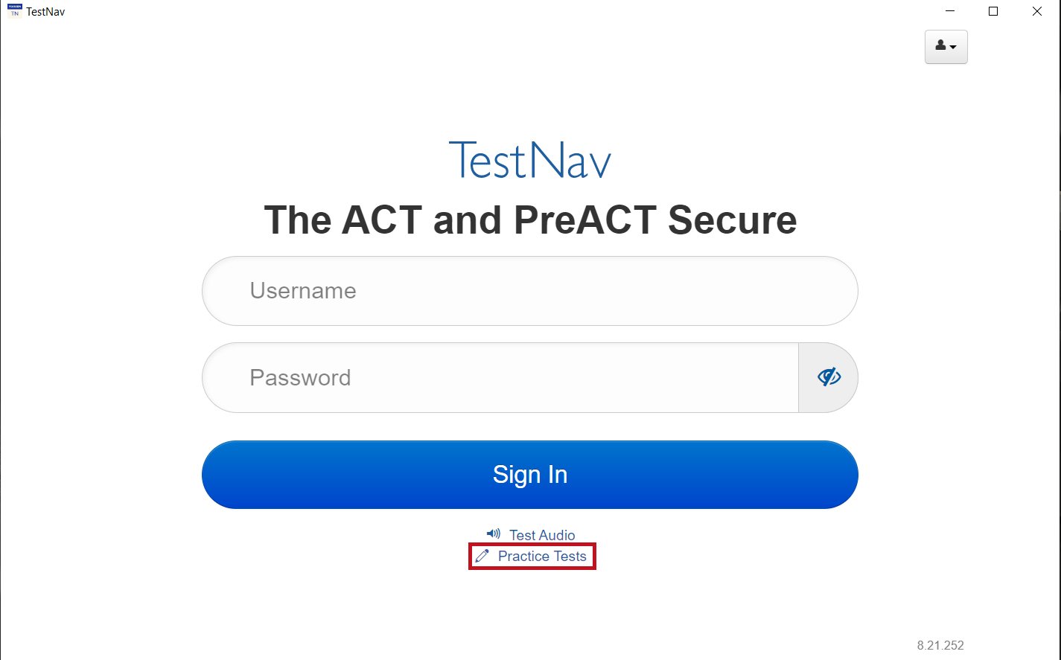
TestNav: Selecting the Right Test
Click “Practice Tests.”
Notes:
TestNav. (2023). Login screen. [Screenshot].

Slide 8
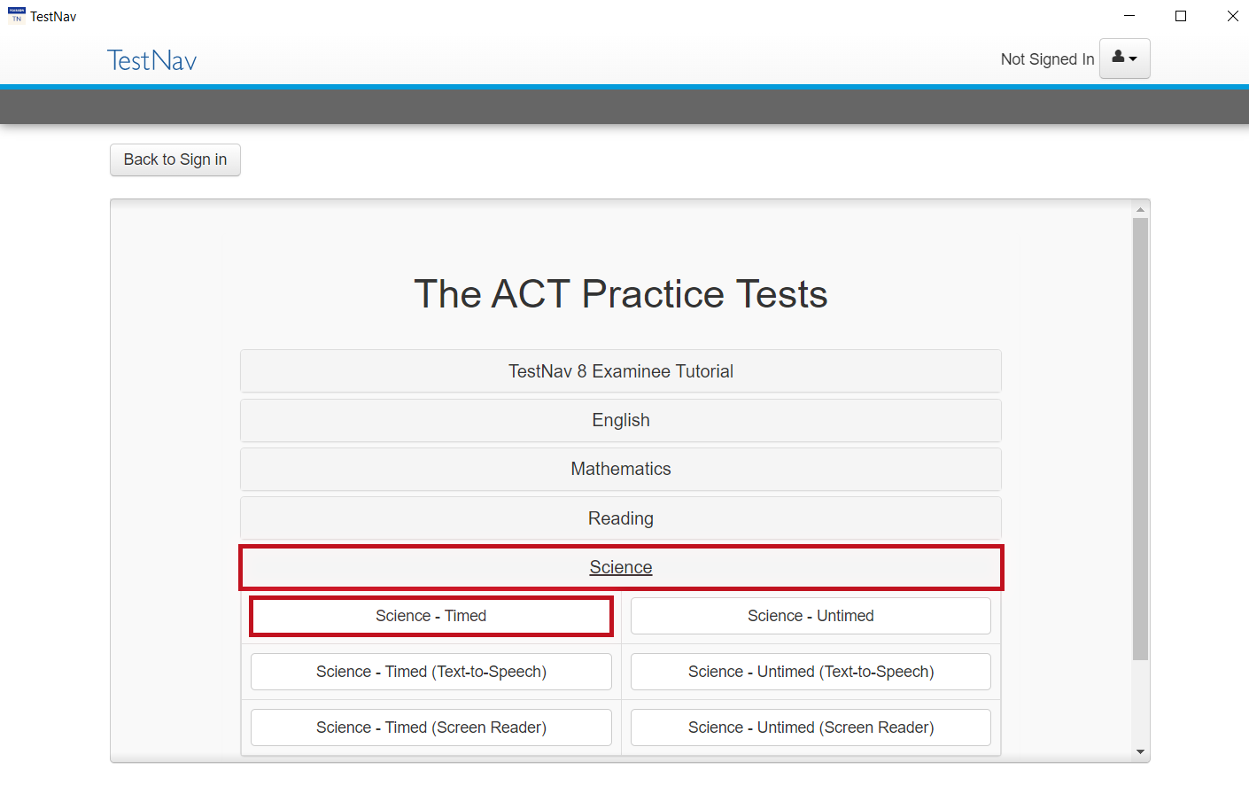
TestNav: Selecting the Right Test
Click “Science.”
Then click
“Science - Timed.”
Notes:
TestNav. (2023). Select practice test. [Screenshot].

Slide 9
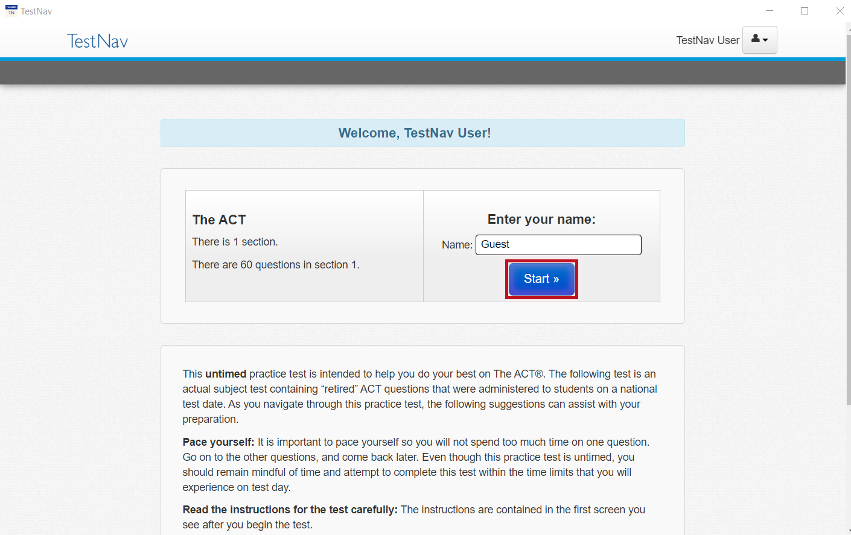

TestNav: Advice
Read the directions.
Press the “Start” button.
Notes:
TestNav. (2023). Welcome, TestNav user. [Screenshot].

Slide 10
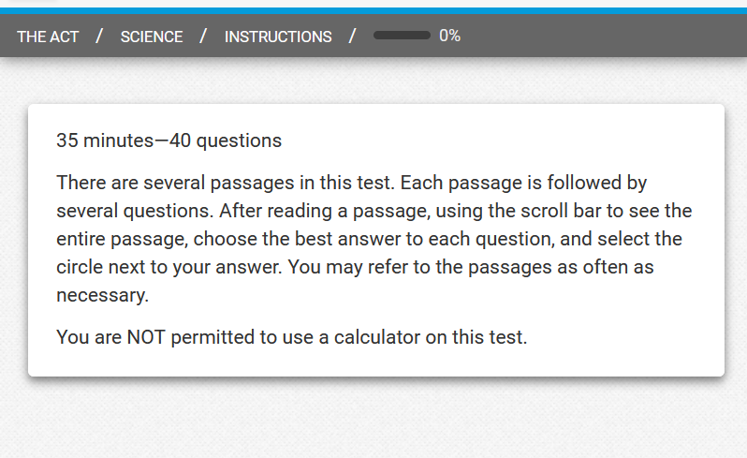
The ACT: General Science Section Directions
Before pressing “Start”
  Read these now so that
  you do not spend time
  during the practice
  test or during the
  actual ACT reading
  these same directions.
  You will be given 35 minutes to answer
  40 questions.
Notes:
TestNav. (2023). General directions. [Screenshot].

Slide 11
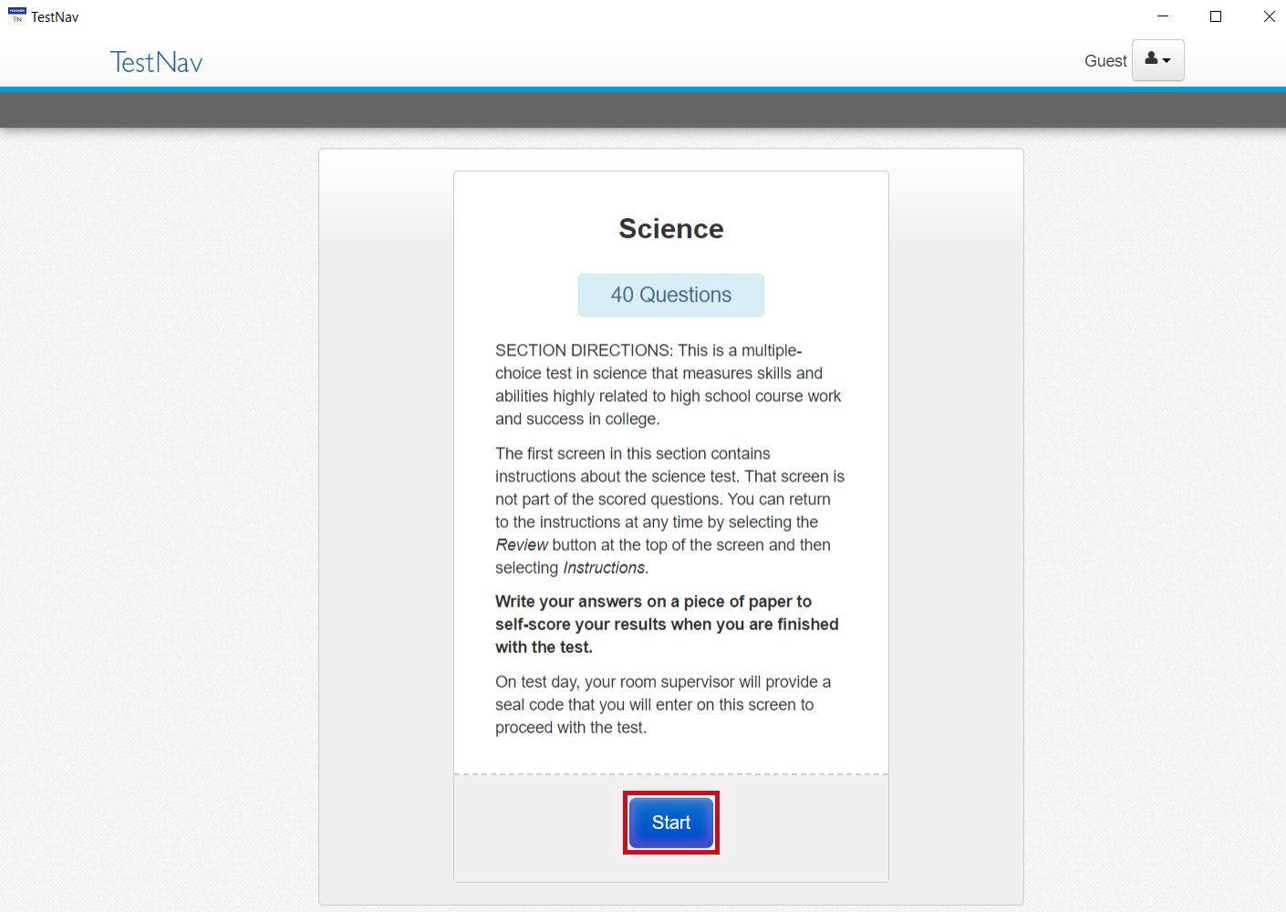
TestNav: Online Science Section Directions
Read the directions.
Wait for teacher
directions to press
the “Start” button.

Slide 12
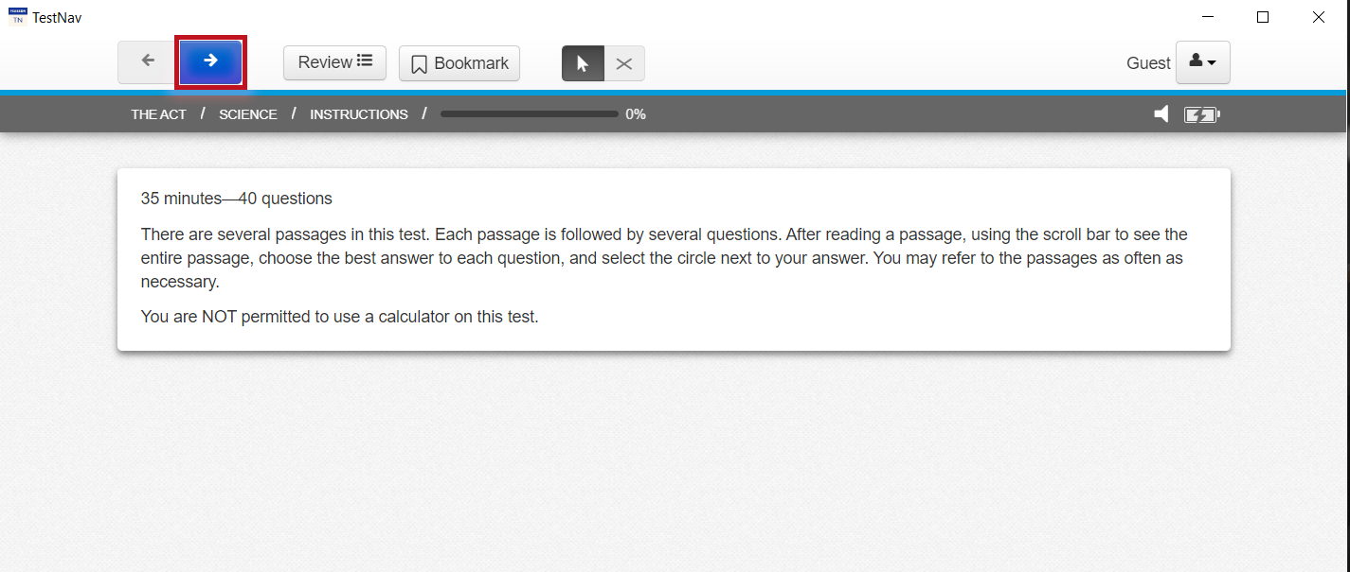
Begin Your Practice Test
Now press the
“Start” button.
Press the “Next” (arrow)
button at the top of
the screen to begin.
Notes:
TestNav. (2023). General directions. [Screenshot].

Slide 13
Congratulations!
You completed your test.
Make note of how many questions you answered correctly.

Slide 14
Science Score Chart
Science Score | Answers Correct
1 | 0
2 | —
3 | 1
4 | 2
5 | —
6 | 3
7 | 4
8 | 5
9 | 6
Science Score | Answers Correct
10 | 7
11 | 8
12 | 9
13 | 10
14 | 12
15 | 13
16 | 14
17 | 16
18 | 17
Science Score | Answers Correct
19 | 19
20 | 21
21 | 23
22 | 25
23 | 28
24 | 30
25 | 31
26 | 33
27 | 34
Science Score | Answers Correct
28 | 35
29 | —
30 | 36
31 | 37
32 | —
33 | 38
34 | 39
35 | —
36 | 40

Slide 15

You Powered Up!
Achievement Unlocked:
Ready for the Real Test!

