Slide 2
Career Quest
Exploring Careers in Your Content Area

Slide 3
Essential Question
What content is used in careers?

Slide 4
Lesson Objectives
Identify how careers use content learned in class.
Research the requirements and pay scale for a chosen career.

Slide 5

Education and Careers Card Sort
In groups of 4, sort the career cards into groups based on the minimum education required.
Use the provided headings as the categories for each group of careers.
Notes:
K20 Center. (n.d.). Card sort. Strategies. https://learn.k20center.ou.edu/strategy/147

Slide 6


Card Sort
With your group, sort the careers by the amount of education you believe is required.
Accessing the Careers Card Sort
  Type in for English Version: k20.ou.edu/careerquest
  Type in for Spanish Version: k20.ou.edu/carreras
  Scan QR code
English
Spanish
Notes:
K20 Center. (n.d.). Card sort. Strategies. https://learn.k20center.ou.edu/strategy/147
Spanish version:

Slide 7
Card Sort Answers
High School Diploma | Vocational and On the Job Training | 2-year College (Associate’s degree) | 4-year College (Bachelor’s degree)
Restaurant or Retail Manager | Dental Assistant | Legal Assistant | Teacher
Military Member | Airplane Mechanic | Medical Technician | Engineer
Police Officer | Cosmetologist | Accounting Assistant/Payroll Technician | Nurse
Administrative Assistant | Welder | Sign Language Interpreter | Forensic Scientist
Notes:
K20 Center. (n.d.). Card sort. Strategies. https://learn.k20center.ou.edu/strategy/147

Slide 8
Card Sort Answers
High School Diploma | Vocational and On the Job Training | 2-year College (Associate’s degree) | 4-year College (Bachelor’s degree)
Call Center Worker | Information Technology Technician | Information Technology Security Specialist | Accountant
Power Plant Operator | Electrician | Radiologist | Program or Network Designer
Realtor | Mechanic | Surveyor | Occupational Therapist
Notes:
K20 Center. (n.d.). Card sort. Strategies. https://learn.k20center.ou.edu/strategy/147

Slide 9


Explore
In 60 seconds, list all the careers that you are interested in.
K20 Center 1-minute Timer
Notes:
K20 Center. (n.d.). Collective brain dump. Strategies. Retrieved from https://learn.k20center.ou.edu/strategy/111
K20 Center. (2021). K20 Center 1-minute Timer. YouTube. https://www.youtube.com/watch?v=6ilD555O_RE.

Slide 10
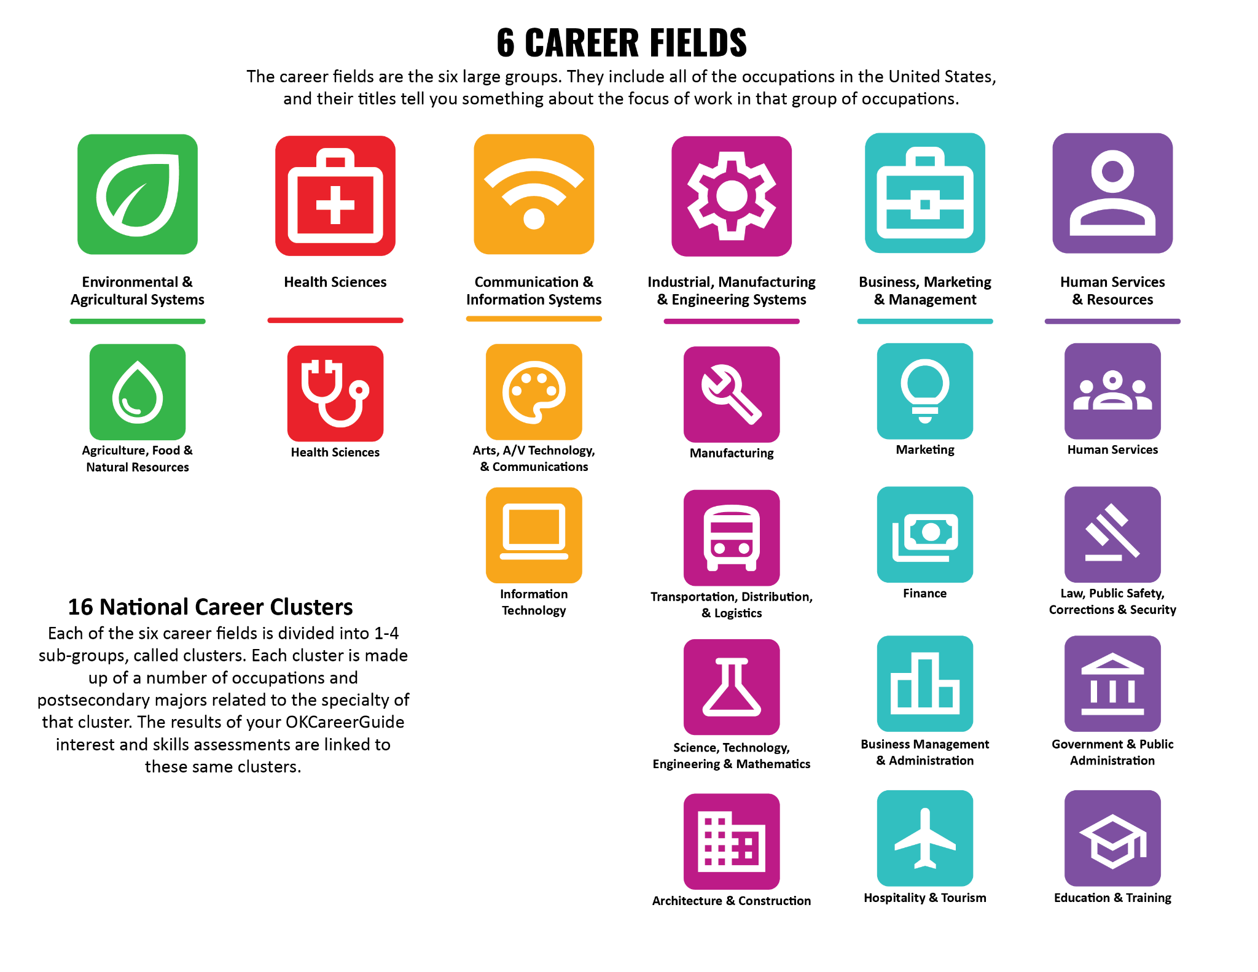
Determine which career field each of the careers listed on your paper fits in.
Which field is most prominent on your paper?

Slide 11
Picking a Career Field
After classifying each career on your paper, choose the field that is most important.
Go to the Career Fields poster in the classroom that displays your most important career field.

Slide 12
Picking a Career Field
At your poster, get into groups of 2-3.
  This will be your group for the rest of the lesson.
When you have formed your groups, move desks and sit together.

Slide 13
ICAP’s 6 Career Fields
The career fields are categorized into 6 large groups. They include all of the occupations in the United States. The title tells you something about the focus of work in this particular group of occupations.
The 6 groups are listed below:

Slide 14


Sticky Bars
With your group, predict which field employs the most people in Oklahoma/your community.
Take a sticky note and place it above your prediction on the Career Cluster poster.
Notes:
K20 Center. (n.d.). Sticky bars. Strategies. Retrieved from https://learn.k20center.ou.edu/strategy/129

Slide 15

Career Fields That Drive Oklahoma’s Job Market
What are some examples of companies in Oklahoma that fall into these three categories?

Slide 16
Presentation Planning handout
Pick 1 career from your chosen career field and create a presentation using your Presentation Planning handout.
Every career uses skills that are gained in [Insert Content Area](ex. Math).
  For example, if you work as an Architect, you would use Right Triangle Trigonometry during your job.
In your group, determine what concept is important to your chosen career and analyze it through that lens.

Slide 17


Create Presentation
With your group, create a digital presentation.
  Use the Presentation Planning handout and Presentation Rubric.
Resources
  Use an online search engine to research the career of your choice and find information.
  Type in: https://www.mynextmove.org/
  Type in: http://k20.ou.edu/career-clusters
  Remember to cite the resources you used.
My Next Move
Career Clusters
Notes:
National Center for O*NET Development. (n.d.). My next move. My Next Move. https://www.mynextmove.org/

Slide 18
Presentation Rubric
5 points
Identifies career, field, and cluster
10 points each
Description of Duties
Salaries
Education Requirements
[Insert Content Area](ex. Math) that is used
Appropriate problem/task
25 points (Design)
Title / Pictures of Career
Creativity (color, font, etc.)
Neatness/Organization
All sources cited
20 points (Presentation)
All group members participate.
Presenters are confident, concise, and share all required information.

Slide 19
Presentations
Digital presentations are to be turned into [insert designated location].
Each group will present their career presentation to the class.
As groups present, pay close attention to the presentation and take notes on your One-Pager Planning handout.

Slide 20

One-Pager
Create a One-Pager to answer the following questions:
What careers require the use of [Insert Content Area](ex. Math)?
What certification exams are required in these careers?
How can a test prep class prepare you for a future careers?
Make sure to include the following:
Title
Border around the page that includes the theme of the lesson
  May include words, symbols, or phrases
Image that represents the subject
  Include descriptions of your images
Personal statement about how you feel about the lesson
Summary over key facts you have learned
A list questions you still have
Notes:
K20 Center. (n.d.). One-Pager. Strategies. https://learn.k20center.ou.edu/strategy/72

