Slide 2
Tailored for Success
Resume Creation Part 2

Slide 3
Essential Question
Why and how should I tailor my resume?

Slide 4
Example/Non-Example
You will be given four aspects of creating a resume. As each topic is displayed, write down an example of what you should DO and you should NOT DO on your resume.

Slide 5
Example/Non-Example
When formatting your resume…
DO / DON’T DO

Slide 6
Example/Non-Example
When listing your work experience…
DO / DON’T DO

Slide 7
Example/Non-Example
Conveying your strengths on a resume…
DO / DON’T DO

Slide 8
Example/Non-Example
Tailoring your resume to a particular job listing…
DO / DON’T DO

Slide 9
Objectives
Understand the significance of tailoring resumes for specific applications
Identify key elements to modify resumes
Create a customized resume for a chosen purpose

Slide 10
Which resume do you think is most likely to get an interview for this job?
Read the three provided handouts.
Discuss with your elbow partner.
Write down 3-5 reasons you and your partner
selected the resume you did.

Slide 11
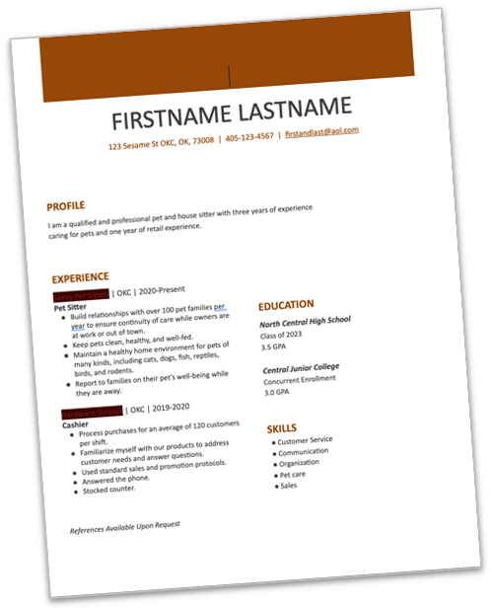
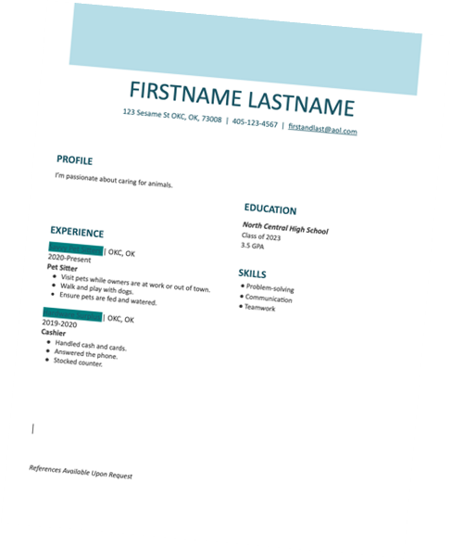
Same person!
vs

Slide 12
Resume Sorting
● Work in groups of 3-4.
You will be given a scenario.
Sort the pieces of the resume into the order of importance to
meet the scenario.
Choose at least three pieces to leave out for each scenario.

Slide 13
Resume Sorting, Round 1
The Common App for college requests a resume that includes… “a list of your activities, work, and family responsibilities. You can share your interests, who you are outside of the classroom, things like hobbies, clubs, community engagement, and family responsibilities. This is a place to show colleges what makes you unique!”

Slide 14
Resume Sorting, Round 2
You are applying for a scholarship and the application requires a resume that summarizes your achievements/accomplishments, academic history, and extracurricular activities onto one page.

Slide 15
Resume Sorting, Round 3
You are applying for an administrative assistant position at the on-campus health clinic. The responsibilities include:
Providing quality customer service – in person, on the phone, emails and more
Scheduling appointments
Billing and payment transactions
Organizing medical supplies
Caring for patient intake
Operating software for records, data entry, and verifying insurance

Slide 16
Transferable Skills
Highlight skills you know you have in the left-side column.
Write down why you know you have that skill in the right-side column (club, school project, job, etc. where you demonstrated the skill).

Slide 17
Find a Job
Go to jobs.ou.edu
Click, “Student Jobs.”
Find one that you would be interested in applying to.
Take notes on requirements, keywords, transferable skills that you should emphasize on your resume.
Number the items you plan to include from most to least important.

Slide 18
STAR Method
Situation: Choose a relevant experience.
Task: Define your role and task.
Action: Outline the actions you took.
Results: Reflect on the outcome.

Slide 19
STAR Example #1
Situation: Led a group science project to design and build a functioning model of a renewable energy source.
Task: Took responsibility for assigning tasks and ensuring everyone contributed to the project.
Action: Facilitated meetings, delegated tasks based on individual strengths, and actively participated in constructing the model.
Result: Received positive teacher feedback, and our team won the "Best Presentation" award during the science fair.
Transferable Skills:
Leadership
Teamwork
Communication
Problem-solving
Time Management
Project-Management

Slide 20
STAR Example #2
Situation: Organized a fundraising supporting a local charity.
Task: Assigned the role of event coordinator, responsible for planning and executing the entire fundraising event.
Action: Conducted thorough research on successful fundraising strategies. Communicated effectively with school staff to secure a suitable venue, date, and any necessary resources. Organized team meetings to delegate responsibilities among volunteers, ensuring everyone understood their role.
Result: The event met our fundraising goal and raised awareness about the local charity.
Transferable Skills:
Leadership
Communication
Organization
Adaptability
Problem-solving
Decision-making

Slide 21
Tailor Your Resume
Adapt your experience and skills to words that translate best to the role you are applying for.
Swap resumes and job listings with your partner and provide feedback.

Slide 22
Why-Lighting
Highlight and make notes where you see opportunity for alignment. Ensure that each of these strategies is addressed:
Incorporate keywords from the job posting.
Align skills and experiences with the job requirements.
Highlight relevant and measurable achievements.
Match resume objective or summary to the role.
Put the most relevant information for the job first.

