Slide 2
Connecting Career Dreams to Postsecondary Education

Slide 3
Housekeeping Norms
Keep cell phones on silent.
Behave like a guest—represent your school well.
Leave campus as clean as it was when you arrived.
Stay engaged in all activities.
Ask related questions.
Follow all instructions.
Stay with your group.

Slide 4
Learning Objectives
Relate personal interests with careers
Discuss postsecondary options that could help people get the job/career that they want

Slide 5
Mental Time Travel
Imagine yourself in 10 years…
…what job would you have?
…where would you live?
…what things would you do for fun?

Slide 6
Career Clusters Interest Survey
Fill out the survey independently.
When you are finished identify your top three scoring boxes.
Notes:
K20 Center. (2021, September 21). K20 Center 10 minute timer [Video]. YouTube. https://www.youtube.com/watch?v=9gy-1Z2Sa-c

Slide 7
Career Clusters
Stand by the poster that corresponds to your highest scoring box.
Read to yourself about the career cluster.
Brainstorm jobs that can fit into the career cluster.
Add the jobs to the poster with sticky notes.
Notes:
K20 Center. (n.d.). Gallery Walk/Carousel. Strategies. Retrieved from https://learn.k20center.ou.edu/strategy/118

Slide 8
Career Clusters
Move to the poster with your second highest scoring box.
You have 2 minutes to read the definition and add other related jobs to the poster.
Notes:
K20 Center. (2021, September 21). K20 Center 2 minute timer [Video]. YouTube. https://www.youtube.com/watch?v=HcEEAnwOt2c

Slide 9
Career Clusters
Move once more to your third highest scoring box.
You have 2 minutes to add other related jobs to the poster.
Notes:
K20 Center. (2021, September 21). K20 Center 2 minute timer [Video]. YouTube. https://www.youtube.com/watch?v=HcEEAnwOt2c

Slide 10
Essential Questions
How can looking into personal interests and career groups help someone plan for postsecondary education and get the job they want?
What types of education are needed for different careers?

Slide 11
Types of Postsecondary Education
Technical Training/Career Tech
Two-year Community College
Four-year College or University

Slide 12
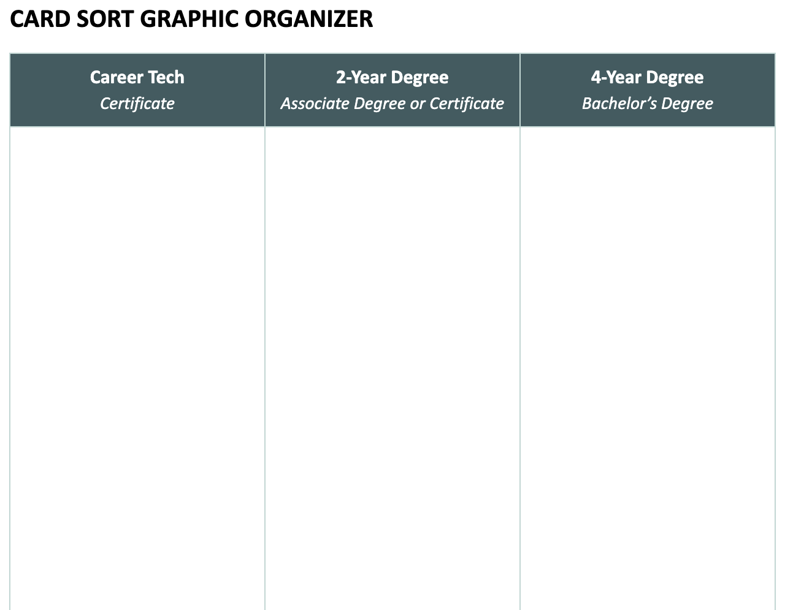
Career Card Sort
Work in your groups to match the careers to the education requirements.
Notes:
K20 Center. (2021, September 21). K20 Center 4 minute timer [Video]. YouTube. https://www.youtube.com/watch?v=kpCsfuvzQeY

Slide 13
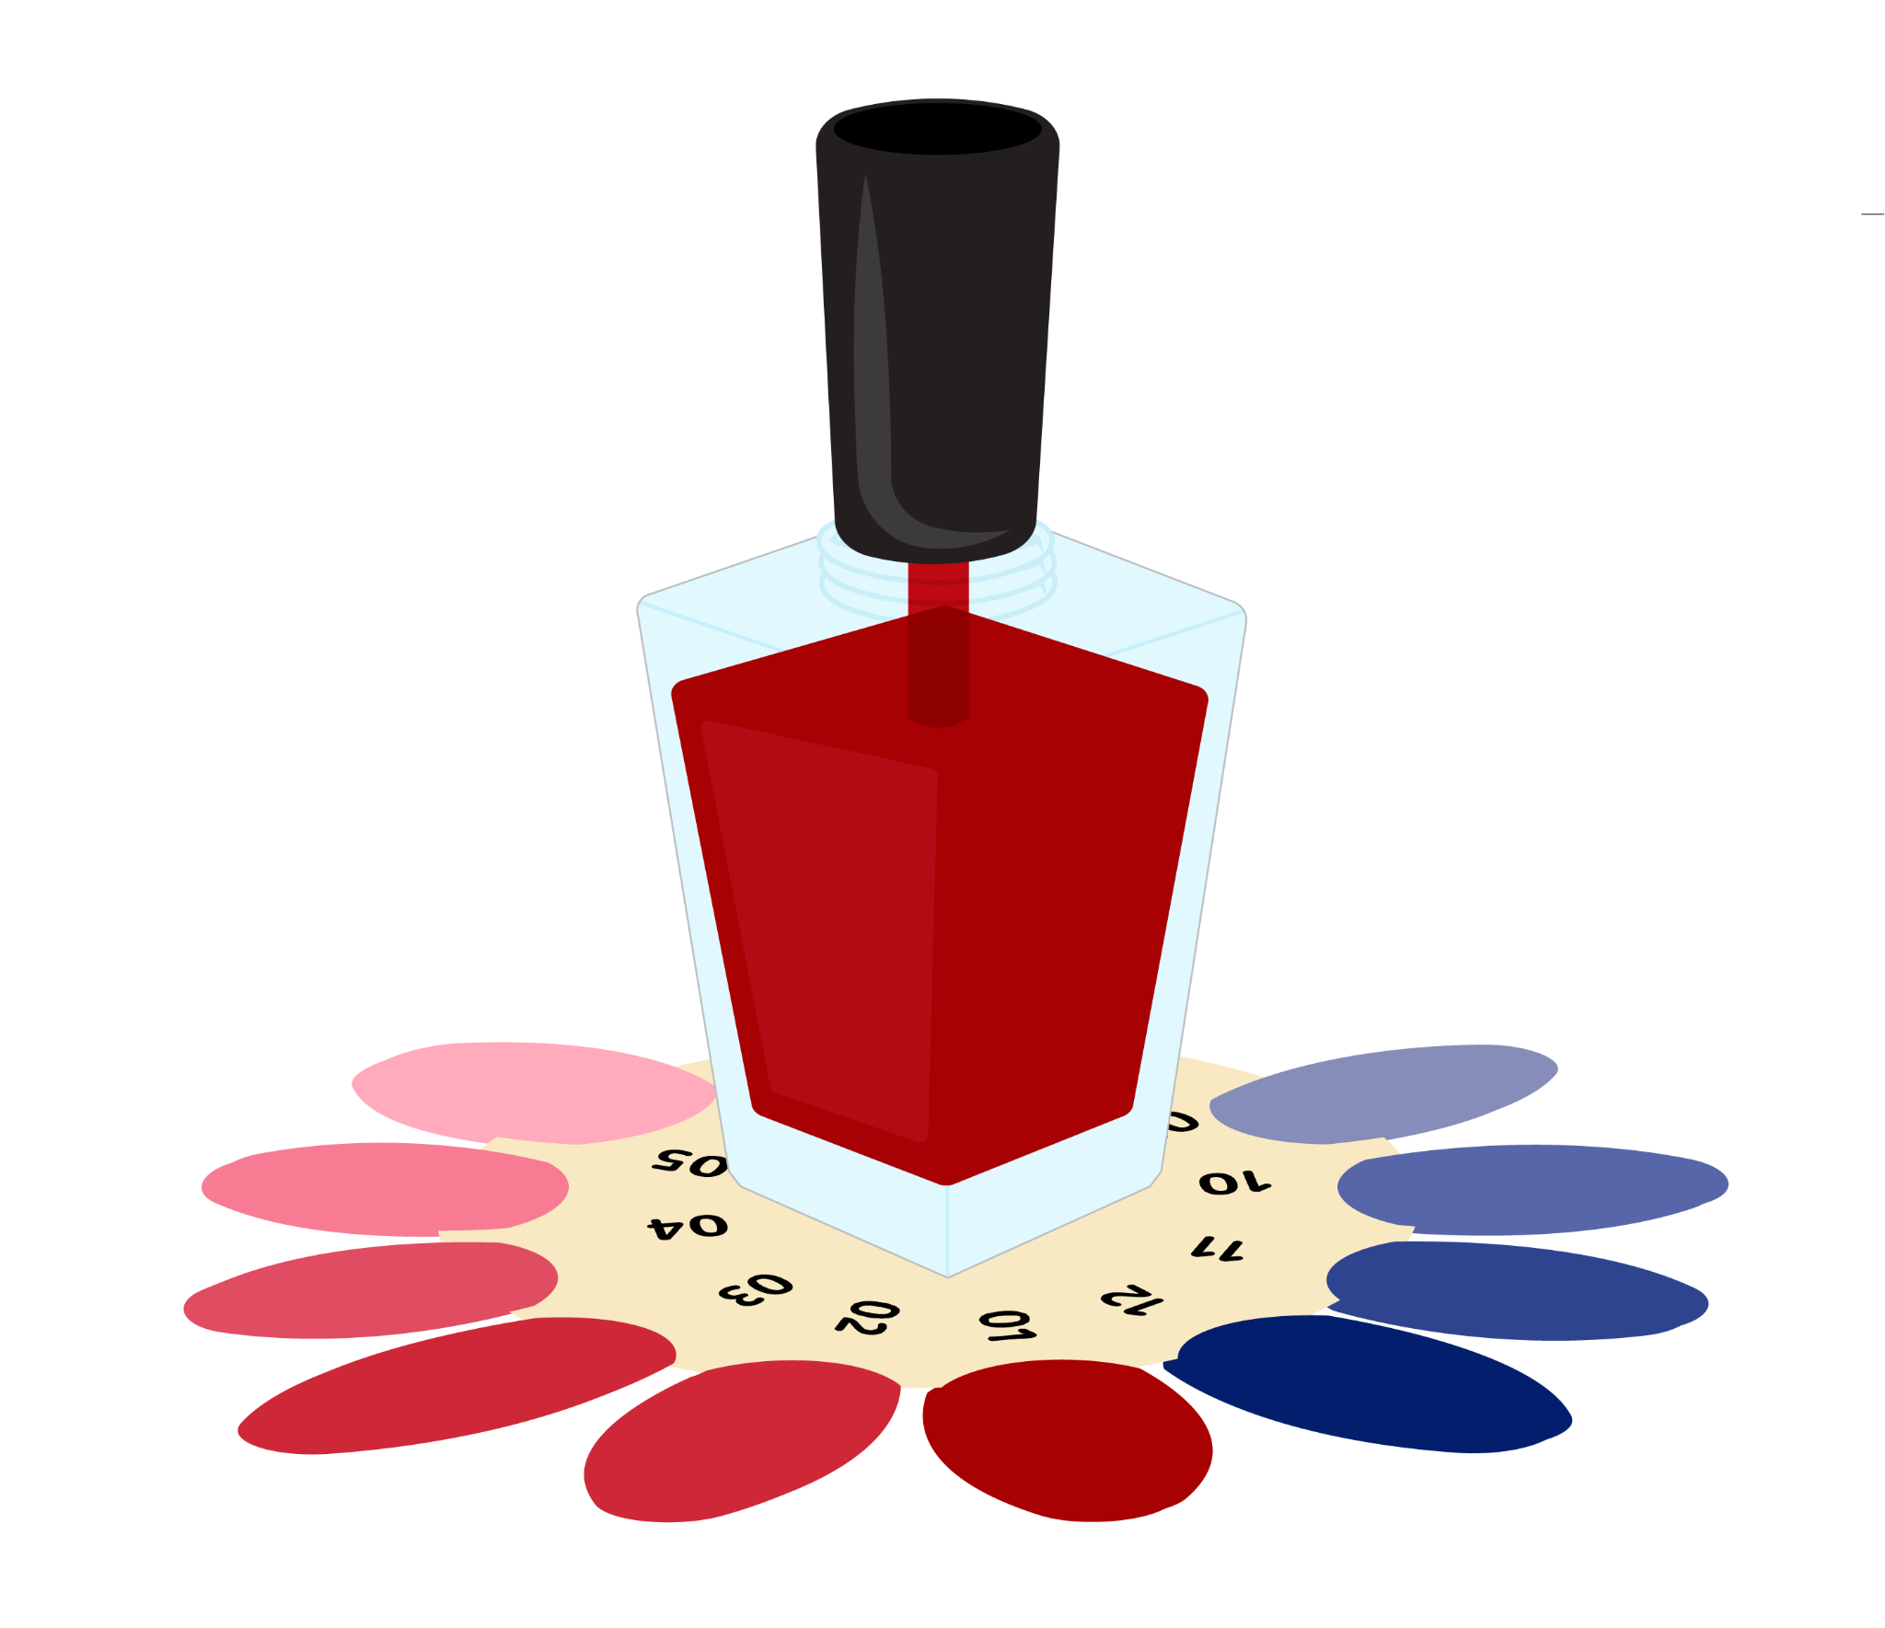
Career Tech
A certificate is awarded in a specialized field.
Programs can take three months to two years to complete.
Aviation Mechanic Career Cluster: Supply Chain & Transportation | Real Estate Agent Career Cluster: Financial Services | Pastry Chef Career Cluster: Hospitality & Events | Nail Technician Career Cluster: Health & Human Services

Slide 14
Two-Year College
An associate degree or certificate is awarded at a community or junior college. After completing an associate degree, many students continue their educations at 4-year institutions.
Paramedic Career Cluster: Public Service & Safety | Drone Pilot Career Cluster: Digital Technology | Social Media Marketer Career Cluster: Marketing & Sales | Radiologist Career Cluster: Health & Human Services

Slide 15
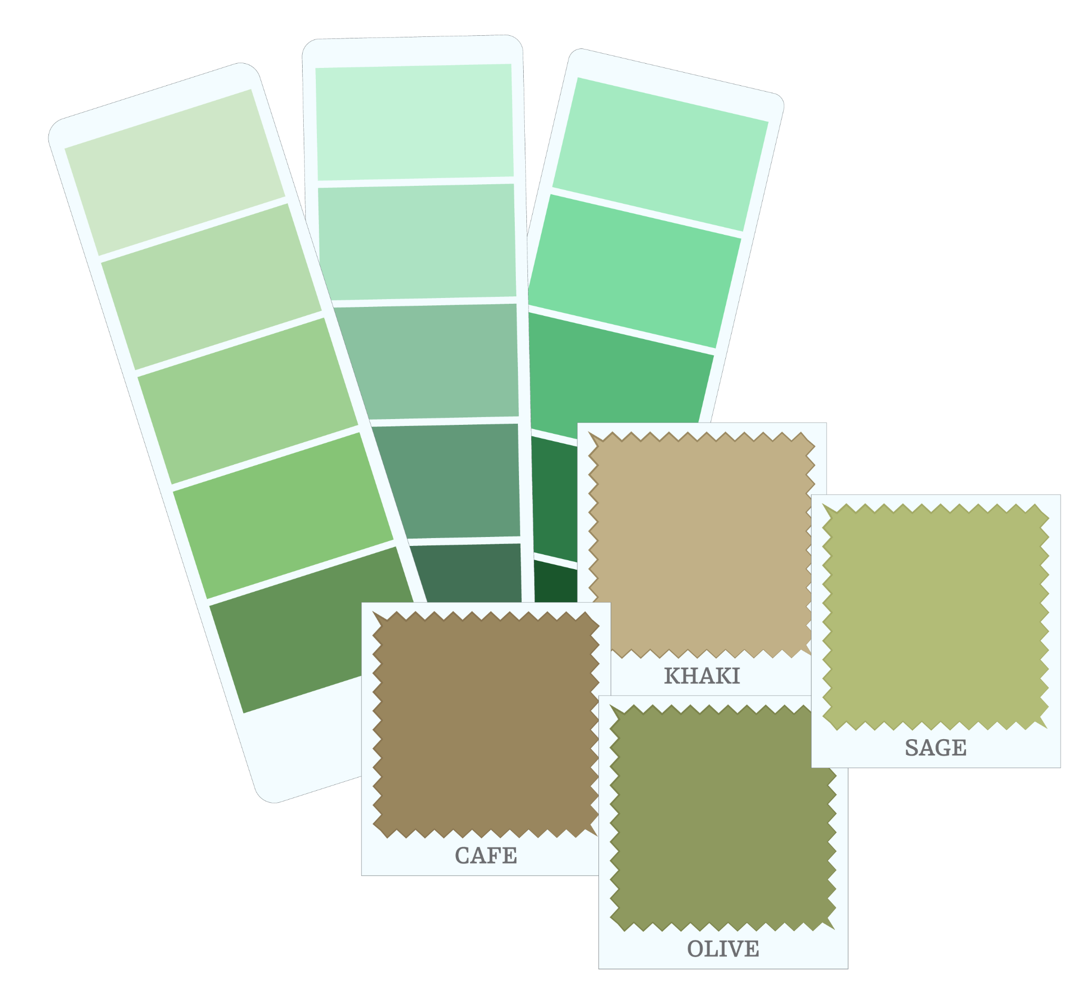
Four-Year College/University
A bachelor's degree is awarded after completing required classes. Universities are generally larger and offer more academic options.
Park Ranger Career Cluster: Energy & Natural Resources | ASL Interpreter Career Cluster: Education | Veterinarian Career Cluster: Agriculture | Interior Designer Career Cluster: Construction

Slide 16
Campus Tour!
What types of programs match your interest or career ideas?

Slide 17
Career Cluster Revisit
Return to your highest scoring box poster.
Sort the careers on the sticky notes into three categories based on the required education:
Career tech
Two-year College
Four-year University

Slide 18
Career Cluster Revisit
Choose one career from the poster that you are interested in.
Research more about the career on your device.
Were you correct about the education requirement?
What are some postsecondary institution options for this career near you or in your state?

Slide 19
Exit Ticket
Reflect on your learning today by answering the following questions:
1. Based on the interest survey and the career posters, do you have ideas about future careers that interest you? Describe.
2. What are you currently doing that is helping you prepare for your life after high school?
3. What are you not doing that you think would help?
Notes:
K20 Center. (n.d.). Exit Ticket. Strategies. Retrieved from https://learn.k20center.ou.edu/strategy/125

