Slide 2
Chapter by Chapter:
Exploring Fraternities and Sororities

Slide 3
Lesson Objectives
Explore the history and structure of fraternities and sororities, recognizing their value in education and society.
Investigate how organizations contribute to creating supportive communities.

Slide 4
What is Greek life? Student Life
In this instance, when referring to “Greek” it is in reference to being a member of a fraternity or sorority, not the nationality.
Fraternities and sororities are collectively referred to as “Greek life”. These are social organizations across North American universities and colleges.

Slide 5
Fiction in the Facts
Examine the following three statements and see if you can determine which statement is false.
Be prepared to share out your reasoning.
Notes:
K20 Center. (n.d.). Fiction in the Facts. Strategies. https://learn.k20center.ou.edu/strategy/60

Slide 6
Fiction in the Facts
Of the six female U.S. Supreme Court Justices to have served or currently serve, four have been a part of a greek organization.
The Naismith Memorial Basketball Hall of Fame Museum is the only hall of fame that does not have members who have participated in Greek life.
The first person to step on the moon was a part of Greek life.

Slide 7
Fiction in the Facts
Of the six female U.S. Supreme Court Justices to have served or currently serve, four have been a part of a greek organization.
The Naismith Memorial Basketball Hall of Fame Museum is the only hall of fame that does not have members who have participated in Greek life.
The first person to step on the moon was a part of Greek life.

Slide 8
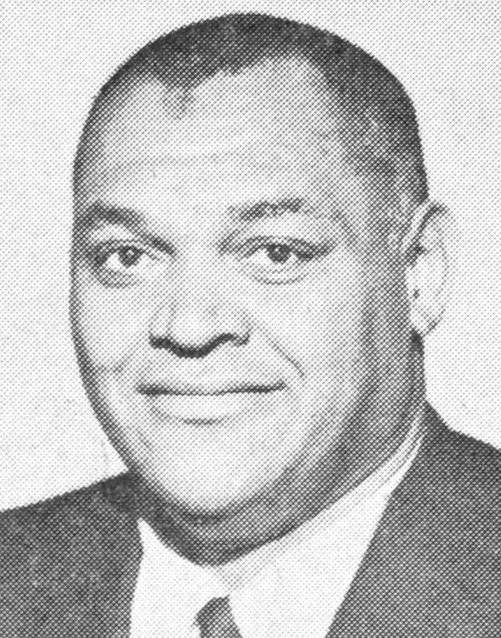
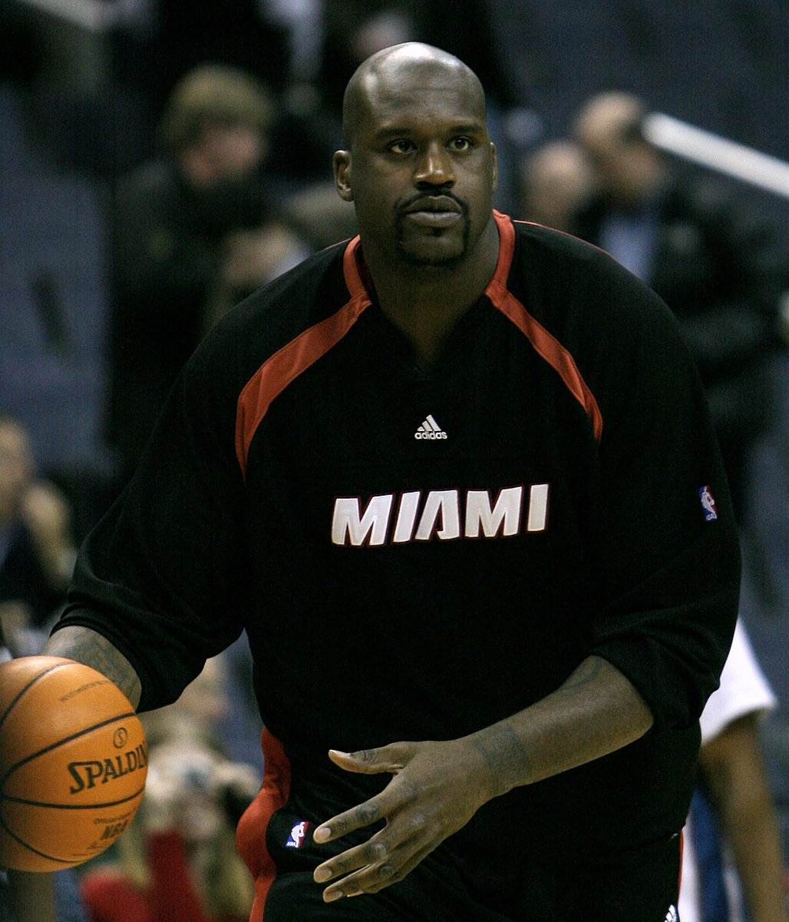
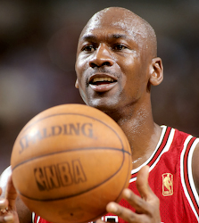
Fiction
The Naismith Memorial Basketball Hall of Fame Museum has several members who have participated in Greek life including names like Clarence E. Gaines, Shaquille O'Neal, and Michael Jordan.
Notes:
All three men are members of Omega Psi Phi Fraternity.
Unknown. (Photographer). 1968. Basketball coach Clarence Gaines. (Photograph). The News Argus. Accessed April, 24, 2024, from https://commons.wikimedia.org/wiki/File:Clarence_Gaines.jpeg
Allison, Keith. (Photographer). February 28, 2007. Shaquille O'Neal at the Washington Wizards v/s Miami Heat game on 02/28/07. (Photograph). Flickr. Accessed April, 24, 2024, from https://commons.wikimedia.org/wiki/File:Shaq_Heat.jpg
Lipofsky, Steve. (Photographer). 1997. Michael Jordan, guard with the Chicago Bulls at the free throw line during an NBA game in 1997. (Photograph). Basketballphoto.com, Chicago. Accessed April, 24, 2024, from https://commons.wikimedia.org/wiki/File:Jordan_Lipofsky.jpg

Slide 9
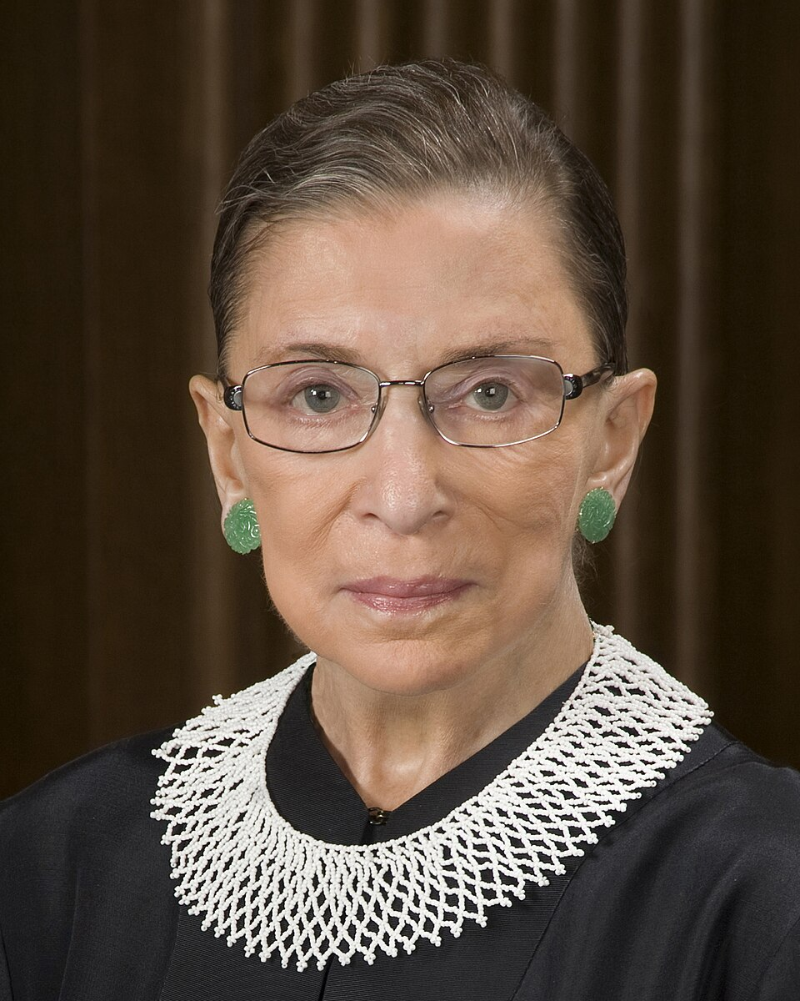
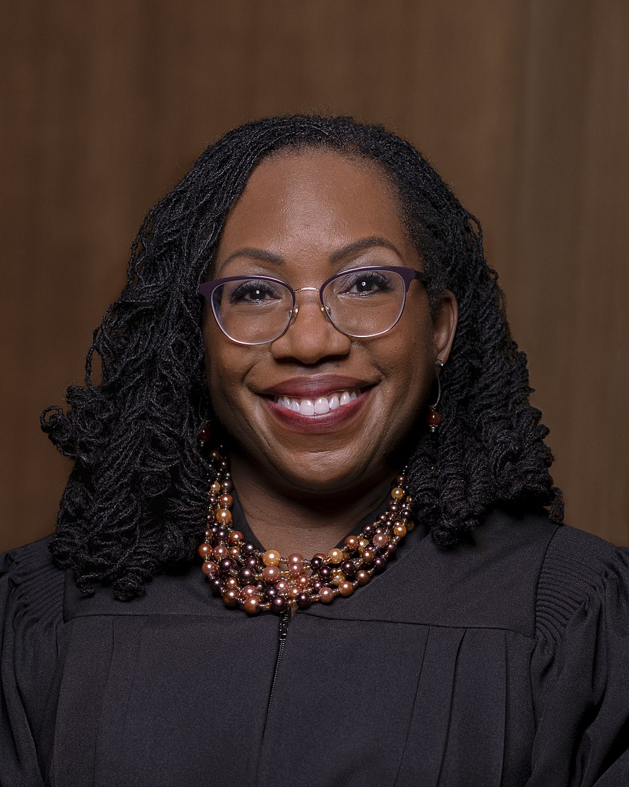
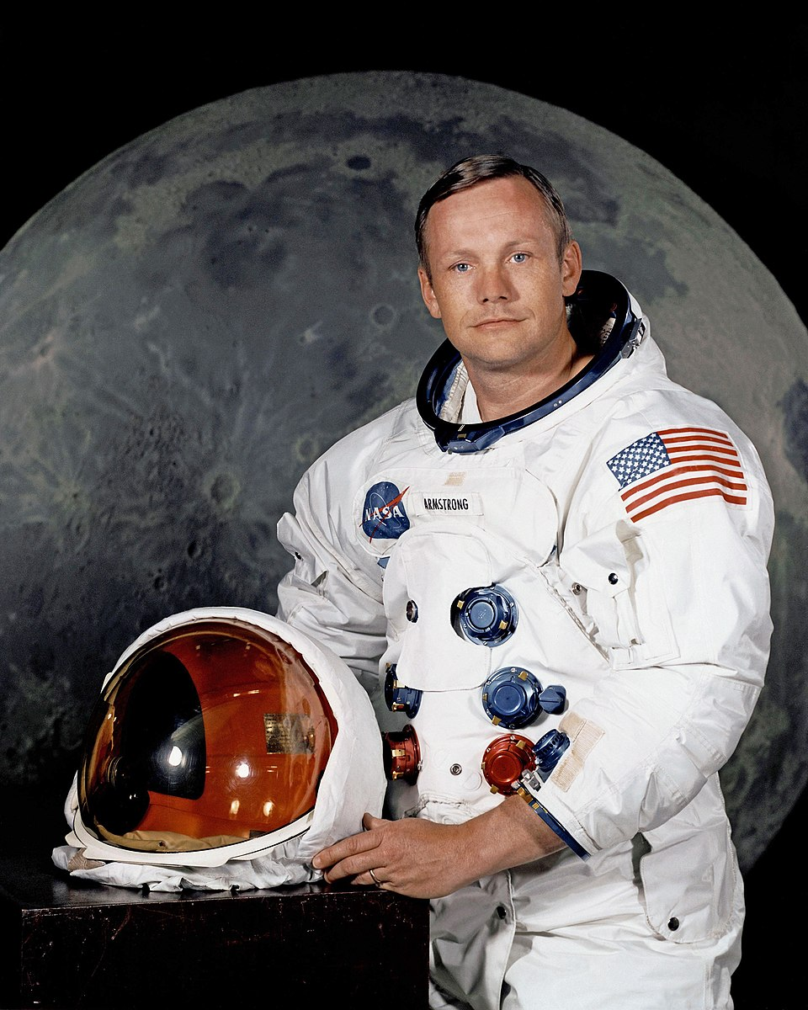
Facts
Of the 6 female U.S. Supreme Court Justices, 4 have been a part of a greek organization.
Neil Armstrong, the first man to step on the moon was a member of a fraternity.
Notes:
RBG: Alpha Epsilon Phi
Jackson: Delta Sigma Theta
Sotomayor: Phi Beta Kappa
Barrett: Omicron Delta Kappa/Phi Beta Kappa
Armstrong: Phi Delta Theta
Petteway, Steve. (Photographer). September 15, 2010. Ruth Bader Ginsburg, Associate Justice of the Supreme Court of the United States. (Photograph). The Oyez Project. Accessed April, 24, 2024, from https://commons.wikimedia.org/wiki/File:Ruth_Bader_Ginsburg,_official_SCOTUS_portrait,_crop.jpg
Schilling, Fred. (Photographer). June 24, 2022. Official photograph of Associate Justice Ketanji Brown Jackson. (Photograph). The Oyez Project. Accessed April, 24, 2024, from https://commons.wikimedia.org/wiki/File:KBJackson.jpg
Unknown. (Photographer). July 1, 1969. Portrait of Astronaut Neil A. Armstrong, commander of the Apollo 11 Lunar Landing mission in his space suit, with his helmet on the table in front of him. Behind him is a large photograph of the lunar surface. (Photograph). NASA Photos. Accessed April, 24, 2024, from https://commons.wikimedia.org/wiki/File:Neil_Armstrong_pose.jpg

Slide 10
Essential Question
What role do social organizations play in fostering a sense of community and belonging for their members?

Slide 11
Card Sort
In your group:
Sort through the terms and definitions.
Match the term with the correct definition.
Use your context clues and prior knowledge to match as many as you can.
Notes:
K20 Center. (n.d.). Card Sort. Strategies. https://learn.k20center.ou.edu/strategy/147

Slide 12
Desmos Card Sort
Go to https://student.desmos.com/
Enter the code provided and sign in to save your progress.
Sort through the terms and definitions.
Match the term with the correct definition.

Slide 13
Sentence-Phrase-Word
You will read the Fraternities and Sororities Article and on your handout jot down the following:
Sentence: One sentence that expresses the main idea or was meaningful to you.
Phrase: One phrase that evokes curiosity or stands out to you.
Word: One word that captures their answer to the question “What role do social organizations play in fostering a sense of community and belonging for their members?”.
Notes:
K20 Center. (n.d.). Sentence-Phrase-Word. Strategies. https://learn.k20center.ou.edu/strategy/54

Slide 14
Surprising-Interesting-Takeaway
As you watch the interview, on your handout identify the following:
Surprising: One surprising fact or idea.
Interesting: One interesting fact or idea.
Takeaway: Overall takeaway from the interview
Notes:
K20 Center. (n.d.). Surprising-Interesting-Troubling. Strategies. https://learn.k20center.ou.edu/strategy/926

Slide 15
Card Sort Revisited
Return to your card sort groups and revisit your card sort.
Using any new information you may have learned, make changes to your card sort if applicable.

Slide 16
I Used To Think…But Now I Know
Reflect on your previous knowledge of Greek life, and how it has changed over time and respond to the following prompt:
I used to think Greek life meant…
But now I know…
Notes:
K20 Center. (n.d.). I Used to Think…But Now I Know. Strategies. https://learn.k20center.ou.edu/strategy/137

