Slide 2
Welcome
Community Collaboration: Building Bridges for Career Exploration

Slide 3
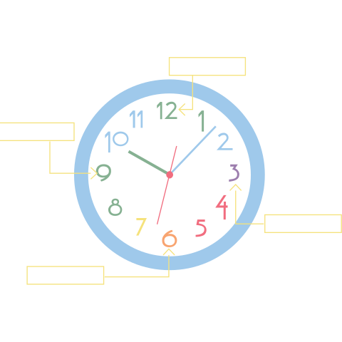
Appointment Clocks
Using your Modified Appointment Clock and your Career Cluster Table handout, list one PSI program, place of business, or career speaker per number.
Follow the order of the CC Table (e.g. 1 is Agriculture, Food, & Natural Resources).

Slide 4
Essential Question
How can I grow and sustain a career-focused mentorship program at my school?

Slide 5
Learning Objectives
Participants will…
Identify and brainstorm a comprehensive list of potential community partners relevant to their school's needs.
Construct a foundational model for a career exploration program.
Evaluate the effectiveness and progress of their existing career exploration program.

Slide 6
Meet the Team!
Notes:
All

Slide 7
Station Activities
Station | Description
Career Expo | Design your own Career Expo using sample room layouts and career cluster banners.
Career Café | View sample Career Cluster survey data and collaborate with your group to find five (5) speakers and/or clusters that match the needs and interests.
College2Career Forum | Brainstorm hands-on experiences students could participate in with expected outcomes and expectations.
Notes:
Debrief at end of 3 station rotations
Mention Planning Doc Mention Table Station Cards

Slide 8
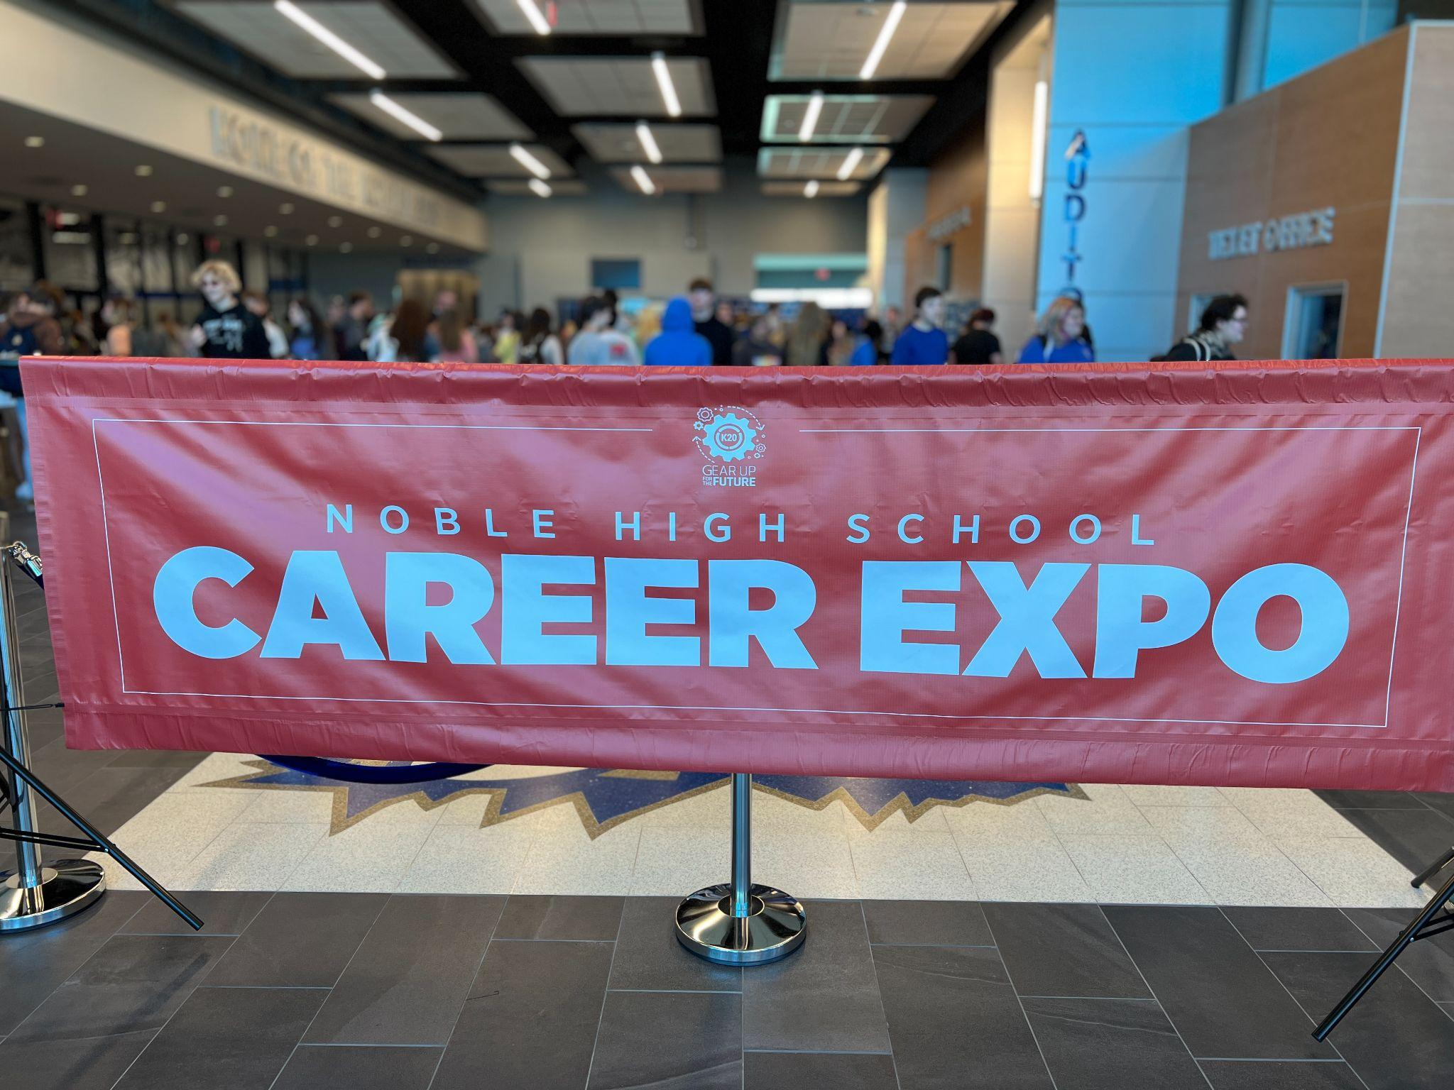
Career Expo
Career Expos connect cohort students with career professionals to provide a broad overview of careers.
Career Expos take place in-person at a specific event location or at your school site.

Slide 9
Career Expo Directions
Work with your table to format and set up a sample expo using the Career Cluster Card Sort and the Career Expo Gym Setup.
On your Planning Document, list community partners who might be interested in helping with your expo.

Slide 10
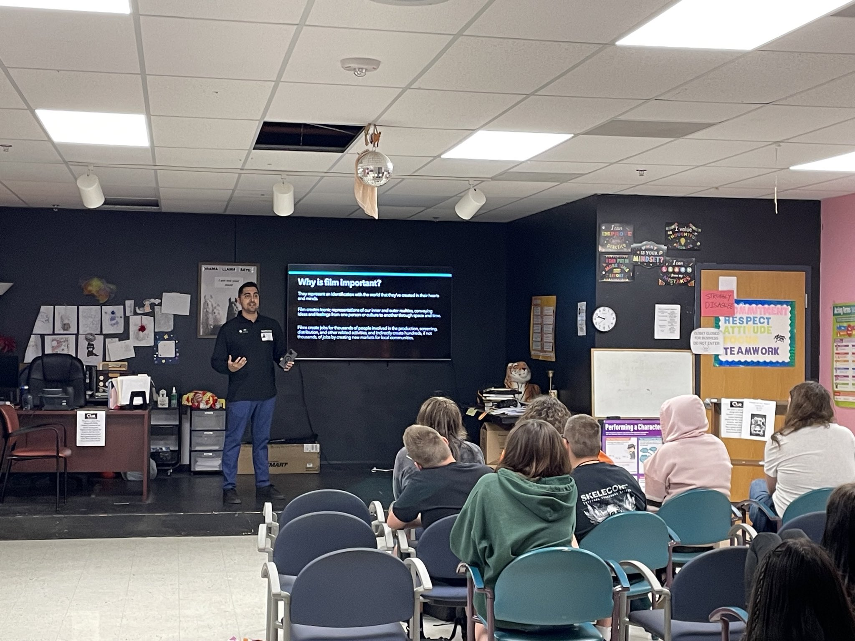
Career Café
Career Cafés enable students to dig deeper into career fields of specific interest to them.
Provide students a way to meet professionals, either in-person or virtually, who work in interested career fields.

Slide 11
Career Café Directions
Analyze the sample Career Cluster Survey Data.
With your group, identify 5 speakers that match the top needs and interests of the data.
On your Planning Document, list community partners who might be interested in helping with your café.
Notes:
Groups will look at the assigned CC survey data.
Using the graph, decide on speakers to match the needs of students.
Use the planning document to record notes and explain reasons for those decisions.

Slide 12
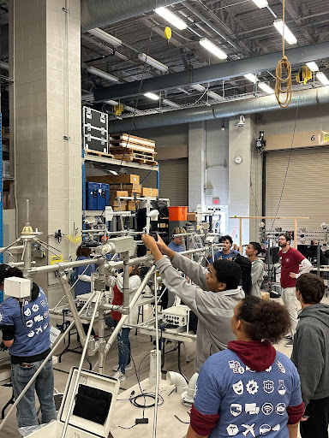
College2Career Forums
College2Career Forums (C2CF) connect students to postsecondary environments and career professionals.
Students experience
real-world career connections through interactive learning experiences.

Slide 13
College2Career Forum Directions
Select one speaker or cluster from the Career Café activity.
Outline a plan to take students to that business or PSI using the Planning Document.
Consider which stakeholders need to be involved in this process.

Slide 14
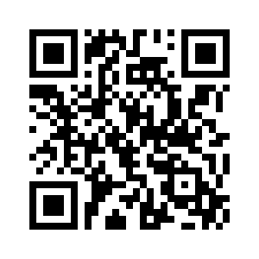
Group Discussion
Looking back at your clock, what clusters are still blank and how can you fill these gaps?
If you have facilitated or participated in a Mentoring event, how did it go?
LEARN Mentoring Collection: tinyurl.com/K20CareerCollection

Slide 15
School-Based Needs Planning
Pair with peers from your school.
Use your Action Plan Template to plan for any upcoming Mentoring events.
Make two copies of your Action Plan; one for your team, and one for GEAR UP.
Mentoring Event | Description
Career Expo | Career professionals to provide a broad overview of careers from a variety of career clusters.
Career Café | Small groups dig deeper into career fields of specific interest to students.
College2Career Forum | Visit postsecondary institutions and career professionals for interactive and hands-on learning experiences.
Notes:
Group with any peers from your school.
Use the Action Plan handout to list out any upcoming mentoring events.
Have someone else record your answers and contact info so your GU coordinator can contact you.

Slide 16
Gallery Walk - Career Exploration
Take 3 Green and 3 Orange sticky notes.
Write your name on the back (sticky side).
Thinking about your schools needs/capabilities:
Green: Write an action item.
Orange: Write a potential barrier.
Notes:
Prep poster paper
Back of sticky note - school name
Front - action/barrier

Slide 17
Career Exploration Resources
K20 Center. (n.d.). Appointment Clock. Strategies. https://learn.k20center.ou.edu/strategy/124
K20 Center. (n.d.). 3-minute timer. https://www.bing.com/videos/search?view=detail&q=K20+Center+time+clock&qpvt=K20+Center+time+clock&mid=FE3F8C7CF888E992E398FE3F8C7CF888E992E398&&FORM=VRDGAR
K20 Center. (n.d.). Gallery Walk/Carousel. Strategies. https://learn.k20center.ou.edu/strategy/118
LEARN Link: tinyurl.com/K20CareerCollection
Notes:
https://tinyurl.com/K20CareerCollection

