Slide 2
Bots in the Classroom
AI-Powered Tutoring at your fingertips

Slide 3
Objective
Explore how to customize AI tools through prompting to support learning needs and give feedback on prompts created by other students.

Slide 4
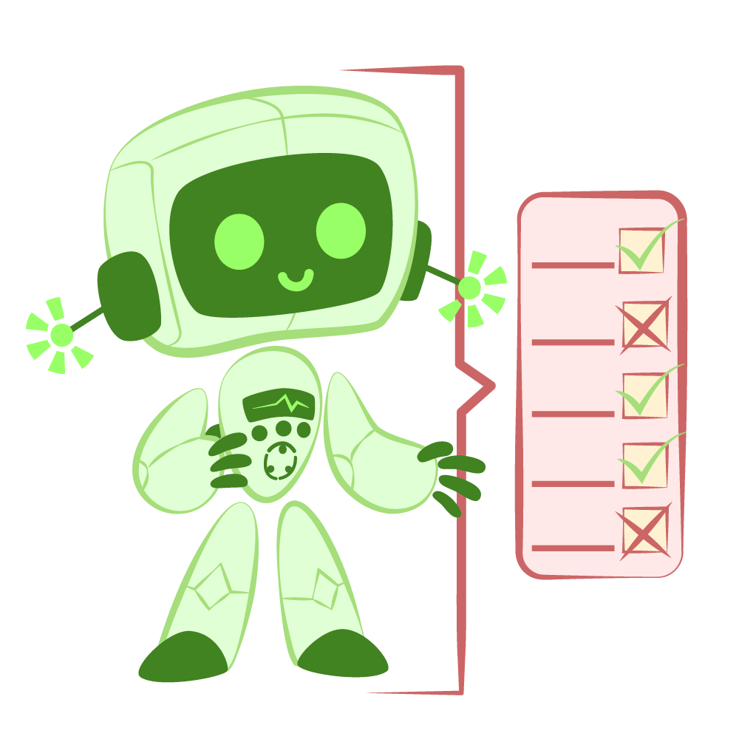
Critique the Bot
Read each prompt and its AI-generated response.
Decide which one is more helpful for a student.
Mark anything that is concerning about the response.
Make notes of any observations and thoughts about the difference between the responses.
Notes:
K20 Center. (n.d.). Critique the Bot. Strategies. https://learn.k20center.ou.edu/strategy/3491

Slide 5

Think-Pair-Share
Find an elbow partner (someone next to you)
Share which response you preferred and why.
Discuss your observations, concerns, and thoughts.
Notes:
K20 Center. (n.d.). Think-pair-share. Strategies. https://learn.k20center.ou.edu/strategy/139

Slide 6

Try an AI Tutor
Open the AI program.
Go to k20.ou.edu/5j
Copy the Example Prompt.
  Click “...”
  Click “Open post”
  Highlight the entire post and copy it.
Paste it into the AI program and begin chatting with the AI tutor.

Slide 7

Stand Up, Sit Down
On a blank sheet of paper, write down your 3 most important understandings from the tutoring session.
Cross off items on your list as they are said by other students.
If all of the items on your list have been said, sit down.
Notes:
K20 Center. (n.d.). Stand up, sit down. Strategies. https://learn.k20center.ou.edu/strategy/1771

Slide 8
Writing Effective Prompts
Element | Description | Example
Task | Use clear action verbs: create, compare, analyze, summarize, translate. | Summarize the arguments of an editorial.
Format | Specify the output form: list, report, paragraph, script, table, chart. | Present your answer as a comparison table
Voice | Indicate tone: formal, neutral, persuasive, humorous, student-friendly. | Use an academic tone suitable for a college research paper.
Context | Provide background, goals, examples, constraints, or rubrics as needed. | Assume the reader is a middle school student unfamiliar with the topic.

Slide 9
Parts of an Effective Prompt
Explain the difference between a fruit and a vegetable. Keep it to no more than a paragraph and write as a tutor for a 9th grade student. Use both scientific and cultural information.
Identify the Task, Format, Voice, and Context

Slide 10
Create and Test Your Own Prompt
Choose a topic you struggle with or that is interesting to you.
Use one of the prompts we have already seen as a starting point to write your own prompt.
Test your prompt by doing a tutoring session.
Make adjustments to your prompt as needed.
Record your experience on the AI Tutoring Practice handout.

Slide 11
Create and Test Your Own Prompt
Choose a topic you struggle with or that is interesting to you.
Go to k20.ou.edu/5g and use the tool to create a prompt.
Test your prompt by doing a tutoring session.
Make adjustments to your prompt as needed.
Record your experience on the AI Tutoring Practice handout.

Slide 12
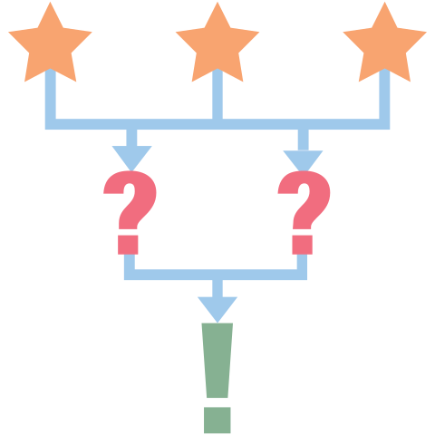
3-2-1
Write down:
3: Three things you learned through this process.
2: Two challenges you faced in this process.
1: One thing that surprised you about AI or prompts.
Notes:
K20 Center. (n.d.). 3-2-1. Strategies. https://learn.k20center.ou.edu/strategy/117

