Slide 2
Guess the Career!
Notes:
K20 Center. (n.d.). ICAP – Guess the Career! https://www.youtube.com/watch?v=-hEoHkOkAp8

Slide 3
Essential Questions
What careers and postsecondary opportunities align to my personal interests and skills?
What resources are readily available to learn about careers?

Slide 4
Lesson Objectives
Discover career opportunities that may not normally be associated with a specific subject.
Connect career pathways that align to students’ interests or skills.

Slide 5
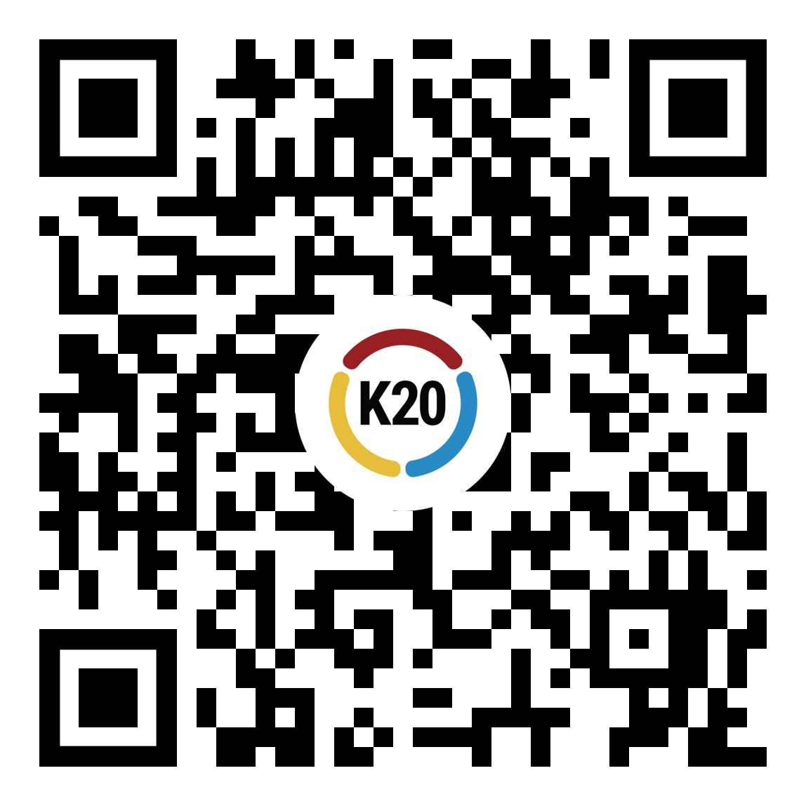
Career Path Exploration
Use a device and navigate to https://k20.ou.edu/cents — or use the QR code below.
Choose a topic that appeals to you, then choose a career path to explore.
Read about the career path and review the careers that are related to that path.
If you are happy with this path, stay on this page.
If you want to explore a different career path, click the green arrow in the bottom left corner to choose a different path.

Slide 6
Career Research
Choose a career to learn more about from the list.
Use the QR code below or go to My Next Move at https://www.mynextmove.org/ to search for the career.
Use the Career Speed Dating Profile to collect information about your chosen career.

Slide 7
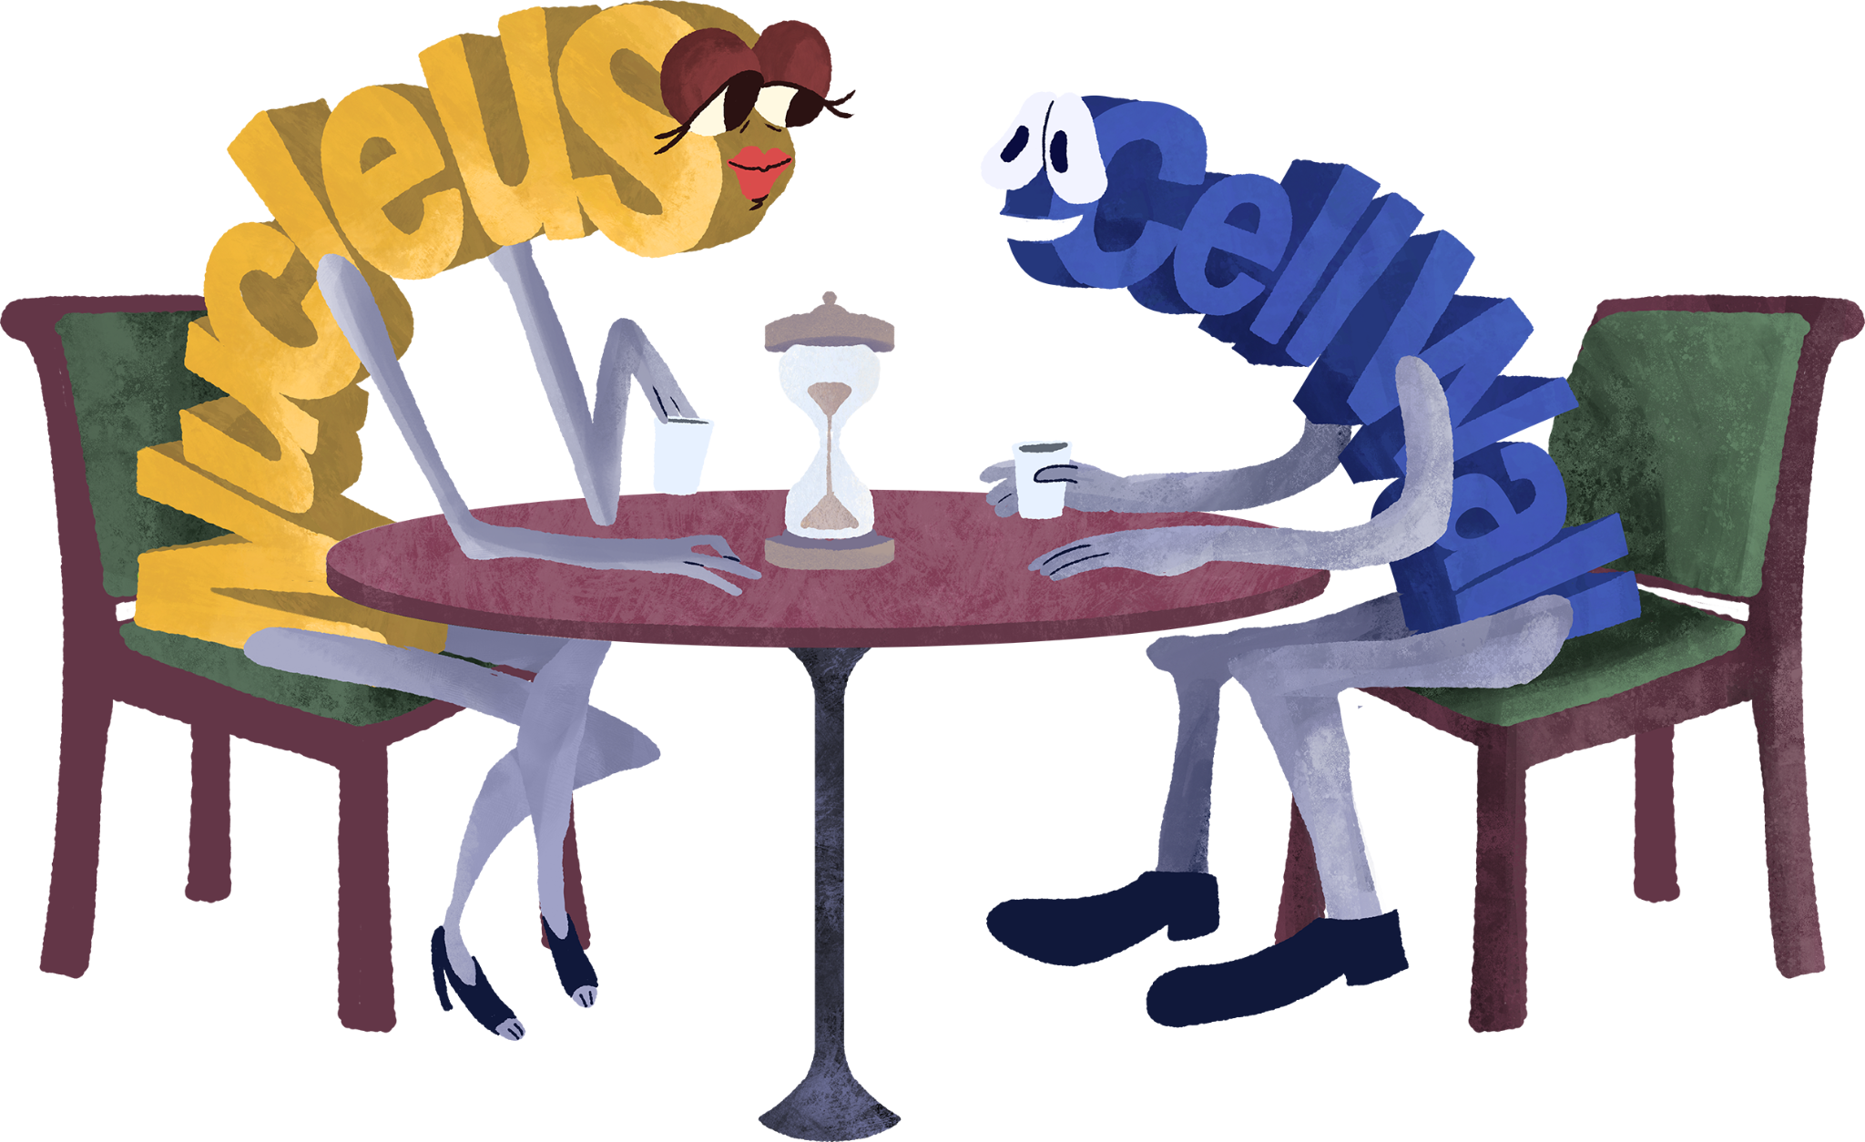
Career Cluster Speed Dating
Talk to one person at a time about your career. You will have:
30 seconds to tell your partner about your job.
30 seconds to collect details on your note catcher about your partner’s job.
Start with your pick-up line.
Add new details to your note catcher if you come across the same job.
Notes:
K20 Center. (n.d.). Concept speed dating. Strategies. https://learn.k20center.ou.edu/strategy/3330

Slide 8
Looking Ahead
How will you use the information from My Next Move to help you plan your career pathway?

Slide 9
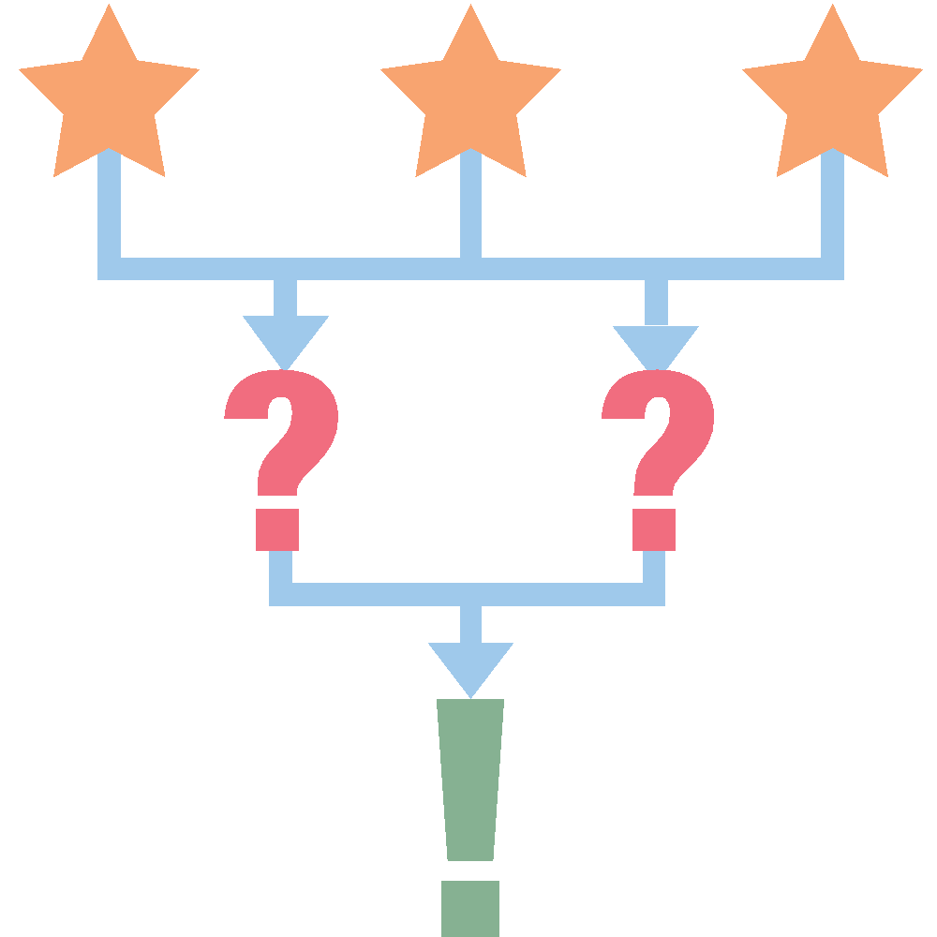
Exit Ticket - 3-2-1
3
career clusters you are interested in
jobs you are considering
job you are NOT interested in
2
1
Notes:
K20 Center. (n.d.). 3-2-1. Strategies. https://learn.k20center.ou.edu/strategy/117

