Slide 2
Hands-On Healing: A Deep Dive into Physical Therapy
Understanding the Role of Physical Therapists in Injury Prevention, Rehabilitation, and Patient Care

Slide 3
Essential Question
How do physical therapists use specialized skills and techniques to help individuals recover from injuries, improve mobility, and manage pain?

Slide 4
Learning Goals
Explore the physical therapist profession by engaging in hands-on activities and simulations to understand the skills, responsibilities, and challenges of the role.
Develop critical thinking, problem-solving, and patient care skills through real-world training exercises and by assessing personal strengths and interests in relation to physical therapy.

Slide 5
Overview: Physical Therapist
A physical therapist (PT) is a healthcare professional that helps people recover from injuries, manage pain, and improve movement.
Where do PTs work?
Physical therapists work in hospitals, outpatient clinics, sport facilities, schools, private practices.

Slide 6
Overview: Physical Therapist
What do PTs do?
Physical therapists assess injuries and movement issues, create personalized rehab plans, use exercises and equipment, perform hands-on therapy, educate patients on injury prevention, and track patient progress.

Slide 7
Overview: Becoming a Physical Therapist
Education and training:
Approximately 7 years of education
  4 years: Bachelor's Degree
  3 years: DPT program
Must pass a licensing exam
Average salary: $99,710/year
Experienced PTs earn over $130,000/year

Slide 8
Overview: Becoming a Physical Therapist
How to start preparing:
Take a science course about biology, anatomy, or similar subjects.
Learn about injury prevention.
Volunteer in hospitals, rehab centers, or with athletic trainers.

Slide 9
Station 1: Geriatric Simulation
Limited vision: Cover your eyes with either a scarf or a pair of goggles with Vaseline smeared on the lenses. Try reading something through the scarf or goggles.
Limited ability to grasp objects: Put large socks or mittens on your hands and try to pick up a paper clip or tie your shoes.
Limited spine mobility: Bend forward and attempt to complete the mobility course in this position.

Slide 10
Reflect
On your Geriatric Simulation Reflection handout, respond to the following questions:
Which challenge was the most difficult?
How did the limitations affect your ability to move, interact, or perform daily tasks?
What adjustments can be made to improve accessibility for older adults in healthcare settings?
In what ways can physical therapy improve the mobility and quality of life of older adults? How did the challenges in the activities highlight the importance of empathy in patient care?

Slide 11
Station 2: Auscultation
Use the Stethoscope Placement Guide to complete the following:
Place the stethoscope on your partner’s chest to locate and listen for heart sounds.
Place the stethoscope on your partner’s back to locate and listen for lung sounds.
Place the stethoscope on your partner’s abdomen to locate and listen for bowel sounds.
Switch roles with your partner and repeat the process.

Slide 12
Discuss
Why is it important for physical therapists to assess heart, lung, and bowel sounds when creating a treatment plan for a patient?
How can abnormal sounds, such as wheezing or crackles, impact a patient’s ability to participate in physical therapy exercises?
In what ways might a physical therapist adjust a rehabilitation plan for a patient with poor circulation or irregular heart sounds?

Slide 13
Station 3: Concussion Simulation
Sensory loss: Put a thick rubber glove on your dominant hand. Reach into the bucket and attempt to identify each item you feel.
Vision impairment: Put on the pair of goggles with petroleum jelly on the lenses. Attempt to complete classroom activities like sharpening a pencil, copying a sentences from the board, writing your name, walking down the hall, etc.
Sensory hypersensitivity: Put on the headphones playing loud music. Try to complete a worksheet while wearing the headphones.

Slide 14

What? So What? Now What?
Respond to the prompts on your What? So What? Now What? handout. Consider how you would diagnose a patient’s symptoms, which exercises you would perform to diagnose a patient, and what you would include on a patient’s treatment plan.
Notes:
K20 Center. (n.d.). What? So what? Now what?. Strategies. https://learn.k20center.ou.edu/strategy/95

Slide 15
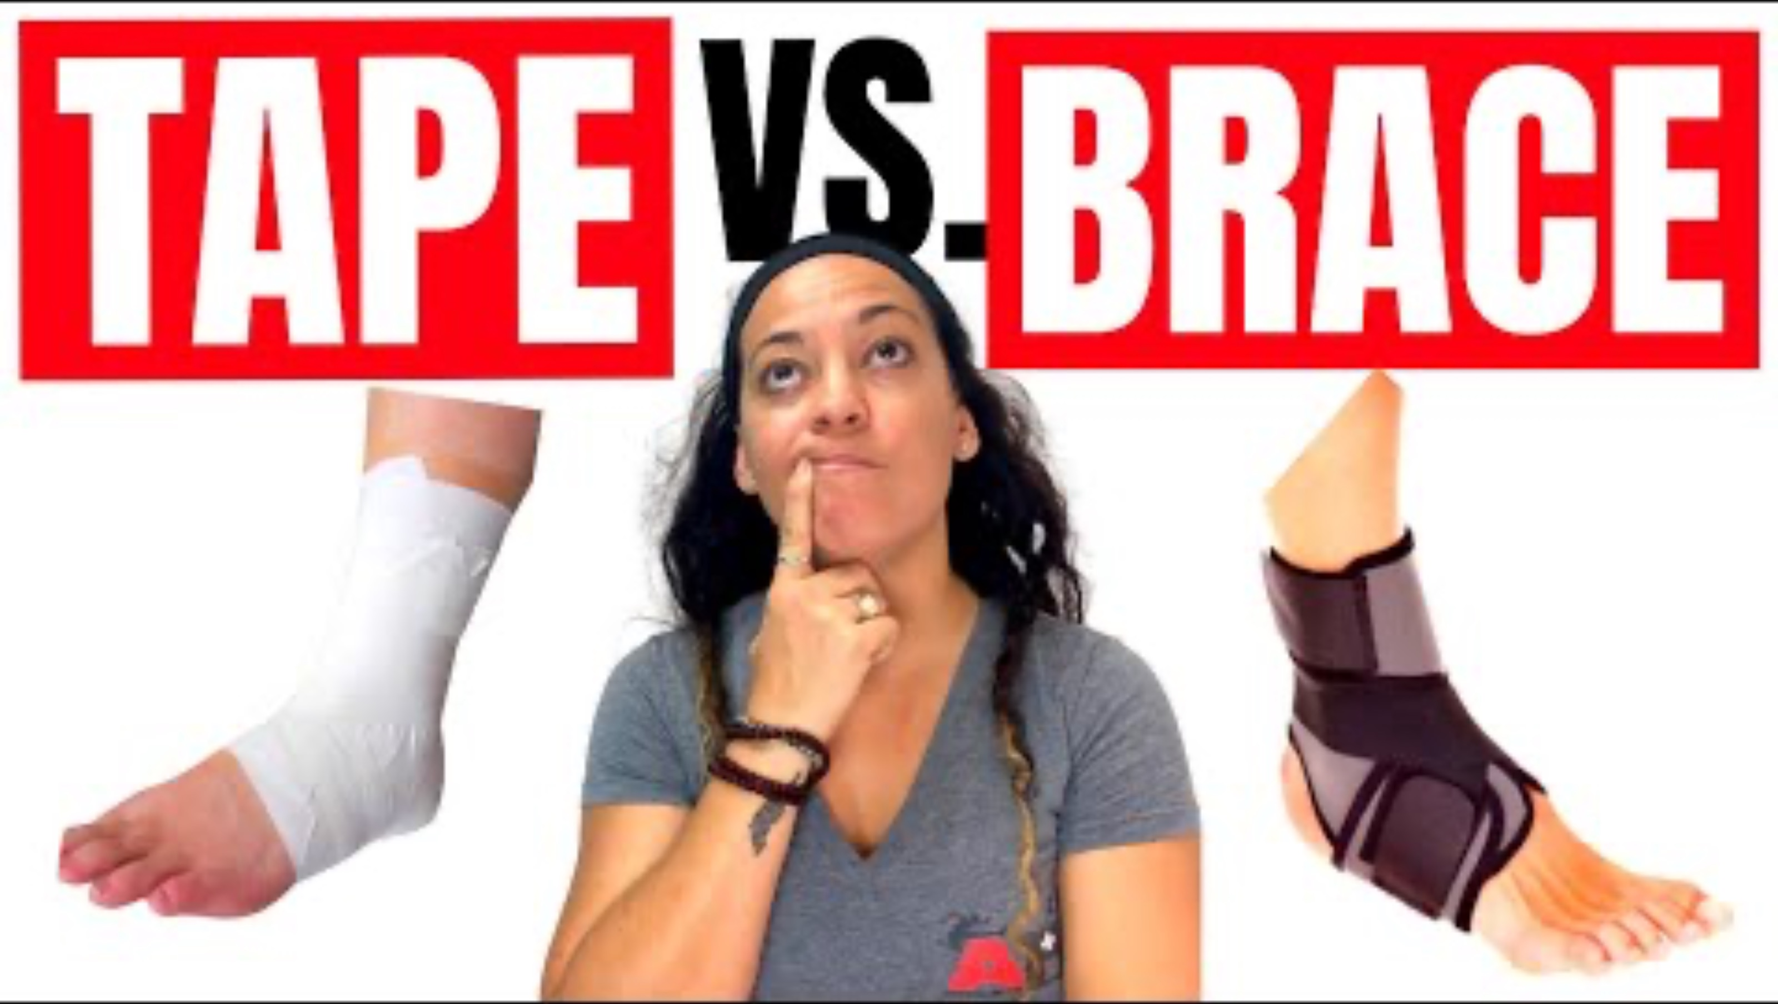
Station 4: Taping and Wrapping
Notes:
Athlete Remedy. (2020, November 17). What is the best ankle support for a game? | Ankle brace vs ankle tape [Video]. YouTube. https://www.youtube.com/watch?v=DyQiQQN0fuk

Slide 16

Taping and Wrapping
Notes:
Enovis ANZ. (2017, September 15). DJO roadshow Powerhouse Physio taping vs bracing [Video]. YouTube. https://www.youtube.com/watch?v=MMvL9swaaF4

Slide 17

Claim, Evidence, Reasoning (CER)
Write a claim about taping used for injury prevention and rehabilitation.
Watch the following videos.
Use the information from all the resources you explored to record evidence that supports your claim.
Provide reasoning that explains how the provided evidence supports your claim.
Notes:
K20 Center. (n.d.). Claim, evidence, reasoning (CER). Strategies. https://learn.k20center.ou.edu/strategy/156

Slide 18

Sports Taping for the Ankle
Notes:
Center for Sports Medicine. (2016, February 3). Sports taping for the ankle – The Center for Sports Medicine [Video]. YouTube. https://www.youtube.com/watch?v=deELy8juCwo

Slide 19
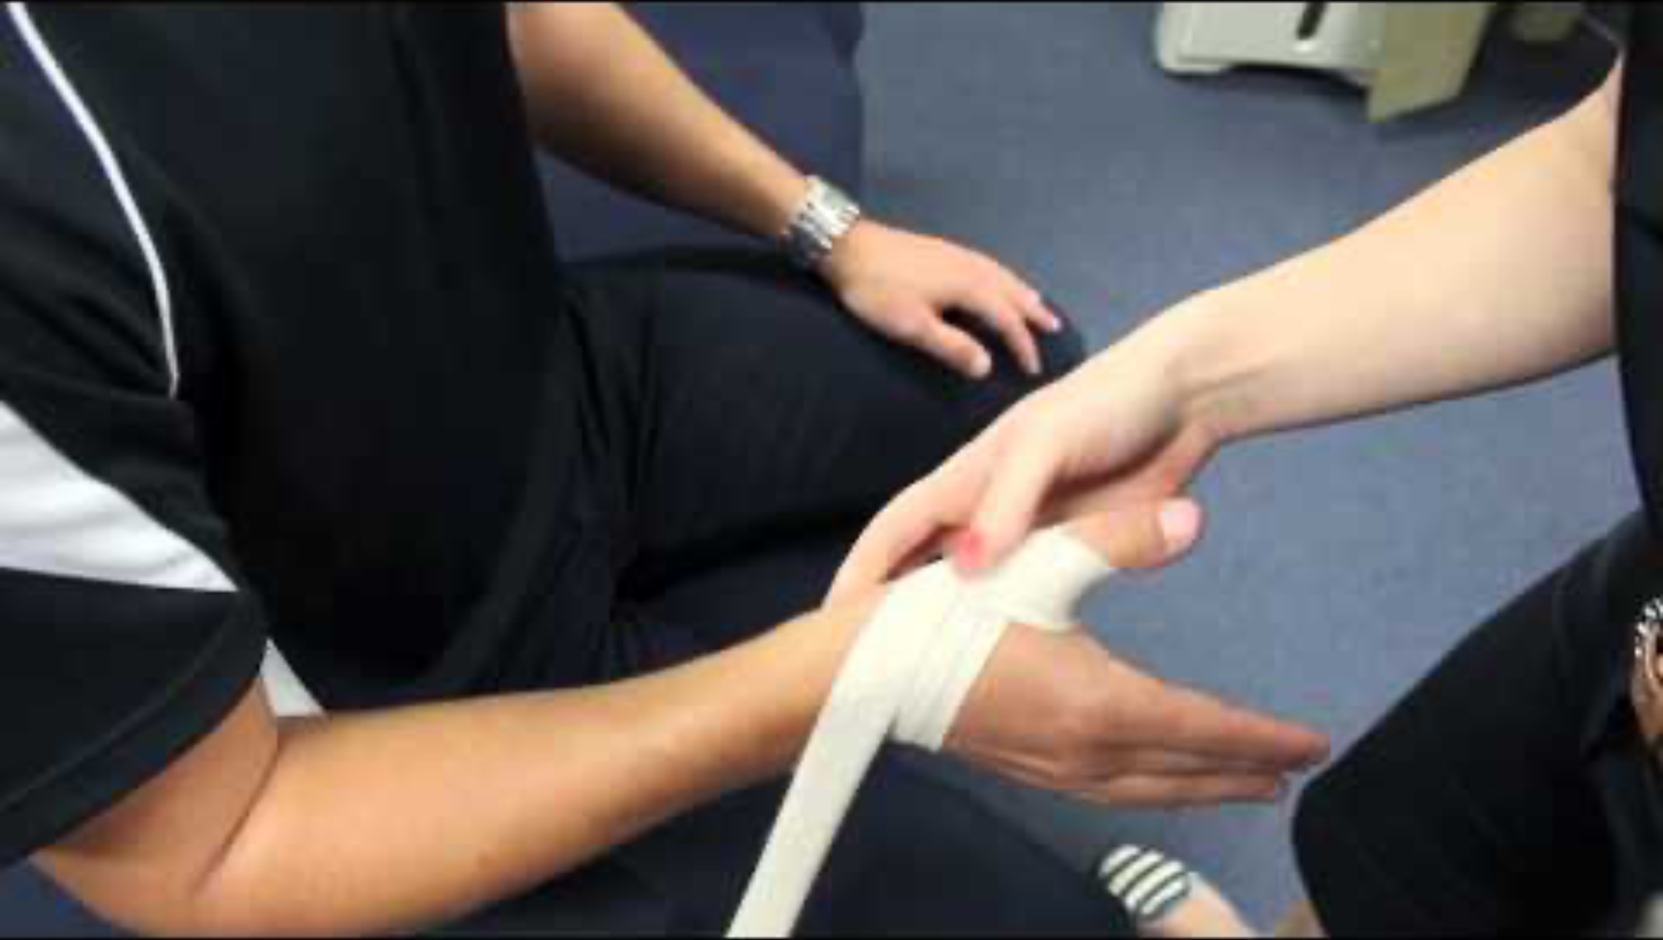
Taping for the Thumb
Notes:
Pivotal Motion Physiotherapy – Physiotherapist Newmarket. (2014, December 7). How to tape a thumb for sports – Presented by Pivotal Motion Physiotherapy [Video]. YouTube. https://www.youtube.com/watch?v=Zaqp2Rt6LpA

Slide 20
Ankle and Thumb Taping
Find a partner.
Visit one station.
Wrap your partner’s thumb or ankle using the provided materials and the taping and wrapping techniques you learned.
Switch stations.

Slide 21

5W Cube
Roll the die. Respond to the question below that matches the number you rolled.
What are some common injuries that require taping or bracing in physical therapy?
When would a physical therapist choose taping over bracing, and what factors might influence this decision for different types of injuries?
Why do some athletes or patients prefer bracing over taping, and how do their personal experiences or specific needs impact this preference?
How might a physical therapist adapt their injury prevention approach for an athlete who frequently plays back-to-back games?
Who should have final say in deciding whether an athlete uses taping or a brace—the physical therapist, the coach, the athlete, or a combination of all three? Why?
Where do physical therapists typically use taping and bracing techniques, and how might the setting (sports field, clinic, hospital) influence the choice between the two?
Notes:
K20 Center. (n.d.). 5W cube. Strategies. https://learn.k20center.ou.edu/strategy/81

Slide 22

Station 5: Sports Medicine
Notes:
Ochsner Health. (2022, August 22). A day in the life | Primary care sports medicine physician Olabode Agaja, DO [Video]. YouTube.
https://www.youtube.com/watch?v=BvcFPAD5NG4

Slide 23

A Day in the Life of a Paramedic ft. an EMT
Notes:
Indeed. (2024, July 30). A day in the life of a paramedic ft. an EMT | Indeed [Video]. YouTube. https://www.youtube.com/watch?v=k0k6tWrISBM

Slide 24

Venn Diagram
In the EMT circle, write all the necessary skills and responsibilities for EMT careers.
Repeat the process for the Sports Medicine Physician and Physical Therapist circles.
Discuss the common skills and responsibilities between the three careers as a whole class.
Write skills and responsibilities shared between the three careers in the overlapping areas.
Notes:
K20 Center. (n.d.). Venn diagram. Strategies. https://learn.k20center.ou.edu/strategy/2918

