Slide 2
Leadership Club
Organizing and Event Planning

Slide 3
Essential Question
Why are leadership skills important when planning an event?

Slide 4
Learning Goals
Examine the leadership skills involved in organizing an event.
Reflect on personal leadership skills, strengths, and areas for development.

Slide 5
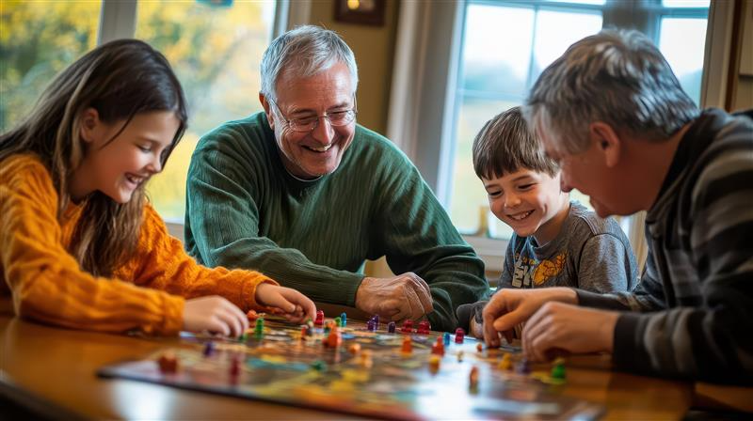
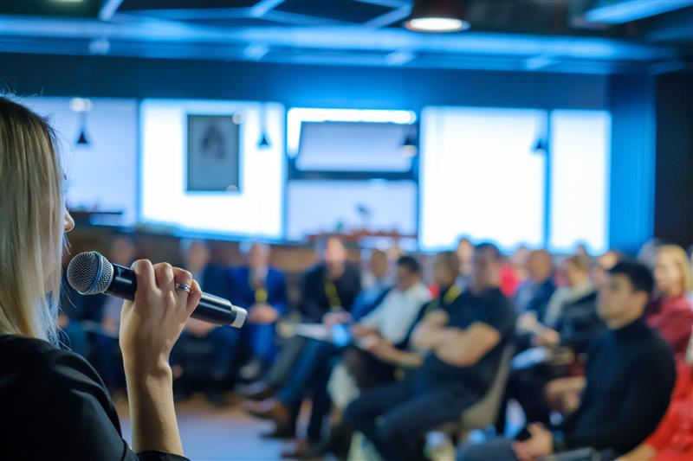
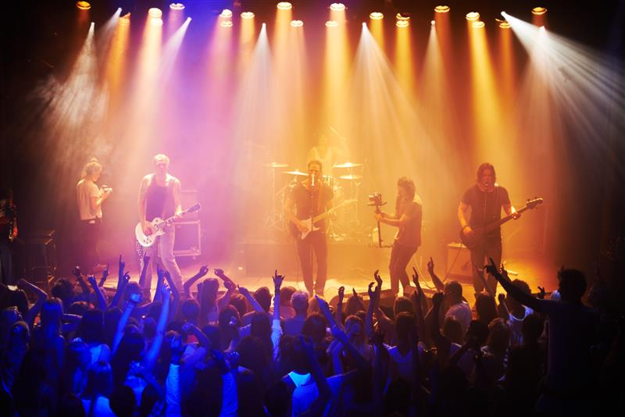
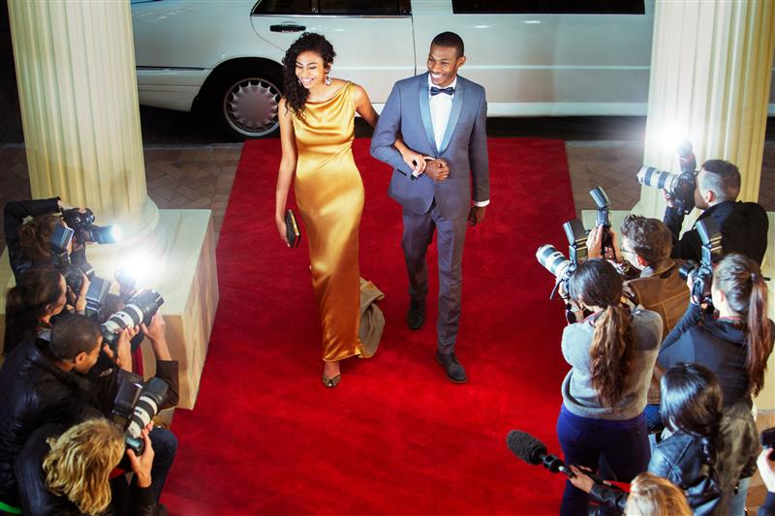
Notes:
doraclub. (n.d.). A joyful family gathering around a table, playing board games together, sharing laughter and creating cherished memories [Image]. Adobe Stock. https://stock.adobe.com/search?k=family+playing+board+games&isUseAsReferenceDialogOpen=false&asset_id=917063363
Daly, R. (n.d.). Celebrity couple arriving at red carpet event being photographed by paparazzi [Image]. Adobe Stock.
Yuri A. (n.d.). Shot of a large crowd at a music concert [Image]. Adobe Stock.

Slide 6
Collective Braindump
What are the steps you need to take to organize an event?
Notes:
K20 Center. (n.d.). Collective brain dump. Strategies. https://learn.k20center.ou.edu/strategy/111
K20 Center. (2021, September 21). K20 Center 4 minute timer [Video]. YouTube. https://www.youtube.com/watch?v=kpCsfuvzQeY

Slide 7
Share Out!
In your groups, share a few responses from your list.
Prepare to share a few responses with the whole class.

Slide 8
Analyze the Scenario
In your groups, respond to the following 5W prompts on your handout about the scenario on your card.
Who is needed to organize this event?
What materials and supplies are needed to organize this event?
When should this event take place?
Where should this event take place?
Why is this event being organized?
How will you measure the success of the event?
Notes:
K20 Center. (n.d.). 5W cube. Strategies. https://learn.k20center.ou.edu/strategy/81

Slide 9
What Are Your Thoughts?
How far in advance do you think you should start planning an event?
Do you think some of the 5W prompts are more important than others?

Slide 10
Advertisement and Promotion
How do you and your family learn about events at your school?
Do you and your family regularly check emails from your school?
Do you ever notice any flyers around your school or in your classrooms that promote school events?
Do you attend all or most events at your school that you hear about?

Slide 11
School Event Checklist
Watch the video and take notes on your Cornell Notes handout.
Notes:
K20 Center. (n.d.). Cornell notes system. Strategies. https://learn.k20center.ou.edu/strategy/56
Vanco. (2023, March 10). 10 step school event checklist to rock your next event [Video]. YouTube. https://www.youtube.com/watch?v=dww6_RFm7gw

Slide 12
Leadership Skills
What leadership skills do you think you need to organize an event?

Slide 13
Card Sort
People with a variety of leadership skills are needed to organize an event.
Lay the Category Cards in a line. Organize them in chronological order based on which steps should be taken first to the steps that should be taken last when planning an event.
With your group, place each Sorting Card under a step that requires that skill.
Notes:
K20 Center. (n.d.). Card sort. Strategies. https://learn.k20center.ou.edu/strategy/147

Slide 14
Reflect and Discuss
Were there any leadership skills that fit under multiple steps? If so, discuss these skills and which steps could use them.
Do you think you have some of these leadership skills?
How could you use what you learned during this activity to help organize an event?

Slide 15
Brainstorm
Review the stages of planning an event.
Brainstorm ideas for the first two stages.
Create an event timeline that includes all the details necessary for a successful event.

Slide 16
Two Stars and a Wish
Stars: What are two leadership skills that you already use or will use to organize your event?
Wish: What is one leadership skill you want to individually develop and improve through the process of organizing your event?
Notes:
K20 Center. (n.d.) Two stars and a wish. Strategies. https://learn.k20center.ou.edu/strategy/83

